Slide 1
Nature and Occurrence of Minerals
UNIT - 5

Slide 2
Where do minerals come from
Minerals can be found throughout the world in the earth's crust but usually in such small amounts that they not worth extracting.
Only with the help of certain geological processes are minerals concentrated into economically viable deposits.
Mineral deposits can only be extracted where they are found.
Mineral deposits come in many shapes and sizes depending on where and how the mineral was concentrated.
Minerals are concentrated by igneous, sedimentary and metamorphic processes.
Mineral deposits are the source of many important commodities, such as copper and gold, used by our society, but it is important to realize that mineral deposits are a nonrenewable resource.
Once mined, they are exhausted, and another source must be found. https://youtu.be/v7g4bQN4vng
New mineral deposits are being continuously created by the Earth but may take millions of years to form.
Mineral deposits differ from renewable resources, such as agricultural and timber products, which may be replenished within a few months to several years.

Slide 3
Where do minerals come from
The different ways to concentrate minerals can often work together.
For example, oil and gas are made by a combination of sedimentary processes which trap and bury plant and animal remains, and then metamorphic processes which heat and change the remains into deposits of oil and gas.
Mineral exploration is undertaken in order to find mineral deposits that are suitable for commercial exploitation.
A variety of methods may be used, including remote sensing (aerial photography and satellite images), geochemical surveys (looking for chemicals in soil and water which indicate certain minerals are present).
Once a mineral deposit has been found it has to be extracted from the ground to access the valuable minerals it contains.
This can be done by opencast quarrying or underground mining. Certain minerals can also be extracted by pumping. This is the case with some salt extraction, where the salt is dissolved in water and pumped from underground, and almost all oil and gas.

Slide 4
What is a Mineral Deposit?
The technical definition of a mineral is a naturally occurring, inorganic, homogeneous solid with a definite chemical composition and an ordered atomic arrangement.
In more general terms, a mineral is a substance that is
(1) made of a single element like gold (Au) or a compound of elements like salt (NaCl) and (or)
(2) a building block of rock (for example, granite is composed primarily of the minerals quartz and feldspar).
Minerals may be metallic, like gold, or nonmetallic, such as talc.
Oil, natural gas, and coal are generally considered to be “energy minerals”.

Slide 5
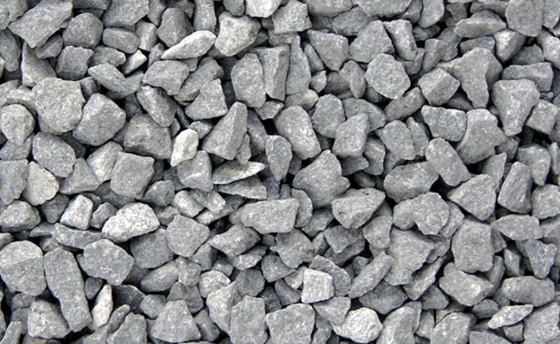
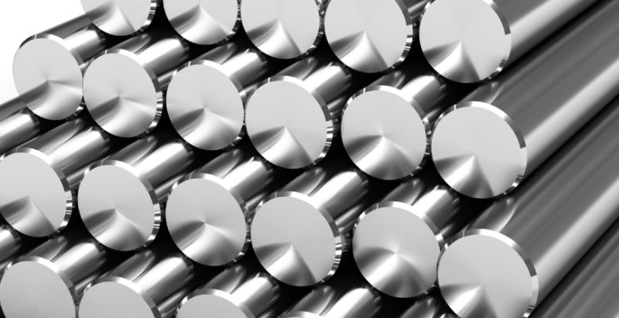
What is a Mineral Deposit?
Additional mineral resource terms are:
Aggregate—A rock or mineral material used separately and as filler in cement, asphalt, plaster, and other materials.
Alloy—A substance having metallic properties and composed of two or more chemical elements, of which at least one is a metal.
Element—A substance whose atoms have the same atomic number.

Slide 6
What is a Mineral Deposit?
Metal—A class of chemical elements, such as iron, gold, and aluminum, that have a characteristic luster, are good conductors of heat and electricity, and are opaque, fusible, and generally malleable and ductile.
Ore—The naturally occurring material from which a mineral or minerals of economic value can be extracted.
Rock—A naturally formed material composed of a mineral or minerals; any hard consolidated material derived from the Earth

Slide 7
What is a Mineral Deposit?
Minerals occur in a range of concentrations, not all of which have economic significance:
• A mineral occurrence is a concentration of a mineral (usually considered in terms of some commodity, such as copper, barite, or gold) that is considered valuable by someone somewhere or that is of scientific or technical interest.
• A mineral deposit is a mineral occurrence of sufficient size and grade (concentration) to enable extraction under the most favorable conditions.
• An ore deposit is a mineral deposit that has been tested and is known to be of sufficient size, grade, and accessibility to be mined at a profit. Testing commonly consists of surface mapping and sampling, as well as drilling through the deposit.

Slide 8
Where and How Do Mineral Deposits Occur?
Two cycles determine how mineral deposits are formed— the rock cycle and the tectonic cycle.
Heat from the Earth’s interior melts some of the rocks in the crust (the upper part of the lithosphere).
Molten rocks lower in density than the surrounding cooler material rise toward the Earth’s surface and eventually cool and harden near to or on the surface.
The composition, temperature, pressure, and cooling process of the molten material determine the minerals and rock types formed.
These are called igneous rocks and contain original or primary minerals.

Slide 9
Where and How Do Mineral Deposits Occur?
When these rocks are subjected to chemical and physical processes, such as freezing and thawing, they break apart into smaller fragments forming sediments.
These smaller particles that compose the sediments can be physically transported and redeposited by gravity, water, and wind.
If the redeposited particles are bound together by compaction or cementation (formation of new secondary minerals in the spaces between the loose particles), sedimentary rocks are formed.
In regions where the Earth’s interior temperature and pressure are high enough to change the chemical composition and mineralogy of buried igneous or sedimentary rocks, without completely melting them, metamorphic rocks are formed.
Distinct groups or assemblages of minerals are typically associated with the formation of each of the three major rock types—igneous, sedimentary, and metamorphic rocks.

Slide 10
Where and How Do Mineral Deposits Occur?
Plate tectonics play a major role in the processes of mineral and rock formation.
In geologic terms, a plate is a large, “rigid” slab of solid rock.
The term plate tectonics refers to the process by which the Earth’s crust is formed and moved.
The theory of plate tectonics states that the Earth’s outermost layer, the crust, is fragmented into a dozen or more plates of various sizes that are moving relative to one another as they are slowly transported on top of and by hotter, more mobile material.
Scientists now have a fairly good understanding of how the plates move and how earthquake activity relates to such movement. Most movement occurs along narrow zones between plates where the effects of tectonic forces are most evident.

Slide 11
Where and How Do Mineral Deposits Occur?
There are four types of plate boundaries:
Divergent boundaries—where new crust is generated as the plates pull away from each other.
Convergent boundaries—where crust is destroyed as one plate dives under another.
Transform boundaries—where crust is neither produced nor destroyed as the plates slide horizontally past each other.
Plate boundary zones—broad belts in which boundaries are not well defined and the effects of plate interaction are unclear

Slide 12
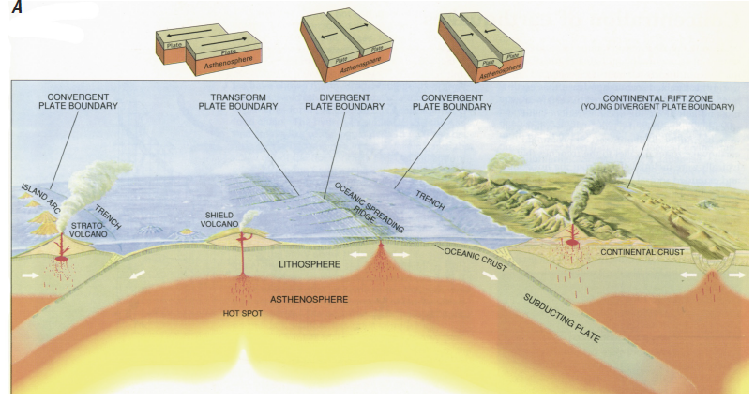
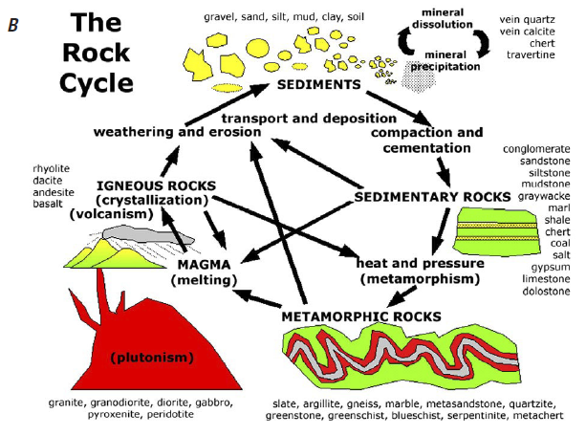
Plate Tectonics and Rock Cycle

Slide 13
Mineral Deposits
The Earth’s crust contains more than 100 naturally occurring elements.
The crust, which ranges from 6 to 30 miles (10 to 50 km) thick, can be subdivided into two distinctly different parts—the oceanic crust and the continental crust—which differ in composition.
Some of the common elements that make up the crust are in order of abundance oxygen (O), silicon (Si), aluminum (Al), iron (Fe), calcium (Ca), sodium (Na), potassium (K), and magnesium (Mg).
Although the same elements are present in both types of crusts, their concentrations are slightly different.
The first eight elements constitute more than 98 percent of all crustal material.
Thus, one can refer to the distribution of elements in terms of their average crustal abundance.
Many useful mineral commodities in the crust are present in very low abundances.
The mining industry cannot use most rocks in the Earth’s crust as sources of metals or other elements because concentrations are too low to allow extraction.
Instead, the mining geologist looks for rocks where the desired mineral has been concentrated by some natural process.

Slide 14
Mineral Deposits
Mineral deposits occur in various tectonic and geologic settings.
Some mineral deposits may be formed in one place but be transported to another geographic location as a result of tectonic forces or other geologic processes.
Thus, the study of tectonic processes and regional geology is important in understanding the distribution of mineral deposits.
Gold, for example, can be concentrated with other minerals in veins that form in fractures in rocks deep underground (typically, igneous rocks).
Tectonic forces uplift these rocks forming mountain ranges where weathering and erosion expose the veins at the Earth’s surface.

Slide 15
Mineral Deposits
Because mountain ranges are constantly worn down by erosion caused by water, ice, and wind, some of the gold veins are eventually deposited as nuggets flakes, or flour-size material in sediments in streams and rivers.
The gold, along with other minerals like platinum and garnet, is sometimes extracted directly from gravels (sedimentary rocks) in the streambed.
Mineral deposits also form when preexisting rocks are deeply buried and changed over geologic time by heat and pressure (metamorphic rocks); for example, limestone is changed by metamorphism into marble.

Slide 16
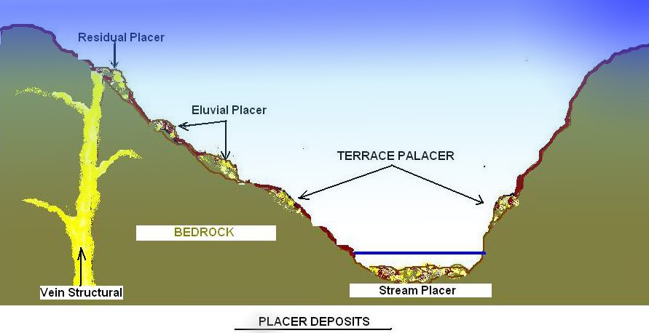
Mineral Deposits

Slide 17
Mineral Deposit Models
To better understand and predict how and where mineral deposits might occur, scientists develop mineral deposit models.
These models are based on existing knowledge of regional geology and the characteristics of known mineral deposits.
Similar mineral deposit types can be grouped together under a particular deposit model.
Mineral deposit models can aid in identifying areas favorable for finding valuable. There are hundreds of deposit models, and new models are being constructed as new types of deposits are identified.
A few examples of deposit model types are
(1) deposits related to mafic and ultramafic intrusions in stable environments,
(2) deposits related to marine mafic extrusive rocks,
(3) deposits in clastic sedimentary rocks,
(4) deposits related to regionally metamorphosed rocks, and
(5) deposits related to surficial processes and unconformities.

Slide 18
How Are Mineral Deposits Found?
Finding a mineral deposit is the first step in the mining life cycle.
Technologies used include, but are not limited to:
Exploration geology,
Geophysics,
Geochemistry, and
Satellite imagery

Slide 19
How Are Mineral Deposits Found?
Geology
Geology is the study of the planet Earth—the materials of which our planet is made, the processes that act on these materials, the products formed, and the history of the planet and its life forms since its origin.
Geologic investigations include:
Reviews of the geologic literature,
Field surveys, and
Geologic mapping to determine areas favorable for mineral deposits

Slide 20
How Are Mineral Deposits Found?
Geophysics
Geophysical exploration involves searching for favorable mineral deposits using the physical properties of rocks, such as magnetic intensity and electrical conductivity.
Geophysical investigations may include aeromagnetic or gravity surveys, ground-penetrating radar studies, or the use of seismic waves to show contrasting rock types.
The selected rock units of interest might then be mapped and sampled to identify areas favorable for mineral deposits, and adjoining areas may also be investigated for the presence of mineral deposits.

Slide 21
How Are Mineral Deposits Found?
Geochemistry
Geochemistry is the study of the distribution and amounts of elements in minerals, ores, rocks, soil, water, and the atmosphere and the study of the circulation of the elements in nature on the basis of the properties of their atoms and ions.
Geochemical investigations commonly include soil sampling, stream sediment sampling, and rock sampling; even plants are also sampled in some studies.
Various techniques are used to examine and measure the abundance, or concentration, of elements contained in the sample.
The results may be used to define favorable areas for mineralization.

Slide 22
How Are Mineral Deposits Found?
Satellite Imagery
The use of satellite imagery has become a valuable tool for exploration geologists.
Geologists are now able to perform large-scale surveys of remote unexplored regions for the presence of geologic structures and key minerals that may indicate areas favorable for mineral deposits.
Ground-based surveys are expensive, and one can often experience difficulty in mapping large-scale structures.
However, large geological structures are often readily visible on satellite imagery.

Slide 23
How Big is the Deposit and How Much is it Worth?
The next step in the mining life-cycle is to identify and measure the known resources in order to determine if the mineral deposit has enough value to be mined.
Identifying the size and grade of the deposit is accomplished by collecting drill-core samples of the ore body.
These samples are analyzed for the concentration of elements of economic value.
For a metallic commodity like gold, analyses are usually reported in ounces of pure gold (Au) per ton of rock.
In other words, for every ton of rock removed, one can expect to retrieve a predetermined number of ounces of the desired commodity based on the results of an average sampling over the entire ore body.
This measurement is called “grade of ore.” Ore grades for metals such as iron, copper, lead, and zinc are often expressed in weight percent.
A higher grade means more of the commodity per ton of rock.
For a nonmetallic commodity, such as sand and gravel or limestone, the resource is identified in terms of volume (cubic yards or meters) or weight (short or metric tons).
The quality of ore is based on the amount and distribution of various grain sizes, from fine sand to gravel and boulders, or for limestone, the percent of calcium.

Slide 24
Examples of Mining Methods
Three main types of mining methods used to recover metallic and nonmetallic minerals are
(1) underground mining,
(2) surface (open pit) mining, and
(3) placer mining
The location and shape of the deposit, strength of the rock, ore grade, mining costs, and current market price of the commodity are some of the determining factors for selecting which mining method is used.
Higher-grade metallic ores found in veins deep under the Earth’s surface can be profitably mined using underground methods, which tend to be more expensive.
Large tabular-shaped ore bodies, having long vertical or horizontal dimensions, or ore bodies lying more than 1,000 feet (300 m) below the surface are generally mined using underground methods as well.
The underground mining method is accomplished by drilling and blasting rock, in order to access and separate ore from the surrounding waste rock.
The blasted material is called muck. The muck is moved to the surface by truck, belt conveyor, or elevator. Once at the surface, the material is sent to a mill.

Slide 25
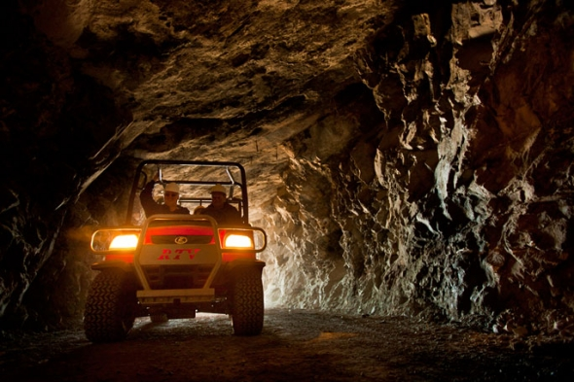
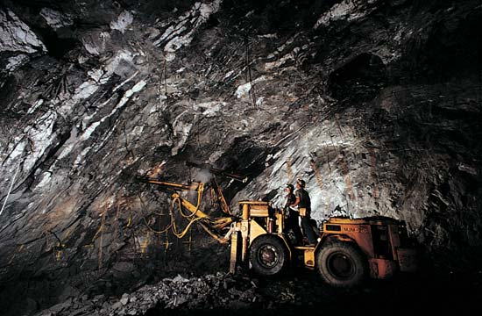
Underground Mining

Slide 26
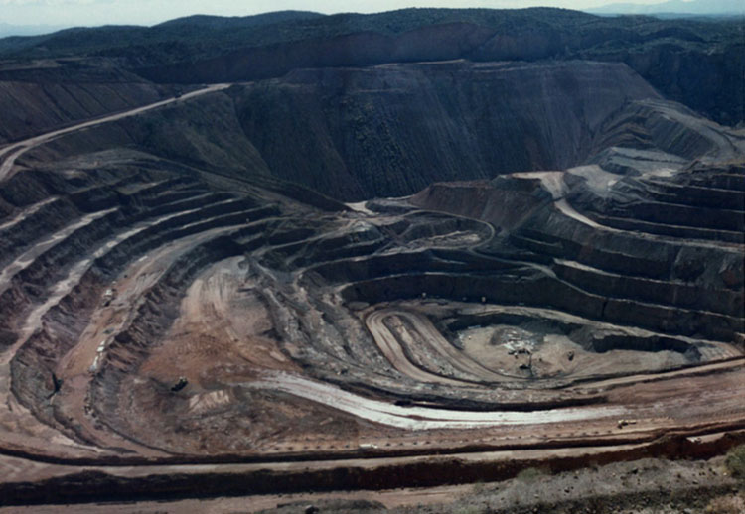
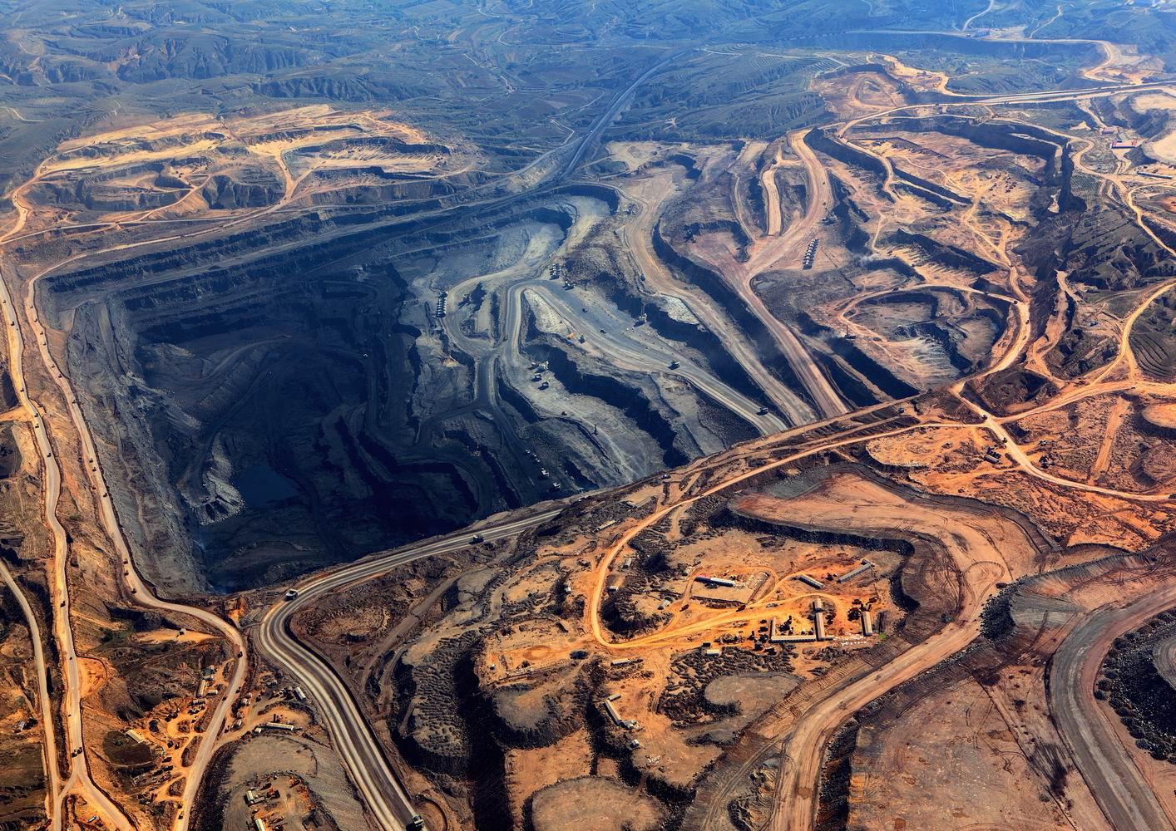
Surface (Open pit) mining

Slide 27
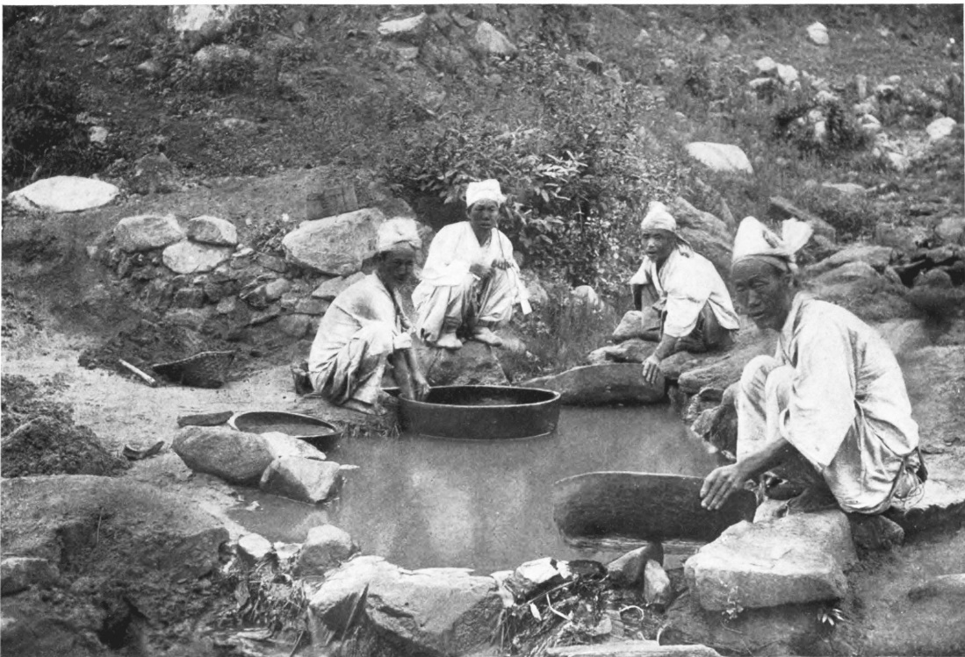
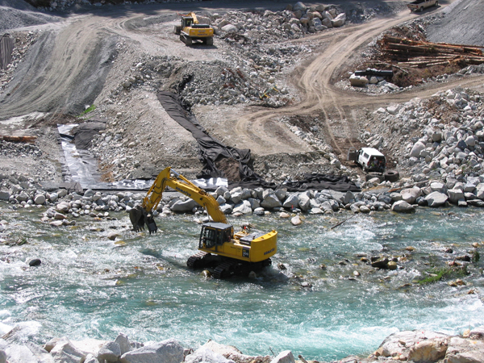
Placer mining

Slide 28
Examples of Mining Methods
Lower grade metal ores found closer to the surface may be profitably mined using surface mining methods, which generally cost less than underground methods.
Many industrial minerals are also mined using surface mining methods, as these ores are usually low in value and were deposited at or near the Earth’s surface.
Generally in a surface mine, hard rock must be drilled and blasted, although some minerals, such as diatomite, are soft enough to mine without blasting.
Large mechanical shovels fill trucks with the broken rock that is then trucked out of the mine for processing.

Slide 29
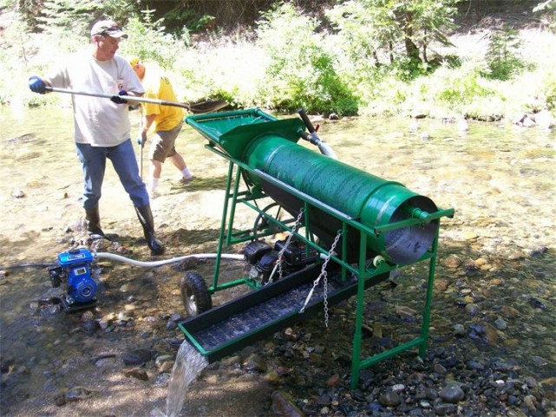
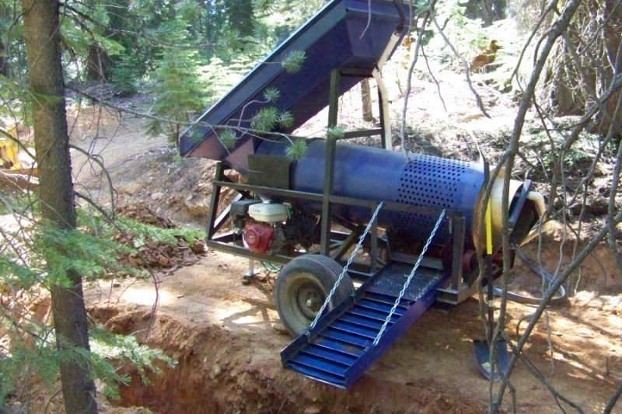
Trommel

Slide 30
Examples of Mining Methods
Placer mining is used to recover valuable minerals from sediments in present-day river channels, beach sands, or ancient stream deposits.
More than half of the world’s titanium comes from placer mining of beach dunes and sands .
In placer operations, the mined material is washed through a trommel to eliminate the coarse materials and a sluice box to concentrate the “heavies.”
A trommel is a revolving cylindrical sieve used to size rock, and the bottom of the sluice has ridges

Slide 31
Recovery Methods
Regardless of the deposit type and mining process, one must separate the ore from the waste rock, once it has been removed from the ground .
The mineral commodity can be separated from the waste rock by using one or more methods, and the separation is usually done in a mill.
One type of milling or recovery method is called floatation.
The ore is crushed into a very fine powder, and the powder is put into an agitated, frothy slurry. Minerals may sink to the bottom or stick to the bubbles and rise to the top, where they are skimmed off.
This process is used to separate the valuable metals from waste rock, after which the recovered metals are sent on for further processing.
The waste material is either used as backfill in the mine or sent to a tailings pond, where the water is removed.

Slide 32
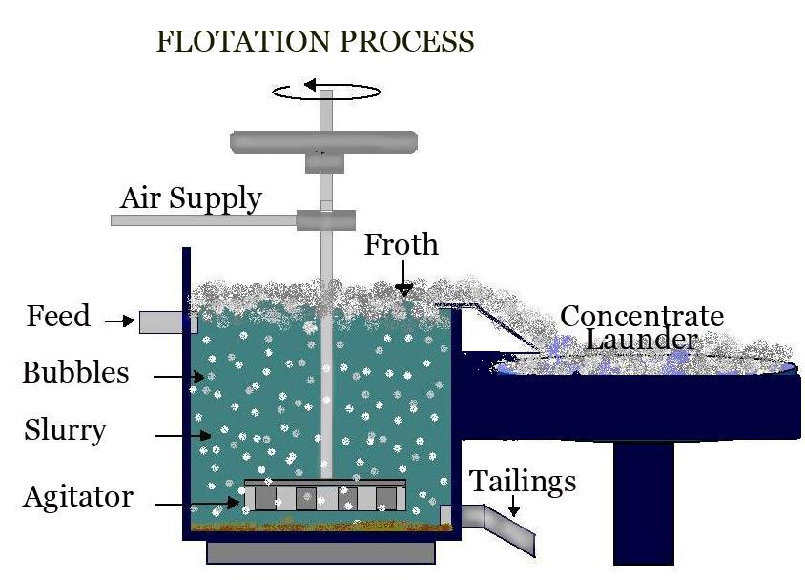
Flotation

Slide 33
Recovery Methods
Cyanide heap leaching is one method used to extract low-grade gold from rock mined using open-pit methods.
Again the rock is crushed and placed on a “leach pile” on a lined pad.
A cyanide solution is sprayed or dripped on top of the pile.
As the leach solution percolates down through the rock, the gold dissolves into the solution.
This solution is then captured, and the gold is recovered by further processing.
After the waste rock is cleaned, it may be used to backfill in the mine pit, when the mineral deposit is exhausted.

Slide 34
Cyanide heap leaching

Slide 35
Reclamation Processes
The reclamation process takes place throughout the mining life cycle.
The process of reclamation includes maintaining water and air quality and minimizing flooding, erosion, and damage to wildlife and habitat caused during the mining life cycle.
The final step in the reclamation process is often topsoil replacement and re-vegetation with suitable plant species.
Habitats must be maintained or restored to their prior condition once the mining process is completed.
Underground mines may be backfilled or sealed or may be preserved for bat habitat.
Open-pit mines are often backfilled or reshaped to become natural areas or pit lakes suitable for waterfowl and fish.
Tailings ponds may be drained, covered and planted with vegetation, or turned into wetlands.

Slide 36
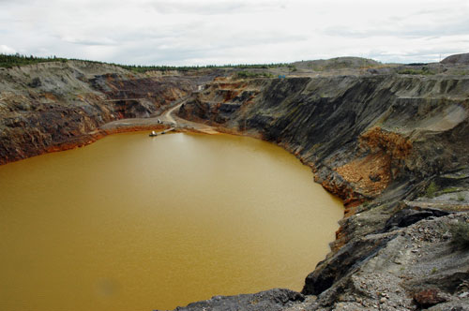
Tailing pond
Mine Reclamation

