Slide 1
Introduction to Crystallography and Mineral Crystal Systems
UNIT-1

Slide 2
Introduction
Mineralogy is the scientific study of minerals, comprising of crystallography, mineral chemistry, economic mineralogy, and determinative mineralogy (concerned mainly with physical properties).
Definition of the term “MINERAL”: A mineral is a naturally occurring, inorganic solid with a characteristic chemical composition and a crystalline structure.
An understanding of mineral structures and properties allows us to answer more immediate questions, such as why quartz and diamond are so hard, and why solid granite rock is destined to become soft, sticky clay.
Minerals are natural resources, providing raw materials for many industries. Therefore, understanding minerals has geological as well as economic applications.

Slide 3
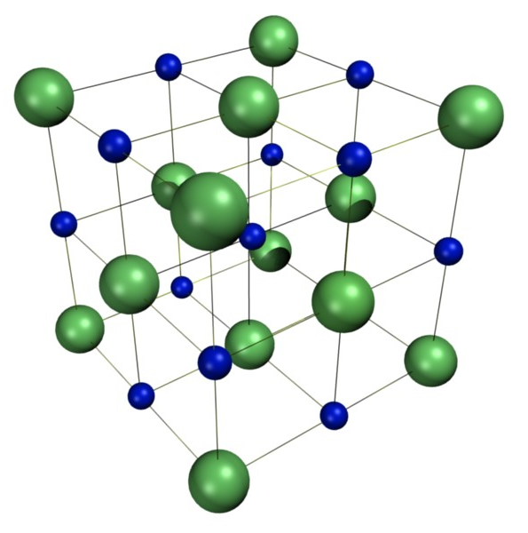
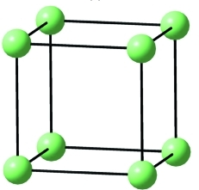
Definition of Crystallography
CRYSTALLOGRAPHY is the study of crystals. It includes the study of crystal form, crustal structure and crystal symmetry.
CRYSTALLOGRAPHY is a part of the entire study of mineralogy.
Crystals are solids that form by a regular repeated pattern of molecules connecting together.
In some solids, the arrangements of the building blocks (atoms and molecules) can be random or very different throughout the material.
In crystals, however, a collections of atoms called the Unit Cell is repeated in exactly the same arrangement over and over throughout the entire material.
Very slow cooling of a liquid allows atoms to arrange themselves into an ordered pattern, which may extend of a long range (millions of atoms). This kind of solid is called crystalline.

Slide 4
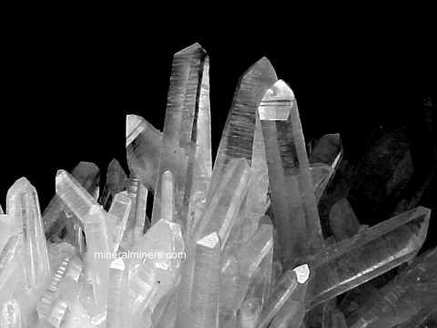
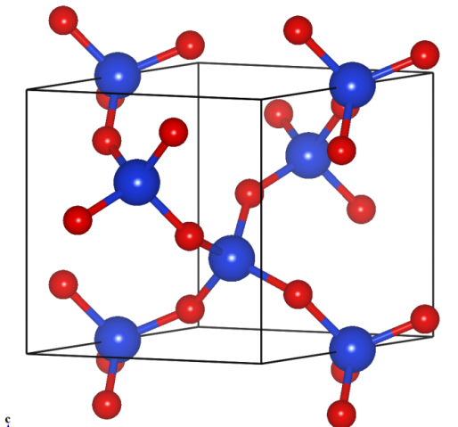
Why Crystallography in Geosciences?
Most of the Earth is made of solid rock. The basic units from which rocks are made are minerals.
There are well over 4,000 officially recognized mineral species and as many as a hundred new ones are described each year.
The properties of rocks are ultimately determined by the properties of the constituent minerals, and many geological processes represent the culmination - on a very grand scale - of microscopic processes inside minerals.
For example, large-scale processes, such as rock formation, deformation, weathering and metamorphic activity, are controlled by small-scale processes, such as movement of atoms (diffusion), shearing of crystal lattices (dislocation movement), growth of new crystals (nucleation, crystallization), and phase transformations.

Slide 5
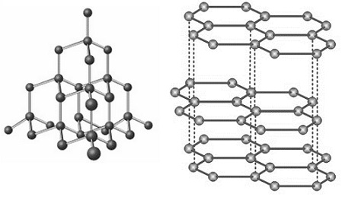
Structural Properties of a Crystal
All minerals are crystalline structures made from a mixture of different elemental compounds, and the shape of a crystal is based on the atomic structure of these elemental building blocks.
Atoms within a mineral are arranged in an ordered geometric pattern called a "motif" which determines its "crystal structure.“
A minerals's crystal structure will determine a its symmetry, optical properties, cleavage planes, and overall geometric shape.
A crystal's growth pattern is referred to as its "Crystal Habit.“
Shown here is the crystal structure of Diamond and Graphite.

Slide 6
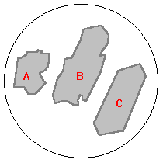
Shapes of Crystals
In rocks the shapes of crystalline grains/crystals are often classified as Euhedral, Anhedral and Subhedral
Anhedral: irregular; little or no evidence for its own growth faces (A)
Subhedral: partly bound by its own growth faces, or growth faces only moderately well developed (B)
Euhedral: grains bounded by its own perfect to near-perfect crystal growth faces (C)

Slide 7
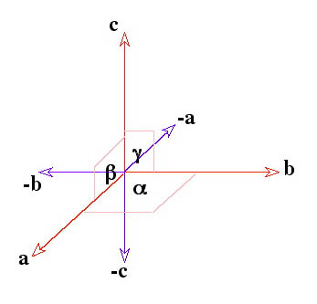
Individual Crystal Systems and the Axial System
The crystal system is a grouping of crystal structures that are categorized according to the axial system used to describe their atomic "lattice" structure.
A crystal's lattice is a three dimensional network of atoms that are arranged in a symmetrical pattern.
Each crystal system consists of a set of three crystallographic axes (a, b, and c) in a particular geometrical arrangement.
The seven unique crystal systems, listed in order of decreasing symmetry, are:
1. Cubic System,
2. Hexagonal System,
3. Tetragonal System,
4. Rhombohedric (Trigonal) System,
5. Orthorhombic System,
6. Monoclinic System,
7. Triclinic System.

Slide 8
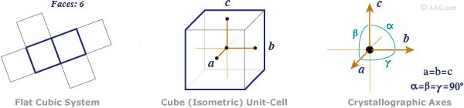
Cubic Crystal System
This is also known as the isometric crystal system
The cubic (Isometric) crystal system is characterized by its total symmetry.
The Cubic system has three crystallographic axes that are all perpendicular to each other, and equal in length.
The three crystallographic axes a1, a2, a3 (or a, b, c) are all equal in length and intersect at right angles (90 degrees) to each other.

Slide 9
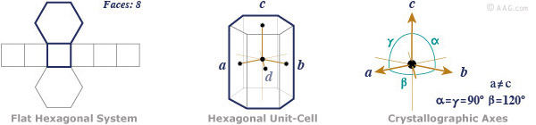
The Hexagonal Crystal System
The hexagonal crystal system has four crystallographic axes consisting of three equal horizontal or equatorial (a, b, and d) axes at 120°, and one vertical (c) axis that is perpendicular to the other three.
The (c) axis can be shorter, or longer than the horizontal axes.

Slide 10
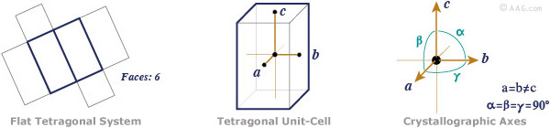
Tetragonal Crystal System
A tetragonal crystal is a simple cubic shape that is stretched along its (c) axis to form a rectangular prism.
The tetragonal crystal will have a square base and top, but a height which is taller.
Three axes, all at right angles, two of which are equal in length (a and b) and one (c) which is different in length (Shorter or Longer)
Note: If c was equal in length to a or b, then we would be in the cubic system!

Slide 11
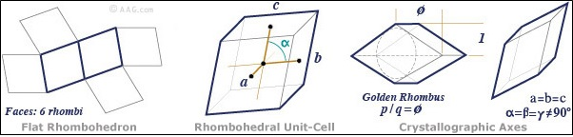
The Rhombohedral Crystal System
A rhombohedron has a three-dimensional shape that is similar to a cube, but it has been skewed or inclined to one side making it oblique.
It is also known as the Trigonal crystal system.
A rhombohedral crystal has six faces, 12 edges, and 8 vertices.
If all of the non-obtuse internal angles of the faces are equal (flat sample, below), it can be called a trigonal-trapezohedron.

Slide 12
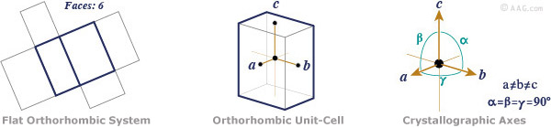
The Orthorhombic Crystal System
Minerals that form in the orthorhombic (aka rhombic) crystal system have three mutually perpendicular axes, all with different, or unequal lengths.
The orthorhombic crystal system is also known as Rhombic crystal system
Three axes, all at right angles, and all three of different lengths.
Note: If any axis was of equal length to any other, then we would be in the tetragonal system!

Slide 13
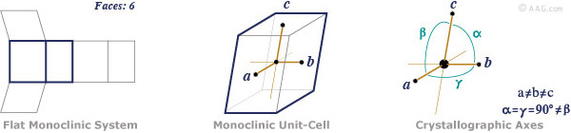
The Monoclinic Crystal System
Crystals that form in the monoclinic system have three unequal axes.
The (a) and (c) crystallographic axes are inclined toward each other at an oblique angle, and the (b) axis is perpendicular to a and c.
The (b) crystallographic axis is called the "ortho" axis.
Note: If a and c crossed at 90 degrees, then we would be in the orthorhombic system!

Slide 14
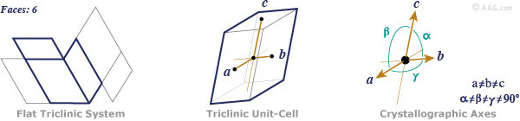
The Triclinic Crystal System
Crystals that form in the triclinic system have three unequal crystallographic axes, all of which intersect at oblique angles.
Triclinic crystals have a 1-fold symmetry axis with virtually no discernible symmetry, and no mirrored or prismatic planes.
Note: If any two axes crossed at 90 degrees, then we would be describing a monoclinic crystal!

Slide 15
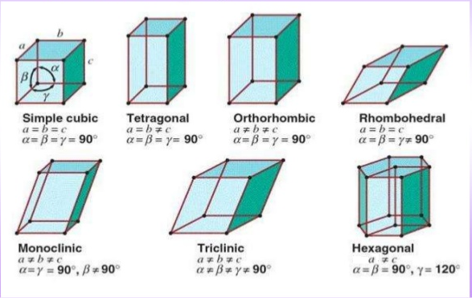
The 7 Crystal Systems

Slide 16

Crystal Symmetry
Crystals, and therefore minerals, have an ordered internal arrangement of atoms.
This ordered arrangement shows symmetry, i.e. the atoms are arranged in a symmetrical fashion on a three dimensional network referred to as a lattice.
A crystal is said to have a symmetry when one shape becomes exactly like another if you flip, slide or turn it.

Slide 17

Crystal Symmetry
To see this, imagine a small 2 dimensional crystal composed of atoms in an ordered internal arrangement as shown below.
Although all of the atoms in this lattice are the same, one of them is gray so that its position can be tracked.
If we rotate the simple crystals by 90º notice that the lattice and crystal look exactly the same as what we started with.
Rotate it another 90º and again its the same. Another 90º rotation again results in an identical crystal, and another 90º rotation returns the crystal to its original orientation.
Thus, in 1 360º rotation, the crystal has repeated itself, or looks identical 4 times. We thus say that this object has 4-fold rotational symmetry.

Slide 18
Crystal Symmetry
There are four elements of symmetry for a crystal.
These include :
  Axes of symmetry
  Plane of symmetry
  Center of symmetry
  Rotoinversion
  These symmetry elements may be or may not be combined in the same crystal. Indeed, we will find that one crystal class or system has only one of these elements.

Slide 19
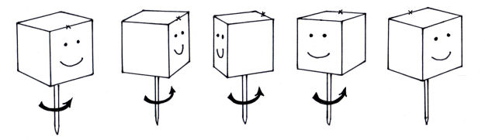
Axes of Symmetry/Rotational Symmetry
If an object can be rotated about an axis and repeats itself every 90º of rotation then it is said to have an axis of 4-fold rotational symmetry.
The axis along which the rotation is performed is an element of symmetry referred to as a rotation axis.

Slide 20
Axes of Symmetry/Rotational Symmetry
When rotation repeats form every 60 degrees, then we have sixfold or HEXAGONAL SYMMETRY. A filled hexagon symbol is noted on the rotational axis.
When rotation repeats form every 90 degrees, then we have fourfold or TETRAGONAL SYMMETRY. A filled square is noted on the rotational axis.
When rotation repeats form every 120 degrees, then we have threefold or TRIGONAL SYMMETRY. A filled equilateral triangle is noted on the rotational axis.
When rotation repeats form every 180 degrees, then we have twofold or BINARY SYMMETRY. A filled oval is noted on the rotational axis.
When rotation repeats form every 360 degrees, then we use a filled circle as notation. This one I consider optional to list as almost any object has this symmetry. If you really want to know the truth, this means NO SYMMETRY!

Slide 21
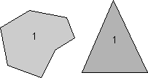
Axes of Symmetry/Rotational Symmetry
The following types of rotational symmetry axes are possible in crystals.
1-Fold Rotation Axis - An object that requires rotation of a full 360º in order to restore it to its original appearance has no rotational symmetry.
Since it repeats itself 1 time every 360º it is said to have a 1-fold axis of rotational symmetry.

Slide 22
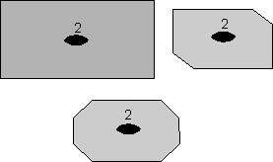
Axes of Symmetry/Rotational Symmetry
2-fold Rotation Axis - If an object appears identical after a rotation of 180º, that is twice in a 360º rotation, then it is said to have a 2-fold rotation axis (360/180 = 2).
Note that in these examples the axes we are referring to are imaginary lines that extend toward you perpendicular to the page or blackboard.
A filled oval shape represents the point where the 2-fold rotation axis intersects the page.

Slide 23
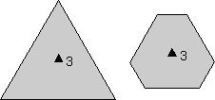

Axes of Symmetry/Rotational Symmetry
3-Fold Rotation Axis- Objects that repeat themselves upon rotation of 120º are said to have a 3-fold axis of rotational symmetry (360/120 =3), and they will repeat 3 times in a 360º rotation.
A filled triangle is used to symbolize the location of 3-fold rotation axis.
4-Fold Rotation Axis - If an object repeats itself after 90º of rotation, it will repeat 4 times in a 360º rotation, as illustrated previously.
A filled square is used to symbolize the location of 4-fold axis of rotational symmetry.

Slide 24
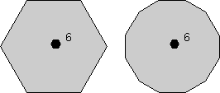
Axes of Symmetry/Rotational Symmetry
6-Fold Rotation Axis - If rotation of 60º about an axis causes the object to repeat itself, then it has 6-fold axis of rotational symmetry (360/60=6).
A filled hexagon is used as the symbol for a 6-fold rotation axis.

Slide 25
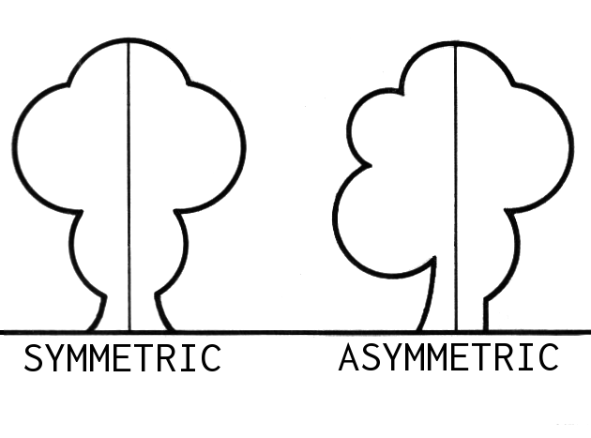
Plane of Symmetry/Reflection Symmetry/
Mirror Symmetry
Any two dimensional surface that, when passed through the center of the crystal, divides it into two symmetrical parts that are MIRROR IMAGES is a PLANE OF SYMMETRY.
A mirror symmetry operation is an imaginary operation that can be performed to reproduce an object.
The operation is done by imagining that you cut the object in half, then place a mirror next to one of the halves of the object along the cut.
If the reflection in the mirror reproduces the other half of the object, then the object is said to have mirror symmetry.
The plane of the mirror is an element of symmetry referred to as a mirror plane, and is symbolized with the letter m.
As an example, the human body is an object that approximates mirror symmetry,

Slide 26
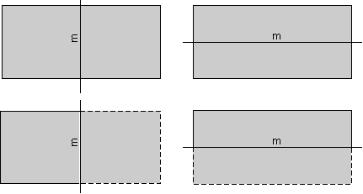
Plane of Symmetry/Reflection Symmetry/
Mirror Symmetry
The rectangles shown here have two planes of mirror symmetry.
The rectangle on the left has a mirror plane that runs vertically on the page and is perpendicular to the page.
The rectangle on the right has a mirror plane that runs horizontally and is perpendicular to the page.
The dashed parts of the rectangles below show the part the rectangles that would be seen as a reflection in the mirror

Slide 27
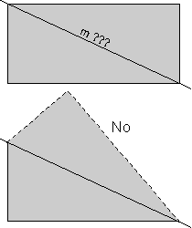
Plane of Symmetry/Reflection Symmetry/
Mirror Symmetry
The rectangles shown above have two planes of mirror symmetry.
Three dimensional and more complex objects could have more. For example, the hexagon shown above, not only has a 6-fold rotation axis, but has 6 mirror planes.
Note that a rectangle does not have mirror symmetry along the diagonal lines. If we cut the rectangle along a diagonal such as that labeled "m ???", as shown in the upper diagram, reflected the lower half in the mirror, then we would see what is shown by the dashed lines in lower diagram.
Since this does not reproduce the original rectangle, the line "m???" does not represent a mirror plane.

Slide 28
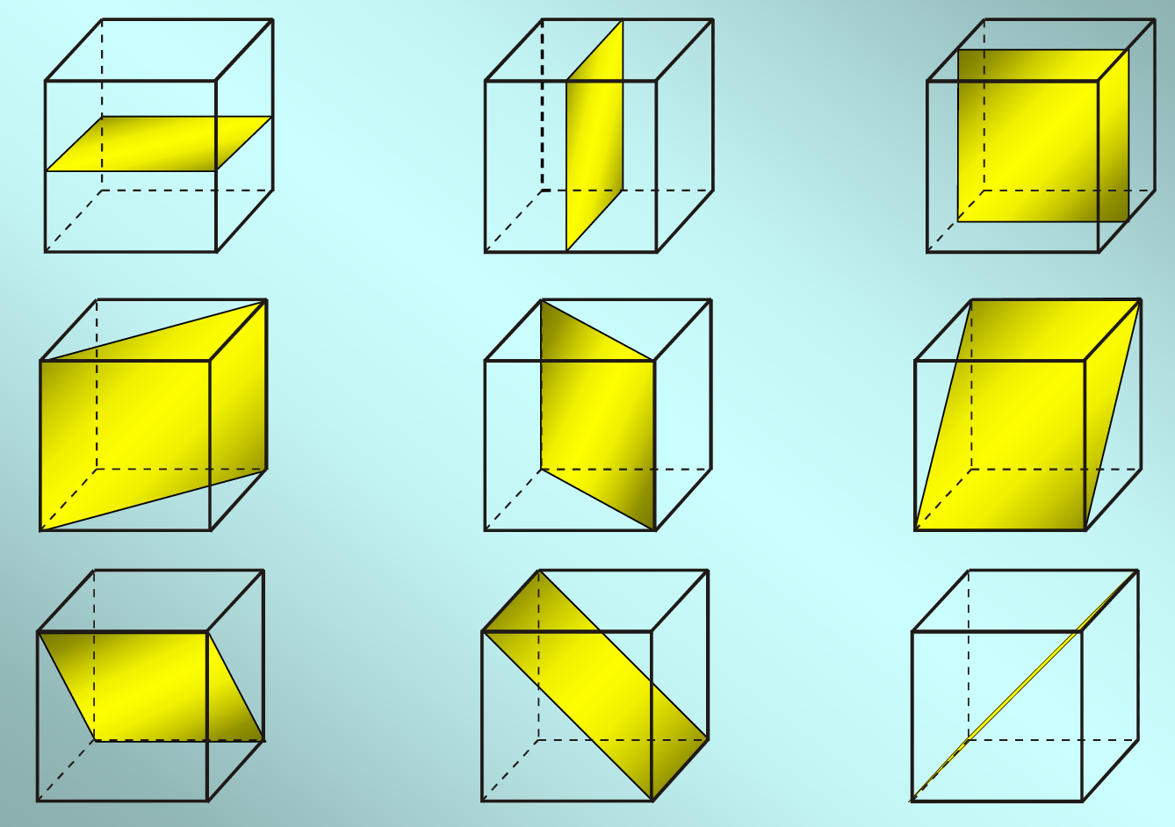
Plane of Symmetry/Reflection Symmetry/
Mirror Symmetry
Plane of Symmetry for the crystals in cubic system

Slide 29
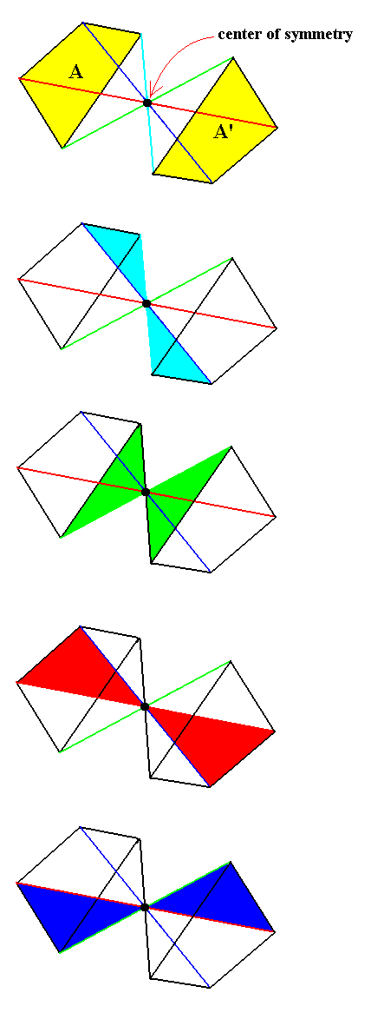
Center of Symmetry/Inversion Symmetry
Most crystals have a center of symmetry, even though they may not possess either planes of symmetry or axes of symmetry.
If you can pass an imaginary line from the surface of a crystal face through the center of the crystal (the axial cross) and it intersects a similar point on a face equidistance from the center, then the crystal has a center of symmetry.
In this operation lines are drawn from all points on the object through a point in the center of the object, called a symmetry center (symbolized with the letter "i").
The lines each have lengths that are equidistant from the original points.
When the ends of the lines are connected, the original object is reproduced inverted from its original appearance.

Slide 30
Reflection versus Inversion
Reflection of a 2 dimensional object occurs across a plane (m)
After inversion everything is an equal and opposite distance through a single point i.

Slide 31
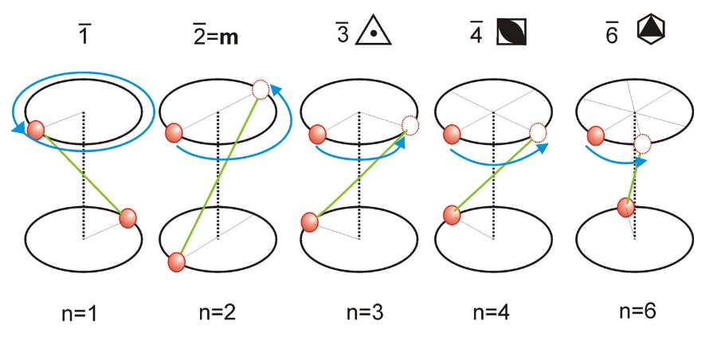
Rotoinversion Symmetry
The combining of the single operations, rotation and inversion, generates a rotoinversion symmetry.
Objects that have rotoinversion symmetry have an element of symmetry called a rotoinversion axis.
To differentiate between normal rotation and rotoinversion we add a bar ¯ above the rotation symbol

Slide 32
Rotoinversion
2-fold Rotoinversion - The operation of 2-fold rotoinversion involves first rotating the object by 180º then inverting it through an inversion center. A 2-fold rotoinversion axis is symbolized as a 2 with a bar over the top, and would be pronounced as "bar 2"
3-fold Rotoinversion - This involves rotating the object by 120º (360/3 = 120), and inverting through a center. A 3-fold rotoinversion axis is denoted as (pronounced "bar 3").
4-fold Rotoinversion - This involves rotation of the object by 90o then inverting through a center. A four fold rotoinversion axis is symbolized as bar 4.
6-fold Rotoinversion - A 6-fold rotoinversion axis involves rotating the object by 60º and inverting through a center and is called as bar 6.

Slide 33
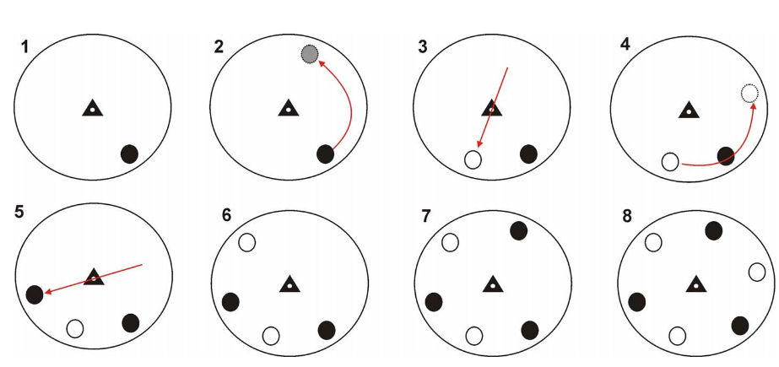
Example: A 3 fold roto-inversion

Slide 34
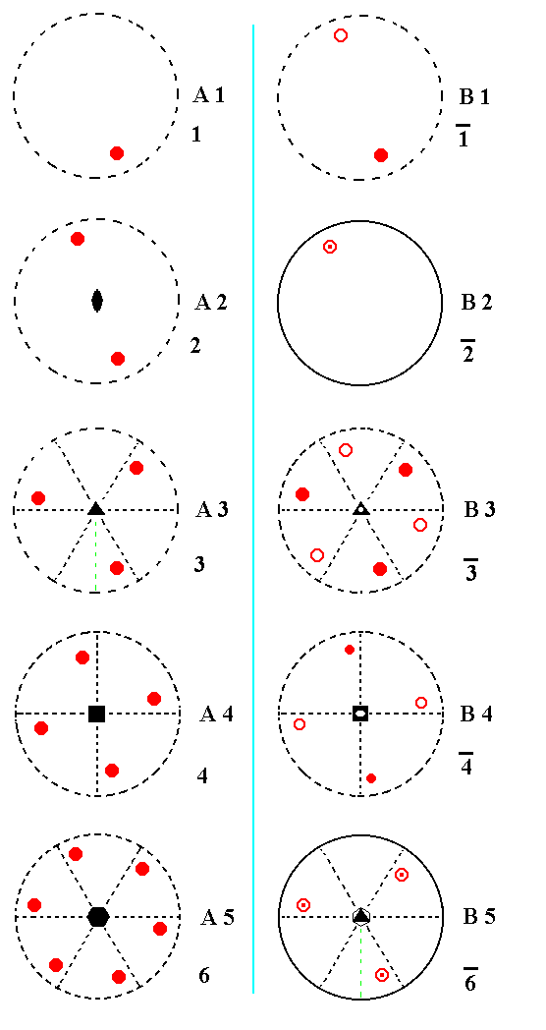
Rotation versus rotoinversion

Slide 35
Combinations of Symmetry Operations
As should be evident by now, in three dimensional objects, such as crystals, symmetry elements may be present in several different combinations.
Combination of mirror, rotation, inversion and rotoinversion symmetry elements leads to 32 possible, non-identical symmetry combinations.
These 32 combinations define the 32 Crystal Classes.
Every crystal must belong to one of these 32 crystal classes.

Slide 36
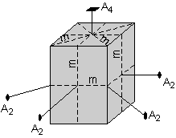
Combinations of Symmetry Operations
Here one example from the Tetragonal System to show how the various symmetry elements are combined in a somewhat completed crystal.
Thus, this crystal has the following symmetry elements:
1 - 4-fold rotation axis (A4)
4 - 2-fold rotation axes (A2), 2 cutting the faces & 2 cutting the edges.
5 mirror planes (m), 2 cutting across the faces, 2 cutting through the edges, and one cutting horizontally through the center.
Note also that there is a center of symmetry (i).
The symmetry content of this crystal is thus: i, 1A4, 4A2, 5m

Slide 37
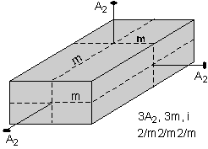
Hermann-Mauguin (International) Symbols
Before going into the 32 crystal classes, we should first see how to derive the Hermann-Mauguin symbols (also called the international symbols) used to describe the crystal classes from the symmetry content.
We'll start with a simple crystal then look at some more complex examples.
The rectangular block shown here has 3 2-fold rotation axes (A2), 3 mirror planes (m), and a center of symmetry (i). The rules for deriving the Hermann-Mauguin symbol are as follows:

Slide 38
Hermann-Mauguin (International) Symbols
Write a number representing each of the unique rotation axes present.
A unique rotation axis is one that exists by itself and is not produced by another symmetry operation.
In this case, all three 2-fold axes are unique, because each is perpendicular to a different shaped face, so we write a 2 (for 2-fold) for each axis
2 2 2
Next we write an "m" for each unique mirror plane. Again, a unique mirror plane is one that is not produced by any other symmetry operation. In this example, we can tell that each mirror is unique because each one cuts a different looking face. So, we write:
2 m 2 m 2 m

Slide 39
Hermann-Mauguin (International) Symbols
If any of the axes are perpendicular to a mirror plane we put a slash (/) between the symbol for the axis and the symbol for the mirror plane.
In this case, each of the 2-fold axes are perpendicular to mirror planes, so our symbol becomes:
2/m2/m2/m

Slide 40
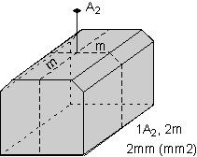
Hermann-Mauguin (International) Symbols
Our second example involves the block shown here to the right. This model has one 2-fold axis and 2 mirror planes. For the 2-fold axis, we write:
2
Each of the mirror planes is unique. We can tell that because each one cuts a different looking face. So, we write 2 "m"s, one for each mirror plane:
2 m m
Note that the 2-fold axis is not perpendicular to a mirror plane, so we need no slashes. Our final symbol is then:
2mm

Slide 41
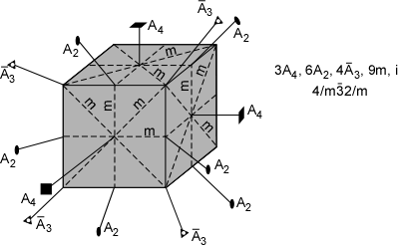
Hermann-Mauguin (International) Symbols
Our last example is from the cubic system and is the most complex.
Note that it has 3 4-fold rotation axes, each of which is perpendicular to a square shaped face.
4 3-fold rotoinversion axes (some of which are not shown in the diagram to reduce complexity), each sticking out of the corners of the cube.
6 2-fold rotation axes (again, not all are shown), sticking out of the edges of the cube.
In addition, the crystal has 9 mirror planes, and a center of symmetry.

Slide 42

Hermann-Mauguin (International) Symbols
There is only 1 unique 4 fold axis, because each is perpendicular to a similar looking face (the faces of the cube).
There is only one unique 3-fold rotoinversion axes, because all of them stick out of the corners of the cube, and all are related by the 4-fold symmetry.
And, there is only 1 unique 2-fold axis, because all of the others stick out of the edges of the cube and are related by the mirror planes the other set of 2-fold axes.
So, we write a 4, a ͞3, and a 2 for each of the unique rotation axes.
There are 3 mirror planes that are perpendicular to the 4 fold axes, and 6 mirror planes that are perpendicular to the 2-fold axes. No mirror planes are perpendicular to the 3-fold rotoinversion axes. So, our final symbol becomes:

Slide 43
The 32 Crystal Classes
The 32 crystal classes represent the 32 possible combinations of symmetry operations.
Each crystal class will have crystal faces that uniquely define the symmetry of the class.
These faces, or groups of faces are called crystal forms.
They are distributed amongst the 7 crystal systems as shown here

Slide 44
The 32 Crystal Classes

Slide 45
The 32 Crystal Classes
Note that the 32 crystal classes are divided into 7 crystal systems
The Triclinic System has only 1-fold or 1-fold rotoinversion axes.
Crystals of this system possess no mirror planes and may have one center of inversion symmetry.
There are two crystal class found in this system: Pedial and Pinacoidal .
Some examples of minerals found in this system are microcline (K-feldspar), plagioclase, turquoise, and wollastonite.

Slide 46
The 32 Crystal Classes
Monoclinic crystals demonstrate a single 2-fold rotation axis and/or a single mirror plane.
The crystals may have a center of symmetry.
There are three crystal class found in this system: Domatic, Sphenoidal and Prismatic .
Some examples of minerals that crystallize in this system include micas (biotite and muscovite), azurite, chlorite, clinopyroxenes, epidote, gypsum, malachite, kaolinite, orthoclase, and talc.

Slide 47
The 32 Crystal Classes
The Orthorhombic System has only two fold axes or a 2-fold axis and/or up to 3 mirror planes.
There are three crystal class found in this system: Pyramidal, Disphenoidal and Dipyramidal .
Some examples of minerals that crystallize in this system include andalusite, anthophyllite, aragonite, barite, cordierite, olivine, sillimanite, stibnite, sulfur, and topaz.

Slide 48
The 32 Crystal Classes
Minerals of the Tetragonal System all possess a single 4-fold symmetry axis.
They may possess up to four 2-fold axes of rotation, a center of inversion, and up to five mirror planes.
There are seven crystal classes found in this system: Disphenoidal, Pyramidal, Dipyramidal , Scalenohedral, Ditetragonal pyramidal, Trapezohedral and Ditetragonal-Dipyramidal.
Some examples of minerals that crystallize in this system include Common minerals that occur with this symmetry are anatase, cassiterite, apophyllite, zircon, and vesuvianite.

Slide 49
The 32 Crystal Classes
All crystals of the hexagonal system possess a single 6-fold axis of rotation.
Crystals of the hexagonal system may possess up to six 2-fold axes of rotation.
They may demonstrate a center of inversion symmetry and up to seven mirror planes.
There are seven crystal classes found in this system: Trigonal Dipyramidal, Pyramidal, Dipyramidal, Ditrigonal Dipyramidal, Dihexagonal Pyramidal, Trapezohedral and Dihexagonal Dipyramidal.
Minerals species which crystallize in the hexagonal division are apatite, beryl, and high quartz.

Slide 50
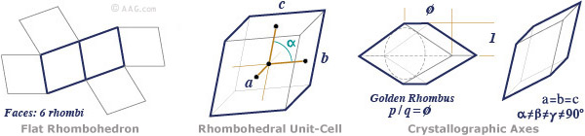
The 32 Crystal Classes
All crystals of the trigonal system have a single 3-fold axis of rotation.
Crystals of this division may possess up to three 2-fold axes of rotation and may have a center of inversion and up to three mirror planes.
There are five crystal classes found in this system: Pyramidal, Rhombohedral, Ditrigonal Pyramidal, Trapezohedral and Hexogonal Scalenohedral. Dipyramidal.
Example of minerals which crystallize in the Trigonal system are calcite, dolomite, low quartz, and tourmaline.

Slide 51
The 32 Crystal Classes
All crystals of the isometric system possess four 3-fold axes of symmetry.
Crystals of the isometric system may also demonstrate up to three separate 4-fold axes of rotational symmetry.
Furthermore crystals of the isometric system may possess six 2-fold axes of symmetry .
Minerals of this system may demonstrate up to nine different mirror planes.
There are five crystal classes found in this system: Tetroidal, Diploidal, Hextetrahedral, Gyroidal and Hexoctahedral.
Examples of minerals which crystallize in the isometric system are halite, magnetite, and garnet.

Slide 52
Crystal Forms
A crystal form is a set of crystal faces that are related to each other by symmetry or any group of crystal faces related by the same symmetry is called a form.
There are 48 possible forms that can be developed as the result of the 32 combinations of symmetry.
Closed forms are those groups of faces all related by symmetry that completely enclose a volume of space.
It is possible for a crystal to have faces entirely of one closed form.
Open forms are those groups of faces all related by symmetry that do not completely enclose a volume of space.
A crystal with open form faces requires additional faces as well.
There are 18 open forms and 30 closed forms.

Slide 53
Crystal Forms
Monohedron: The monohedral crystal form is also called a pedion.
It consists of a single face which is geometrically unique for the crystal and is not repeated by any set of symmetry operations.
Members of the triclinic crystal system produce monohedral crystal forms.
These are open crystal forms.
Parallelohedron: The parallelohedral crystal form is also called a pinacoid.
It consists of two and only two geometrically equivalent faces which occupy opposite sides of a crystal.
The two faces are parallel and are related to one another only by a reflection or an inversion symmetry.
Members of the triclinic crystal system produce parallelohedral crystal forms.
These are open crystal forms.

Slide 54
Crystal Forms
Dihedron: The dihedron consists of two and only two nonparallel geometrically equivalent faces.
The two faces may be related by a reflection or by a rotation.
The dihedron is termed a dome if the two faces are related only by reflection across a mirror plane.
If the two faces are related instead by a 2-fold rotation axis then the dihedron is termed a sphenoid.
Members of the monoclinic crystal system produce dihedral crystal forms.
These are open crystal forms.
Disphenoid: Members of the orthorhombic and tetragonal crystal systems produce rhombic and tetragonal disphenoids, which possess two sets of nonparallel geometrically equivalent faces, each of which is related by a 2-fold rotation.
The faces of the upper sphenoid alternate with the faces of the lower sphenoid in such forms.
These are closed crystal forms.

Slide 55
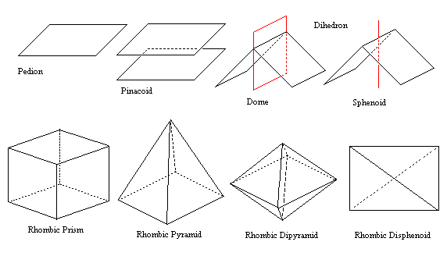
Crystal Forms

Slide 56
Crystal Forms
Prism: A prism is composed of a set of 3, 4, 6, 8, or 12 geometrically equivalent faces which are all parallel to the same axis.
Each of these faces intersects with the two faces adjacent to it to produce a set of parallel edges.
Variants of the prism form include the rhombic prism, tetragonal prism, trigonal prism, and hexagonal prism.
Prisms are associated with the members of the monoclinic crystal system.
These are open crystal forms.
Pyramid: A pyramid is composed of a set of 3, 4, 6, 8, or 12 faces which are not parallel but instead intersect at a point.
The orthorhombic, tetragonal and hexagonal crystal systems all produce pyramids. Variants of the pyramid include rhombic pyramid, tetragonal pyramid, trigonal pyramid, and hexagonal pyramid.
These are open crystal forms.

Slide 57
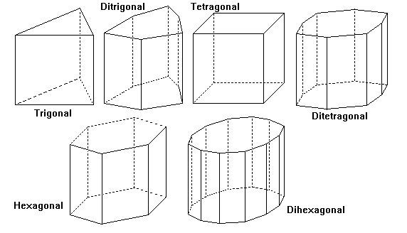
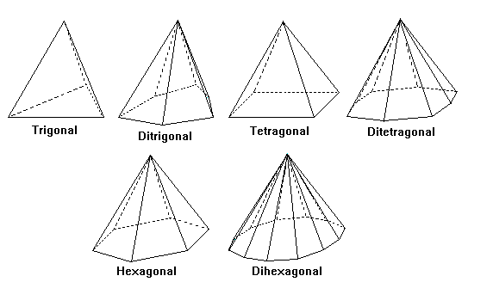
Crystal Forms
PRISM
PYRAMID

Slide 58
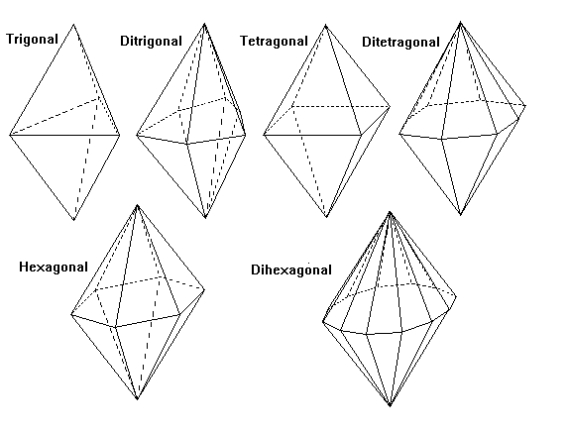
Crystal Forms
Dipyramid: The dipyramidal crystal form is composed of two pyramids placed base-to-base and related by reflection across a mirror plane which runs parallel to and adjacent to the pyramid bases.
The upper and lower pyramids may each have 3, 4, 6, 8, or 12 faces; the dipyramidal form therefore possesses a total of 6, 8, 12, 16, or 24 faces.
The orthorhombic, tetragonal and hexagonal crystal systems all produce dipyramids.
They can be called as rhombic dipyramid, trigonal dipyramid, tetragonal dipyramid, and hexagonal dipyramid.
They are closed crystal forms.

Slide 59
Crystal Forms
Trapezohedron: A trapezohedron is a crystal form possessing 6, 8, or 12 trapezoidal faces.
The tetragonal crystal system, the trigonal and hexagonal crystal system produce trapezohedral crystal forms.
Trigonal trapezohedra possess three trapezoidal faces on the top and three on the bottom for a total of six faces;
Tetragonal trapezohedra have four faces on top and four on the bottom for a total of eight faces; and hexagonal trapezohedra have six faces on top and six on the bottom, resulting in twelve faces total.
They are closed crystal forms.
Scalenohedron: A scalenohedron consists of 8 or 12 faces, each of which is a scalene triangle.
The faces appear to be grouped into symmetric pairs.
The tetragonal, trigonal and hexagonal crystal systems produce the scalenohedral crystal form, of which examples may be further described as trigonal, tetragonal and hexagonal scalenohedra.
They are closed crystal forms

Slide 60
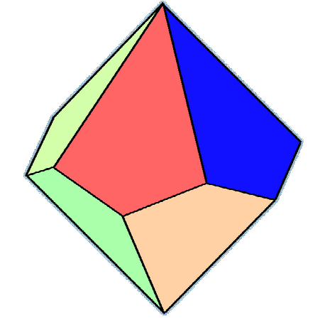
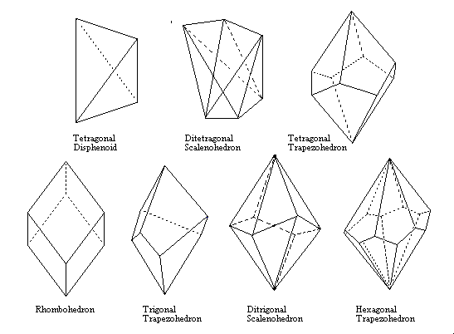
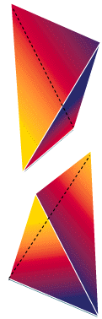
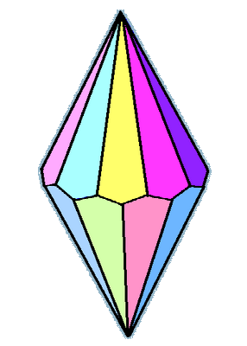
Crystal Forms

Slide 61
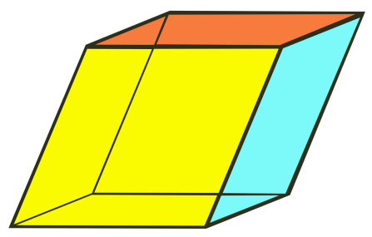
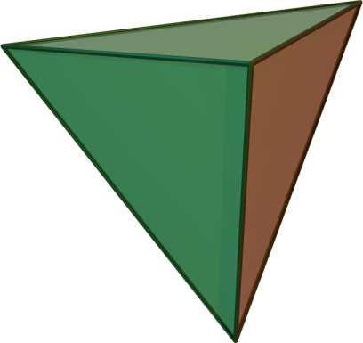
Crystal Forms
Rhombohedron: The rhombohedral crystal form possesses six rhombus-shaped faces.
The rhombohedral crystal form is produced only by members of the trigonal /rhombohedral crystal system.
They are closed crystal forms.
Tetrahedron: A tetrahedron is composed of four triangular faces.
The tetrahedron crystal form is produced by the members of the isometric crystal system.
They are closed crystal forms.

Slide 62
Crystal forms -OPEN
The Pedion
The Pinacoid
The Dome
The Sphenoid
The Prism
The Pyramid

Slide 63
Crystal Forms-CLOSED (Non-isometric)
The Scalenohedron
The Rhombohedron
The Trapezohedrons
The Dipyramids
The Disphenoid

Slide 64
Crystal Forms-CLOSED (Isometric)
The Cube
The Octahedron
The Pyritohedron
The Dodecahedron
The Tetartoid
The Tetrahedron
The Diploid
The Gyroid
The Tetartoid
The Trapezohedron
The Hexoctahedron
The Tetrahexahedron
The Tristetrahedron
The Trisoctahedron
The Hextetrahedron

Slide 65
The 48 possible Crystal Forms

Slide 66
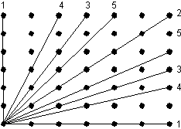
Crystal Morphology
The symmetry observed in crystals as exhibited by their crystal faces is due to the ordered internal arrangement of atoms in a crystal structure, as mentioned previously.
This arrangement of atoms in crystals is called a lattice.
Crystal faces develop along planes defined by the points in the lattice.
In other words, all crystal faces must intersect atoms or molecules that make up the points.
A face is more commonly developed in a crystal if it intersects a larger number of lattice points. This is known as the Bravais Law.

Slide 67
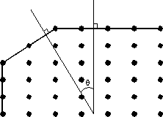
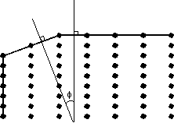
Crystal Morphology
The angle between crystal faces is controlled by the spacing between lattice points.
Since all crystals of the same substance will have the same spacing between lattice points (they have the same crystal structure), the angles between corresponding faces of the same mineral will be the same.
This is known as the Law of constancy of interfacial angles.

Slide 68
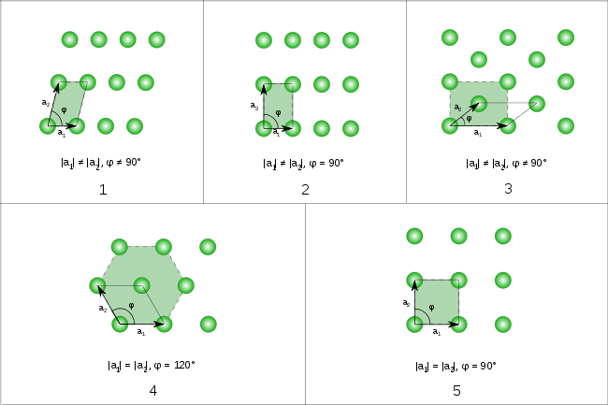
Crystal Morphology
In two dimensions, there are five Bravais lattices, called oblique, rectangular, centered rectangular (rhombic), hexagonal, and square.[

Slide 69
Crystal Morphology
Although there are only 7 crystal systems or shapes, there are 14 different crystal lattices, called Bravais Lattices in 3 dimesion.
3 different cubic types,
2 different tetragonal types,
4 different orthorhombic types,
2 different monoclinic types,
1 rhombohedral,
1 hexagonal,
1 triclinic

Slide 70
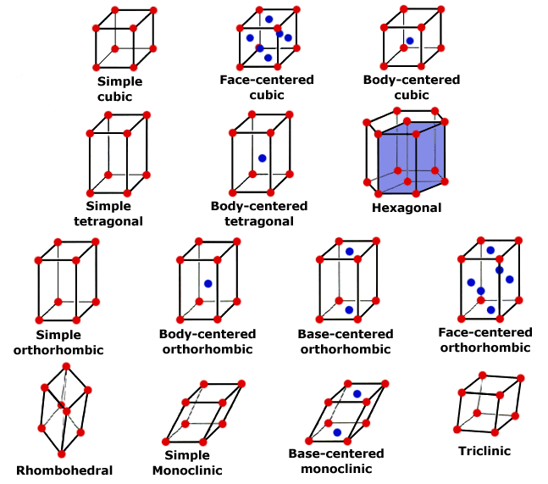
Crystal Morphology

