Slide 1
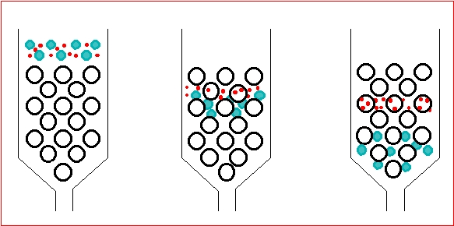
Gel Filtration Chromatography.

Slide 2
Objectives
The objective of this experiment is for students to learn the principles of gel filtration chromatography by separating of two substance according to the molecular weights.
2. A practical experience on gel filtration chromatography in the laboratory.
3. Importance of gel filtration chromatography and procedures in purification.

Slide 3
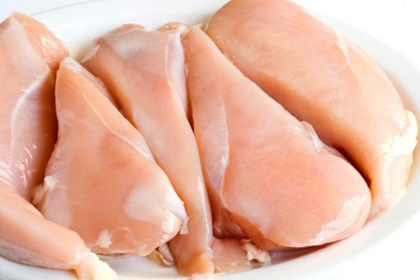
Protein Isolation and Purification
Protein purification is a series of processes intended to isolate one or a few proteins from a complex mixture, usually cells, tissues or whole organisms.
Cell debris and other proteins are removed by centrifugation and other protein could be removed by salting out
You will have a mixture of proteins that have different charges, Sizes , and other properties
Whole Tissue
Tissue homogenization

Slide 4
Gel filtration Chromatography
One of the techniques that is used to separate molecules according to size and shape is Gel filtration
The molecules pass through a gel filtration medium packed in a column.
Molecules move through a bed of porous beads, diffusing into the beads to greater or lesser degrees

Slide 5
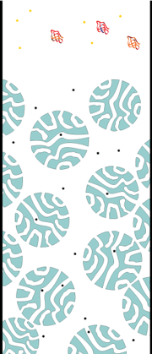
Gel filtration chromatography
Mobile phase:
NaCl, buffers,..
In this lab the mobile phase is NaCl.
Stationary phase:
(column matrix)
"beads" of hydrated, porous polymer.

Slide 6
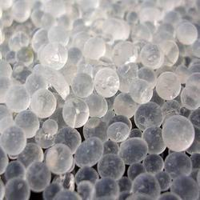
Stationary phase
The stationary phase in gel filtration chromatography is made of a gel consisting of beads containing pores of a defined size range.

Slide 7
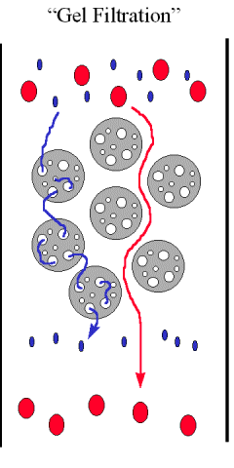
Example
A (red) size larger than the pores
B (blue) size that can enters the pores
Which one will eluted first?
A will move only in the space between
the beads and are not retarded by the beads
So it will eluted first
B diffuse in and out of the so they are slowed down in their movement through the column

Slide 8
Principle
If an aqueous solution containing molecules of various sizes is passed through a column containing such molecular sieve "beads", the molecules that are larger than the pores move only in the space between the beads and are not retarded by the beads.
However, molecules smaller than the pores diffuse in and out of the beads with a probability that increase with decreasing molecular size; by this way, they are slowed down in their movement through the column.
Therefore, these large molecules cross the column more rapidly in a smaller elution volume , than the molecules that pass through the pores.
The elongated molecules are less likely to penetrate a given gel pore than spherical molecules of the same molecular weight
The samples are moving by the addition of buffer (mobile phase)

Slide 9
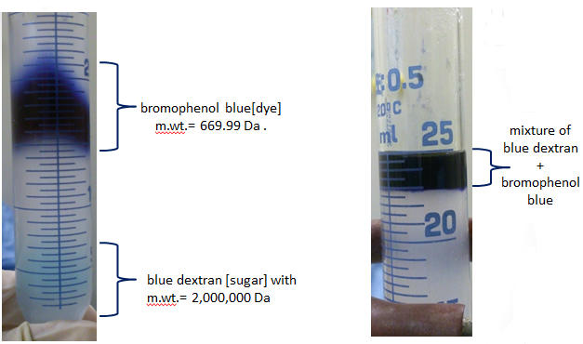
After few mins.
At the beginning

Slide 10
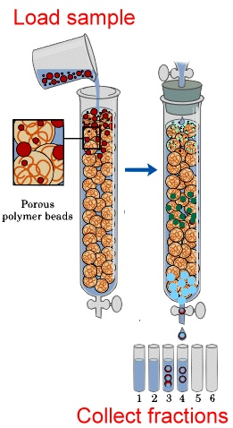

Slide 11
For every column, three volumes should be distinguished:
The void volume, V_{o}:
The volume of the mobile phase in the space between the beads . [which is the volume external to the beads].
-Can be determined by the elution of High MW molecules which can not enter the pores .
2. The total volume, Vt (bed volume):
The total volume of material in the column (both solid and liquid).
[can be calculated from the dimension of the column.]
3. The elution volume, Ve, of molecules:
The amount of liquid (mobile phase) that must be added to produce a peak of
a particular solute in the effluent.
Or the volume required for completely eluting the solute from column.

Slide 12
Gel Filtration Chromatography.

Slide 13
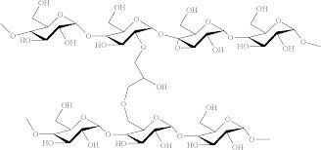
Stationary phase
Gel beads come in various sizes large, medium, fine, and superfine.
All consist of semi-permeable, porous gels of cross linked polymers with a range of pore sizes.
The degree of cross linking is controlled to yield a series of gels having different pore sizes.
The pore size determines the range of molecular weight in which fractionation occurs.
The beads must be inert, uncharged .
Suitable materials for gel are: agarose, dextran or polyacrylamide

Slide 14
Mobile phase
Molecules in the sample can be separated in order of their size by collecting fractions as the mobile phase is eluted through the column, with the largest molecules eluting first and the smallest last.

Slide 15
-Loading the sample :
small volume of sample is placed on the stationary phase and allowed to enter the column.
-Packing the column:
Preparation of the gel and loading it in the column.

Slide 16
Advantages of gel filtration:
It is the best method for separation of molecules differing in molecular weight because:
1. It doesn’t depend on temperature, pH, ionic strength and buffer composition, so, separation can be carried out under any conditions.
2. There is less zonal spreading than in other techniques.
3. The elution volume is related to the molecular weight.
4. Important method in protein purification.
5.This separation method is unique in fractionating without requiring protein binding, thus significantly reducing the risk of protein loss.

Slide 17
The most common application of gel filtration in biochemistry are:
-Molecular weight determination.
-Fractionation of macromolecules.
-purification.

Slide 18
elution volume, V_{e} is proportional to log of molecular weight.
For high molecular weight less elution volume is needed, and for small molecular weight the large elution volume is needed to elute the sample.

Slide 19
Cautions must be taken:
It is important that the gel should be:
Homogenous.
Free from bubbles.
Free from cracks.
Free from spaces between the walls.
And it should be covered by the liquid "mobile phase" all the time.

Slide 20
Practical Considerations
-Gels of various pore size are available → choose the one with the best fractionation range for your sample
-Good separation usually require long columns and slow flow rate.
-Gel filtration is NOT recommended for separating proteins with only a small difference in molecular weight .

Slide 21
Practical part

Slide 22
Practical Considerations
-Gels of various pore size are available → choose the one with the best fractionation range for your sample
-Good separation usually require long columns and slow flow rate.
-Gel filtration is NOT recommended for separating proteins with only a small difference in molecular weight .

Slide 23
The gel filtration material that will be used in the experiment is called Sephadex G-100 and it will separate molecules with molecular weights from 4,000 to 150,000 Da.
So, Those molecules which are with molecular weight larger than 150,000 will be excluded from the beads, because of their huge size they can not get through the pores of the beads, and elute first.
In your experiment:
you will separate a mixture of blue dextran [sugar] with m.wt.= 2,000,000 Da and bromophenol blue[dye] m.wt.= 669.99 Da .

Slide 24
1. Remove the excess buffer, then add 1 ml of your sample
2. Collect the fractions.
3. Read the absorbance for each fraction.
4. Draw the curve.(absorbance Vs fraction number)

Slide 25
Diffusion

