Slide 1
ENGINEERING MANAGEMENT (GE 404)
بسم الله الرحمن الرحيم
Lecture #13
Analysis of delay schedule
Notes:
This is a title slide.

Slide 2
Contents
Objectives of the present lecture
Quality of Schedule
Schedule Manipulation
Types of project schedule
Purpose of as-built schedules
Responsibility of delay
Common causes of delay
Critical and noncritical delays
Delay and disruption
Types of delay
Techniques for delay analysis
Day-by-day analysis technique
Problems
Further reading

Slide 3
Objectives of the Present lecture
To discuss types, causes and parties responsible for delays in a project
To learn how to carry out the delay analysis using Day-by-Day analysis technique

Slide 4
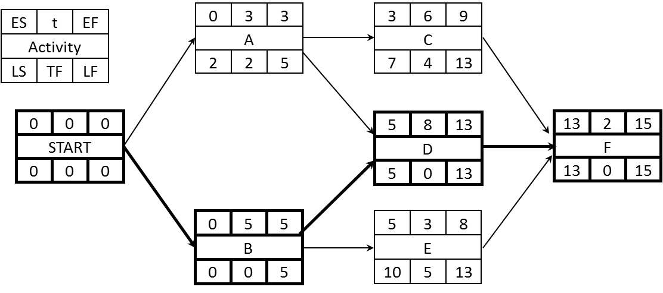
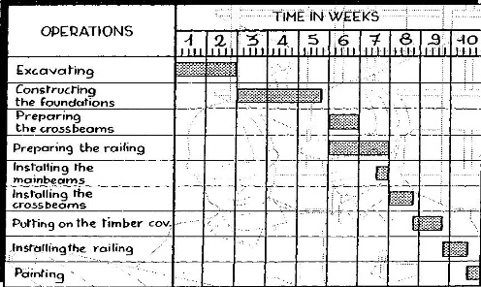
Quality of a Schedule
When scheduling, the schedule must be:
Reliable
Reflect the intended Plan
Approved
Free from Mistakes
Free from Manipulations
However, project flow of work may not properly executed hence delay can occur

Slide 5
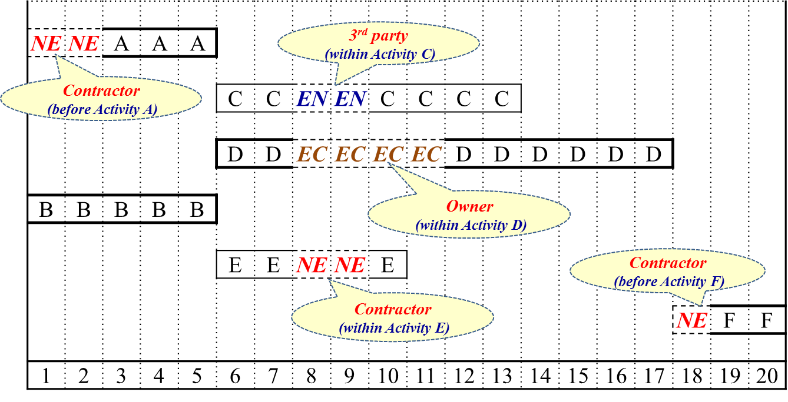
Schedule Manipulation
Schedule can be Manipulated by
Reducing or Increasing activity duration
Manipulating activities constraints (lag/lead time)
Manipulating the activity status or history
Change schedule sequencing
Schedule the activity based on late start
Notes:
manipulate something (formal) to control or use something in a skilful way
to manipulate the gears and levers of a machine
Computers are very efficient at manipulating information.

Slide 6
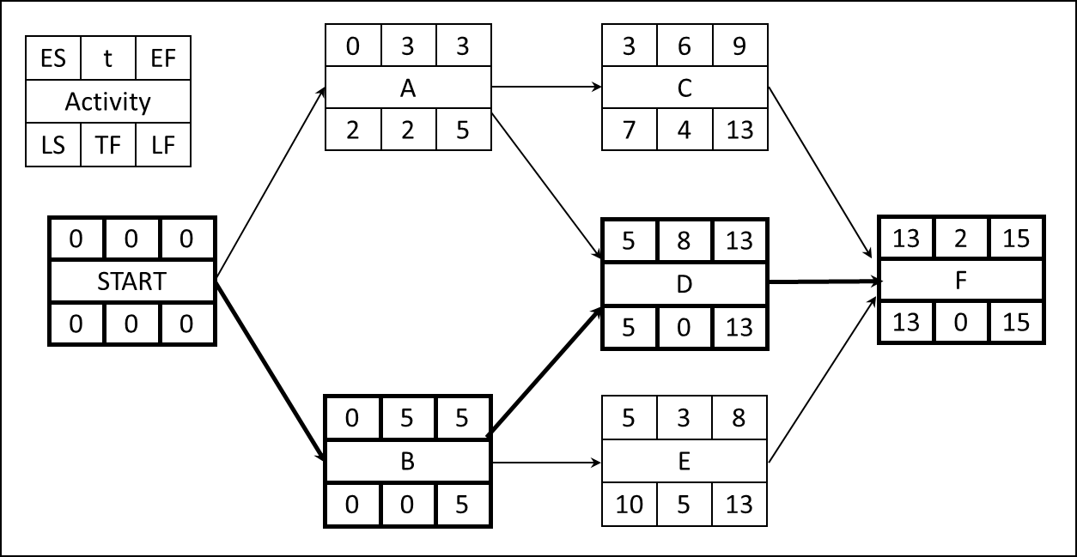
Types of Project Schedule
Three types of project schedule can be identified:
As planned schedule: it is schedule at the beginning of project execution
Adjusted schedule: it is schedule during the progress of the project
As built schedule: It is the schedule at the end of project execution
As planned schedule
As-built schedule

Slide 7
Purpose of as-built schedules
The most widely recognized use of as-built schedules is in the area of claims, especially delay claims
From a contractor’s point of view, an as-built schedule might be prepared to demonstrate how a particular owner-caused delay or unforeseen condition resulted in a significant project delay
From the owner’s point of view, an as-built schedule (covering the entire duration of a project) might be prepared to demonstrate the variations from the original schedule which were significant even when no intervening events took place
As-built schedules are sometimes also prepared to develop a clear historical record of a project
Note: As-built schedules are not prepared on most projects

Slide 8
Responsibility of Delay
Usually as-built schedule duration is different from as-planned schedule duration. Hence, it is required to find who is responsible about the delay:
Owner
Contractor
Subcontractors
Third Party (they may have no interest in the project)
Suppliers
Labor unions
Utility companies
politicians
Nature etc.
As planned schedule
As-built schedule

Slide 9
Common Causes of Delay
Site conditions
Change in requirements or design
Inclement weather
Unavailability of labor, material, or equipment
Defective plans or specifications
Owner caused delay: permits, owner-supplied equipment, materials, ..etc.
Notes:
Inclement:(of the weather) not pleasant; cold, wet, etc.

Slide 10
Critical and Noncritical Delays
Critical Delay
Non-critical Delay
Delays that extend the project completion date are known as critical delays
Delays that do not extend the project completion date are called noncritical delays

Slide 11
Delay and Disruption
Project Delay
Project Disruption
A “Delay” is the time during which some part of the project has been extended or not performed due to an unanticipated circumstance
It can be critical or non critical
Disruption is an interruption in the planned work sequence or flow of work
It is distinguished from delay in that the duration of work activities or the overall project completion may not be extended
Notes:
the act of stopping something from continuing in the normal way

Slide 12
Types of Delay
Excusable Delay
Compensable Delay (EC)-Owner Responsibility
Non-compensable Delay (EN)-3rd party Responsibility
Non-excusable Delay (NE)-Contractor Responsibility
Concurrent Delay
Delays that happen in two or more parallel Critical path activities in the same time period are classified as concurrent delays.

Slide 13
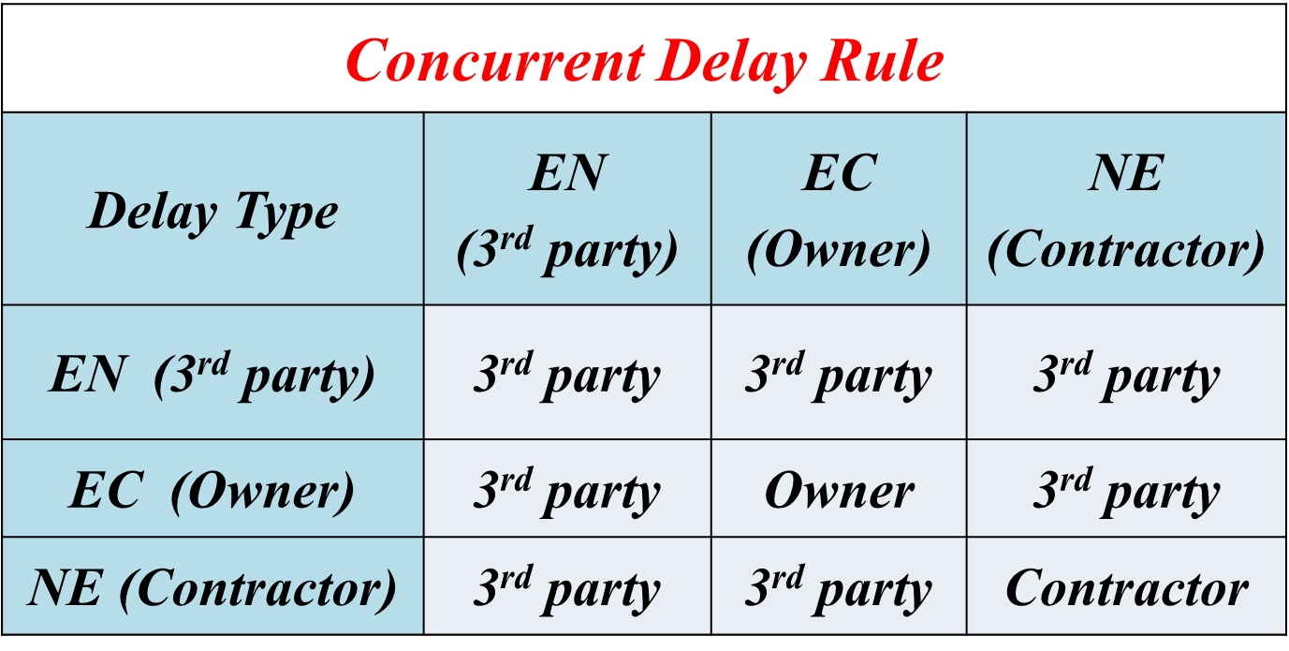
Concurrent Delay rule
If there is two or more critical delay events in the same analysis day, assign the delay responsibility according to concurrent delay rule

Slide 14
Concurrent Delay: An Example
Activity A
Activity B
Activity C
Activity D
Activity E
Activity F
Delay
Activity A
EC Delay
Activity B
Activity C
Activity D
NE Delay
Activity E
Activity F

Slide 15
Techniques for Delay Analysis
Day-by-Day analysis technique
Simple technique (does not consider changing of CP)
As-Built Schedule
But-for
More advanced technique (consider changing of CP)
Window/Snapshot
Window/But-for
Note: Only Algorithm of Day-by-Day analysis technique will be discussed.

Slide 16
Day-by-day analysis technique
Step(1) Prepare the analysis data
Determine AON network at the beginning of project (as planned schedule)
Determine Bar Chart (BC) at the end of the project (as built schedule) including all delays
Review as built Bar chart day by day from 1st day and identify delay times
Build an analysis table as follows and fill all delay day-by-day in column one
Note: in case of having identical delay events in 2 or more days in the As-Built schedule, you can combine the analysis of these days together in one step, since it will be repeated).

Slide 17
Contd.
Step (2) Carry out repeated process start with first delay day(s) considering day by day until all delays are considered. The process is as follows:
Identify affected activity(s) at considered delay day(s) and who is responsible about the delay
From the affected activity(s) in part (a), identify the critical activity
Based on the delay type of responsibility of critical affected activity(s), assign responsibility of delay according to following condition:
If there is only one critical delay event, assign the delay responsibility based on the responsible party
If there is two or more critical delay events in the same analysis day, assign the delay responsibility according to concurrent delay rule
Fill column 2 to column 5 for analysis table
Update AON times and determine the project duration and updated critical path(s)

Slide 18
Note
If there is a delay on activity start, increase the lag time of finish-start (FS) type and EST of the successor activity is delayed by that delayed time.
If there is a delay on activity duration, increase the duration of the activity and the EFT of the affected activity is delayed by that delayed time.

Slide 19
Contd.
Step (3) Repeat step (2) until all delay days are considered. To speed up the process of day-by-day analysis, day-by-day analysis cycles can be combined by satisfy the following two conditions:
All the combined cycles have identical delay types linked with their activities
None of the Network Noncritical activities are converted to be Critical
Step (4) Check solution:
Days extended due to delay = Sum of days assigned to responsibility

Slide 20
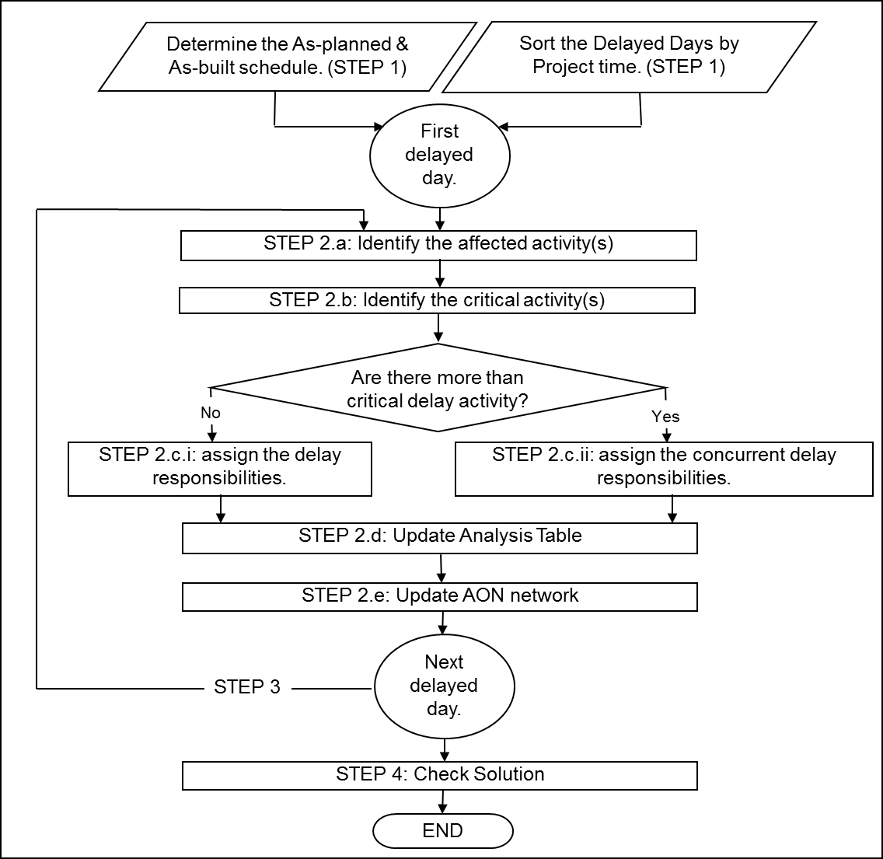
Algorithm

Slide 21
Problem-1
The AON network indicating as-planned schedule of a project, and bar chart illustrating as-built schedule of the same project are given below. Use day-by day analysis technique to analyze schedule delay.
As-planned schedule
As-built schedule

Slide 22
Solution Day 0 Analysis
Day(s) | Affected Activity(s) | Critical Activity(s) | Responsibility |  |  | Project Duration
 |  |  | EC (Owner) | NE (Contractor) | EN (3rd party)
0 | ------ | -------- | 0 | 0 | 0 | 15

Slide 23
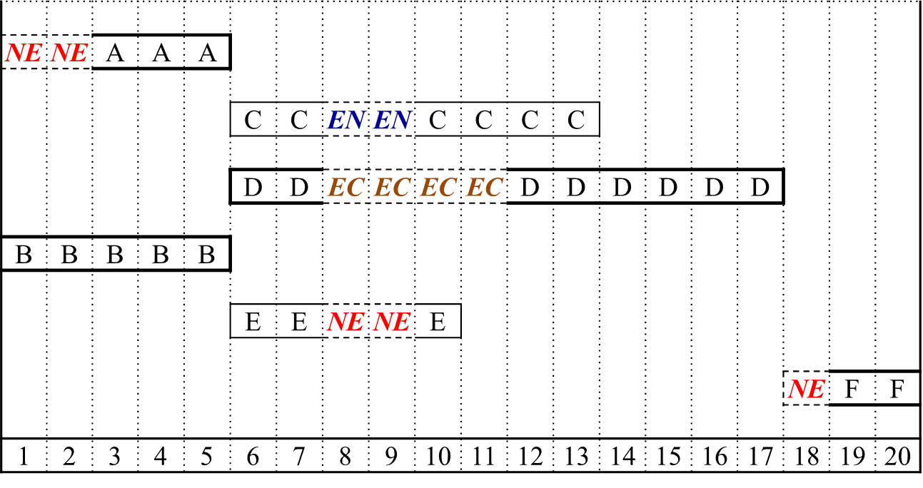
Solution (Contd.) Day 1 and 2 Analysis
Day(s) | Affected Activity(s) | Critical Activity(s) | Responsibility |  |  | Project Duration
 |  |  | EC (Owner) | NE (Contractor) | EN (3rd party)
0 | ------ | -------- | 0 | 0 | 0 | 15
1&2 | A | ------- | 0 | 0 | 0 | 15

Slide 24
Solution (Contd.) Day 8 and 9 Analysis
Day(s) | Affected Activity(s) | Critical Activity(s) | Responsibility |  |  | Project Duration
 |  |  | EC (Owner) | NE (Contractor) | EN (3rd party)
0 | ------ | -------- | 0 | 0 | 0 | 15
1&2 | A | ------- | 0 | 0 | 0 | 15
8&9 | C, D, E | D (EC) | 2 | 0 | 0 | 17

Slide 25
Solution (Contd.) Day 10 and 11 Analysis
Day(s) | Affected Activity(s) | Critical Activity(s) | Responsibility |  |  | Project Duration
 |  |  | EC (Owner) | NE (Contractor) | EN (3rd party)
0 | ------ | -------- | 0 | 0 | 0 | 15
1&2 | A | ------- | 0 | 0 | 0 | 15
8&9 | C, D, E | D (EC) | 2 | 0 | 0 | 17
10&11 | D | D (EC) | 2 | 0 | 0 | 19

Slide 26
Solution (Contd.) Day 18 Analysis (Final Result)
Conclusion: Out of a total delay of 5 days, 4 days are due to owner and remaining 1 day is due to contractor.
Day(s) | Affected Activity(s) | Critical Activity(s) | Responsibility |  |  | Project Duration
 |  |  | EC (Owner) | NE (Contractor) | EN (3rd party)
0 | ------ | -------- | 0 | 0 | 0 | 15
1&2 | A | ------- | 0 | 0 | 0 | 15
8&9 | C, D, E | D (EC) | 2 | 0 | 0 | 17
10&11 | D | D (EC) | 2 | 0 | 0 | 19
18 | F | F (NE) | 0 | 1 | 0 | 20

Slide 27
Problem-2
Consider the following As-planned and As-built schedule for a project. Determine the delay responsibilities between the owner and the contractor.

Slide 28
Solution Day 0 Analysis
Day(s) | Affected Activity(s) | Critical Activity(s) | Responsibility |  |  | Project Duration
 |  |  | EC (Owner) | NE (Contractor) | EN (3rd party)
0 | ------ | -------- | 0 | 0 | 0 | 12

Slide 29
Solution (Contd.) Day 3 Analysis
Day(s) | Affected Activity(s) | Critical Activity(s) | Responsibility |  |  | Project Duration
 |  |  | EC (Owner) | NE (Contractor) | EN (3rd party)
0 | ------ | -------- | 0 | 0 | 0 | 12
3 | A, D, F | A (EC) | 1 | 0 | 0 | 13

Slide 30
Solution (Contd.) Day 5 and 6 Analysis
Day(s) | Affected Activity(s) | Critical Activity(s) | Responsibility |  |  | Project Duration
 |  |  | EC (Owner) | NE (Contractor) | EN (3rd party)
0 | ------ | -------- | 0 | 0 | 0 | 12
3 | A, D, F | A (EC) | 1 | 0 | 0 | 13
5&6 | G | -------- | 0 | 0 | 0 | 13

Slide 31
Solution (Contd.) Day 11 Analysis
Remark: notice delays of days 11,12,13 are for different responsible parties for concurrent activities. Hence, consider day by day analysis and concurrent rule. (If the reason is not either owner or contractor, the reason is 3rd party)
Day(s) | Affected Activity(s) | Critical Activity(s) | Responsibility |  |  | Project Duration
 |  |  | EC (Owner) | NE (Contractor) | EN (3rd party)
0 | ------ | -------- | 0 | 0 | 0 | 12
3 | A, D, F | A (EC) | 1 | 0 | 0 | 13
5&6 | G | -------- | 0 | 0 | 0 | 13
11 | C, G | C(NE), G(EC) | 0 | 0 | 1 | 14

Slide 32
Solution (Contd.) Day 12 Analysis
Remark: notice delays of days 11,12,13 are for different responsible parties for concurrent activities. Hence, consider day by day analysis and concurrent rule. (If the reason is not either owner or contractor, the reason is 3rd party)
Day(s) | Affected Activity(s) | Critical Activity(s) | Responsibility |  |  | Project Duration
 |  |  | EC (Owner) | NE (Contractor) | EN (3rd party)
0 | ------ | -------- | 0 | 0 | 0 | 12
3 | A, D, F | A (EC) | 1 | 0 | 0 | 13
5&6 | G | -------- | 0 | 0 | 0 | 13
11 | C, G | C(NE), G(EC) | 0 | 0 | 1 | 14
12 | C, G | C(NE), G(NE) | 0 | 1 | 0 | 15

Slide 33
Solution (Contd.) Day 13 Analysis
Remark: notice delays of days 11,12,13 are for different responsible parties for concurrent activities. Hence, consider day by day analysis and concurrent rule. (If the reason is not either owner or contractor, the reason is 3rd party)
Conclusion: Out of a total delay of 4 days, 1 day delay is due to Owner, 1 day due to contractor and 2 days delay are due to third party.
(FINAL RESULT)
Day(s) | Affected Activity(s) | Critical Activity(s) | Responsibility |  |  | Project Duration
 |  |  | EC (Owner) | NE (Contractor) | EN (3rd party)
0 | ------ | -------- | 0 | 0 | 0 | 12
3 | A, D, F | A (EC) | 1 | 0 | 0 | 13
5&6 | G | -------- | 0 | 0 | 0 | 13
11 | C, G | C(NE), G(EC) | 0 | 0 | 1 | 14
12 | C, G | C(NE), G(NE) | 0 | 1 | 0 | 15
13 | C, G | C(NE), G(en) | 0 | 0 | 1 | 16

Slide 34
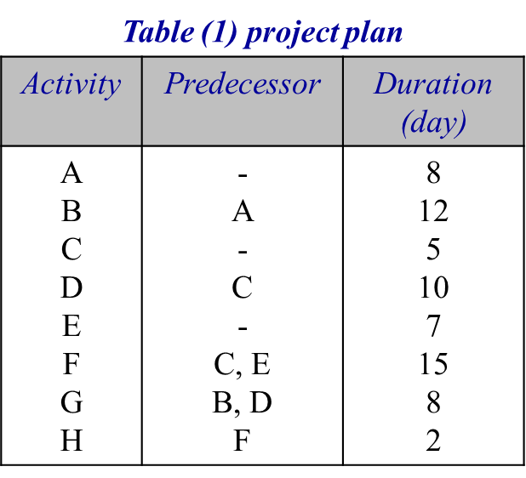
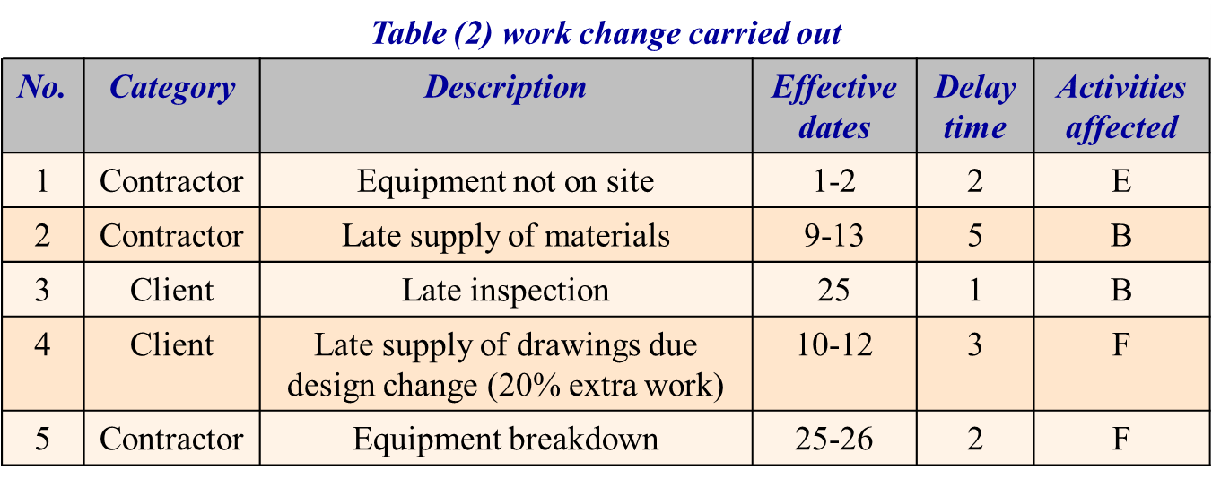
Home Work (HW)
Consider the small contract initial planning shown in table (1). During project execution, work changes and delays were recorded as shown in table (2).
Draw the as-planned and as-built schedule, and
Determine how each party is responsible for the contract delayed completion.

Slide 35
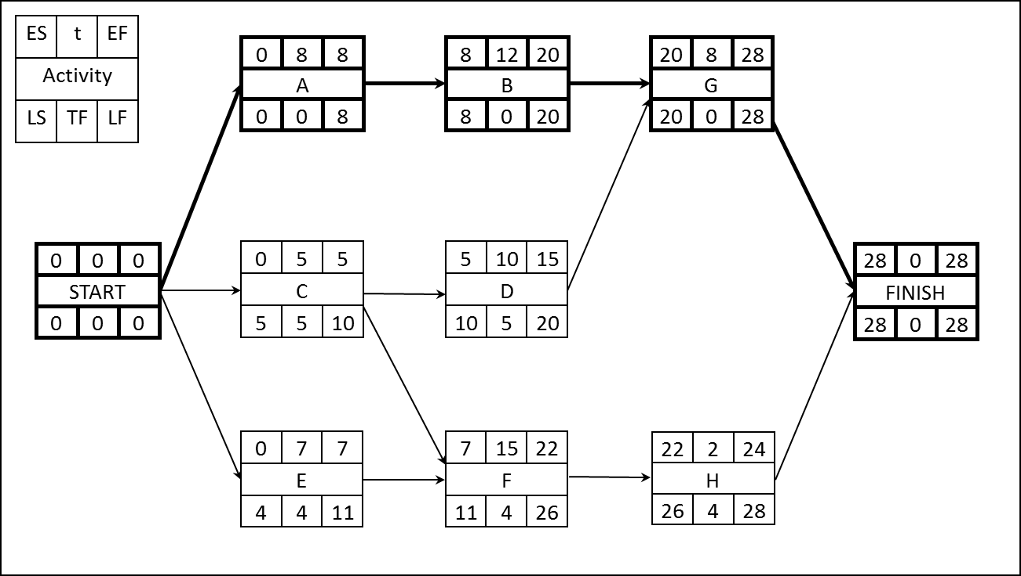
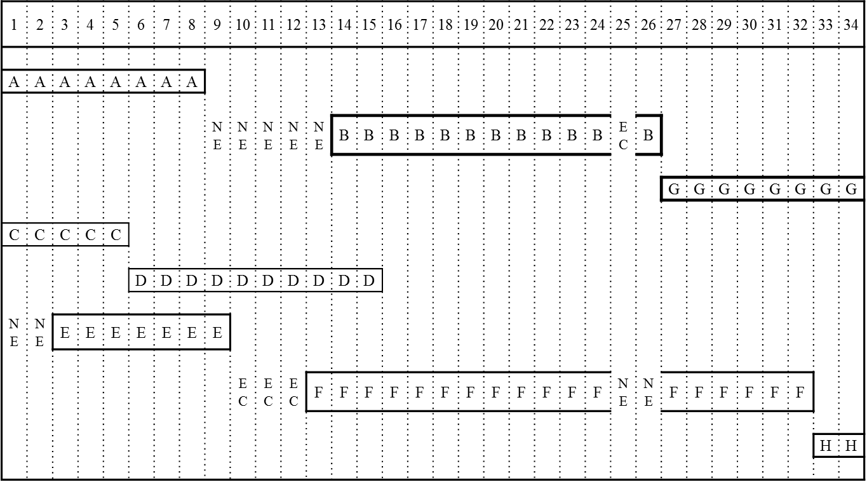
HW (Contd.)
As-planned Schedule
As-built Schedule

Slide 36
Further Reading
Read more about the Project Cost Control from Chapter 8 of:
Jimmie W. Hinze. “Construction Planning and Management,” Fourth Edition, 2012, Pearson.

Slide 37
Thank You
Questions Please

