Slide 1
ENGINEERING MANAGEMENT (GE 404)
بسم الله الرحمن الرحيم
Tutorial # 8
Project Time Control
Instructor: Eng.Alothman
Notes:
This is a title slide.

Slide 2
Measure and Report Progress
Methods
Estimated number of working days req. to complete the activity.
Estimated % completion of the activity.
Quantities of work units put in place.
Equations
Working days to complete = d (1 - P/100)
Working days to complete = d (1 – (W/T))
Where
d= total activity duration in working days
P = estimated percentage of completion
W= number of work units put into place.
T= total number of work units associated with the activity.
Based on the assumption of straight-line variation between time and work accomplishment

Slide 3
Example1:
The initial AON diagram for a small engineering project is shown below with its planned activity times in weeks.
At the end of the 5th week, the field progress report gives you the following information:
Activities “B, C, D and E” have been completed on schedule.
Activity “F” is ready to start at the beginning of the week 6.
Remaining duration of activity “H” is 4 weeks.
Remaining duration of activity “I” is 3 weeks.
Activity “G” will not start until end of week 7.
Volume of work in activity “L” has been increased by 33% approximately.
Activity “J” has been omitted
It is decided to shorten activity “K” by 2 weeks.
Construct the updated schedule indicating the critical path and showing new activities times.

Slide 4
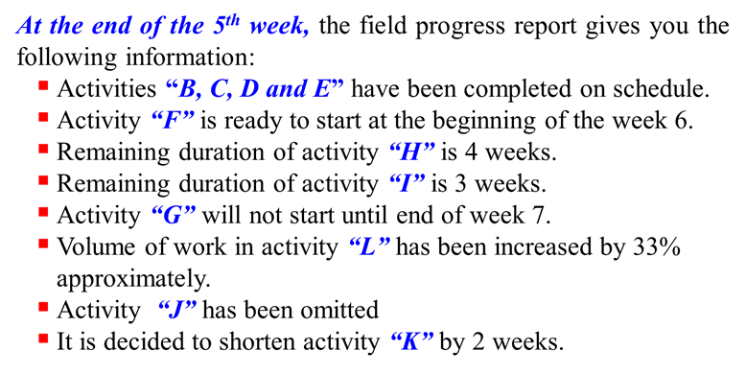
2 | 2 | 4
E
14 |  | 16
0 | 2 | 2
B
3 |  | 5
2 | 6 | 8
F
5 |  | 11
8 | 2 | 10
J
16 |  | 18
0 | 0 | 0
START
0 |  | 0
0 | 5 | 5
C
0 |  | 5
5 | 6 | 11
G
5 |  | 11
11 | 7 | 18
K
11 |  | 18
18 | 2 | 20
N
18 |  | 20
0 | 3 | 3
D
6 |  | 9
3 | 6 | 9
H
9 |  | 15
9 | 3 | 12
L
15 |  | 18
3 | 4 | 7
I
12 |  | 16
9 | 2 | 11
M
16 |  | 18

Slide 5
At the end of the 5th week, the field progress report gives you the following information:
Activities “B, C, D and E” have been completed on schedule.
 | 0
E
 | 0
B
2 | 6 | 8
F
5 |  | 11
8 | 2 | 10
J
16 |  | 18
0 | 0 | 0
START
0 |  | 0
 | 0
C
5 | 6 | 11
G
5 |  | 11
11 | 7 | 18
K
11 |  | 18
18 | 2 | 20
N
18 |  | 20
 | 0
D
3 | 6 | 9
H
9 |  | 15
9 | 3 | 12
L
15 |  | 18
3 | 4 | 7
I
12 |  | 16
9 | 2 | 11
M
16 |  | 18

Slide 6
At the end of the 5th week, the field progress report gives you the following information:
Activity “F” is ready to start at the beginning of the week 6.
 | 0
E
LIVE
 | 0
B
5 | 6 | 11
F
5 |  | 11
11 | 2 | 13
J
16 |  | 18
0 | 0 | 0
START
0 |  | 0
 | 0
C
5 | 6 | 11
G
5 |  | 11
11 | 7 | 18
K
11 |  | 18
18 | 2 | 20
N
18 |  | 20
 | 0
D
3 | 6 | 9
H
9 |  | 15
9 | 3 | 12
L
15 |  | 18
3 | 4 | 7
I
12 |  | 16
9 | 2 | 11
M
16 |  | 18

Slide 7
At the end of the 5th week, the field progress report gives you the following information:
Remaining duration of activity “H” is 4 weeks.
 | 0
E
LIVE
 | 0
B
5 | 6 | 11
F
5 |  | 11
11 | 2 | 13
J
16 |  | 18
0 | 0 | 0
START
0 |  | 0
 | 0
C
5 | 6 | 11
G
5 |  | 11
11 | 7 | 18
K
11 |  | 18
18 | 2 | 20
N
18 |  | 20
LIVE
 | 0
D
5 | 4 | 9
H
9 |  | 15
9 | 3 | 12
L
15 |  | 18
3 | 4 | 7
I
12 |  | 16
9 | 2 | 11
M
16 |  | 18

Slide 8
At the end of the 5th week, the field progress report gives you the following information:
Remaining duration of activity “I” is 3 weeks.
 | 0
E
LIVE
 | 0
B
5 | 6 | 11
F
5 |  | 11
11 | 2 | 13
J
16 |  | 18
0 | 0 | 0
START
0 |  | 0
 | 0
C
5 | 6 | 11
G
5 |  | 11
11 | 7 | 18
K
11 |  | 18
18 | 2 | 20
N
18 |  | 20
LIVE
 | 0
D
5 | 4 | 9
H
9 |  | 15
9 | 3 | 12
L
15 |  | 18
LIVE
5 | 3 | 8
I
12 |  | 16
9 | 2 | 11
M
16 |  | 18

Slide 9
At the end of the 5th week, the field progress report gives you the following information:
Activity “G” will not start until end of week 7.
 | 0
E
LIVE
 | 0
B
5 | 6 | 11
F
7 |  | 13
11 | 2 | 13
J
18 |  | 20
0 | 0 | 0
START
0 |  | 0
 | 0
C
7 | 6 | 13
G
7 |  | 13
13 | 7 | 20
K
13 |  | 20
20 | 2 | 22
N
20 |  | 22
LIVE
 | 0
D
5 | 4 | 9
H
13 |  | 17
9 | 3 | 12
L
17 |  | 20
LIVE
Remark:
As G start late, this affect times all activities successors and reflect on times
5 | 3 | 8
I
15 |  | 18
9 | 2 | 11
M
18 |  | 20

Slide 10
At the end of the 5th week, the field progress report gives you the following information:
Volume of work in activity “L” has been increased by 33% approximately.
 | 0
E
LIVE
 | 0
B
5 | 6 | 11
F
7 |  | 13
11 | 2 | 13
J
18 |  | 20
0 | 0 | 0
START
0 |  | 0
 | 0
C
7 | 6 | 13
G
7 |  | 13
13 | 7 | 20
K
13 |  | 20
20 | 2 | 22
N
20 |  | 22
LIVE
 | 0
D
5 | 4 | 9
H
13 |  | 17
9 | 4 | 13
L
17 |  | 20
LIVE
5 | 3 | 8
I
15 |  | 18
9 | 2 | 11
M
18 |  | 20

Slide 11
At the end of the 5th week, the field progress report gives you the following information:
Activity “J” has been omitted
 | 0
E
LIVE
 | 0
B
5 | 6 | 11
F
7 |  | 13
 | 0
J
0 | 0 | 0
START
0 |  | 0
 | 0
C
7 | 6 | 13
G
7 |  | 13
13 | 7 | 20
K
13 |  | 20
20 | 2 | 22
N
20 |  | 22
LIVE
 | 0
D
5 | 4 | 9
H
13 |  | 17
9 | 4 | 13
L
17 |  | 20
LIVE
5 | 3 | 8
I
15 |  | 18
9 | 2 | 11
M
18 |  | 20

Slide 12
At the end of the 5th week, the field progress report gives you the following information:
It is decided to shorten activity “K” by 2 weeks.
 | 0
E
LIVE
 | 0
B
5 | 6 | 11
F
7 |  | 13
J
0 | 0 | 0
START
0 |  | 0
 | 0
C
7 | 6 | 13
G
7 |  | 13
13 | 5 | 18
K
13 |  | 18
18 | 2 | 20
N
18 |  | 20
LIVE
 | 0
D
5 | 4 | 9
H
11 |  | 15
9 | 4 | 13
L
15 |  | 18
Remark:
As k duration is reduced, this affect times all activities successors and reflect on times
LIVE
5 | 3 | 8
I
13 |  | 16
9 | 2 | 11
M
16 |  | 18

Slide 13
Modified AON at the end of the 5th week, after adjusting changes
E
B
5 | 6 | 11
F
7 |  | 13
J
0 | 0 | 0
START
0 |  | 0
C
7 | 6 | 13
G
7 |  | 13
13 | 5 | 18
K
13 |  | 18
18 | 2 | 20
N
18 |  | 20
D
5 | 4 | 9
H
11 |  | 15
9 | 4 | 13
L
15 |  | 18
Critical Path:
G,K,N
5 | 3 | 8
I
13 |  | 16
9 | 2 | 11
M
16 |  | 18

Slide 14
Thank You
Questions Please

