Slide 1
STATICS (ENGINEERING MECHANICS-I)
بسم الله الرحمن الرحيم
Force Systems, Moment, and couple moment
By
Dr. Fahed Alrshoudi
Notes:
This is a title slide.

Slide 2
Objectives
To define what a force is and its types
To demonstrate through examples how to find rectangular and non-rectangular components of a give force
To explain scalar and vector definitions of moment of a force about an axis
To derive expressions for scalar and vector calculations of moment of a given force about a point
To illustrate the use of above expressions through a simple example
To define couple and couple moments
To derive scalar and vector expressions of couple moments
To illustrate the concept of couple through examples

Slide 3
Force Systems
Force: Action of one body on another.
Specification include:
Magnitude
Direction
Point of application (or line of action)
Effects of a force
External: Reactions
Internal: Stresses and strains
In dealing with the mechanics of rigid bodies concern is only to the net external effects of forces.

Slide 4
Two-Dimensional Force Systems (Addition of two Forces)
Parallelogram law
Triangle law

Slide 5
Two-Dimensional Force Systems (Force Components)
y
Rectangular Components
Non-rectangular Components
x

Slide 6
Law of sines and cosines
Law of sines
Law of cosines

Slide 7
Problem-1

Slide 8
Solution

Slide 9
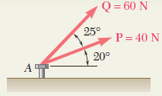
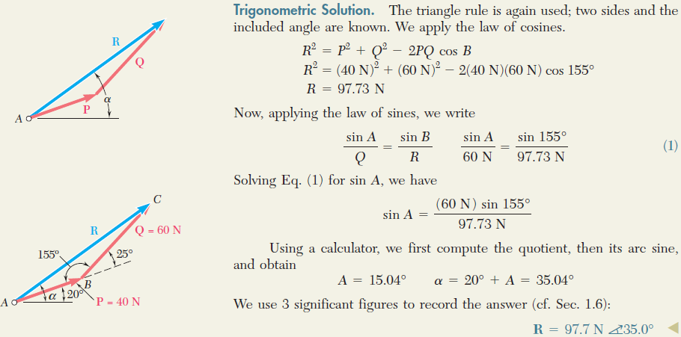
EXAMPLE - 1
CHAPTER 2 – FORCE SYSTEMS

Slide 10
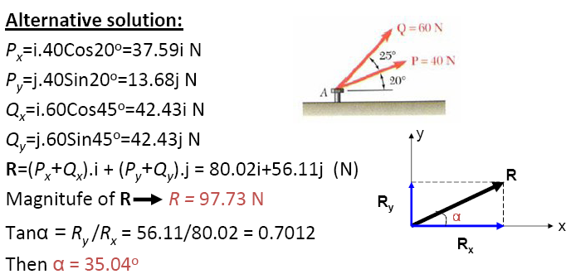
CHAPTER 2 – FORCE SYSTEMS
EXAMPLE – 1 (CONTINUED)
Rectangular components

Slide 11
Problem-2
Determine the magnitude of the resultant R of the two forces (shown below), and the angle θ which R makes with the positive x-axis.

Slide 12
Solution
This problem can be viewed how two non-rectangular force components can be replaced by a single resultant force R.

Slide 13
Alternative Solution
This method can be also discussed in rectangular components.

Slide 14
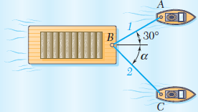
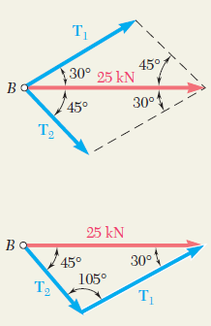
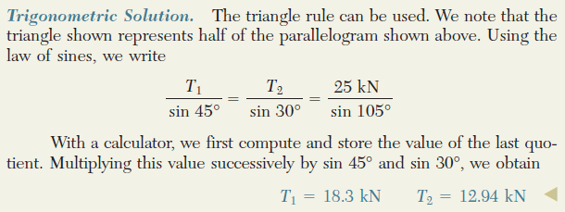
EXAMPLE - 2
CHAPTER 2 – FORCE SYSTEMS

Slide 15
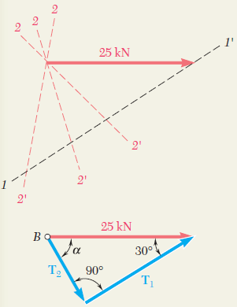
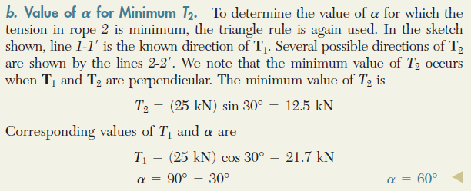
CHAPTER 2 – FORCE SYSTEMS
EXAMPLE – 2 (CONTINUED)

Slide 16
Moment

Slide 17
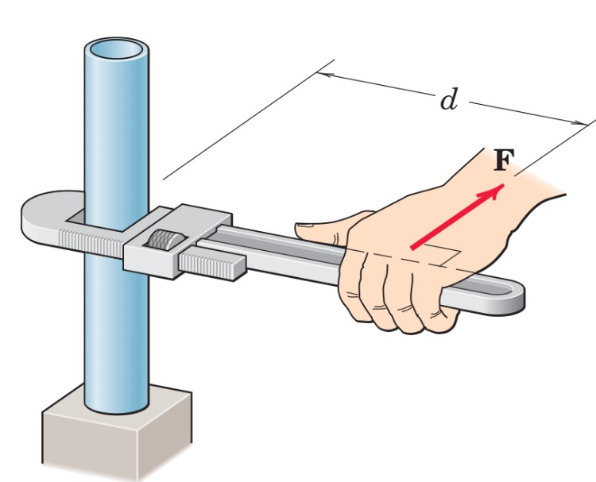
Moment
In addition to the tendency to move a body in the direction of its application, a force can also tend to rotate a body about an axis.
The axis may be any line which neither intersects nor is parallel to the line of action of the force.
M=Fd

Slide 18
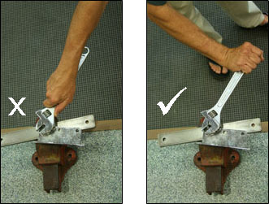
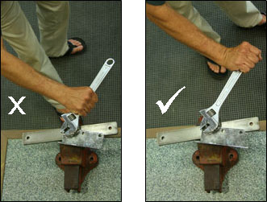
Moment about a Point
Point of application of a force and line of action of a force are as in Figure: F line of action of a force
point of application
The magnitude of the moment or tendency of the force to rotate the body about the axis perpendicular to the plane of the body is proportional both to the magnitude of the force and to the moment arm d, which is the perpendicular distance from the axis to the line of action of the force.

Slide 19
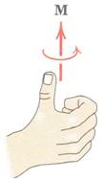
Moment: Vector Definition
In some two-dimensional and many of the three-dimensional problems to follow, it is convenient to use a vector approach for moment calculations.

Slide 20
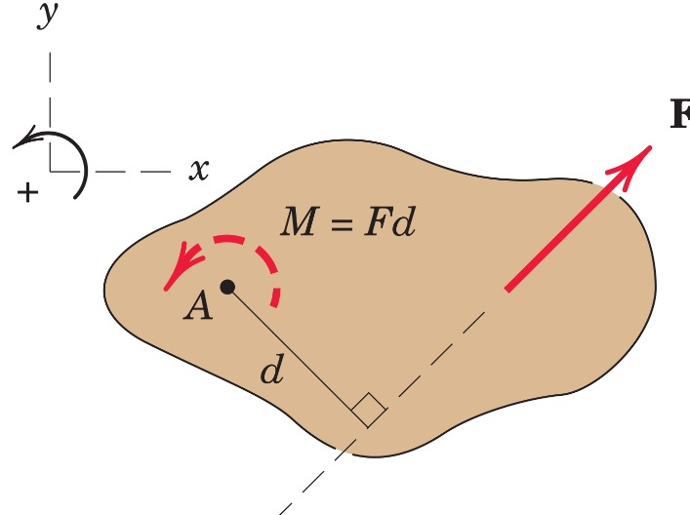
Clockwise and Counterclockwise moments:
If tendency of the force is to rotate its moment arm in a counter clockwise manner it is called counterclockwise moment (CCW). We will assume CCW moment as a positive moment (+).
If tendency of the force is to rotate its moment arm in a clockwise manner it is called clockwise moment (CW). We will assume CW moment as a negative moment (-).

Slide 21
Zero moments
- If line of action of the force intersects the axis of rotation, there is no moment of the force about this axis of rotation
- If line of action of the force is parallel to the axis of rotation, there is no moment of the force about this axis of rotation

Slide 22
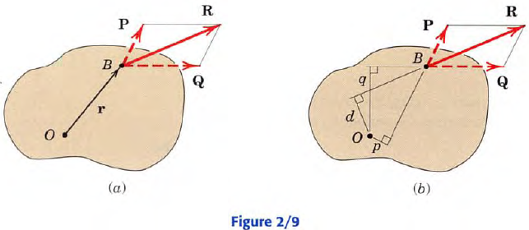
Varignon’s Theorem
The moment of a force about any point is equal to the sum of the moments of the components of the force about the same point.

Slide 23
Problems
For the figure shown below, find moment of 400 N force about point A using:
Scalar approach
vector approach.
3 m
y
O
x
45
0
400 N
6 m
A

Slide 24
Scalar Approach
3 m
y
O
x
45
0
400 N
6 m
A

Slide 25
Vector Approach
3 m
y
(-3,0)
O
x
45
0
400 N
6 m
(0,-6)
A

Slide 26
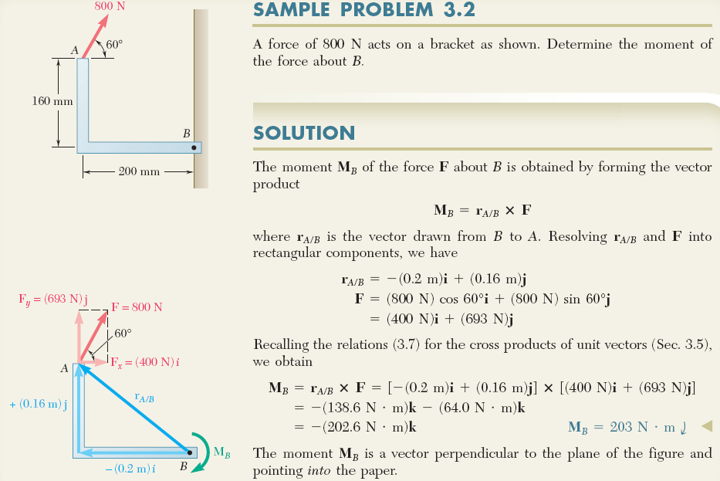

Slide 27
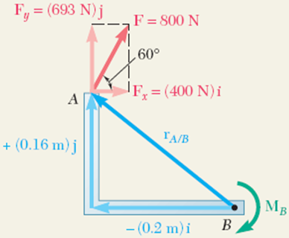
Alternative Solution (Using Varignon’s Theorem):
Assuming that the counterclockwise moment is positive;
M_{B} = - F_{x}.(0.16m) - F_{y}.(0.2m)
where F_{x}= 400 N and F_{y}= 693 N
M_{B} = -400N(0.16m)-693N(0.2m) = -202.6 N.m
We can say M_{B} = -203 N.m
Since we assumed that the counterclockwise moment is positive and we obtained a negative moment value, this implies that the direction of M_{B} is actually clockwise.
So; the result is exactly the same as before, i.e.

Slide 28
Couple and Couple Moment

Slide 29
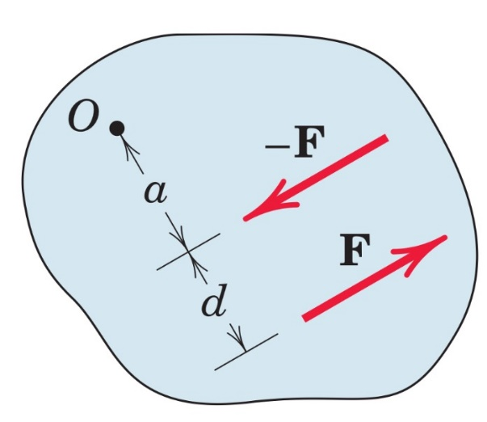
Couple Moment
The moment produced by two equal, opposite, and non-collinear forces is called a couple.
Mo=F(a+d)-Fa
Mo=Fd
Its direction is counterclockwise

Slide 30
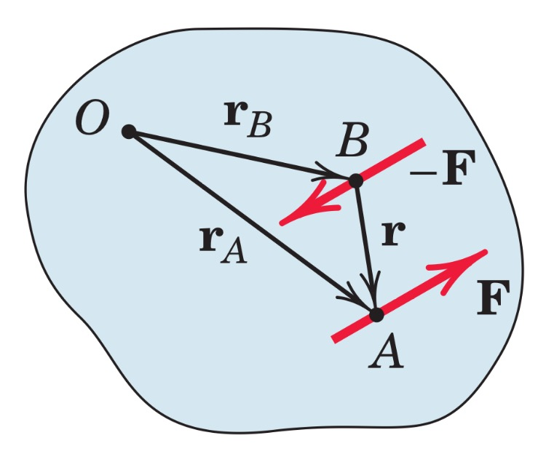
Vector
We may also express the moment of a couple by using vector algebra.
where rA and rB are position vectors which run from point O to arbitrary points A and B on the lines of action of F and F, respectively.

Slide 31
Equivalent Couples
The Figure shows four different configurations of the same couple M.

Slide 32
Force-Couple Systems
The replacement of a force by a force and a couple is illustrated in the Figure, where the given force F acting at point A is replaced by an equal force F at some point B and the counterclockwise couple M=Fd. The transfer is seen in the middle figure, where the equal and opposite forces F and F are added at point B without introducing any net external effects on the body. We now see that the original force at A and the equal and opposite one at B constitute the couple M=Fd, which is counterclockwise for the sample chosen, as shown in the right-hand part of the figure. Thus, we have replaced the original force at A by the same force acting at a different point B and a couple, without altering the external effects of the original force on the body. The combination of the force and couple in the right-hand part of the Figure is referred to as a force–couple system.

Slide 33
Counterclockwise and Clockwise couples

Slide 34
Problem-1
Calculate the combined moment of the two 2-kN forces, shown in the Figure, about point O and A using :
Scalar approach
Vector approach
y
2 kN
1.6 m
A
1.6 m
x
0.8 m
O
2 kN

Slide 35
y
2 kN
i- scalar
1.6 m
As 2 kN forces are forming a couple, moments will be the same about A and O as couple moment is independent of moment centres.
A
1.6 m
x
0.8 m
O
2 kN

Slide 36
y
ii- vector
(0, 3.2)
As 2 kN forces are forming a couple, moments will be the same about A and O as couple moment is independent of moment centres.
1.6 m
A
1.6 m
x
0.8 m
O
(0,-0.8)

Slide 37
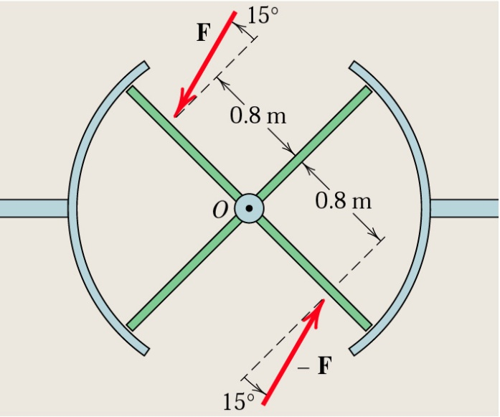
Problem-2
The top view of a revolving entrance door is shown in the Figure. Two persons simultaneously approach the door and exert forces of equal magnitude as shown. If the resulting moment about point O is 25 N.m, determine the force magnitude F.

Slide 39
Problem-3
A square plate of 200 mm × 200 mm is subjected to two forces, each of magnitude 50 N, as shown in the figure:
Calculate the moment of the forces about points O, A, C, and D.
Find the moment of the forces about y-axis.
y
100 mm
50 N
E
D
45⁰
C
50 N
200 mm
45⁰
B
100 mm
A
x
O
200 mm

Slide 40
y
1-
100 mm
50 N
E
D
45⁰
C
d
50 N
200 mm
45⁰
B
100 mm
A
x
O
200 mm

Slide 41
y
2-
100 mm
50 N
E
D
45⁰
C
d
50 N
200 mm
45⁰
B
100 mm
A
x
O
200 mm
Since forces are acting in xy plane, they will either intersect the axes or they will be parallel to them. Therefore, moment about x- or y-axis of all the coplanar forces = 0

Slide 42
Problem-4
Replace the 12-kN force acting at point A by a force-couple system acting at point O .

Slide 44
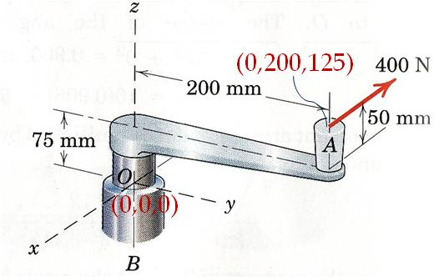
Problem
A force of 400 N is applied at A to the handle of control level which is attached to the fixed shaft OB. Replace this force by an equivalent force at O and a couple. Describe this couple as a vector .

Slide 45
Solution

