Slide 2

STATICS
(ENGINEERING MECHANICS-I)
بسم الله الرحمن الرحيم
Lecture #2
Vectors
By
Dr. Fahed Alrshoudi
Notes:
This is a title slide.

Slide 3
Contents
Objective(s) of the present lecture (#2)
Quantities: Scalars and Vectors
Vector operations

Slide 4
Objectives of the Present lecture
To define scalar and vector quantities
To provide an overview of most common vector operations

Slide 5
Scalars and Vectors
ENGINEERING MECHANICS : STATICS
SCALAR QUANTITIES
A scalar is a quantity that has only magnitude, either positive or negative.
For example; mass, length, area, volume and speed are the scalar quantities frequently used in Statics.
Scalars are indicated by letters in Itallic type, such as the scalar ‘A’.

Slide 6
Scalars and Vectors
ENGINEERING MECHANICS : STATICS
VECTOR QUANTITIES
A vector is a quantity that has both a magnitude and a direction.
For example; weight, force, moment, position, velocity and acceleration are the vector quantities frequently used in Statics.
Vectors are indicated by bold letters, such as ‘A’ or A
The magnitude of a vector is always a positive quantity and is symbolized in Itallic type, written as A or A

Slide 7
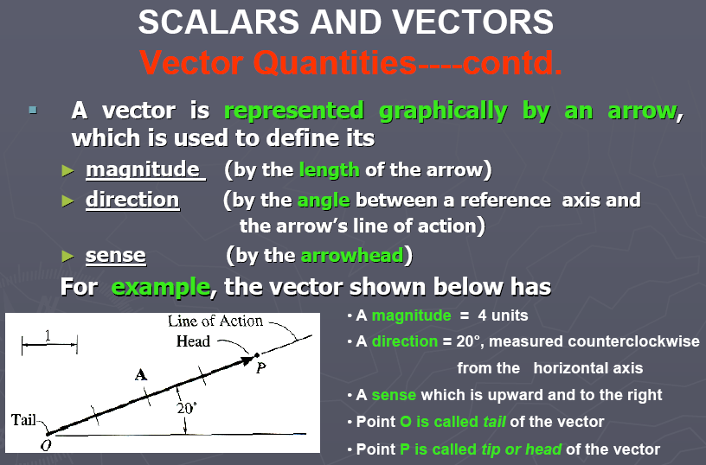
Scalars and Vectors
ENGINEERING MECHANICS : STATICS
1 - 7

Slide 8
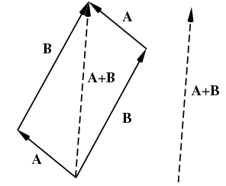
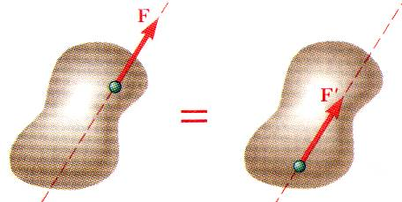
Fundamental Principles – Paralellogram Law & Transmissibility
ENGINEERING MECHANICS : STATICS
Vectors must obey the parallelogram law of combination. This law states that two vectors
A and B, treated as free vectors, may be replaced by their equivalent vector (A+B), which is the diagonal of the parelellogram formed by A and B as its two sides, as shown in the figure.
Principle of Transmissibility
Conditions of equilibrium or motion are not affected by transmitting a force along its line of action.
NOTE: F and F’ are equivalent forces.

Slide 9
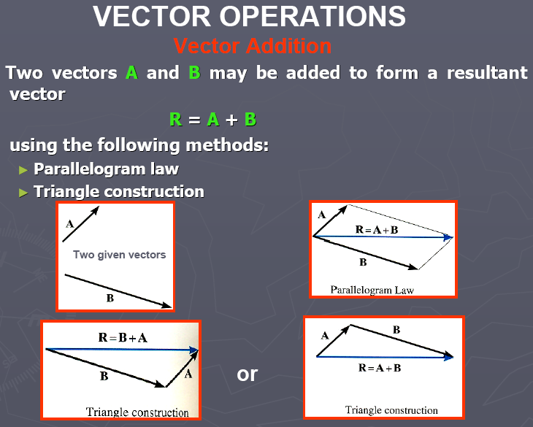

Slide 10
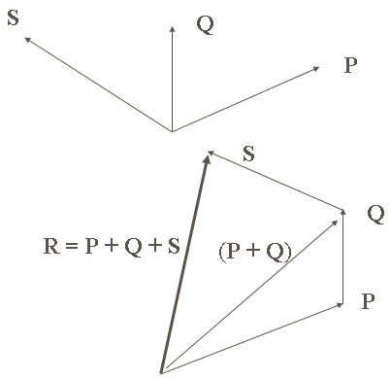
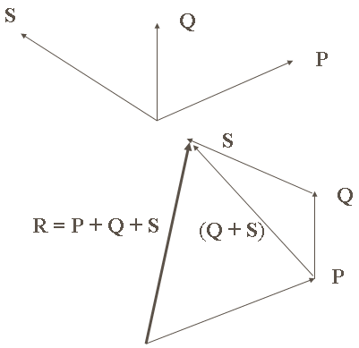
Polygon Rule:
can be used for the addition of more than two vectors. Two vectors are actually summed and added to the third and so on...
P + Q + S = (P + Q) + S = P + (Q + S)
This is the Associative Law of Vector Addition

Slide 11
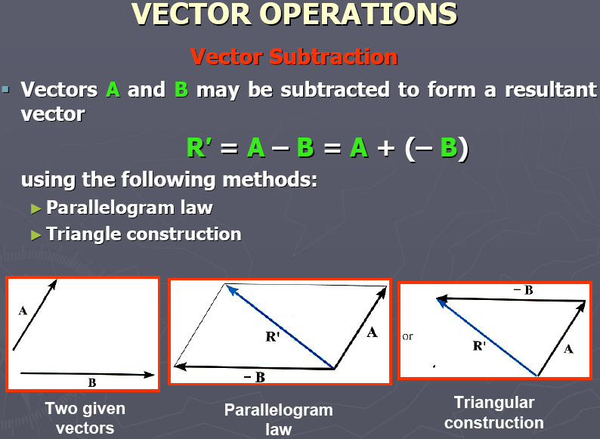

Slide 12
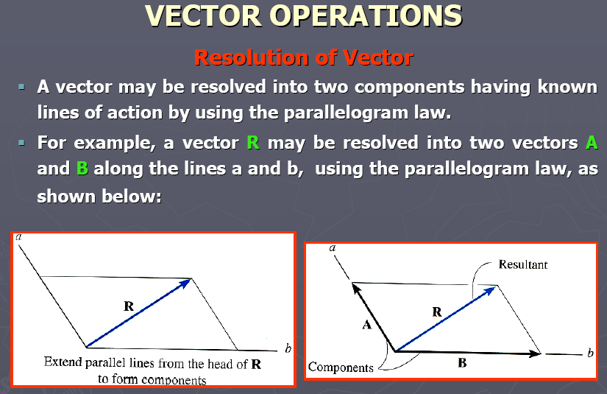

Slide 13
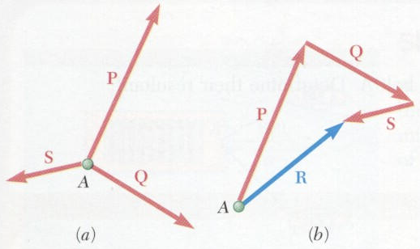
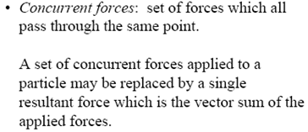
CHAPTER 2 – FORCE SYSTEMS
(RESULTANT OF VECTORS)

Slide 14
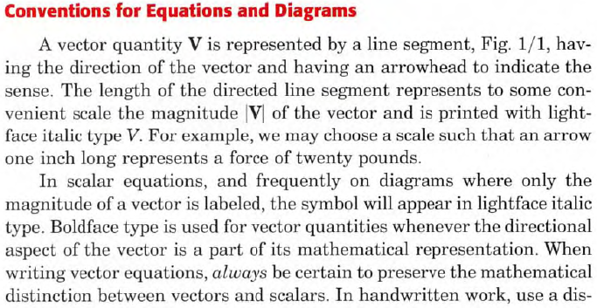
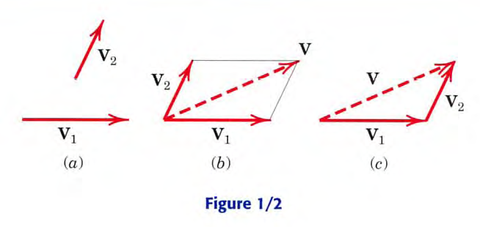
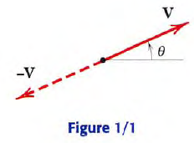
ENGINEERING MECHANICS : STATICS

Slide 15
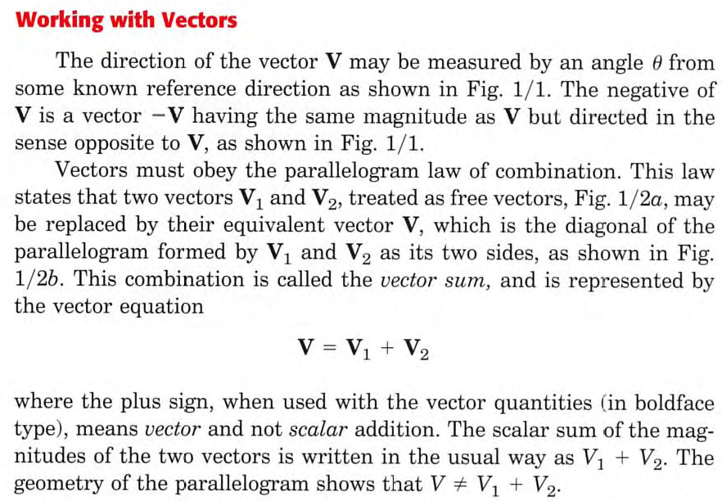
ENGINEERING MECHANICS : STATICS

Slide 16
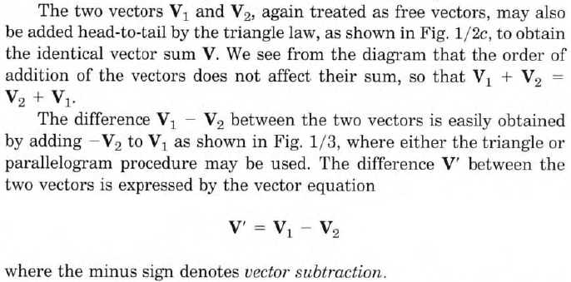
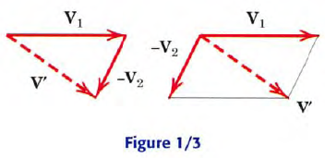
ENGINEERING MECHANICS : STATICS

Slide 17
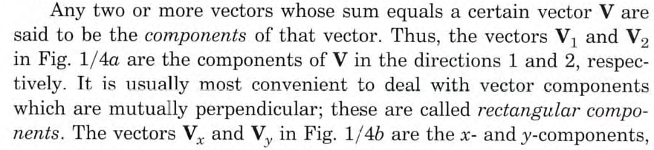
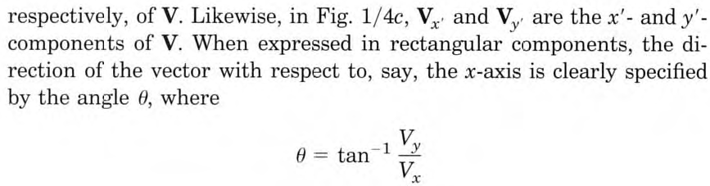
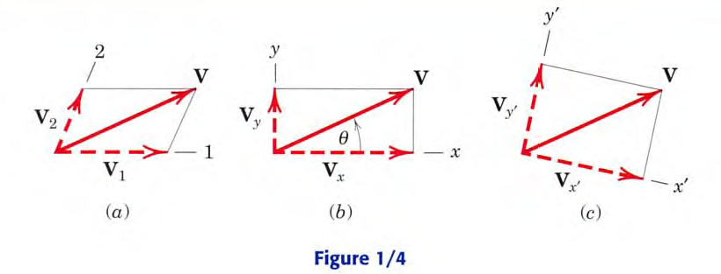
ENGINEERING MECHANICS : STATICS

Slide 18
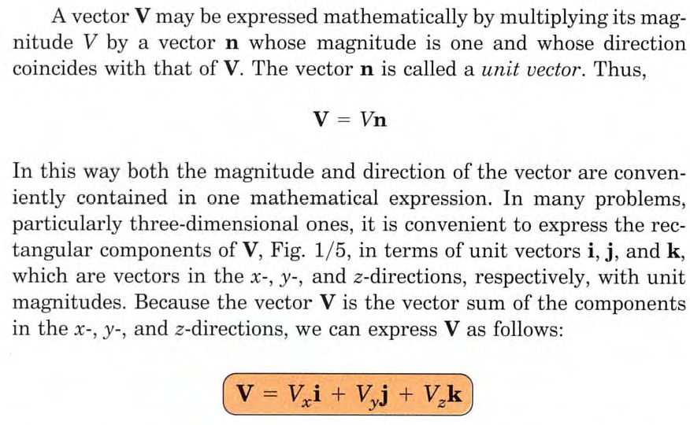
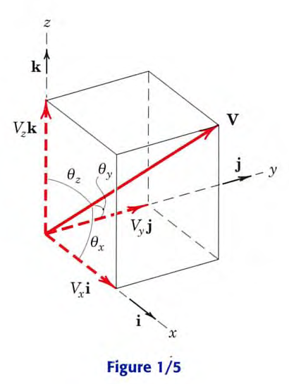
ENGINEERING MECHANICS : STATICS

Slide 19
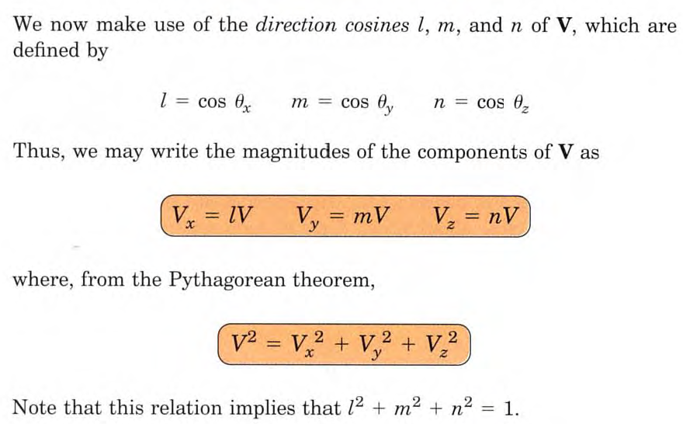
ENGINEERING MECHANICS : STATICS

