Slide 1
Couple Moment

Slide 2
Couple moment: Scalar formula
Thus moment of a couple is same for all moment centers.

Slide 3
Couple moment: Vector formula
Thus moment of a couple is same for all moment centers.

Slide 4
Direction of couple moment

Slide 5
Force-couple System
A force acting on a body has the tendency
To push or pull the body in the direction of the force; and
To rotate the body about an axis which does not intersect the line of action of the force.
This dual effect of a given force is often shown by replacing the given force by an equal-parallel force and a couple. This system of force and couple is known as force-couple system.

Slide 6
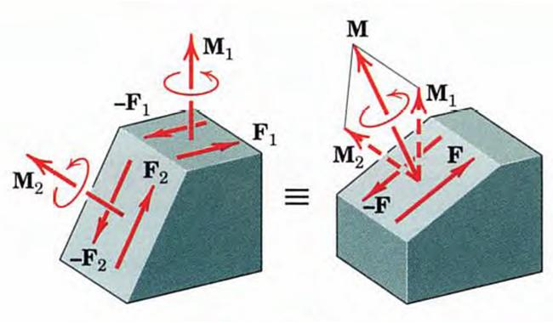
Addition of two couple vectors
Couple vectors obey all of the rules which govern vector quantities. Thus, in shown Figure, the couple vector M₁ due to F₁ and –F₁ may be added as shown to the couple vector M₂ due to F₂ and –F₂ to produce the couple M, which in turn can be produced by F and –F.

Slide 7
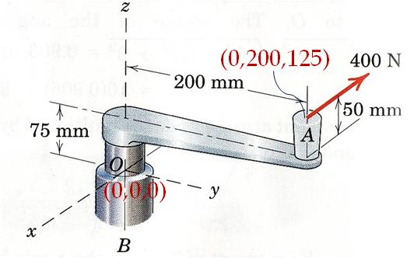
Problem
A force of 400 N is applied at A to the handle of control level which is attached to the fixed shaft OB. Replace this force by an equivalent force at O and a couple. Describe this couple as a vector .

Slide 8
Solution

Slide 9
Resultants

Slide 10
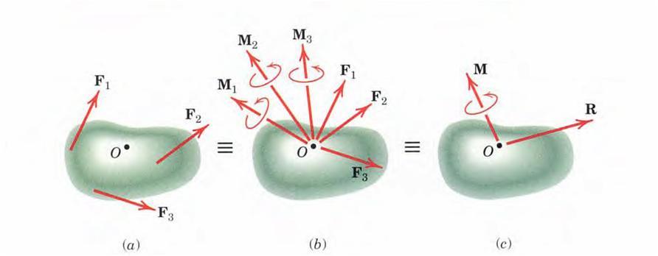
Resultants
In general any system of forces may be replaced by its resultant force R and the resultant couple M without altering the external effects of the system (on the rigid body to which the forces are applied).

Slide 11
Resultant Calculation

Slide 12
Wrench Resultant
When the resultant couple vector M is parallel to the resultant force R, the resultant is said to be a wrench.

Slide 13
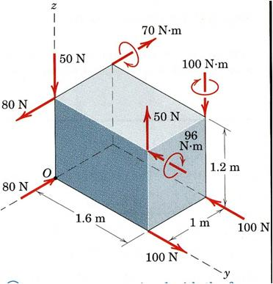
Problem-1
Determine the resultant of the force and couple system which acts on the rectangular solid.
x

Slide 14
Solution
In the present problem CCW moments about x, y, and z-axes will point towards the +ve x, y, and z-axes respectively.
x

Slide 15
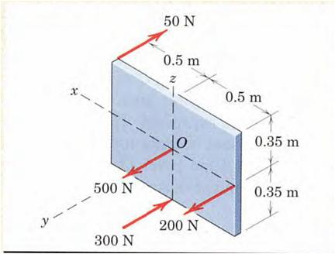
Problem-2
Determine the resultant of the system of parallel forces which act on the plate. Solve using vector approach.

Slide 16
Solution
As all the forces are parallel to y-axis there is no moment about y-axis.

Slide 17
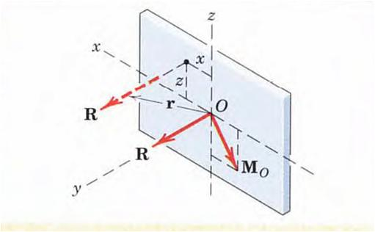
Placement of Single resultant force R
Hence x = -0.357 m, and z = 0.25 m are the coordinates through which the line of action of R must pass. The value of y may, of course, be any value, as permitted by the principle of transmissibility.

Slide 21
