Slide 1
Extra Examples

Slide 2
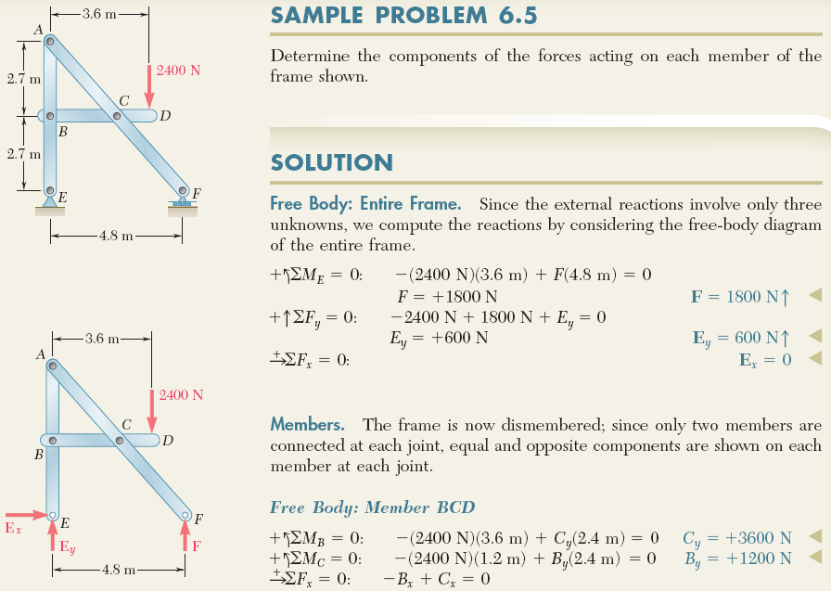

Example 9: Analysis of Frames
6 - 2

Slide 3

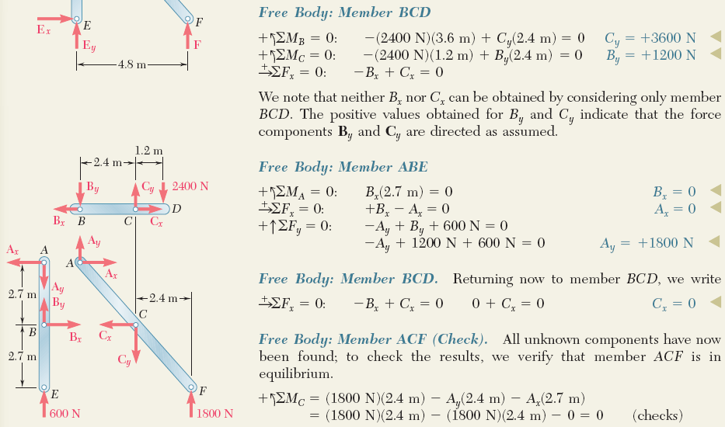
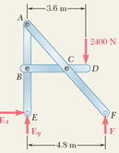
Example 9 (continued):
ENGINEERING MECHANICS : STATICS
i.e. B_{x}=C_{x}
6 - 3

Slide 4
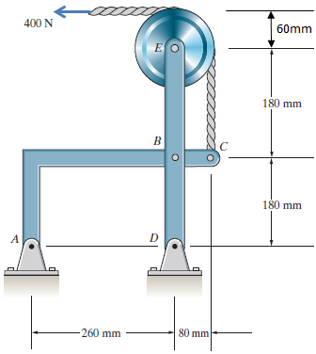
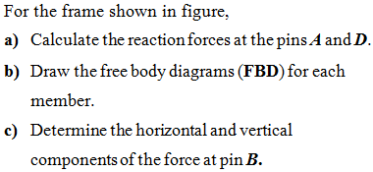
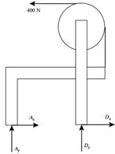

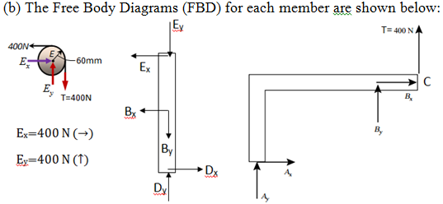
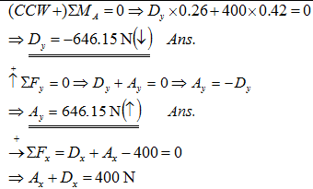
Example 10: Analysis of Frames
ENGINEERING MECHANICS : STATICS
6 - 4

Slide 5
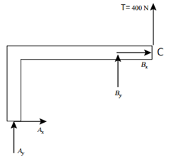
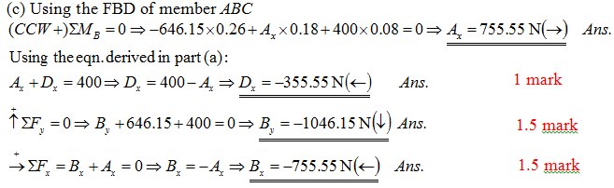
Example 10 (continued):
ENGINEERING MECHANICS : STATICS
If the total force at B is required, then
6 - 5

Slide 6
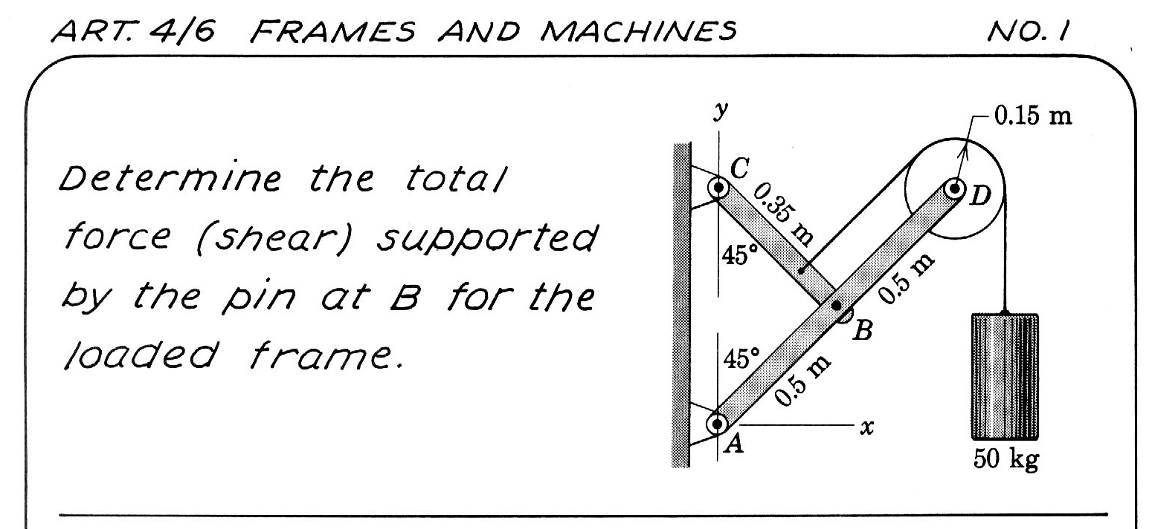

Slide 7
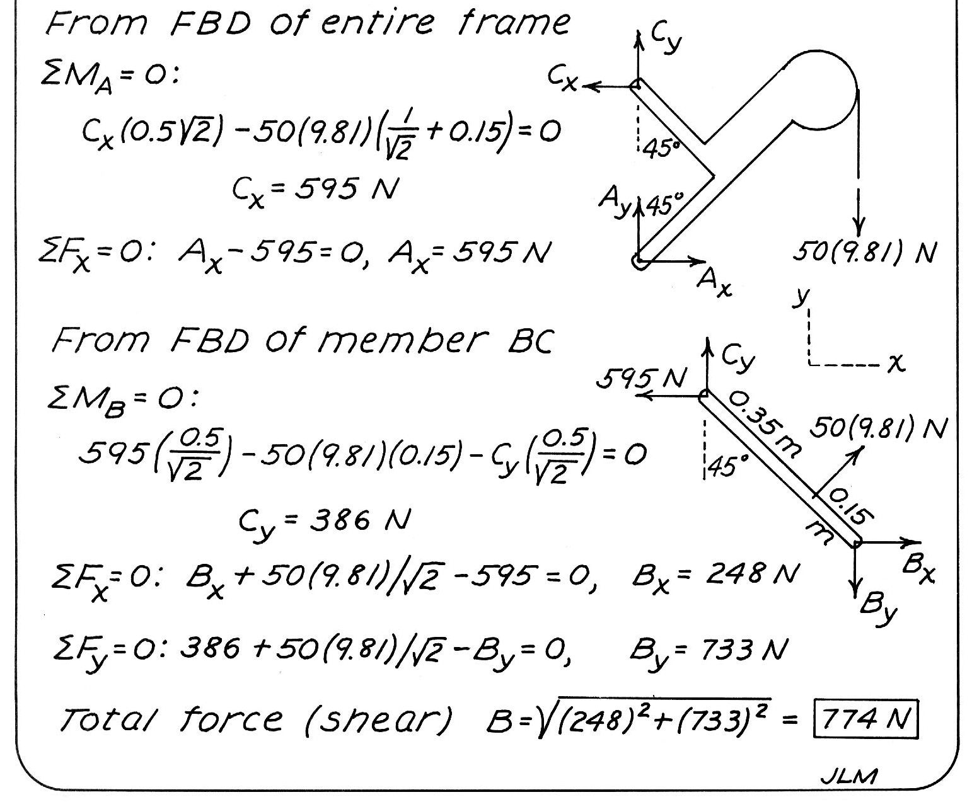

Slide 8
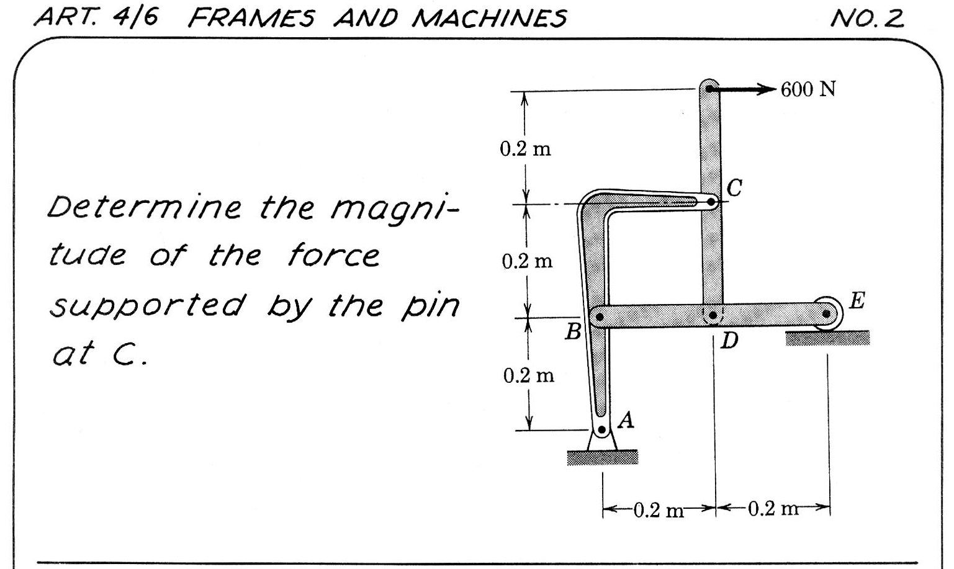
F

Slide 9
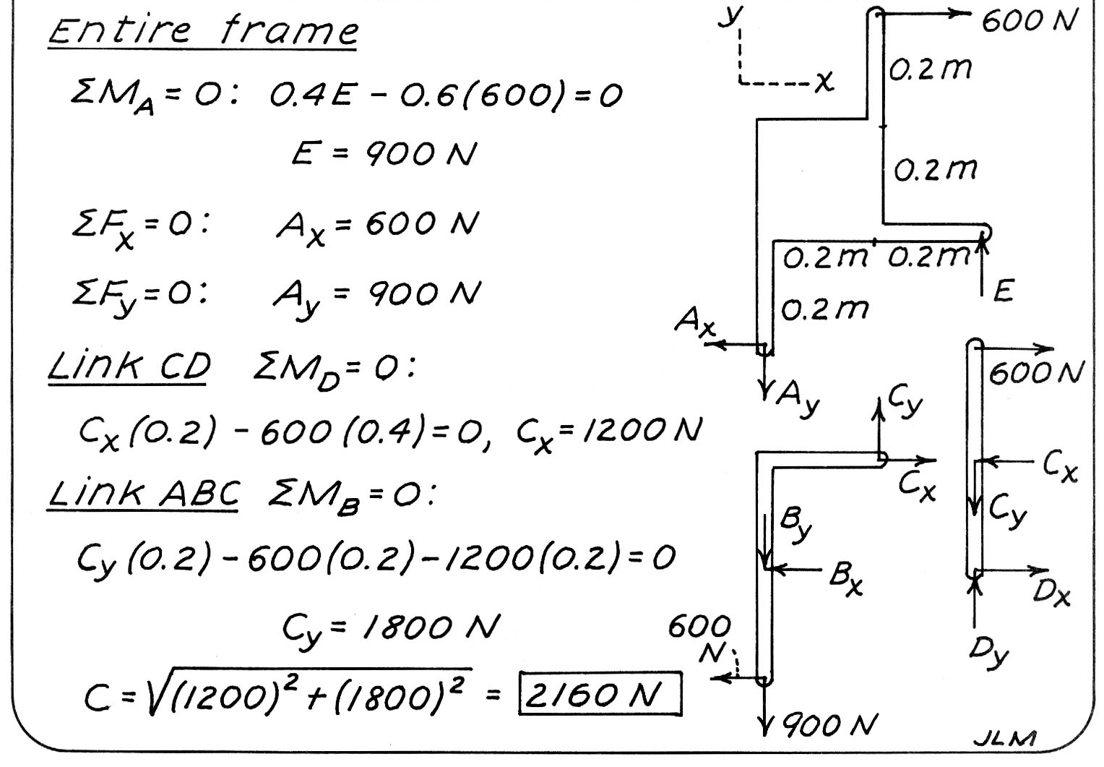
F
F
FD

