Slide 1
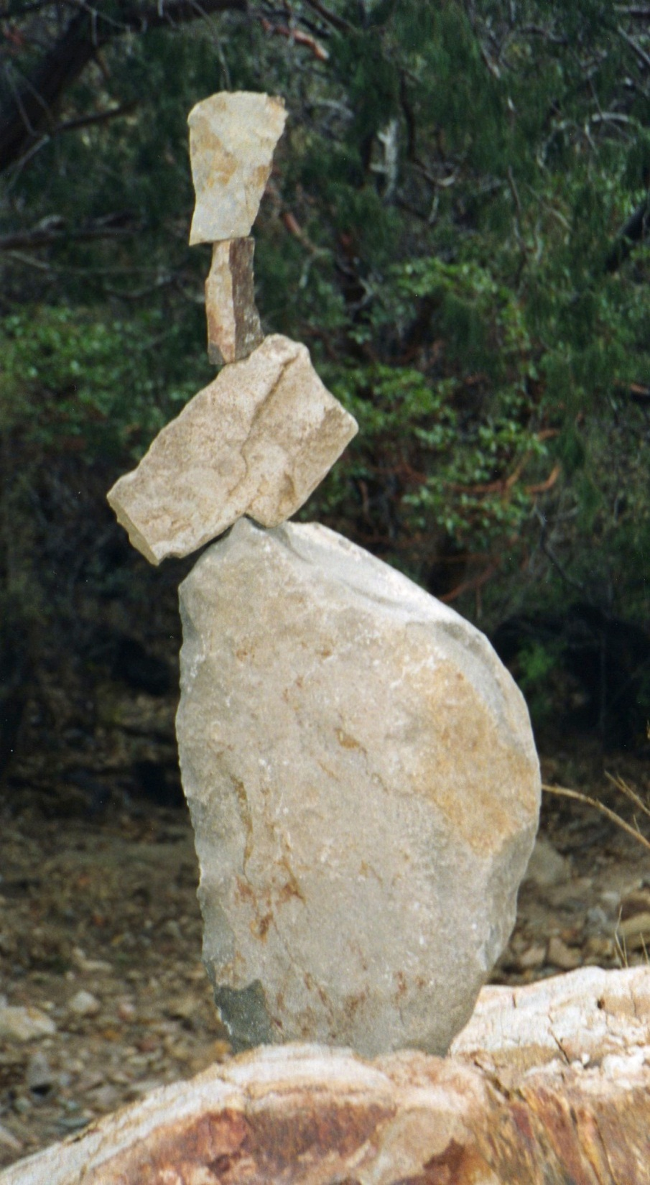
Equilibrium

Slide 2
Equilibrium
Statics deals primarily with the description of the force conditions necessary and sufficient to maintain the equilibrium of engineering structures.
This chapter on equilibrium, therefore, constitutes the most important part of statics, and the procedures developed here form the basis for solving problems in both statics and dynamics.
We will make continual use of the concepts developed in Chapter 2 involving forces, moments, couples, and resultants as we apply the principles of equilibrium.

Slide 3
Equilibrium
When a body is in equilibrium, the resultant of all forces acting on it is zero. Thus, the resultant force R and the resultant couple M are both zero.

Slide 4
Modeling the Action of Forces

Slide 6
Construction of Free-Body Diagrams

Slide 8
Categories of Equilibrium

Slide 9
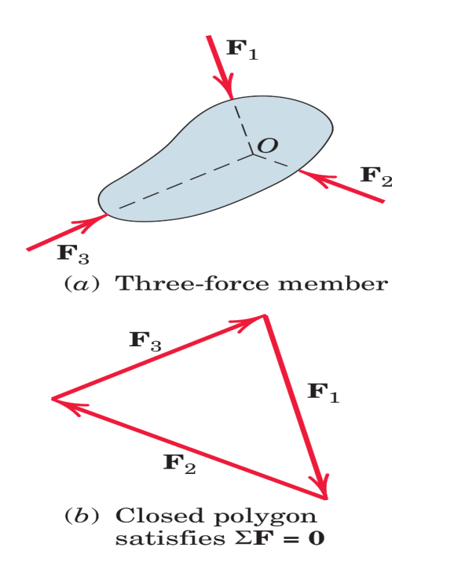
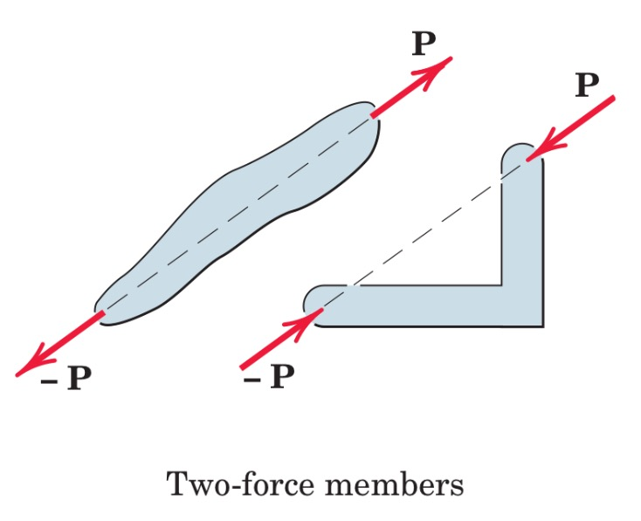
Two- and Three-Force Members
we see that for such a two-force member to be in equilibrium, the forces must be equal, opposite, and collinear. The shape of the member does not affect this simple requirement.
we consider the weights of the members to be negligible compared with the applied forces.
At the three-force member, We see that equilibrium requires the lines of action of the three forces to be concurrent.

