Slide 1

STATICS
(ENGINEERING MECHANICS-I)
بسم الله الرحمن الرحيم
Beams-External Effects
Notes:
This is a title slide.

Slide 2
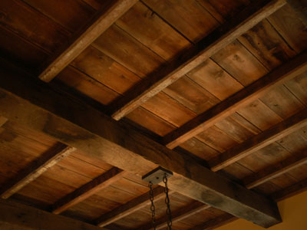
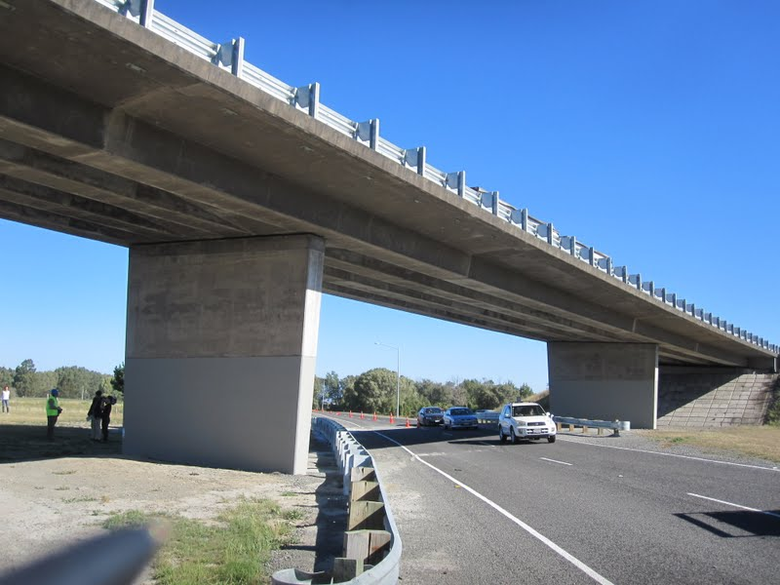
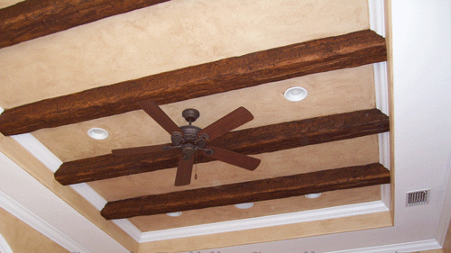
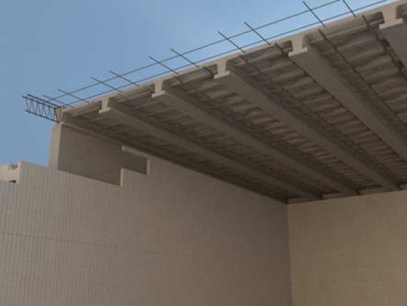
Beams-External Effects
Beams: Structural members which offer resistance to bending due to applied loads are known as Beams.
Most beams are long prismatic bars, and the loads are usually normal to the axes of the bars.
Prismatic: In the shape of a prism.
Prism: a solid figure with ends that are parallel and of the same size and shape, and with sides whose opposite edges are equal and parallel.

Slide 3
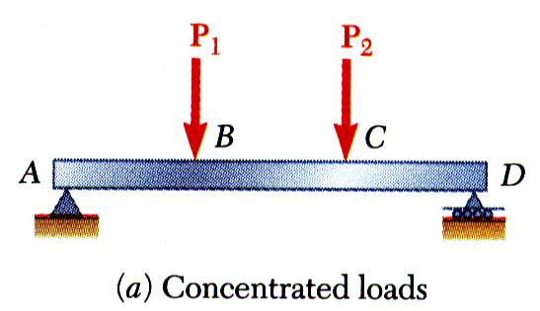
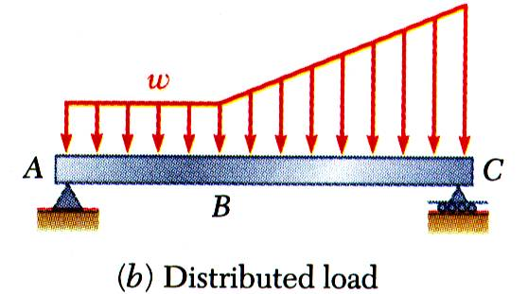
Beams: External Effects
ENGINEERING MECHANICS : STATICS
Beam - structural member designed to support loads applied at various points along its length.
Beam can be subjected to concentrated loads or distributed loads or combination of both.
Beam design is two-step process:
  determine shearing forces and bending moments produced by applied loads
  select cross-section best suited to resist shearing forces and bending moments
5- 3

Slide 4
Types of Beams
Statically Determinate Beams: Beams supported in such a way that their external support reactions can be calculated by the equations of equilibrium alone are called statically determinate beams.
Statically Indeterminate Beams: A beam that has more supports than are necessary to provide equilibrium is said to be statically indeterminate.
  For such beams it is necessary to consider the load-deformation properties of the beam in addition to the equations of statical equilibrium to determine the support reactions.

Slide 5
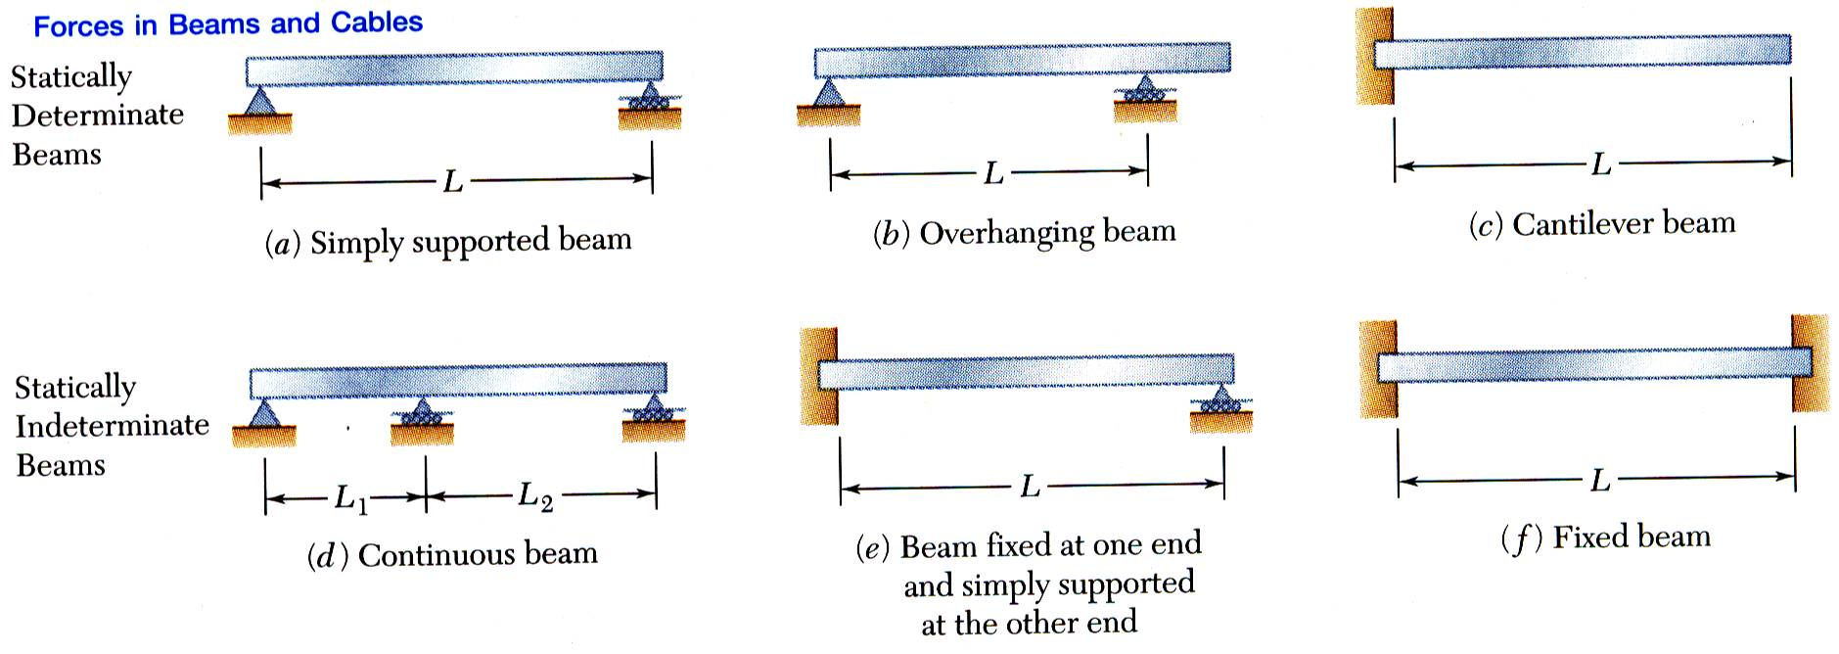
Various Types of Beams
Beams are classified according to way in which they are supported.
Reactions at beam supports are determinate if they involve only three unknowns. Otherwise, they are statically indeterminate.
5- 5

Slide 6
Distributed load Resultant
The distributed loads can be reduced to equivalent concentrated (or point) loads. The magnitude and point of application of this equivalent load is computed as follows.
Magnitude: The equivalent concentrated load R is represented by the area formed by the intensity w (force per unit length of the beam) and the length L over which the force is distributed.
Point of Application: The resultant passes through the centroid of this area.

Slide 7
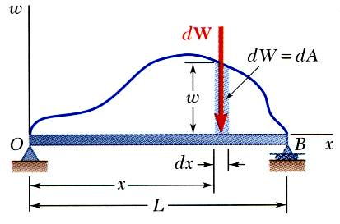
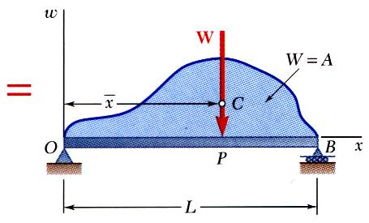
Distributed Loads on Beams
A distributed load is represented by plotting the load per unit length, w (N/m) . The total load is equal to the area under the load curve.
A distributed load can be replace by a concentrated load with a magnitude equal to the area under the load curve and a line of action passing through the area centroid.
5 - 7

Slide 8
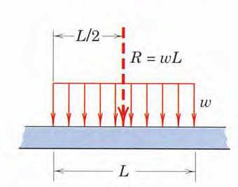
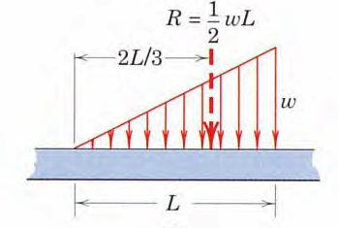
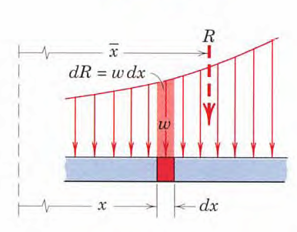

Slide 9
Support Reactions
(for a coplanar 2D structures)
Fixed Support: 3 Reactions
Pin or Hinge Support: 2 Reactions
Roller Support: 1 Reaction
Note: Reaction develops in that direction in which movement/displacement is obstructed.

Slide 10
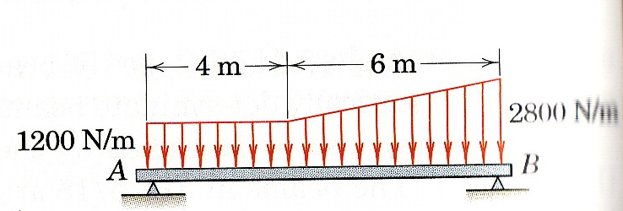
Problem 1
Determine the equivalent concentrated load(s) and external reactions for the simply supported beam which is subjected to the distributed load as shown.
Assume for given loading there are no horizontal reactions at the supports.

Slide 11
Solution

Slide 12
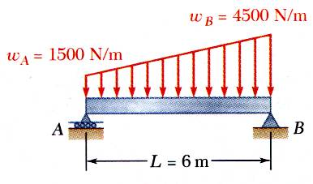
Sample Problem 2
ENGINEERING MECHANICS : STATICS
SOLUTION:
The magnitude of the concentrated load is equal to the total load or the area under the curve.
The line of action of the concentrated load passes through the centroid of the area under the curve.
Determine the support reactions by summing moments about the beam ends.
A beam supports a distributed load as shown. Determine the equivalent concentrated load with its location and also the reactions at the supports.
5 - 12

Slide 13
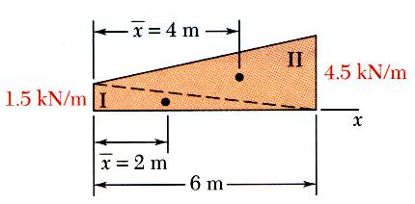
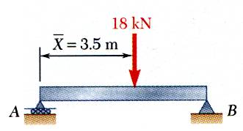
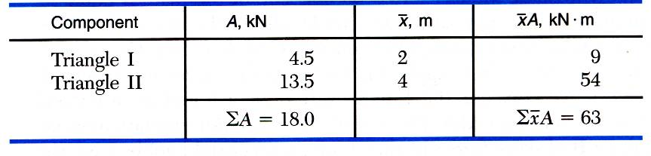
Sample Problem 2 - Continued
SOLUTION:
The magnitude of the concentrated load is equal to the total load or the area under the curve.
The line of action of the concentrated load passes through the centroid of the area under the curve.
5 - 13

Slide 14
Sample Problem 2 - Continued
Determine the support reactions by summing moments about the beam ends.
5 - 14

Slide 15
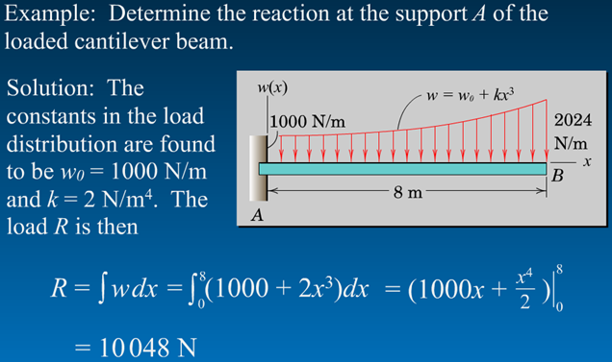
ENGINEERING MECHANICS : STATICS
Sample Problem 3
5- 15

Slide 16
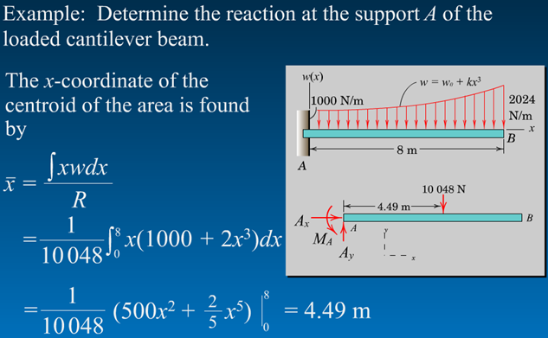
ENGINEERING MECHANICS : STATICS
Sample Problem 3 - Continued
5- 16

Slide 17
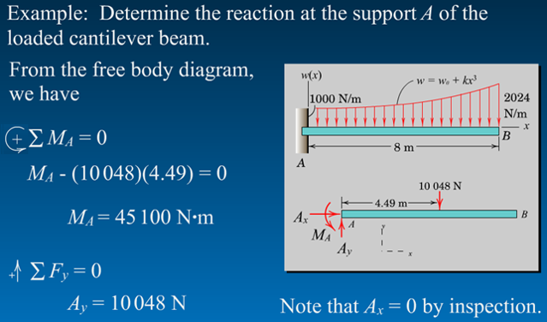
ENGINEERING MECHANICS : STATICS
Sample Problem 3 - Continued
_
5- 17

