Slide 1
STATICS (ENGINEERING MECHANICS-I)
بسم الله الرحمن الرحيم
Friction
Notes:
This is a title slide.

Slide 2
Friction
Friction is a force that resists the movement of two contacting surfaces that slide relative to one another.
This force always acts tangent to the surface at the points of contact.
Friction force is directed to oppose the possible or existing motion between the surfaces.

Slide 3
Types of Friction
Dry Friction: Dry friction is encountered when two un-lubricated surfaces of two solids are in contact under a condition of sliding or tendency to slide.
Fluid Friction: Fluid friction is developed when adjacent layers in a fluid (liquid or gas) are moving at different velocities.
Internal Friction: Internal friction is found in all solid materials that are subjected to cyclic loading. For highly elastic materials the recovery from deformation occurs with very little loss of energy caused by internal friction.

Slide 4
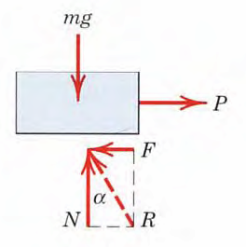
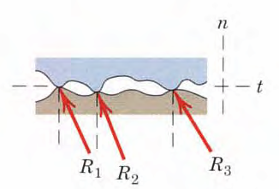
Dry Friction
Mechanism of Friction
The contacting surfaces possess a certain amount of roughness.
The experiment will involve the application of a horizontal force P which will vary continuously from zero to a value sufficient to move the block and give it an appreciable velocity.

Slide 5
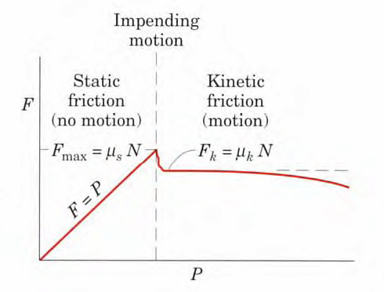
Dry Friction (Contd.)
The region up to the point of slippage or impending motion is known as the range of static friction, and the value of the friction force is determined by the equations of equilibrium (thus, F = P).
The maximum value of static friction F_{max} is proportional to the normal force N. Therefore

Slide 6
Variation of Friction Force
For a condition of static equilibrium when motion is not impending:
After slippage occurs, a condition of kinetic friction accompanies the ensuing motion.
Kinetic friction force is somewhat less than the maximum static friction force.

Slide 7
Kinetic Friction
Kinetic friction force is also proportional to the normal force. Hence,
As the velocity of the block increases, the kinetic friction coefficient decreases somewhat, and when high velocities are reached, the effect of lubrication by an intervening fluid film may become appreciable
The coefficient greatly depends on the exact condition of the surfaces, as well as on the velocity, and are subject to a considerable measure of uncertainty.

Slide 8
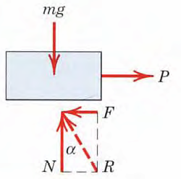
Friction Angles
Friction Angles: The direction of the resultant R measured from the direction of N.

Slide 11
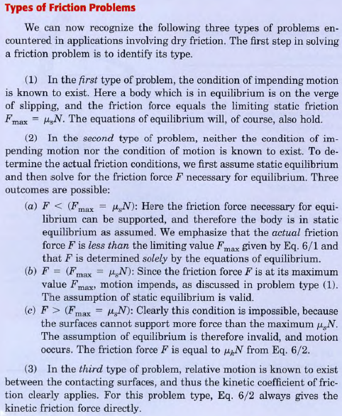

Slide 12
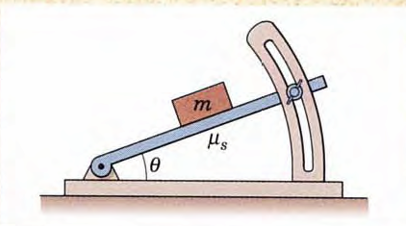
Problem-1
Determine the maximum angle θ which the adjustable incline may have with the horizontal before the block of mass m begins to slip. The coefficient of static friction between the block and the inclined surface is μ_{s}.

Slide 13
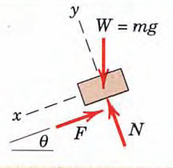
Solution

Slide 14
Problem-2
Determine the range of values which the mass m₀ may have so that the 100-kg block shown in the figure will neither start moving up the plane nor slip down the plane. The coefficient of static friction for the contact surfaces is 0.30.

Slide 15
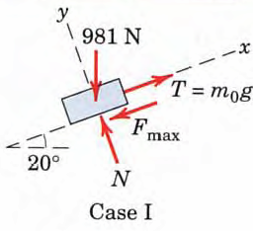
Solution
Case I: The block tends to move up

Slide 16
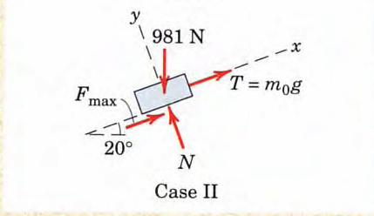
Solution (contd.)
Case II: The block tends to move down
Thus, m₀ may have any value from 6.01 to 62.4 kg, and the block will remain at rest.

