Slide 1
Hash Table

Slide 2
Hash Table
Several ADTs for storing and retrieving data were discussed – Linear Lists, Binary Trees, BSTs, Heap Trees.
An important operation Findkey() has a time complexity: O(n) in Lists, O(n) in Binary Trees, O(log n) in BSTs, O(log n) in Heap trees.
Can Findkey() be implemented with a time complexity better than O(log n)? – With Hash Tables it is possible to implement Findkey() with O(1) time complexity.

Slide 3
Hash Table
Hashing is a technique that is used to uniquely identify a specific object from a group of similar objects. Some examples of how hashing is used in our lives include:
In universities, each student is assigned a unique roll number that can be used to retrieve information about them.
In libraries, each book is assigned a unique number that can be used to determine information about the book, such as its exact position in the library or the users it has been issued to etc.
In both these examples the students and books were hashed to a unique number.

Slide 4
Hash Table
Assume that you have an object and you want to assign a key to it to make searching easy. To store the key/value pair, you can use a simple array like a data structure where keys (integers) can be used directly as an index to store values. However, in cases where the keys are large and cannot be used directly as an index, you should use hashing.
A hash table for a given key type consists of
◦Hash function
◦Array (called table) of size N

Slide 5
Hash Table
In hashing, large keys are converted into small keys by using hash functions. The values are then stored in a data structure called hash table.
The idea of the hashing:
distribute entries (key/value pairs) uniformly across an array.
Each element is assigned a key (converted key).
By using that key you can access the element in O(1) time.
The converted key is the index that suggests where an entry can be found or inserted in the array.

Slide 6
Hash Table
Hashing is implemented in two steps:
An element is converted into an integer by using a hash function. This element can be used as an index to store the original element, which falls into the hash table.
The element is stored in the hash table where it can be quickly retrieved using hashed key.

Slide 7
Hash Table
Hash function A hash function is any function that can be used to map a data set of an arbitrary size to a data set of a fixed size, which falls into the hash table.
To achieve a good hashing mechanism:
Easy to compute: It should be easy to compute and must not become an algorithm in itself.
Uniform distribution: It should provide a uniform distribution across the hash table and should not result in clustering.
Less collisions: Collisions occur when pairs of elements are mapped to the same hash value. These should be avoided.

Slide 8
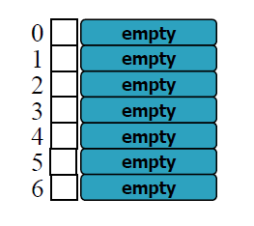
Example
Table Size, N = 7.
Hash Function: H(key) = key mod 7.
Initially Hash Table is empty

Slide 9
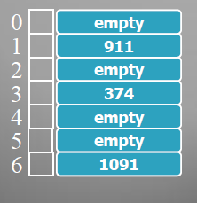
Example
Insertions: keys 374, 1091, 911are inserted.
H(374) = 374 mod 7 = 3
H(1091) = 1091 mod 7 = 6
H (911) = 911 mod 7 = 1

Slide 10
Example
Retrievals: keys 374 and 740 are retrieved
H(374) = 374 mod 7 = 3
Table address 3 contains the key.
H(740) = 740 mod 7 = 5
Table address 5 is empty.

Slide 11
Example
Insertions: key 227 is to be inserted.
•H(227) = 227 mod 7 = 3
•Hash functions tells us store it in home address 3 but there is already a key stored in home address 3. This called a collision.
•Since table is not empty the collided key 227 must be stored somewhere in the table.
- Rehashing or Collision Resolution Strategies

Slide 12
Hash Function
Digit selection
Division
Multiplication
And more

Slide 13
Digit Selection
Keys may be student id. numbers (e.g. 427102345) or social security numbers (e.g. 981-101-0002)
Hash function based on digit selection selects a subset of digits from the key e.g. last 3 digits may be selected.
345 H(427102345)

Slide 14
Division
Hash function based on division is of the following form: H(key) = key mod m (key % m).
These functions lead to a number of collisions for certain values of m. E.g. if m = 25 all keys divisible by 5 map to positions 0, 5, 10, 15 and 20.

Slide 15
Division
Ideally m must have no common factors with the keys … an easy way to ensure this is to chose m a prime number -prime number (or a prime) is a natural number greater than 1 that has no positive divisors other than 1 and itself-.
Example:
2 , 3 , 5 , 7 , 11 , 13 , 17 , 19 , 23 , 29 , 31 , 37 , 41 , 43 , 47 , 53 , 59 , 61 , 67 , 71 , 73 , 79 , 83 , 89 , 97 , 10

Slide 16
Multiplication
A hash function based on multiplication first squares the key and then chooses a certain subset of the digits of the product.
Suppose key = 54321. Hash function finds the square: (54321)2 = 2950771041 and then middle 3 digits are chosen i.e. 077.

Slide 17
Collision Resolution Strategies
Also known as rehashing techniques.
Strategies determine where to store a collided key in the event of a collision.
Strategies can be grouped into the following three categories:
Open address methods
External or separate chaining
Coalesced chaining

Slide 18
Open Address Methods
The strategy finds an empty position in the table after the collision and stores the collided key at the empty position.
Linear rehashing, quadratic rehashing, random rehashing and double rehashing fall in this category.

Slide 19
Linear Rehashing
Also called linear probing.
Each table location inspected is referred to as a “probe”
Linear rehashing starts a (circular) sequential search through the table until an empty location is found or all the table has been examined.
If an empty location is found at the rehash address the collided key is stored at the location.

Slide 20
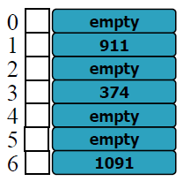
Linear Rehashing
Consider the hash table in the state shown. Attempt to insert 227 leads to a collision with 374 … H(227) = 227 mod 7 = 3.
According to linear rehashing the collided key 227 will be stored in the circularly next empty location, which is at table address 4. (See the next slide)

Slide 21
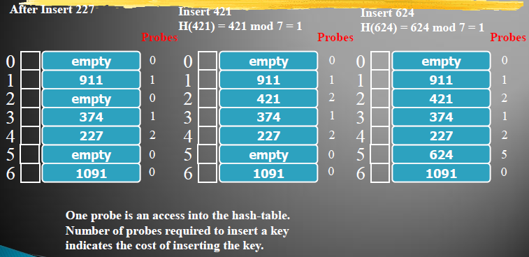
Linear Rehashing

Slide 22
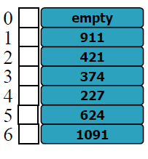
Linear Rehashing
Suppose key 624 is to be retrieved. H(624) = 1. After rehashing and 5 probes the key is found at address 5.
Suppose key 631 is to be retrieved. H(631) = 1. After rehashing and 7 probes the „empty‟ location 0 is found – if the key was present it would have been at 0. Therefore, retrieval algorithm returns „not found‟

Slide 23
Linear Rehashing
The performance of a hash table employing linear rehashing as collision resolution strategy is measured in terms of the average number of probes required to insert a set of keys.

Slide 24
External Chaining
Also called separate chaining
According to this strategy the collided keys are stored in a list associated with the home address.
Hash table is an array of lists.
Insertions and deletions are easy to implement.

Slide 25
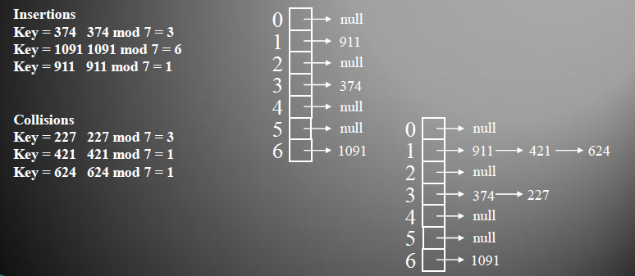
External Chaining

Slide 26
External Chaining
Advantages (compared to Linear Rehashing)
Deletions are easily possible.
Number of elements can be greater than the table size.
Retrieval operations are efficient since hash function is computed only once during retrieval.

Slide 27
Coalesced Chaining
Similar to external chaining – collided elements are stored in lists.
Similar to linear rehashing – lists are stored within the hash table.
Hash table is divided into two regions: an address region – stores normal keys and a cellar – stores collided keys.
epla – empty position with largest address.

Slide 28
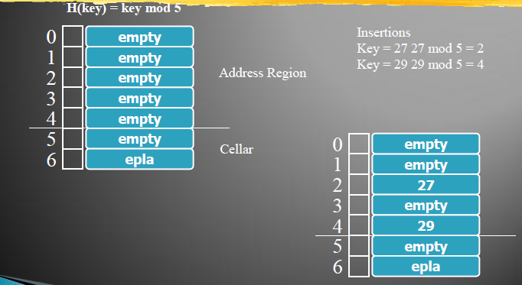
Coalesced Chaining

Slide 29
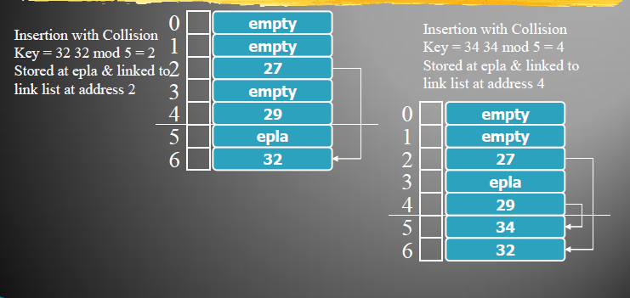
Coalesced Chaining

Slide 30
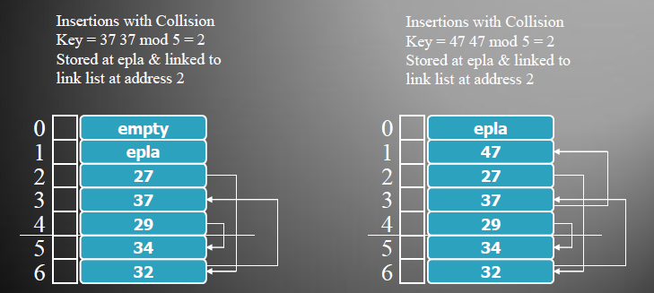
Coalesced Chaining

