Slide 1
Chapter 10: Method Overriding and method Overloading

Slide 2
Overriding Methods
A child class can override the definition of an inherited method in favor of its own
The new method must have the same signature as the parent's method, but can have a different body
The type of the object executing the method determines which version of the method is invoked
A parent method can be invoked explicitly using the super reference

Slide 3
Method Overriding
If subclass has a method of a superclass (same signature),
that method overrides the superclass method:
public class A { ...
public int M (float f, String s) { bodyA }
}
public class B extends A { ...
public int M (float f, String s) { bodyB }
}
If we call M on an instance of B , bodyB runs
In B we can access bodyA with: super.M(...)
The subclass M must have same return type as superclass M

Slide 4
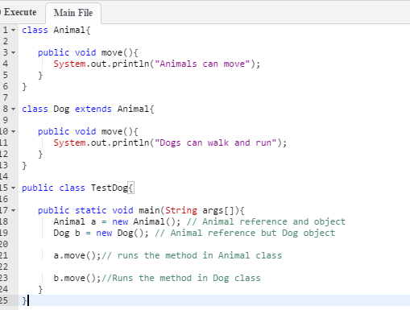
Method overriding Example

Slide 5
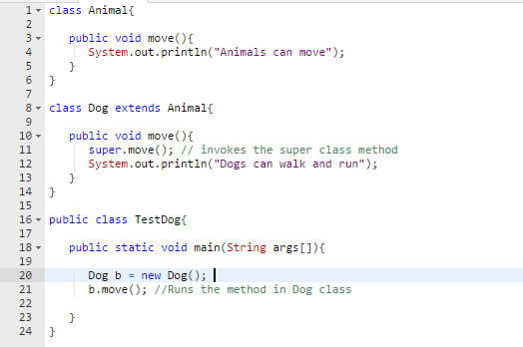
Method overriding Example with Super keyword

Slide 6
Method Overloading
Method overloading: multiple methods ...
With the same name
But different signatures
In the same class
Constructors are often overloaded
Argument lists could differ in – 1. Number of parameters. 2. Data type of parameters. 3. Sequence of Data type of parameters.
Example:
MyClass (int inputA, int inputB)
MyClass (float inputA, float inputB)

Slide 7
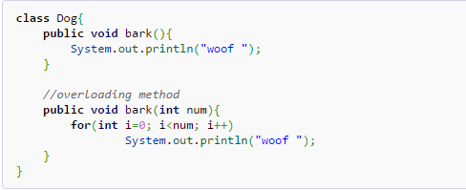
Method overloading Example

Slide 8
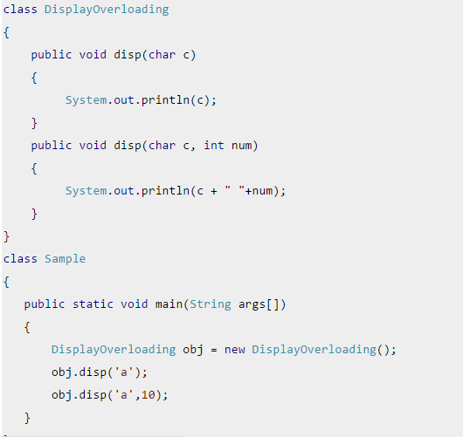
Overloading – Different Number of parameters in argument list

Slide 9
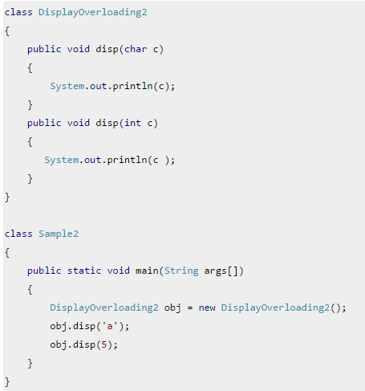
Overloading – Difference in data type of arguments

Slide 10
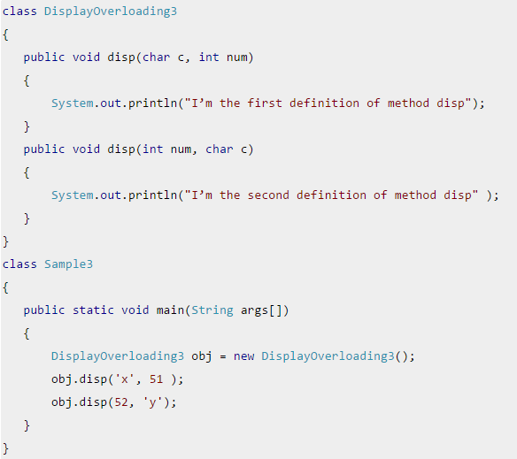
Overloading – Sequence of data type of arguments

Slide 11
Valid/invalid cases of method overloading
Case 1:
int mymethod(int a, int b, float c)
int mymethod(int var1, int var2, float var3)
Result: Compile time error. Argument lists are exactly same. Both methods are having same number, data types and same sequence of data types in arguments.

Slide 12
Valid/invalid cases of method overloading
Case 2:
int mymethod(int a, int b)
int mymethod(float var1, float var2)
Result: Perfectly fine. Valid case for overloading. Here data types of arguments are different.

Slide 13
Valid/invalid cases of method overloading
Case 3:
int mymethod(int a, int b)
int mymethod(int num)
Result: Perfectly fine. Valid case for overloading. Here data types of arguments are different.

Slide 14
Valid/invalid cases of method overloading
Case 4:
float mymethod(int a, float b)
float mymethod(float var1, int var2)
Result: Perfectly fine. Valid case for overloading. Sequence of the data types are different, first method is having (int, float) and second is having (float, int).

Slide 15
Overloading vs. Overriding
Don't confuse the concepts of overloading and overriding
Overloading deals with multiple methods with the same name in the same class, but with different signatures
Overriding deals with two methods, one in a parent class and one in a child class, that have the same signature
Overloading lets you define a similar operation in different ways for different data
Overriding lets you define a similar operation in different ways for different object types

