Slide 1
Chapter 1
GC 101
Introduction to computers and programs

Slide 2
Course Description
Official Description: Elementary introduction to programming. The characteristics of computers are discussed and students design, code, and debug programs using a high level programming language (Java).
2

Slide 3
What the class is really about
There are two main goals of this course:
1. Basics of Java
Core Concepts of Programming Languages
plus
Introduction to computers
3

Slide 4
1. Learn the Basics of Java Programming
Java is a popular programming language, widely used in industry.
We will learn all the specifics of how to program in Java.
This includes all the rules that are specific to Java.
We will cover the fundamentals: Variables, Arithmetic, If / Else, For Loops, While Loops, Arrays, Methods, etc.
4

Slide 5
For Example
This program counts from 1 to 10. In a few weeks, it will all make sense (I promise!)
/* Sample Java Program */
public class Sample
{
public static void main (String [] args)
{
int i;
for (i = 1; i <= 10; i++)
{
System.out.println ("Number: " + i);
}
}
}
5

Slide 6
2. Learn the Core Concepts of all Programming Languages
There are many programming languages available: Pascal, c, Java, Perl and Python.
All of these languages share core concepts.
By focusing on these concepts, you are better able to learn any programming language.
Hence, by learning Java, you are poised to learn other languages, such as C++ or Perl.
By learning the core concepts, you are also much more marketable as you are able to learn new technologies quicker.
6

Slide 7
An Example: For Loops
Java has a construct called a for loop that enables a program to repeat actions over and over.
Most other languages also have a for loop.
Hence, by learning about for loops in Java, you can easily learn for loops in C or Python.
7

Slide 8
Introduction
The purpose of this course is to teach you about computing, but particularly, programming in Java (a powerful, widely-used programming language).
Why care about computers and programming?
Enabling technology
Growing field with great opportunity
Creative outlet
8

Slide 9
What Is a Computer?
Computer
Performs computations and makes logical decisions
Millions / billions times faster than human beings
Computer programs
Sets of instructions by which a computer processes data
Hardware
Physical devices of computer system
Software
Programs that run on computers
© 2003 Prentice Hall, Inc. All rights reserved.

Slide 10
Computer Organization
Six logical units of computer system
Input unit
Mouse, keyboard
Output unit
Printer, monitor, audio speakers
Memory unit
Retains input and processed information
Arithmetic and logic unit (ALU)
Performs calculations
Central processing unit (CPU)
Supervises operation of other devices
Secondary storage unit
Hard drives, floppy drives
© 2003 Prentice Hall, Inc. All rights reserved.

Slide 11
What Is a Computer?
How is a computer defined?
Electronic device operating under the control of instructions stored in its own memory

Slide 12
What is the information processing cycle?
Input
Process
Output
Storage
Communication

Slide 13
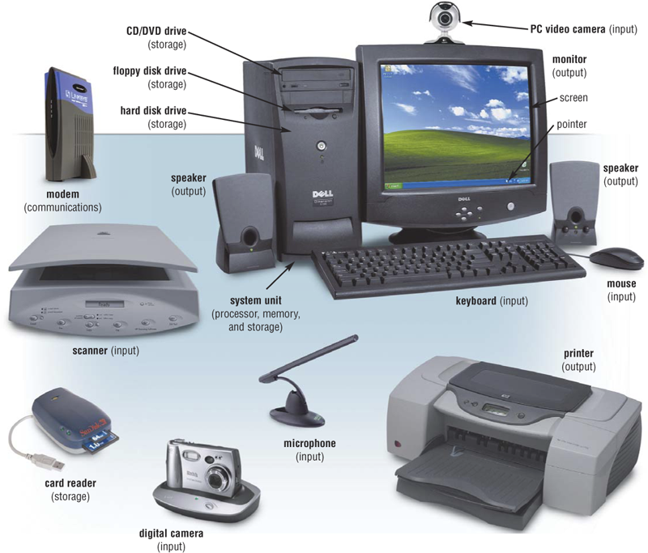
The Components of a Computer
What is an input device?
What is an input device?
Hardware used to enter data and instructions

Slide 14
The Components of a Computer
What is an output device?
Hardware that
conveys information to a user

Slide 15
The Components of a Computer
What is the system unit?
Box-like case Containing electronic components used to process data

Slide 16
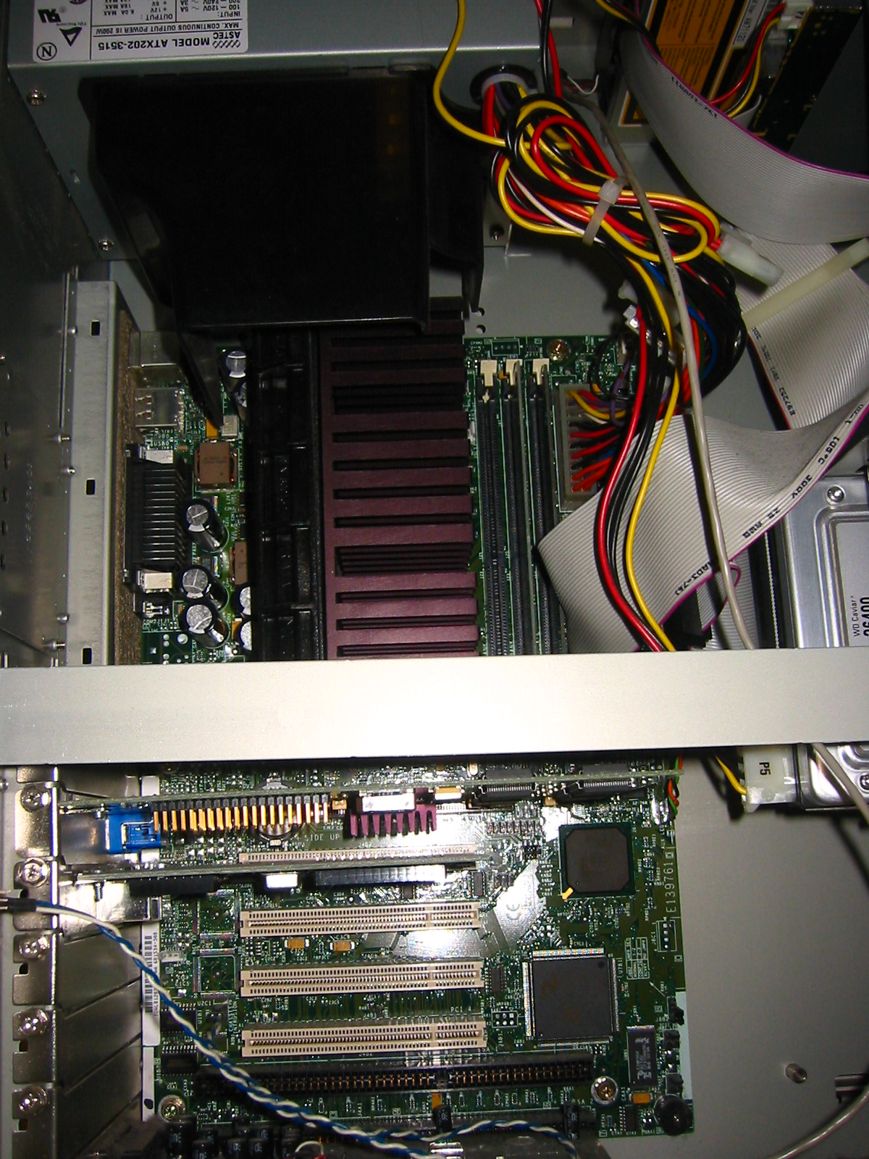
What is the magical inside the black box?
Storage Units
Memory card
Video Card
Power
Supply
CPU
Sound Card

Slide 17
The Components of a Computer
What are two main components on the motherboard?
Central Processing Unit (CPU)
Also called a processor
Carries out instructions that tell computer what to do
Memory
Temporary holding place for data and instructions

Slide 18
The Components of a Computer
What is storage?
Holds data, instructions, and information for future use

Slide 19
Why Is a Computer So Powerful?
What makes a computer powerful?
Speed
Reliability
Accuracy
Storage
Communications

