Slide 1
CHAPTER-9
Repetition Structures

Slide 2
Sections of computer code can be categorized as sequences, selection structures, and repetition structures (if repeated more than three times). Repetition structures are often called loops. Loops allows repetition of sequences of commands until some criterion is met. All loops consist of five basic parts.
A parameter that controls the loop.
Initialization of this parameter.
Updating this parameter in every cycle.
A comparison to a criterion to end the loop.
Calculations inside the loop.
MATLAB supports two different types of loops:
for loop (more appropriate when number of cycles are predefined)
while loop (more appropriate when number of cycles are NOT predefined)
~find and matrices operation

Slide 3
9.1 FOR LOOPS
variable
The first line identifies the loop and defines an index, which is a number that changes in each cycle and is used to determine when to stop. Next comes the group of commands. Finally, the end commands signals the end of the loop.
for index = [matrix]
commands to be executed
end
for k = 1:5
a(k) = k^2
end
for k = [1,3,7]
k
end
for k = 1:3
a = 5^k
end
a =
1
a =
1 4
a =
1 4 9
a =
1 4 9 16
a =
1 4 9 16 25
k =
1
k =
3
k =
7
a =
5
a =
25
a =
125
k = 1:5
a = k.^2
a =
1 4 9 16 25
Vectorization: easier than loop!

Slide 4


Another common use for a for loop is to combine it with an if statement and determine how many times something is true. For example, in the list of test scores shown in the first line, how many are above 90?
How many students have scores more than 90
$$\left(\begin{matrix}1 & 2 & 3 \\ 1 & 4 & 9 \\ 1 & 8 & 27\end{matrix}\right)$$
length(scores)
scores = [76,45,98,97];
count = 0;
for k=1:length(scores)
if scores(k)>90
count = count + 1;
end
end
disp(count)
for k = [1,2,3; 1,4,9; 1,8,27]
a = k‘
end
a =
1 1 1
a =
2 4 8
a =
3 9 27
if a two-dimensional matrix is defined in the index specification, MATLAB ® uses an entire column as the index each time through the loop
$$\left(\begin{matrix}1 & 1 & 1 \\ 2 & 4 & 8 \\ 3 & 9 & 27\end{matrix}\right)$$

Slide 5
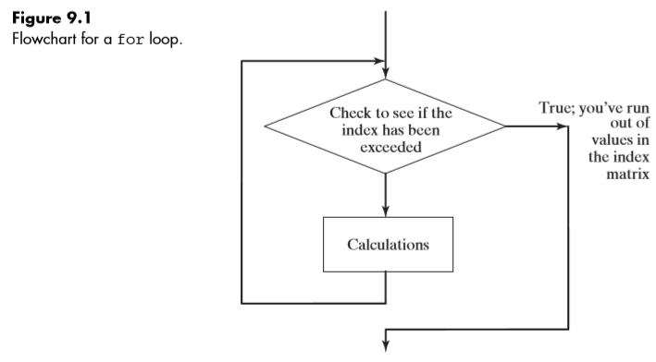
Any of the techniques learned to define a matrix can be used to define the index matrix. One common approach is to use the colon operator, as in
for index = start:inc:final
• If the expression is a row vector, the elements are used one at a time—once for each time through the loop.
• If the expression is a two-dimensional matrix (this alternative is not common), each time through the loop the index will contain the next column in the matrix. This means that the index will be a column vector!
• Once you’ve completed a for loop, the index variable retains the last value used.
• For loops can often be avoided by vectorizing the code.

Slide 6
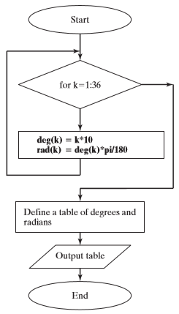
Create a table that converts angle values from degrees to radians, from 0 to 360 degrees, in increments of 10 degrees.
% Create a table of degrees to radians
clear
%Use a for loop for calculations
for k=1:36
deg(k) =k*10;
rad(k) = deg(k)*pi/180;
end
% Create atable
t = [deg;rad]
disp(‘Degree to Radians’)
Fprintf(‘%8.0f %8.2f \n’,t)

Slide 7
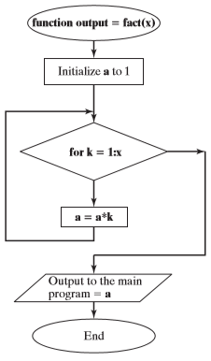
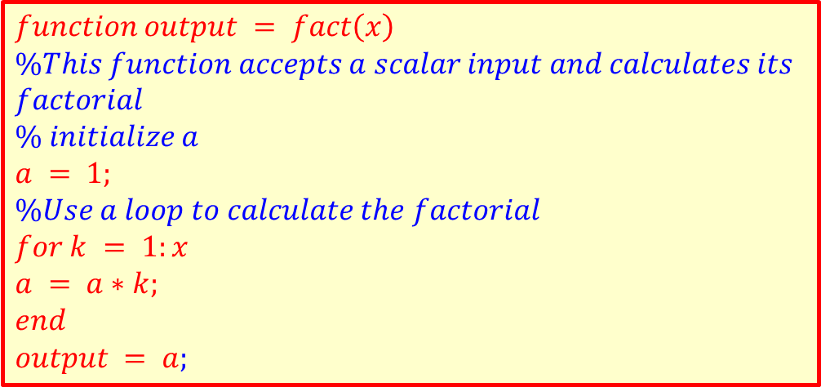
Create a function called fact to calculate the factorial of any number. Assume scalar input.
$$function output = fact\left(x\right)$$
$$\%This function accepts a scalar input and calculates its$$
$$factorial$$
$$\% initialize a$$
$$a = 1;$$
$$\%Use a loop to calculate the factorial$$
$$for k = 1:x$$
$$a = a∗k;$$
$$end$$
$$output = a;$$

Slide 8
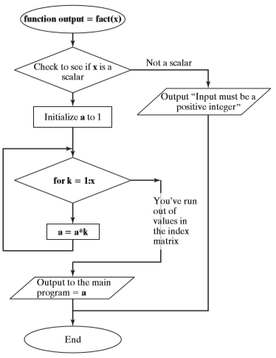
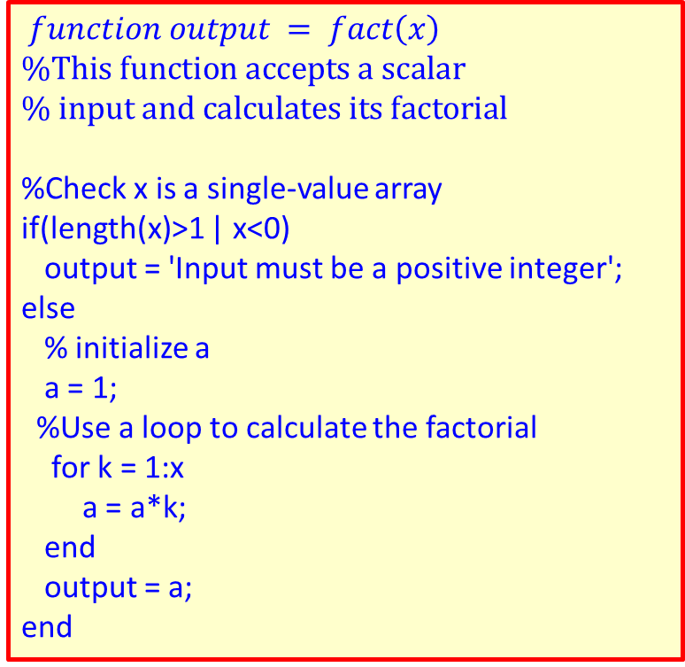
Create a function called fact to calculate the factorial of any number. Assume scalar input.
$$function output = fact\left(x\right)$$
$$\%This function accepts a scalar$$
$$\% input and calculates its factorial$$
%Check x is a single-value array
if(length(x)>1 | x<0)
output = 'Input must be a positive integer';
else
% initialize a
a = 1;
%Use a loop to calculate the factorial
for k = 1:x
a = a*k;
end
output = a;
end

Slide 9
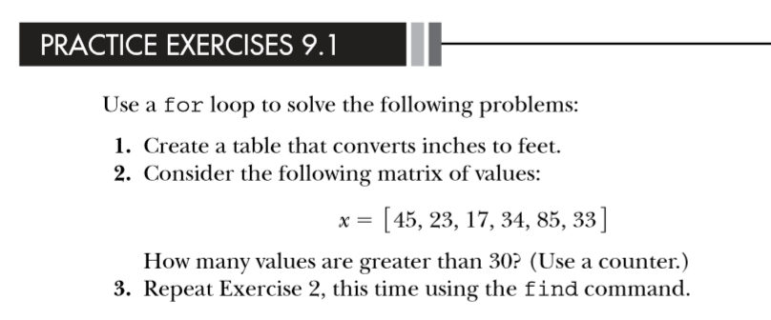
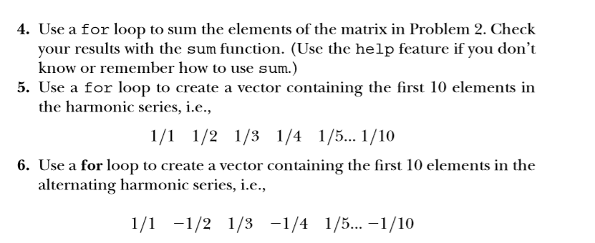

Slide 10
9.2 WHILE LOOPS
While loop format
while criterion
commands to be executed
end
While loops are similar to for loops. While loops continue until some criterion is met.
A counter, k, is initialized
Comparison: k less than 3
k is incremented by 1 in every cycle (k = k+1)
Loop is repeated three times, giving
k = 1, k = 2, k = 3 so long the comparison is true
Notice that when k=3 the criterion in the while statement k < 3 is false
k = 0;
while k<3
k = k+1
end
k =
1
k =
2
k =
3
k = 0;
while k<3
k = k+1;
a(k) = 5^k
end
K as an index number
for k = 1:3
a (k) = 5^k
end
a =
5
a =
5 25
a =
5 25 125
for = while

Slide 11
How many students have scores more than 90
for loop approach while loop approach
k = 0;
while (a<10)
a = a+3;
end
scores = [76,45,98,97];
count = 0;
for k=1:length(scores)
if scores(k)>90
count = count + 1;
end
end
disp(count)
scores = [76,45,98,97]; count = 0;
k = 0;
while k< length(scores)
k = k+1;
if scores(k)>90
count = count + 1;
end
end
disp(count)
a =
3
a =
6
a =
9
a =
12
To terminate the code : Ctrl+c
x = input('Enter a positive value of x')
while (x<=0)
disp('log(x) is not defined for negative numbers')
x = input('Enter a positive value of x')
end
y = log10(x);
fprintf('The log base 10 of %4.2f is %5.2f \n',x,y)
Notes:
num = xlsread('????? ????? ????? ????????','k4:k52')

Slide 12
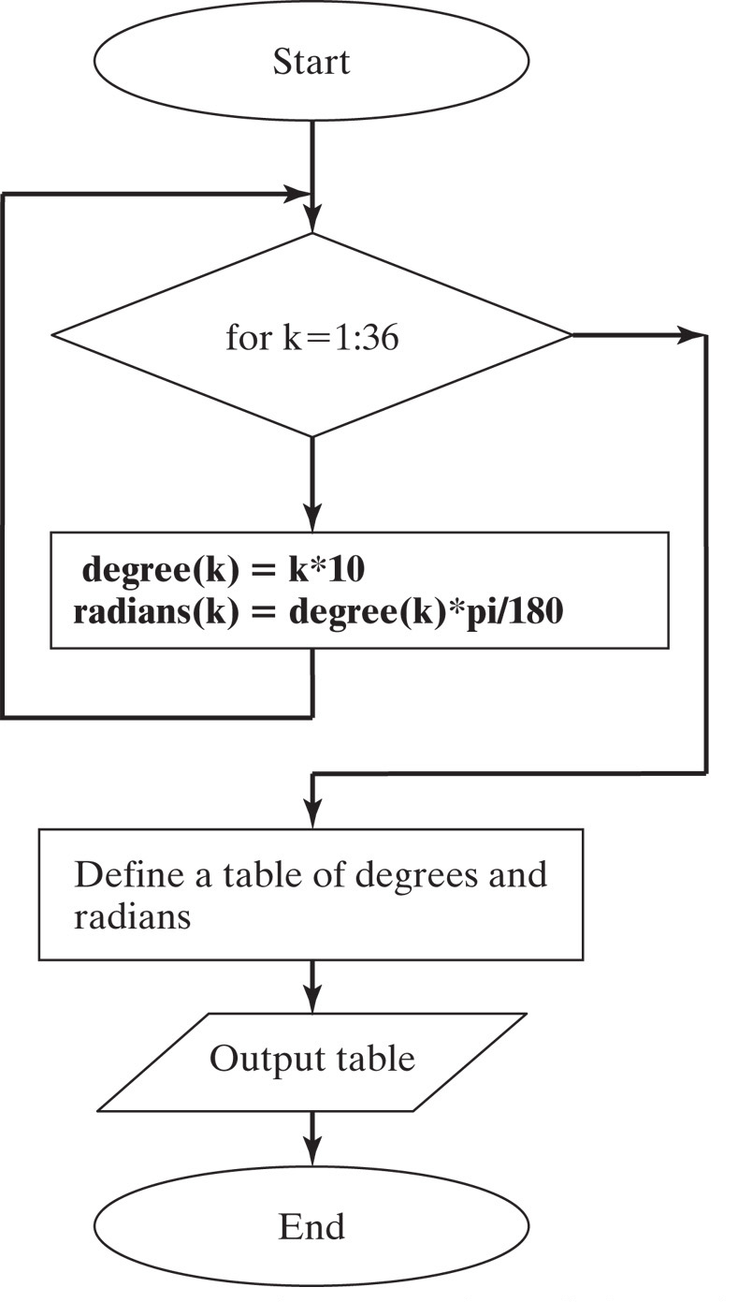
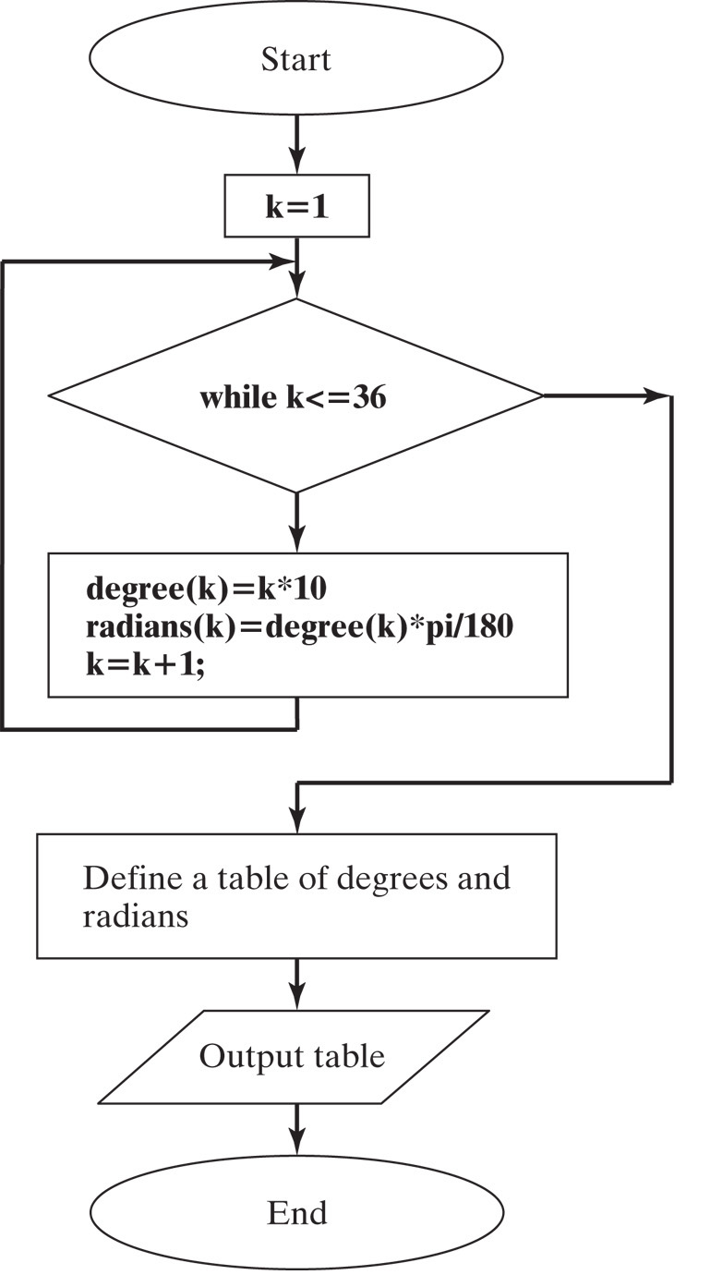
for function
loop function

Slide 13
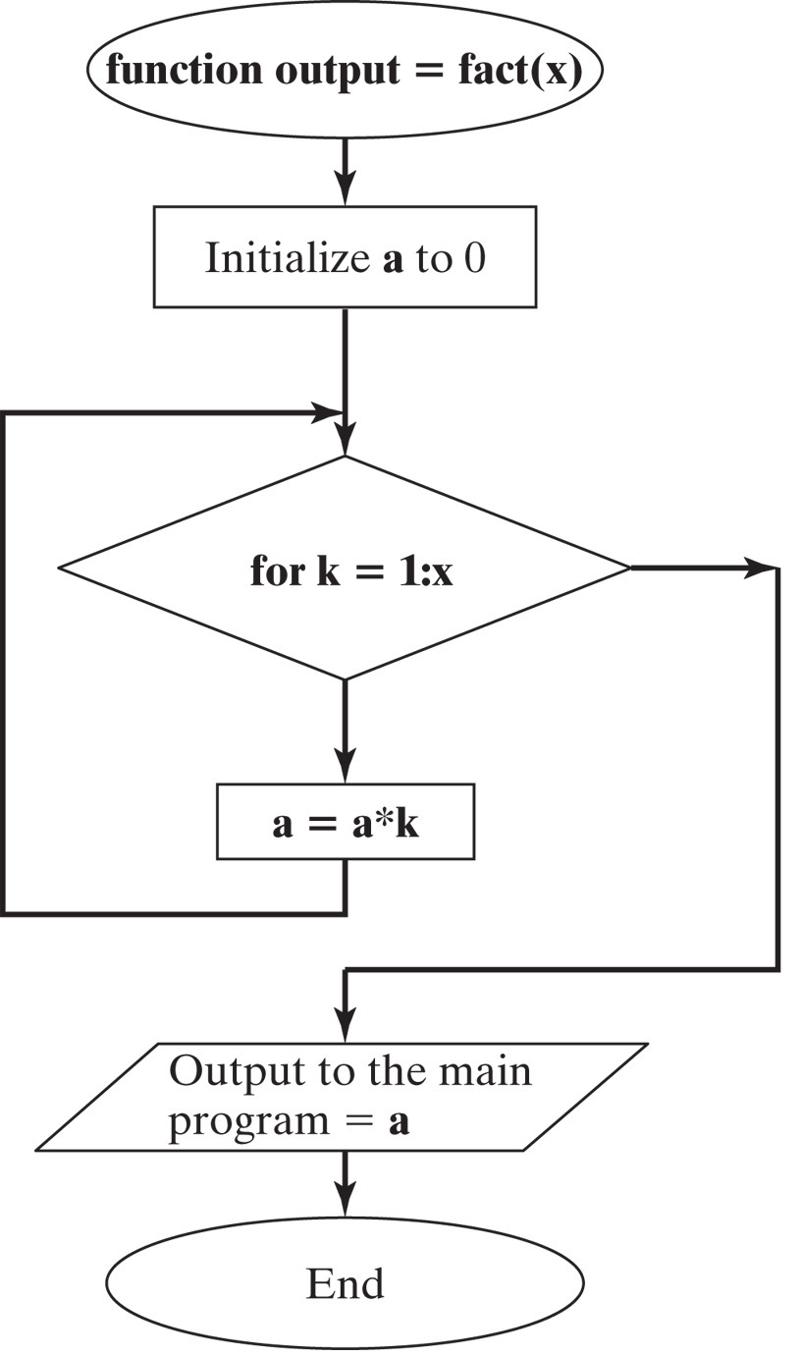
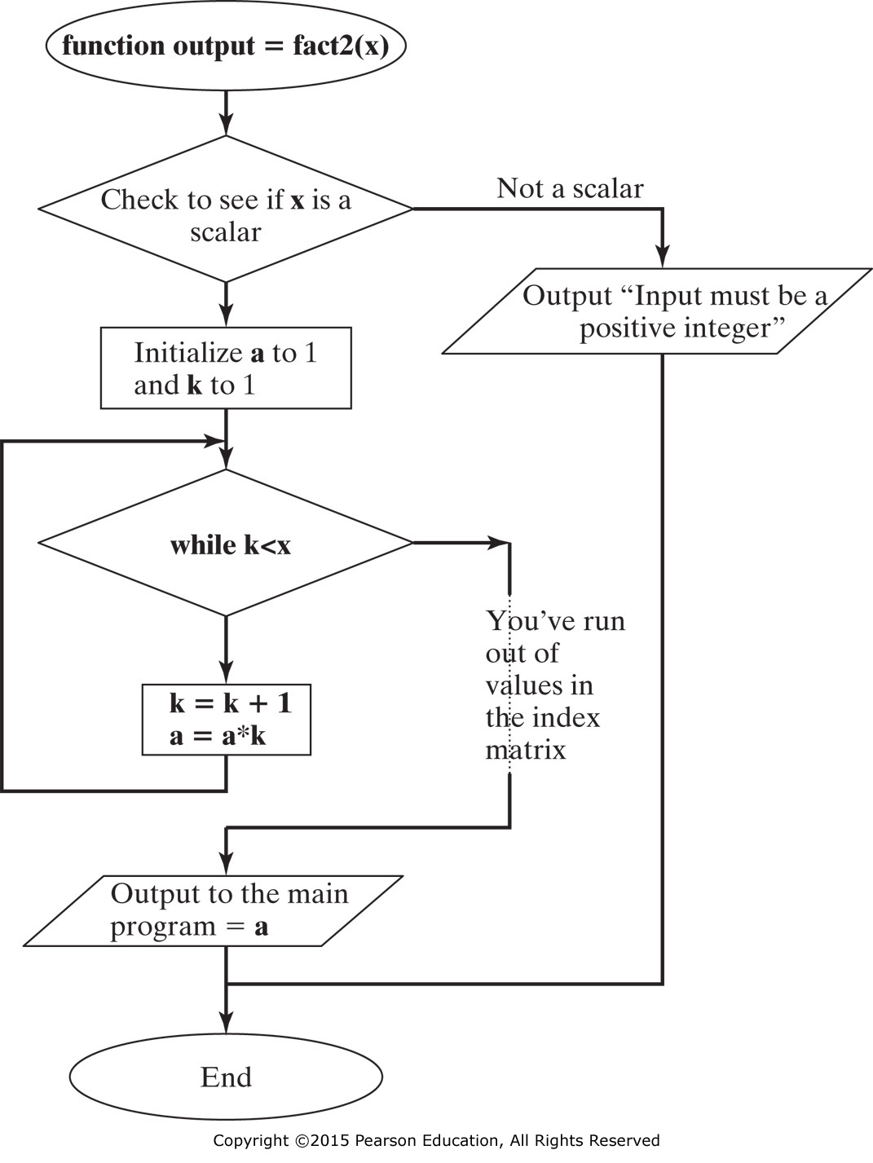
function output = fact2(x)
% It uses a while loop to find x!
%The input must be a positive integer
if(length(x)>1 | x<0)
disp('The input must be a positive integer')
else
%Initialize the running product
a = 1;
%Initialize the counter
  k = 1;
  while k<x
  %Increment the counter
  k = k + 1;
  %Calculate the running product
  a = a*k;
  end
output = a;
end

Slide 14
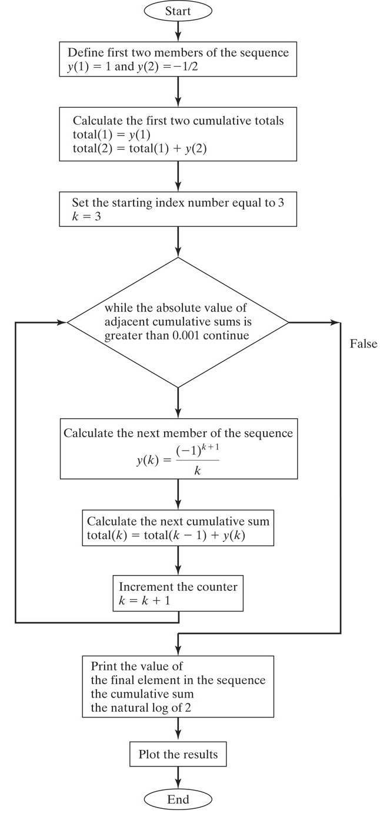
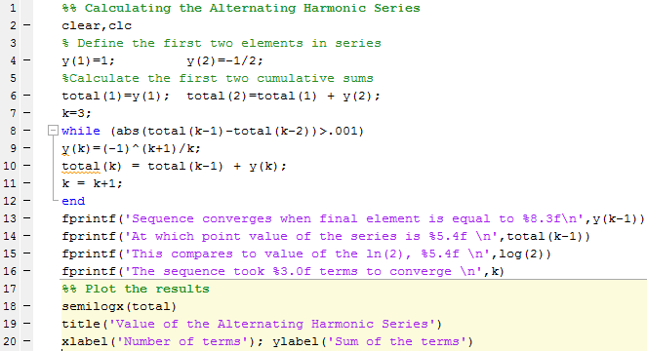

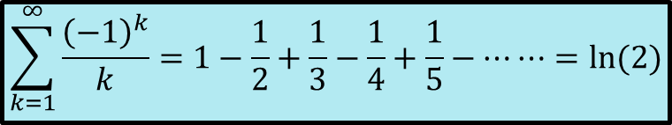
THE ALTERNATING HARMONIC SERIES
$$\sum_{k=1}^{∞}{\frac{{\left(−1\right)}^{k}}{k}}=1−\frac{1}{2}+\frac{1}{3}−\frac{1}{4}+\frac{1}{5}−⋯⋯=ln⁡(2)$$

Slide 15
%% Calculating the Alternating Harmonic Series
clear,clc
% Define the first two elements in series
y(1)=1; y(2)=-1/2;
%Calculate the first two cumulative sums
total(1)=y(1); total(2)=total(1) + y(2);
k=3;
while (abs(total(k-1)-total(k-2))>.001)
y(k)=(-1)^(k+1)/k;
total(k) = total(k-1) + y(k);
k = k+1;
end
fprintf('Sequence converges when final element is equal to %8.3f\n',y(k-1))
fprintf('At which point value of the series is %5.4f \n',total(k-1))
fprintf('This compares to value of the ln(2), %5.4f \n',log(2))
fprintf('The sequence took %3.0f terms to converge \n',k)
%% Plot the results
semilogx(total)
title('Value of the Alternating Harmonic Series')
xlabel('Number of terms'); ylabel('Sum of the terms')

Slide 16
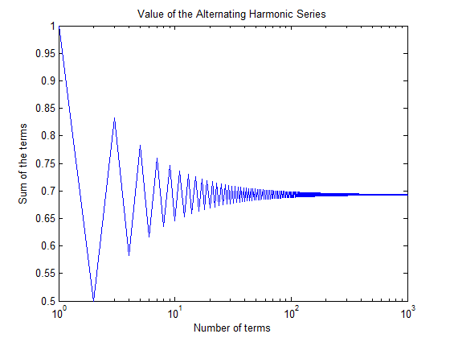
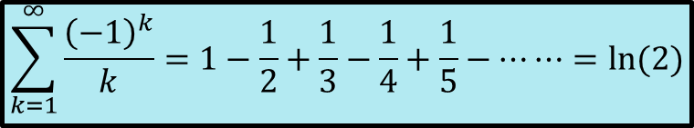
$$\sum_{k=1}^{∞}{\frac{{\left(−1\right)}^{k}}{k}}=1−\frac{1}{2}+\frac{1}{3}−\frac{1}{4}+\frac{1}{5}−⋯⋯=ln⁡(2)$$

Slide 17
9.4 MIDPOINT BREAK LOOPS
while(1) %always pass with True & inf. no of iterations
num_candy_bars = input('Enter the number of candy bars ');
if num_candy_bars<0
disp('Must be a positive number')
else
total = num_candy_bars *.75;
fprintf('The total cost is %5.2f dollars \n',total)
break
end
end
Enter the number of candy bars -3
Must be a positive number
Enter the number of candy bars 5
The total cost is 3.75 dollars
NEVER ENDING LOOP: if the user keeps replying with a negative number, the program will continue to prompt for a positive value
for k=1:3
num_candy_bars = input('Enter the number of candy bars');
if num_candy_bars<0
disp('Must be a positive number')
else
total = num_candy_bars *.75;
fprintf('The total cost is %5.2f dollars \n',total)
break
end
end
Enter the number of candy bars -3
Must be a positive number
Enter the number of candy bars -2
Must be a positive number
Enter the number of candy bars -5
Must be a positive number

Slide 18

% Example 9.6
% Calculating the Alternating Numeric Series
clear, clc
%% Define the starting parameters
y(1)=1; total(1)=y(1); criterion = .01;
max_iterations = 50;
%% Execute the loop
for k=2:max_iterations
y(k)=(-1)^(k+1)*k;
total(k) = total(k-1) + y(k);
if(abs(total(k)-total(k-1))<criterion)
break
end
end
%% Specify the output
if k==max_iterations
fprintf('The sequence did not converge in %5.0f iterations \n',max_iterations)
fprintf('At which point the value of the series is %8.3f \n', total(k))
else
fprintf('The sequence converged in %5.0f iterations \n',k)
fprintf('The final element is equal to %8.3f \n',y(k))
fprintf('At which point the value of the series is %8.3f \n', total(k))
end
plot(total)
xlabel('Number of Iterations')
ylabel('Cumulative Sum')
title('Summation of the Alternating Numeric Series')
1-2+3-4+5-6 ... ... ......+(n-1)-n
$$\sum_{k=1}^{n}{{\left(−1\right)}^{k+1}k}$$

Slide 19
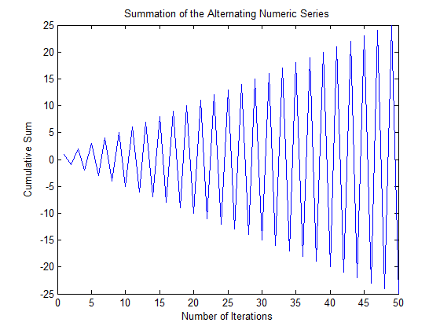
The sequence did not converge in 50 iterations
At which point the value of the series is -25.000

Slide 20
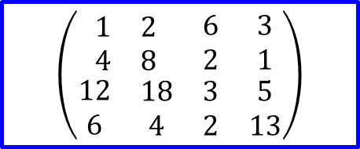
9.5 NESTED LOOPS
$$\left(\begin{matrix}\begin{matrix}1 & 2\end{matrix} & 6 & 3 \\ \begin{matrix}4 & 8\end{matrix} & 2 & 1 \\ \begin{matrix}\begin{matrix}12 \\ 6\end{matrix} & \begin{matrix}18 \\ 4\end{matrix}\end{matrix} & \begin{matrix}3 \\ 2\end{matrix} & \begin{matrix}5 \\ 13\end{matrix}\end{matrix}\right)$$
It is often useful to nest loops inside other loops. This is actually how many of the MATLAB ® built-in functions operate. For example, consider the max function. This function looks for the maximum value for each column in a matrix. We can develop a program to find the maximum, using a simple 4 × 4 array, x
max(x) =
12 18 6 13
[rows,cols]=size(x);
for k=1:cols
  maximum(k)=x(1,k);
  for j=1:rows
    if x(j,k)>maximum(k)
      maximum(k)=x(j,k);
    end
  end
end
maximum % Screen display

Slide 21
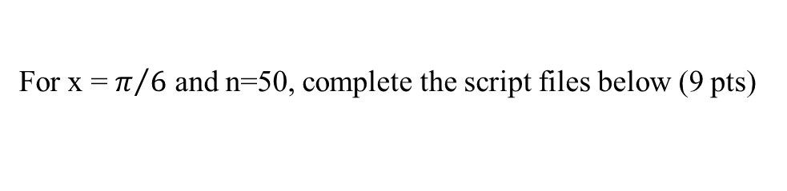
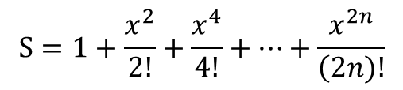
Write the output of the following program (the matrices should be displayed in Mathematical format) (5 pts)
clc clear; M = ones(4,3); [x1 x2] = size(M); for i=1:x1 for j=i:x2 M(i, j) = i+j; M(j, i)= M(i,j); end end; M | M = 2 3 4 3 4 5 4 5 6 1 1 1
It is desired to code the following sum (S) using two methods
$$S=1+\frac{x^{2}}{2!}+\frac{x^{4}}{4!}+…+\frac{x^{2n}}{\left(2n)!\right.}$$
For x = $π/6$ and n=50, complete the script files below (9 pts)
% Using for loop clear; x= pi/6; n =50; sum1 =1; for i=1:n sum1 = sum1 + x^(2*i))/factorial(2*i); end; | % Using while loop clear; x= pi/6; n =50; sum2 = 1; while j<=n; sum2 = sum2 + (x^(2*j))/factorial(2*j); j= j+1; end;

Slide 22
1.0000 1.9748
2.0000 1.9874
3.0000 1.9937
4.0000 1.9968
The solution to sqrt(2x)-x=0 is :
xsol =
1.9968
% use a while-loop
clear all
xo=1.95;
xold=xo;
counter=0;
while counter<=3
  xsol=sqrt(2*xold);
  xold=xsol;
  counter=counter+1;
  disp([counter xsol])
end
disp('The solution to sqrt(2x)-x=0 is :'), xsol

Slide 23
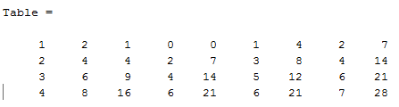
Follow the execution of the program
clear counti=0;countj=0;ri=0;rj=0;
Table=[];
for i=1:4
  counti=counti+2;
  ri=i^2;
  cRj=[];
  for j=1:3:7
    if j>i
      countj=countj+1;
      rj=i*j;
    end
    cRj=[cRj countj rj];
  end
  Table(i,:)=[i counti ri cRj];
end
Table

Slide 24
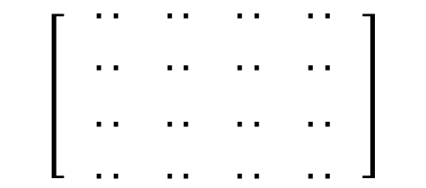
QUESTION (3) [15 Pts]
Follow the execution of this program by filling the table and giving the final output for n=4
clear; clc
n=4
for i = 1:n
for j = 1:n
if i == 1
A(i,j) = 1;
elseif j == 1
A(i,j) = 1;
else
A(i,j) = A(i,j-1) + A(i-1,j);
end
end
end
A
i | j | A(i,j)
1 | 1 | 1
A =
1 1 1 1
1 2 3 4
1 3 6 10
1 4 10 20
$$\left[ \begin{aligned}&\begin{matrix}\begin{matrix}.. & .. \\ .. & ..\end{matrix} & \begin{matrix}.. & .. \\ .. & ..\end{matrix}\end{matrix} \\ & \\ &\begin{matrix}\begin{matrix}.. & .. \\ .. & ..\end{matrix} & \begin{matrix}.. & .. \\ .. & ..\end{matrix}\end{matrix}\end{aligned} \right]$$

Slide 25
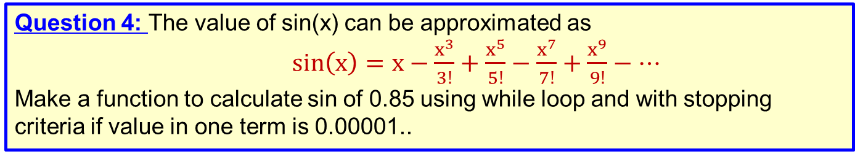
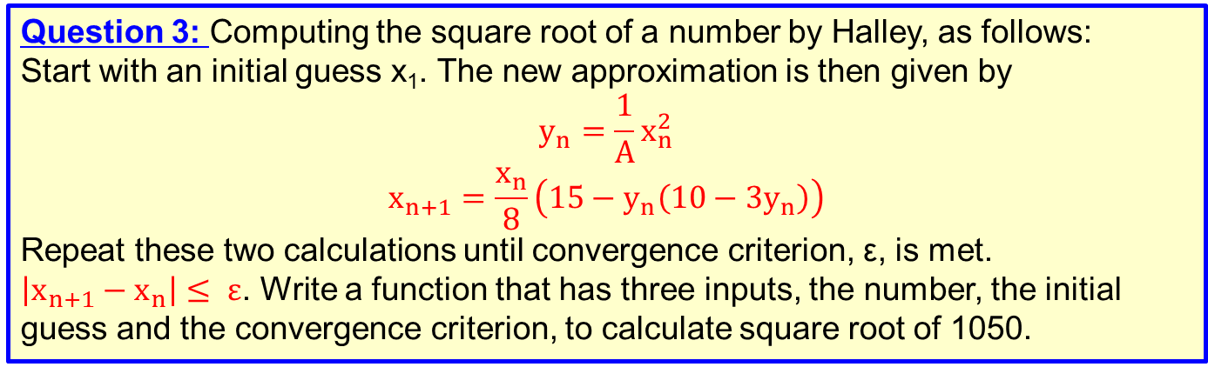
Question 1: Use a for loop to sum the elements in the following vector:
x= [1, 23, 43, 72, 87, 56, 98, 33]
Check your answer with the sum function
Question 2: Create a Fibonacci sequence by adding the two previous elements. The simplest Fibonacci sequence starts with 1, 1 and proceeds as follows:
1, 1, 2, 3, 5, 8, 13, …. , until 20 numbers.
Question 3: Computing the square root of a number by Halley, as follows:
Start with an initial guess x₁. The new approximation is then given by
$$y_{n}=\frac{1}{A}x_{n}^{2}$$
$$x_{n+1}=\frac{x_{n}}{8}\left(15−y_{n}\left(10−3y_{n}\right)\right)$$
Repeat these two calculations until convergence criterion, ε, is met.
$\left|x_{n+1}−x_{n}\right|≤ ε$. Write a function that has three inputs, the number, the initial guess and the convergence criterion, to calculate square root of 1050.
Question 4: The value of sin(x) can be approximated as
$\sin\left(x\right)=x−\frac{x^{3}}{3!}+\frac{x^{5}}{5!}−\frac{x^{7}}{7!}+\frac{x^{9}}{9!}−…$
Make a function to calculate sin of 0.85 using while loop and with stopping criteria if value in one term is 0.00001..

