Slide 1
CHAPTER-8 Logical Functions & Selection Structure
Objectives:
• Understand how MATLAB ® interprets relational and logical operators
• Use the find function
• Understand the appropriate uses of the if/else family of commands
• Understand the switch/ case structure

Slide 2
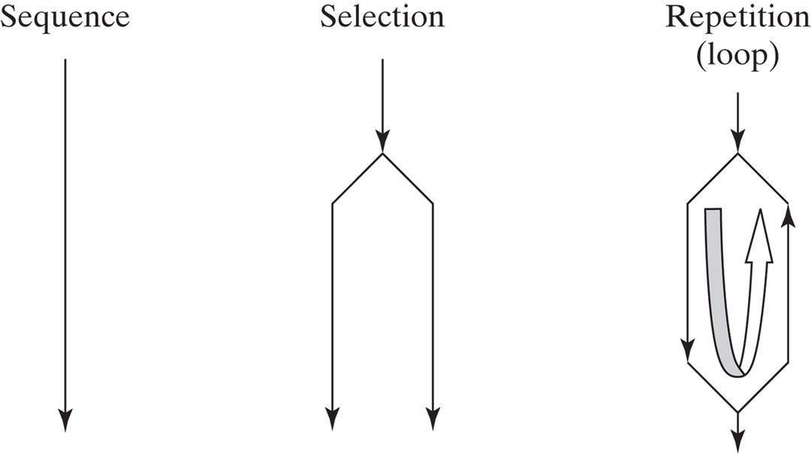
Computer code usually consists of sequences, selection structures, and repetition structures
• A sequence is a list of commands that are executed one after another.
• A selection structure allows the execution of one command (or set of commands) if some criterion is true and a second command (or set of commands) if the criterion is false. A selection statement provides the means of choosing between these paths, based on a logical condition . The conditions that are evaluated often contain both relational and logical operators or functions.
• A repetition structure, or loop, causes a group of statements to be executed multiple times. The number of times a loop is executed depends on either a counter or the evaluation of a logical condition.

Slide 3
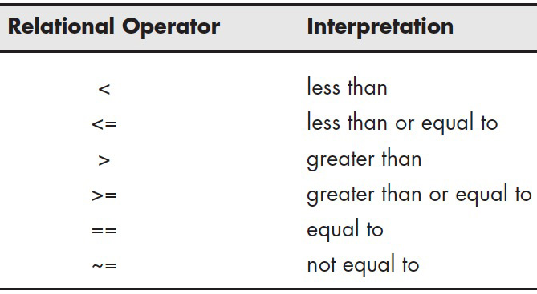
8.1 RELATIONAL AND LOGICAL OPERATORS
The selection and repetition structures depend on relational and logical operators. MATLAB has six relational operators for comparing two matrices of equal size. Comparisons are either true (1) or false (0). In fact, any number that is not 0 is taken as true. If we define two scalars
x = 5; y = 1;
and use a relational operator such as <, then
x<y
is either true or false. In this case,
ans =
0
indicating that the comparison is false. This answer can be used in selection statements and in repetition structures to make decisions. Similarly,
x = [ 1, 2, 3, 4, 5]; y = [-2, 0, 2, 4, 6];
x<y
then
ans =
0 0 0 0 1

Slide 4
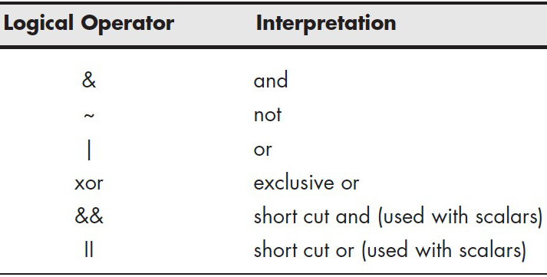
It is possible to combine comparisons with logical operators and, not, and or. Thus,
x = [ 1, 2, 3, 4, 5];
y = [-2, 0, 2, 4, 6];
z = [ 8, 8, 8, 8, 8];
z>x & z>y
returns
ans =
1 1 1 1 1
because z is greater than both x and y for every element.
The statement
x>y | x>z
is read as “ x is greater than y or x is greater than z ” and returns
ans =
1 1 1 0 0
This means that the condition is true for the first three elements and false for the last two.
These relational and logical operators are used in both selection structures and loops to determine what commands should be executed.
5<3 && 10>2 12>3 || 2>5

Slide 5
A | B | A&B | A|B
0 | 0 | 0 | 0
0 | 1 | 0 | 1
1 | 0 | 0 | 1
1 | 1 | 1 | 1
A | ~A
1 | 0
0 | 1
Mathematical expression | Math condition in MATLAB
(L=1) or (M > 5) | (L==1)|(M>5)
(5<x≤15) | (x>5.0) & (x<=15)

Slide 6
Precedence | Operation
1 (highest) | Parentheses (if nested, the inner ones have precedence)
2 | Exponentiation
3 | Logical NOT (~)
4 | Multiplication, division
5 | Addition, subtraction
6 | Relational operators (>,<,>=,<=,==,~=)
7 | Logical AND (&)
8 (lowest) | Logical OR (|)
>> x=-2; >> -5<x<-1 | ans = 0 | This inequality is correct mathematically, however, the answer is false since MATLAB executes from left to right. -5<x is true (=1) and then 1<-1 is false (=0)
>> -5<x & x<-1 | ans = 1 | The mathematically correct statement is obtained by using the logical operator &.
>> y = 5; >> ~(y<7) | ans = 0 | …
>> ~y<7 | ans = 1 | …
>> ~((y>=8)|(x<-1)) | ans = 0 | …
>> ~(y>=8)&(x<-1) | ans = 1 | …

Slide 7
8.2 FLOWCHARTS AND PSEUDOCODE
A flowchart is a graphical approach to creating a coding plan, and pseudocode is its verbal description.
For simple programs, pseudocode may be the best (or at least the simplest) planning approach:
Outline a set of statements describing the steps to solve a problem.
Convert these steps into comments in an M-file.
Insert the appropriate codes into the file between the comment lines.
For example, a program to convert mph to ft/s is needed. The output should be a table, complete with a title and column headings. A tentative outline can be as follows:
Define a vector of mph values
Convert mph to ft/s
Combine mph and ft/s vectors into a matrix
Create a table title
Create column headings.
Display the table
%Define a vector of mph values
mph = 0:10:100;
%Convert mph to ft/s
fps = mph*5280/3600;
%Combine mph and ft/s into matrix
table = [mph;fps]
%Create a table title
disp('Velocity Conversion Table')
%Create column headings
disp(' mph f/s')
%Display the table
fprintf('%8.0f %8.2f \n',table)

Slide 8
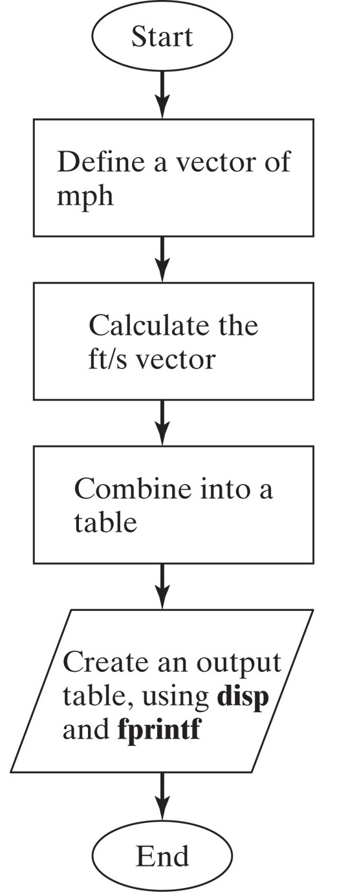
FLOWCHART is a pictorial representation of a computer program. It make it easy to visualize the structure of a program
Nonpogrammers

Slide 9
8.3 : LOGICAL FUNCTIONS
MATLAB offers both traditional selection structures, such as the family of if functions, and a series of logical functions that perform almost the same task.
The primary logical function is find, which can often be used in place of both traditional selection structures and loops.
8.3.1 Find
The find command searches a matrix and identifies which elements in that matrix meet a given criterion. For example, the U.S. Naval Academy requires applicants to be at least 5’6’’ (66’’) tall. Consider this list of applicant heights:
height = [63,67,65,72,69,78,75]
using the find command:
accept = find(height>=66 )
returns the index numbers from the matrix that meet the criterion
accept = 2 4 5 6 7
Typing,
height(accept)
ans = 67 72 69 78 75
Using following command
decline = find(height<66)
returns the index numbers from the matrix that do not meet the criterion
decline = 1 3
Alternatively, use nesting
height(find(height >=66))

Slide 10
To create a more readable report use the disp and fprintf functions:
disp('The following candidates meet the height requirement'); fprintf('Candidate # %4.0f is %4.0f inches tall \n', [accept;height(accept)])
These commands return the following table in the command window:
The following candidates meet the height requirement
Candidate # 2 is 67 inches tall
Candidate # 4 is 72 inches tall
Candidate # 5 is 69 inches tall
Candidate # 6 is 78 inches tall
Candidate # 7 is 75 inches tall
Clearly, you could also create a table of those who do not meet the requirement:
disp('The following candidates do not meet the height requirement') fprintf('Candidate # %4.0f is %4.0f inches tall \n', [decline;height(decline)])

Slide 11
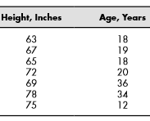
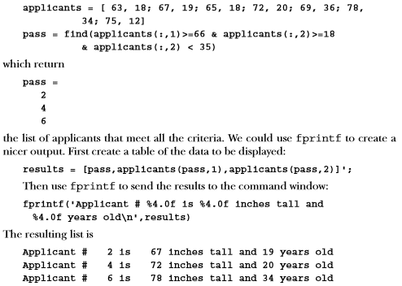
For example, suppose besides satisfying the height condition the applicants must be at least 18 years old and less than 35 years old.
applicants = [ 63, 18; 67, 19; 65, 18; 72, 20; 69, 36; 78, 34; 75, 12]
pass = find(applicants(:,1)>=66 & applicants(:,2)>=18 & applicants(:,2) < 35)

Slide 12
We could use fprintf to create a nicer output. First create a table of the data to be displayed:
results = [pass,applicants(pass,1),applicants(pass,2)]';
Then use fprintf to send the results to the command window:
fprintf('Applicant # %4.0f is %4.0f inches tall and %4.0f years old\n',results)

Slide 13
[row, col] = find(criteria)
it will return the appropriate row and column numbers (also called the row and column index numbers or subscripts).
Now, imagine that you have a matrix of patient temperature values measured in a clinic. The column represents the number of the station where the temperature was taken. Thus, the command
temp = [95.3, 100.2, 98.6; 97.4,99.2, 98.9; 100.1,99.3, 97]
gives
temp =
95.3000 100.2000 98.6000
97.4000 99.2000 98.9000
100.1000 99.3000 97.0000
element = find(temp>98.6)
[row, col] = find(temp>98.6)

Slide 14
Using fprintf, we can create a more readable report. For example,
fprintf('Patient%3.0f at station%3.0f had a temp of%6.1f \n', [row,col,temp(element)]')
Patient 3 at station 1 had a temp of 100.1 Patient 1 at station 2 had a temp of 100.2 Patient 2 at station 2 had a temp of 99.2 Patient 3 at station 2 had a temp of 99.3 Patient 2 at station 3 had a temp of 98.

Slide 15
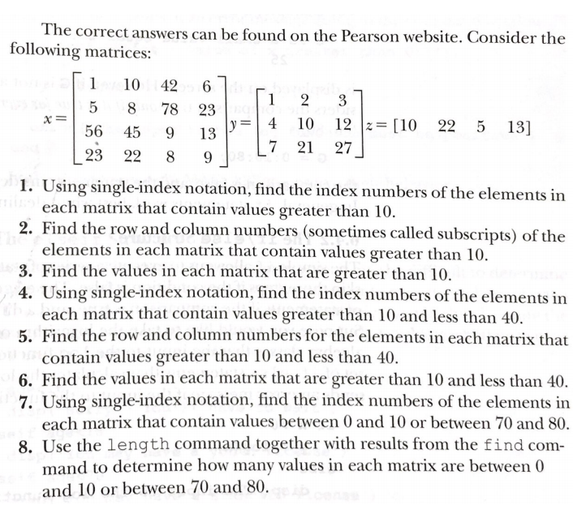
Ex. 6.1

Slide 16
8.4 SELECTION STRUCTURES
Using the find command is recommended instead of an if statement. In some cases, however, the if statement is required.
- Indent
8.4.1 The Simple If
If the comparison (a logical expression) is true, the statements between the if statement and the end statement are executed.
If the comparison is false, the program jumps immediately to the statement following end.
Structure
if comparison
statements
end
Check the output for
G= 25
G=0:10:80
%Example
if G<50
disp('G is a small value equal to:')
disp(G);
end
Grade Score A 90 to 100 B 80 to 90 C 70 to 80 D 60 to 70 E 60
When vector: True for every element

Slide 17
8.4.2 The If/Else Structure
The simple if allows execution of a series of statements if a condition is true and skips those steps if the condition is false. The else clause allows us to execute one set of statements if the comparison is true and a different set if the comparison is false.
%Example (log must be greater than 0)
if x >0
y = log(x)
else
disp('The input to the log function must be positive')
end
Check the output for
x= 10
x = 0:0.5:2; (Comparison is true only if it is true for every element in the matrix)
The comparison is true only if it is true for every element in the matrix.
Since the elements in the matrix are not all greater than 0, therefore, MATLAB skips to the else portion of the statement and displays the error message.

Slide 19
8.4.3 The elseif Structure
When several levels of if/else statements are nested, it may be difficult to determine which logical expressions must be true (or false) in order to execute each set of statements. The elseif function allows to check multiple criteria while keeping the code easy to read.
Consider the following lines of code that evaluate whether to issue a driver’s license, based on the applicant’s age:
%Example
if age<16
disp('Sorry – You'll have to wait')
elseif age<18
disp('You may have a youth license‘
elseif age<70
disp('You may have a standard license')
else
disp('Drivers over 70 require a special license')
end
If age < 16, the program executes the next line or set of lines, displays the message Sorry— You'll have to wait, and then exits the if structure.
If the comparison is false, it checks if age < 18. The program continues through the if structure until it finally finds a true comparison or until it encounters the else.
Notice that the else line does not include a comparison, since it executes if the elseif immediately before it is false.

Slide 20
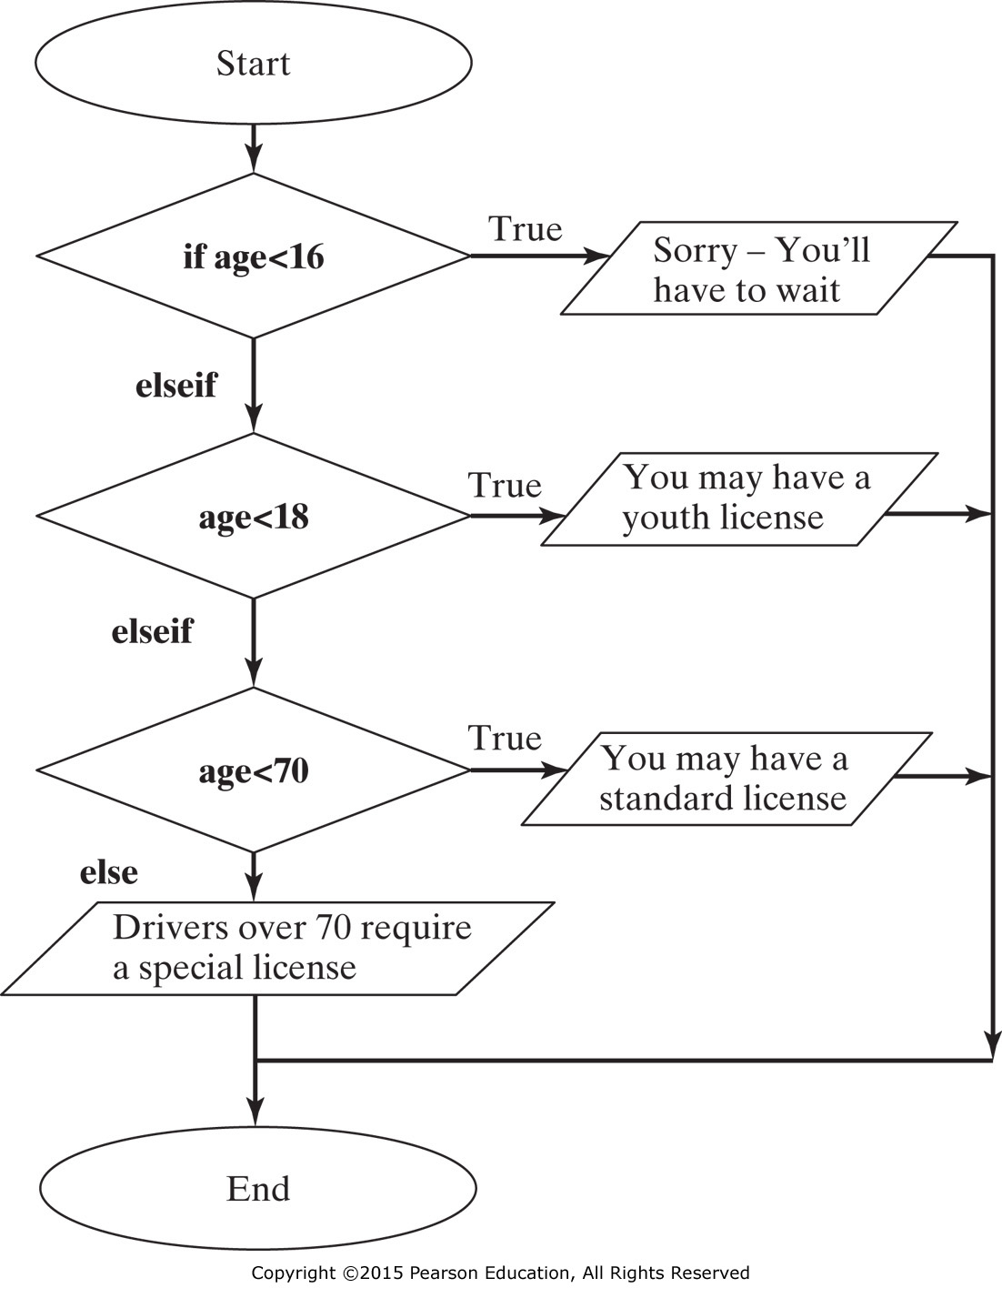

Slide 21
This structure is easy to interpret if age is a scalar. If it is a matrix, the comparison must be true for every element in the matrix.
Consider this age matrix
age = [15,17,25,55,75]
The first comparison, if age < 16, is false, because it is not true for every element in the array.
The second comparison, elseif age < 18, is also false.
The third comparison, elseif age < 70, is false as well, since not all of the ages are below 70.
The result is Drivers over 70 require a special license.

Slide 22
Write the program that evaluates the student's grade according to the university scale:
% Case 1a: Implementation s=input('Enter the student''s score: '); if s < 60 g = 'F'; elseif s < 70 g = 'D'; elseif s < 80 g = 'C'; elseif s < 90 g = 'B'; else g = 'A'; end disp('The student''s grade is') disp(g) | % Case 1b: Implementation s=input('Enter the student''s score: '); if s < 60 g = 'F'; elseif s <= 70 g = 'D'; elseif s <= 80 g = 'C'; elseif s <= 90 g = 'B'; else g = 'A'; end disp('The student''s grade is') disp(g)
Student's score | Student's grade
100 ≥ Score ≥ 90 | A
90 > Score ≥ 80 | B
80 > Score ≥ 70 | C
70 > Score ≥ 60 | D
Score < 60 | F
???
Function Error (‘ ***’)
% Case 2a: Implementation s=input('Enter the student''s score: '); if s <= 100 g = 'A'; elseif s < 90 g = 'B'; elseif s < 80 g = 'C'; elseif s < 70 g = 'D'; else s < 60 g = 'F'; end disp('The student''s grade is') disp(g) | %Case 2b: Implementation s=input('Enter the student''s score: '); if s >= 90 g = 'A'; elseif s >= 80 g = 'B'; elseif s >= 70 g = 'C'; elseif s >= 60 g = 'D'; else g = 'F'; end disp('The student''s grade is') disp(g) | function results = grade(x) % It requires a scalar input if (x>=90) results = 'A'; elseif (x>=80) results = 'B'; elseif (x>=70) results = 'C'; elseif (x>=60) results = 'D'; else results = 'E'; end

Slide 23
8.4.4 Switch and case
The switch/case structure is often used when a series of programming path options exists for a given variable, depending on its value. The switch/case is similar to the if/else/elseif. As a matter of fact, anything you can do with switch/case could be done with if/else/elseif. However, the code is a bit easier to read with switch/case, a structure that allows you to choose between multiple outcomes, based on some criterion. This is an important distinction between switch/case and elseif. The criterion can be either a scalar (a number) or a string. In practice, it is used more with strings than with numbers.
%Example
switch variable
case option1
code to be executed if variable is equal to option 1
case option2
code to be executed if variable is equal to option 2 o
case option_n
code to be executed if variable is equal to option n
otherwise
code to be executed if variable is not equal to any of the options
end

Slide 24
8.4.4 Switch and case
Here’s an example: Suppose you want to create a function that tells the user what the airfare is to one of three different cities:
%Example
city = input('Enter the name of a city in single quotes: ')
switch city'
case 'Boston’
disp('$345')
case 'Denver'
disp('$150')
case 'Honolulu'
disp('Stay home and study')
otherwise
disp('Not on file’)
end
You can tell the input command to expect a string by adding “s” in a second field. This relieves the user of the awkward requirement of adding single quotes around any string input. With the added “s”, the preceding code now reads as follows:
city = input('Enter the name of a city: ','s')
Otherwise is optional but important if you expect the user will enter a different value

Slide 25
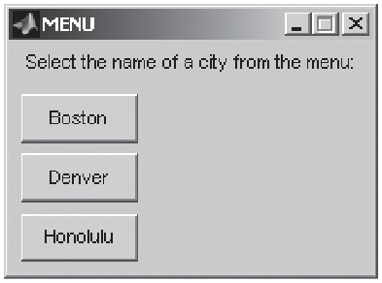
8.4.5 Menu
The menu function is often used in conjunction with a switch/case structure. This function causes a menu box to appear on the screen, with a series of buttons defined by the programmer.
We can use the menu option in our previous airfare example to ensure that the user chooses only cities about which we have information. This also means that we don’t need the otherwise syntax, since it is not possible to choose a city “not on file.”
city = menu('Select a city from the menu: ','Boston','Denver','Honolulu')
%Example
input = menu(' Message to the user ',' text for button 1 ',' text for button 2 ', etc.)
%Example
city = menu('Select a city from the menu:','Boston','Denver','Honolulu’)
switch city
case 1
disp('$345’)
case 2
disp('$150’)
case 3
disp('Stay home and study’)
end

Slide 26
Create a function that accepts a single value of x and checks to see if it is between -1 and +1. If x is outside the range, send an error message to the screen. If it is inside the allowable range, return the value of asin.
Create a function called g that satisfies the following criteria: For x < -π, g(x)= -1 For x ≥ -π and x ≤ π , g(x)= cos(x) For x > π, g(x)= -1 Plot your results for values of x from -2π to +2π
Make a function to calculate the height of a rocket with the equation:
$$h=2.13t^{2}−0.0013t^{4}+0.000034t^{4.75}$$ (a) Use the find function to determine when the rocket hits the ground.
(b) Determine the maximum height of the rocket and the time
Notes:
function [n1]=my_asin(valor)
if abs(valor) > 1 % checks both <-1 and >1 condition
error('Fuera de Rango') % stops execution with an error
else
n1 = asind(valor); % computes the result and places it in the return variable
end

