Slide 1
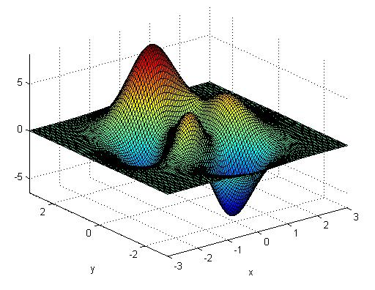
CHAPTER 6 User Defined Functions

Slide 2
6.1 CREATING FUNCTION M-FILES
Functions are useful for calculations that are performed frequently. A set of commands used for such calculations can be stored as M-files by the user, and is called user-defined function. A function accepts input arguments and provides outputs to the program like built-in functions.
6.1.1 Syntax
Both built-in functions and user-defined functions have same structure. Each consists of a name, user-provided inputs, and calculated outputs. For example, the function cos(x)
• is named cos ,
• takes inputs inside the parentheses (in this case, x)
• calculates a result

Slide 3
Similarly, creating a user-defined function and then calling it in a program or from the command window will return output/result if:
x is defined
logic in the definition of the function works.
User-defined functions are created in M-files. Each must start with a function definition line that contains:
The word function
A variable that defines the function output
A function name
A variable used for the input argument

Slide 4
Example 1:
function output = my_function(x)
is the first line of the user-defined function called my_function .
It requires one input argument (x) and will calculate one output argument (called output in this example). The function name and the names of the input/output variables depends upon the user choice.
Example 2:
function result = calculation(a)
Here, function name is calculation, input argument is a, output is result .
When saving the function M-file (in the same path), its name must be the same as the function name in order for the MATLAB to find it. Note that the usual naming conventions for variables also apply to user-defined functions, e.g.,
• Function name must start with a letter.
• It can consist of letters, numbers, and the underscore.
• Reserved names cannot be used.
• Any length is allowed (shorter names are preferred).

Slide 5
function output = poly(x)
%This function calculates the value of a third-order polynomial
output = 3*x.^3 + 5*x.^2 - 2*x +1;
After saving a function M-file, it can be used like a built-in function. Consider the above M-file named ‘poly’. Typing poly(4) gives
ans =
265
If a is set equal to 4, and used as the input argument, it will give:
a = 4; poly(a)
ans =
265
Using a vector input will yield a vector output. For example,
y = 1:5; poly(y)
gives
ans =
7 41 121 265 491
Note: A function M-file can not be executed from inside the file itself.

Slide 6
function results = f(x)
%This function converts seconds to minutes
results = x./60;
6.1.2 Comments
Typing help preceding the name of the function returns the comment lines following the function definition line. For example, typing
help f
returns
This function converts seconds to minutes

Slide 7
6.1.3: Functions with Multiple Inputs and Outputs
function output = g(x,y)
% This function multiplies x and y together
% x and y must be the same size matrices
a = x .*y;
output = a;
When x and y are defined and the function g is called, a vector of output values is returned:
x = 1:5;
y = 5:9;
g(x,y)
ans =
5 12 21 32 45

Slide 8
function [dist, vel, accel] = motion(t)
% Computes distance, velocity, and acceleration of a car for a given
% value of t assuming all 3 parameters are initially 0.
accel = 0.5 .*t;
vel = t.^2/4;
dist = t.^3/12;
[distance, velocity, acceleration] = motion(10)
distance =
83.33
velocity =
25
acceleration =
5
Calling the function motion without specifying all the three outputs returns only the first output
motion(10)
ans =
83.33
Not all functions require an input, e.g. clock, pi etc.
tic (does not also return an output value)

Slide 9
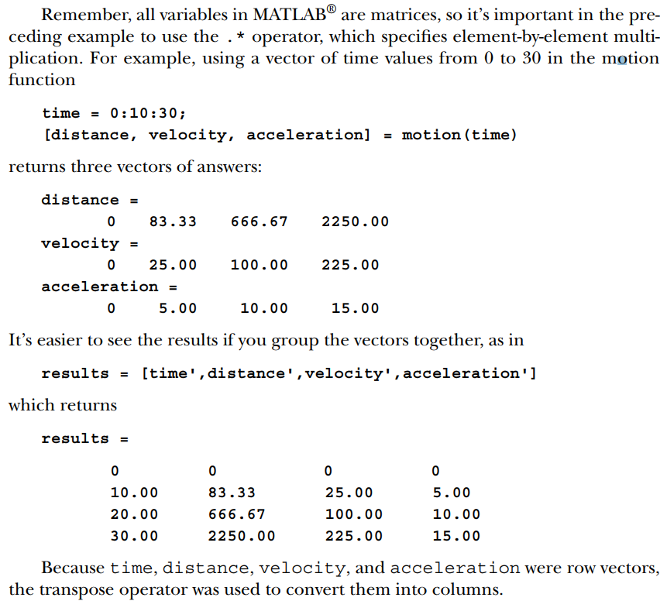

Slide 10
Example 6.3 : Metals composed of small crystals are stronger than metals composed of fewer large crystals. The metal yield strength (the amount of stress at which the metal starts to permanently deform) is related to the average grain diameter by the Hall–Petch equation :
$$σ=σ_{0}+K/{\sqrt{d}}$$
where the symbols $σ_{0}$ and K represent constants that are different for every metal.
Create a function called HallPetch that requires three inputs— $σ_{0}$, K, d— and calculates the yield strength. Call this function from a MATLAB ® program that supplies values of $σ_{0}$ and K , then plots the yield strength for values of d from 0.1 to 10 mm.
function output = HallPetch(sigma0,K,d)
%Hall–Petch equation to determine yield
%strength of metals
output = sigma0 + K*d.^(-0.5);
clear,clc
format compact
s0 = 12000
K = 9600
%Define the values of grain diameter
diameter = 0.1:0.1:10;
yield = HallPetch(s0,K,diameter);
%Plot the results
figure(1)
plot(diameter,yield)
title('Yield strengths found with the Hall–Petch equation')
xlabel('diameter, mm')
ylabel('yield strength, psi')

Slide 11
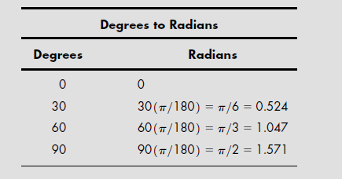
Exercise: Converting between degree and radians

Slide 12
Exercise: Cont.
State the problem: two functions; DR and RD.
Describe the input and the output.

Slide 13
Exercise: Cont.
%Define a vector of degree values
degrees = 0:15:180;
% Call the DR function, and use it to find radians
radians = DR(degrees);
%Create a table to use in the output
degrees_radians = [degrees;radians]'
%Define a vector of radian values
radians = 0:pi/12:pi;
%Call the RD function, and use it to find degrees
degrees = RD(radians);
radians_degrees = [radians;degrees]'

Slide 14
Exercise cont.
DR:
function output = DR(x)
%This function changes degrees to radians
output = x*pi/180;
RD:
function output = RD(x)
%This function changes radians to degrees
output = x*180/pi;

Slide 15
Quiz
Write a function to calculate the circumference of a circle:
Hint: the circumference of a circle=2*π* half_radi
function circumference_circle = CirCir(r)
circumference_circle=2*pi.*r;
end

Slide 16
Functions with Multiple Inputs and Outputs
function triangle_area = TriAr(base,height)
% This function calculates the area of triangle
% base and height must be the same size matrices
a = (base .*height)/2;
triangle_area = a;

Slide 17
Multiple input variable
TriAr(10,5)=?
% base and height must be the same size matrices
TriAr([10,20,50],[5,10,3])
b=1:5;
h=6:10;
TriAr(b,h)

Slide 18
Functions with No Input or No Output
function [] = star( )
theta = pi/2:0.8*pi:4.8*pi;
r = ones(1,6);
polar(theta,r)

Slide 19
6.1.5 Determining the Number of Input and Output Argument
The nargin function determines the number of input arguments in either a user-defined function or a built-in function. The name of the function must be specified as a string. For example,
nargin('sin')
ans =
1
The nargout function is similar to nargin, but it determines the number of outputs from a function.
6.1.6 Local Variables
The variables used in function M-files are known as local variables . The only way a function can communicate with the workspace is through input arguments and the output it returns. Any variables defined within the function exist only during the execution of the function, and are not stored in the workspace.

Slide 20
6.1.7 Global Variables
Unlike local variables, global variables are available to all parts of a computer program. However, its use should be avoided.
Global variables needs to be identified both in the command-window environment (or in a script M-file) and in the function. This helps to avoid its unintentional use. Consider the distance function:
function result = distance(t)
% Computes the distance a falling object travels due to gravity
global G
result = 1/2*G*t.^2;
The global command instructs the function to look in the workspace for the
value of G, which must also have be defined in the command window (or script M-file) as a global variable:
global G
G = 9.8;

Slide 21
6.2 CREATING TOOLBOX OF FUNCTIONS
When a function in called, the program first looks in the current folder to see if the function is defined. If it can’t find the function listed there, it starts down a predefined search path, looking for a file with the function name. To view the path the program takes as it looks for files, select
File : Set Path
from the menu bar or type
pathtool
in the command window.
A directory (folder) can be added to the path by selecting Add Folder from the list of option buttons in the Set Path dialog window.

Slide 22
6.3 ANONYMOUS FUNCTIONS AND FUNCTION HANDLES
Anonymous functions are defined in the command window or in a script M-file and are available (like variable names) until the workspace is cleared. For example, the following commands creates an anonymous function:
ln = @(x) log(x)
symbol @ tells that ln is an anonymous function
input to the function is listed next after the symbol @ in parentheses
the function is defined after the input
It is listed in the variable window as function_handle
clearing the workspace erases the anonymous function
Anonymous functions can be saved as .mat files, just like any variable. For example, typing save my_ln_function ln creates file my_ln_function.mat, which contains the anonymous ln function. Once the workspace is cleared, the ln function no longer exists, but it can be reloaded from the .mat file
load my_ln_function
function result = distance(t)
result = 1/2*9.8*t.^2;
A function handle can be assigned to any M-file function. For example, the command
distance_handle = @(t) distance(t)
assigns the handle distance_handle to the distance function.

Slide 23
6.4 FUNCTION FUNCTIONS
Function functions are functions that require other functions as input, e.g. fplot. This function requires two inputs:
a function or a function handle,
a range over which to plot.
Example 1:
Function handle can be used as input to the fplot function, e.g. fplot(ln,[0.1, 10])
Alternatively, the fplot function can also be used without the function handle, e.g.
fplot('log(x)',[0.1, 10])
Example 2:
fplot(’-5*x.^5 + 400*x.^4 + 3*x.^3 + 20*x.^2 - x + 5’,[-30,90])
fplot(poly5,[-30,90])
ln = @(x) log(x)
poly5 = @(x) -5*x.^5 + 400*x.^4 + 3*x.^3 + 20*x.^2 - x + 5;

Slide 24
Question 1:
Generate temperature-conversion table from 0 to 50˚C use an increment of 10˚. Use the following equations, in your function, which describe the relationships between temperatures in Celsius, Fahrenheit, Kelvin and Rankine.
$T_{F}={\frac{9}{5}T}_{C}+32$; $T_{K}=T_{C}+273.15$; $T_{R}=\frac{9}{5} \left(T_{C}+273.15\right)$
Question 2:
A rocket is launched vertically. At time t= 0, the rocket’s has reached an altitude of 500 m and is rising at a velocity of 125 m/s. The height of the rocket as a function of time is
$h=−\frac{9.8}{2}t^{2}+125 t+500$
Create a function to calculate height of the rocket and plot height versus time from 0 to 30 seconds use an increment of 0.5 and find the time when the rocket starts to fall back to the ground.

Slide 25
Question 3:
The distance to the horizon (d) as you climb a hill, follow the expression: $$d=\sqrt{2rh+h^{2}}$$
where, r = radius of the earth (3963 miles); h = height of the hill.
Create a function to plot d, for h values from 0 to 10000 miles with increment 2000.
Question 4:
Create functions to evaluate the following simple mathematical functions with multiple input vectors and multiple output vectors, for a= 3 to 5 and b=2 to 6.
$$f=ae^{b}$$
$$g=be^{a}$$
Plot the value of f and g using a value as x-axis.
Question 6:
One equation in physics is E = mc² .The speed of light (c) in a vacuum is 2.9979 x 10⁸ m/s. Make function to find the energy corresponding to masses from 1 kg to 10⁶ kg using logspace.
Plot of your results using loglog command.

