Slide 1
CHAPTER 4 Working and Understanding Matrices in MATLAB

Slide 2
4.1.1 Defining Matrices
B = [1.5, 3.1];
B = [1.5 3.1];
C =[-1, 0, 0; 1, 1, 0; 0, 0, 2];
C = [-1, 0, 0;
1, 1, 0;
1, -1, 0;
0, 0, 2]
C = [-1, 0, 0 % another way
1, 1, 0
1, -1, 0
0, 0, 2]
F = [1, 52, 64, 197, 42, -42, 55, 82, 22, 109];
F = [1, 52, 64, 197, 42, -42, ...
55, 82, 22, 109];%another way
S = [3.0 1.5 3.1]; T = [ 1, 2, 3; S]
T =
1 2 3
3 1.5 3.1
S(2) = -1.0; % Replaces 1.5 by
-1.0
S
S =
3.0 -1.0 3.1
index
Argument?

Slide 3
4.1.2 Using the Colon Operator
M = [1 2 3 4 5;
2 3 4 5 6;
3 4 5 6 7];
x = M(:,2) % will give
x =
2
3
4
z = M(3,:) % will give
z =
3 4 5 6 7
w = M(2:3,:) % will give
w =
2 3 4 5 6
3 4 5 6 7
w = M(2:3, 4:5) % will give
w =
5 6
6 7
H = 1:8 % generates array, default spacing =1
H =
1 2 3 4 5 6 7 8
t = 0.0 : 0.5 : 2.0 % spacing = 0.5
t =
0 0.5000 1.0000 1.5000 2.0000
M(:,1) % all rows
M(1,:) % all columns
M(2:3,:) % all columns with only rows 2 and 3
a = [ ]; % generates empty matrix
b = 4:-1:5; % generates empty matrix
% highlight the command
M(3,4)
rows
columns
Notes:
% highlight the command

Slide 4
M = [1 2 3 4 5;
2 3 4 5 6;
3 4 5 6 7];
M(:)
row vector
column vector
M(:)’
1 2 3 2 3 4 3 4 5 4 5 6 5 6 7
M(2,3)
ans =
4
M(8)
ans =
4
M(1,end)
ans =
5
M(end,end)
ans =
7
M(2:3, [1 2])
ans =
2 3
3 4
M([2 1 3],:)
ans = ???
M(:,3:5) = []
M =
2
3
4
end = last row/column

Slide 5
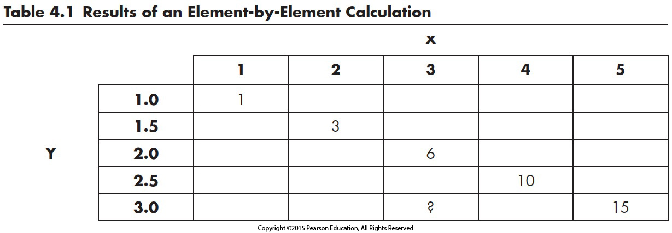
4.2 PROBLEMS WITH TWO VARIABLES
x = 1:5
X=
1 2 3 4 5
y = linspace(1,3,5)
y =
1.0000 1.5000 2.0000 2.5000 3.0000
A = x .* y
A =
1 3 6 10 15
Table 4.1 Results of an Element-by-Element Calculation

Slide 6
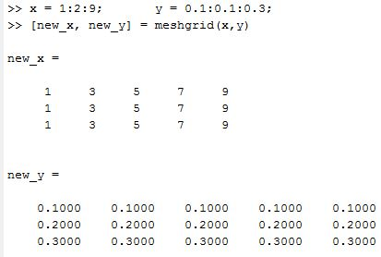
Mapping of vectors into two-dimensional array using meshgrid
The meshgrid command uses two input vectors, e.g. x and y, to create two 2-D matrices. Both have same size such that
number of columns = number of elements in x vector
number of rows = number of elements in y vector
x = 1:5; y = 1:3;
[n_x, n_y] = meshgrid(x,y)
n_x =
1 2 3 4 5
1 2 3 4 5
1 2 3 4 5
n_y =
1 1 1 1 1
2 2 2 2 2
3 3 3 3 3
A = n_x.*n_y
A =
1 2 3 4 5
2 4 6 8 10
3 6 9 12 15

Slide 7
4.3 SPECIAL MATRICES
*-1

Slide 8
A = 1 2 3
3 4 5
1 2 3

Slide 9
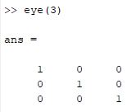
A = 1 0 0
0 2 0
0 0 3
eye (n) command generates a nxn matrix with 1’s in main diagonal
Notes:
MATLAB includes a matrix function called magic that generates a matrix with unusual properties. At the present time, there does not seem to be any practical use.

Slide 10
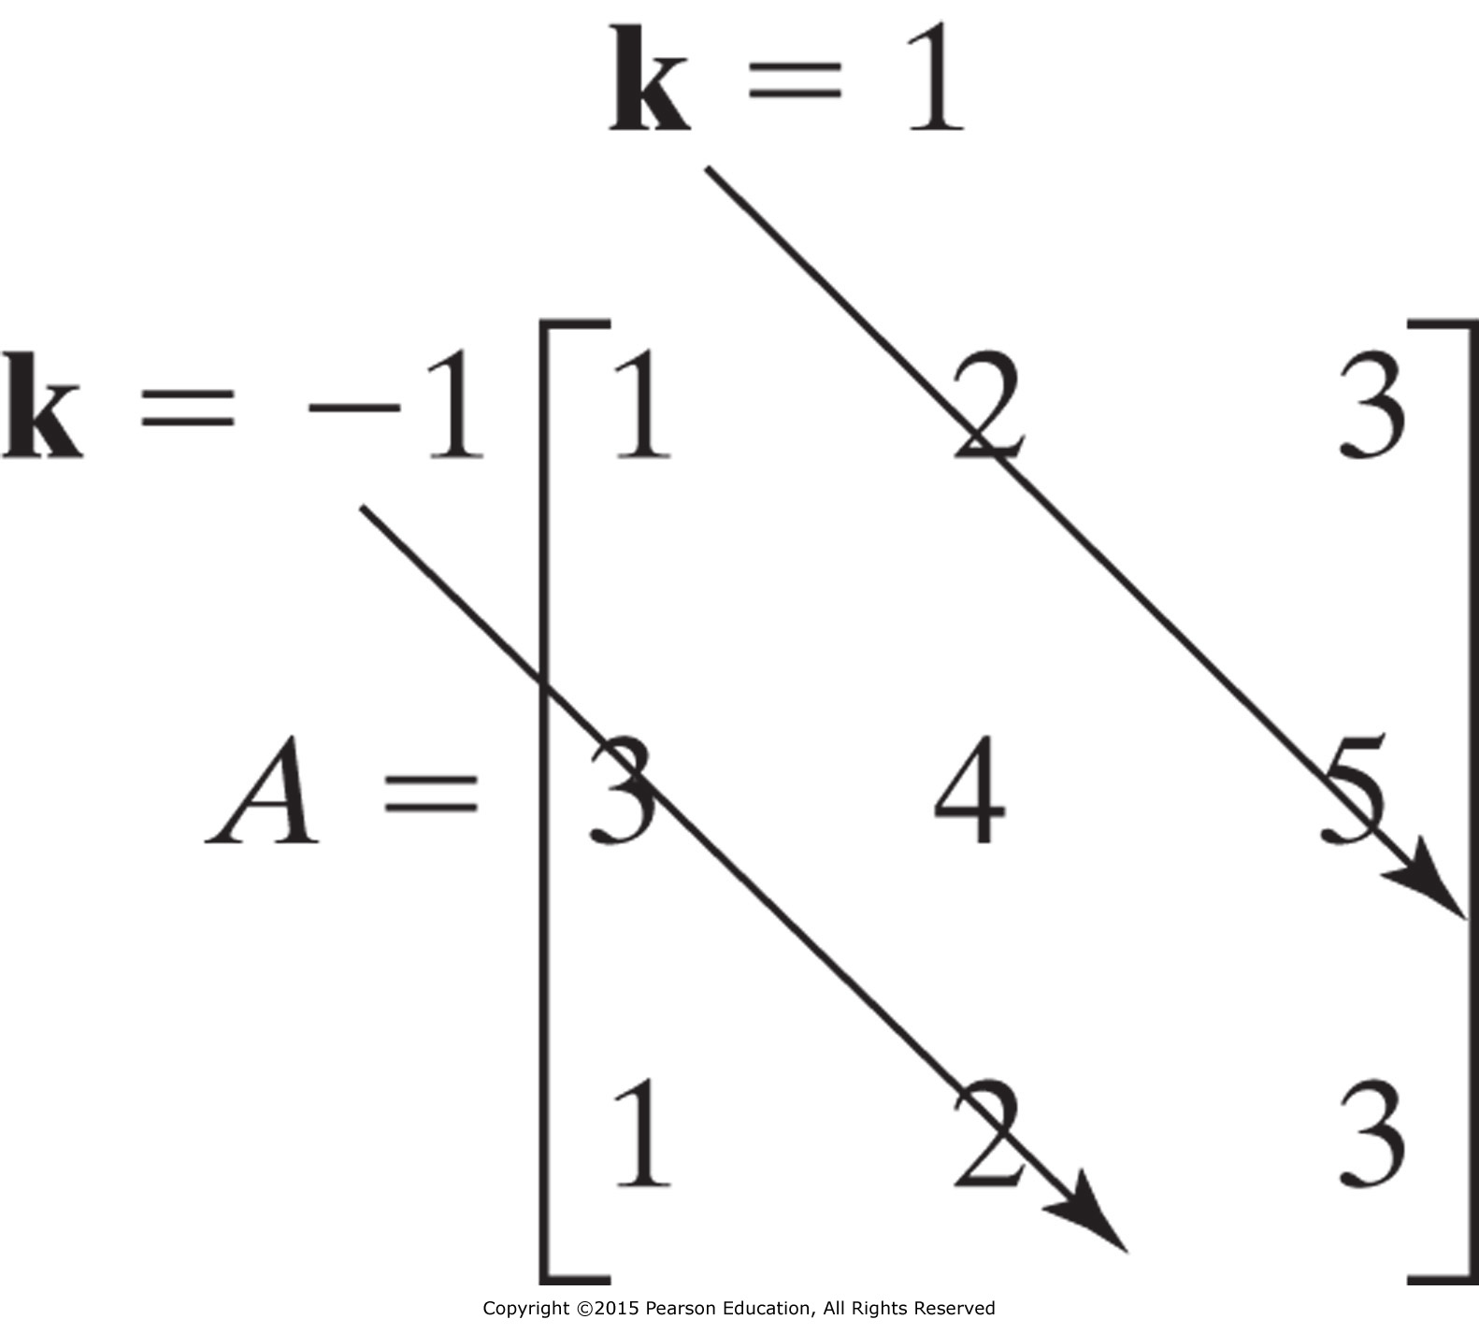
Each diagonal in a matrix can be described by parameter k
>>diag(A)
ans =
1
4
3
>>diag(A,1)
ans =
2
5
>>B = [1 2 3];
>>diag(B)
ans =
1 0 0
0 2 0
0 0 3
>>diag(B,1)
ans =
0 1 0 0
0 0 2 0
0 0 0 3
0 0 0 0

Slide 11
A = magic(4)
A =
16 2 3 13
5 11 10 8
9 7 6 12
4 14 15 1
sum(A)
ans =
34 34 34 34
Sum of rows
sum(A')
ans =
34 34 34 34
Sum of diagonal
= Sum of a row
= Sum of a column
diag(A)
ans =
16
11
6
1
sum(diag(A))
ans =
34
fliplr(A)
ans =
13 3 2 16
8 10 11 5
12 6 7 9
1 15 14 4
diag(ans)
ans =
13
10
7
4
sum(ans)
ans =
34

Slide 12
Concatenating matrices
a = zeros(1,5); b = a+pi % will give
b =
3.1416 3.1416 3.1416 3.1416 3.1416
a = ones(1,5); b = a*pi % will give
b =
3.1416 3.1416 3.1416 3.1416 3.1416
C =zeros(2,3); D = [C ones(2,3); ones(3) pi*eye(3)] % will give
D =
0 0 0 1.0000 1.0000 1.0000
0 0 0 1.0000 1.0000 1.0000
1.0000 1.0000 1.0000 3.1416 0 0
1.0000 1.0000 1.0000 0 3.1416 0
1.0000 1.0000 1.0000 0 0 3.1416

Slide 13
Ex. 4.1

Slide 14
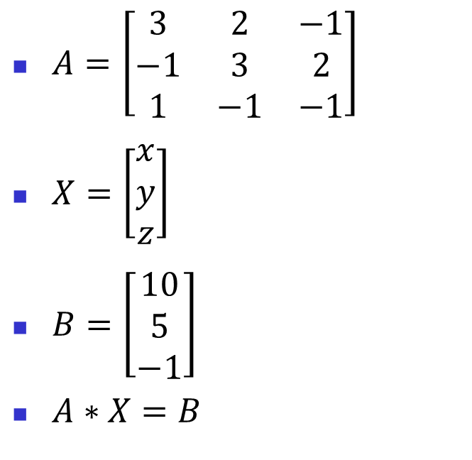
SOLUTIONS OF SYSTEMS OF LINEAR EQUATIONS
Equations system
Rewrite using matrices
$$3x+2y −z=10$$
$$2z−x+3y=5$$
$$−y+x −z=−1$$
Three equations with three unknowns.
$A=\left[\begin{matrix}3 & 2 & −1 \\ −1 & 3 & 2 \\ 1 & −1 & −1\end{matrix}\right]$
$X=\left[\begin{matrix}x \\ y \\ z\end{matrix}\right]$
$B=\left[\begin{matrix}10 \\ 5 \\ −1\end{matrix}\right]$
$A∗X=B$

Slide 15
10.2.1 Solution Using the Matrix Inverse
Using matrix multiplication, we can then write the system of equations
$A∗X=B$
Using the matrix inverse.
Where, $\left(A^{−1}\right)∗A=1$
Multiply each side by ${(A}^{−1}):$
${(A}^{−1})∗A∗X={(A}^{−1})∗B$
${X=(A}^{−1})∗B$

Slide 16

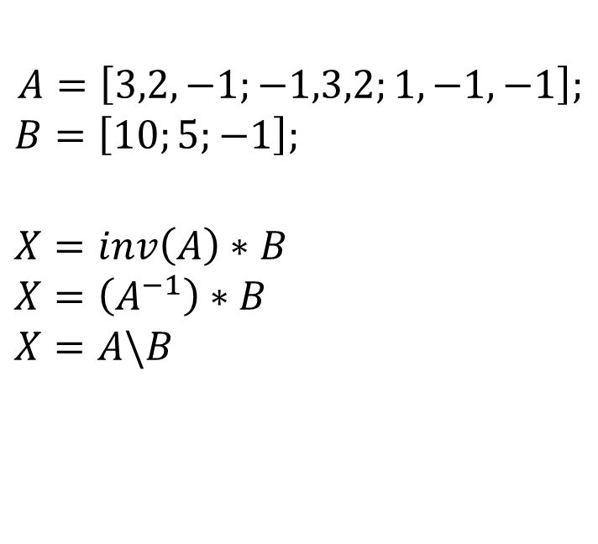
Solution Using the Matrix Inverse cont.
Commands
Code returns:
$$A=\left[3,2,−1;−1,3,2;1,−1,−1\right];$$
$$B=\left[10;5;−1\right];$$
$$X=inv\left(A\right)∗B$$
$$X=\left(A^{−1}\right)∗B$$
$$X=A\backslash B$$
$x=$
$$\begin{matrix}−2 \\ 5 \\ −6\end{matrix}$$
$x=X\left(1\right)=−2$
$y=X\left(2\right)=5$
$z=X\left(3\right)=−6$

Slide 17
Exercise
Consider the following system of equations where the unknown are (u),(z) and (w).
The other parameters are constants and have the following values:
A=10; B=-5; C=20; θ=30

Slide 18
Exercise Cont.
$Az+\left(B−C\right)w+cos\left(θ\right)=Cu$
$Bw+Cu+\sin^{2}\left(θ\right)=(C−A)$z
$Cu+Bz+tan\left(θ\right)=\left(A−B\right)w$
Convert the system of equations above to the following matrix form Dx=E

Slide 19
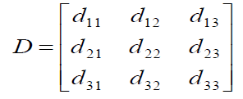
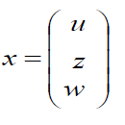
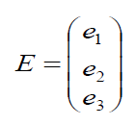
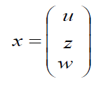


Exercise Cont.
Dx=E
$Az+\left(B−C\right)w+cos\left(θ\right)=Cu$
$Bw+Cu+\sin^{2}\left(θ\right)=(C−A)$z
$Cu+Bz+tan\left(θ\right)=\left(A−B\right)w$
$$E=\left[\begin{matrix}−cos⁡(θ) \\ −\sin^{2}(θ) \\ −tan⁡(θ)\end{matrix}\right]$$

Slide 20
Exercise Cont.
MATLAB commands to solve the linear system
clear, clc
% Define the constant parameters A,B,C and $θ$
A=10;B=-5;C=20;theta=30; % Any other variable is accepted
% Define the matrix (D)
D(1,1)=-C; D(1,2)=A; D(1,3)=B-C ;
D(2,1)=C; D(2,2)=-(C-A); D(2,3)=B;
D(3,1)=C; D(3,2)=B; D(3,3)=-(A-B);
% Define the vector (E)
E=[-cos(theta); -sin(theta)^2; -tan(theta)];
% Solve for (x)
x=inv(D)*E % x=D\E % x=D^-1*E are accepted
% Find (u), (z) and (w) using the vector (x)
u= x(1);z=x(2) ;w=x(3)

