Slide 1
Full class example

Slide 2
Write a class Student that contains the following:
Student name , Student Id, 3 exam grades
A default constructor
A constructor with parameters to set the name and ID
A method to set the 3 grades
A method to calculate the average of grades and return the average
A method to check if the average is above 60 then return PASS else return FAIL
Test it in a main class

Slide 3
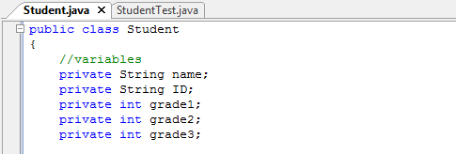
attributes

Slide 4
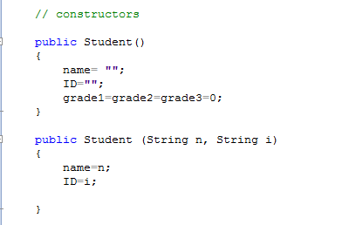
Constructors

Slide 5
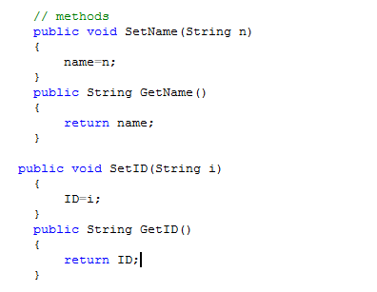
Setter and getter

Slide 6
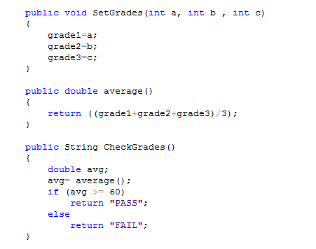
methods

Slide 7
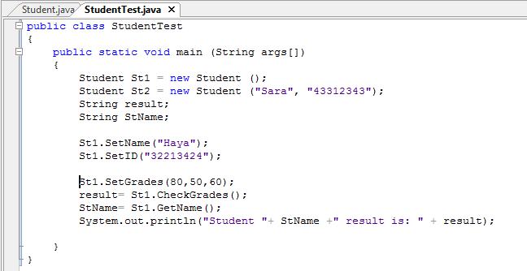
Main class

