Slide 1
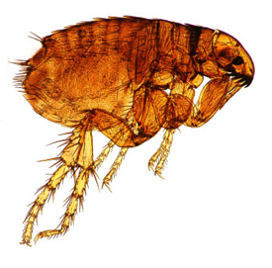
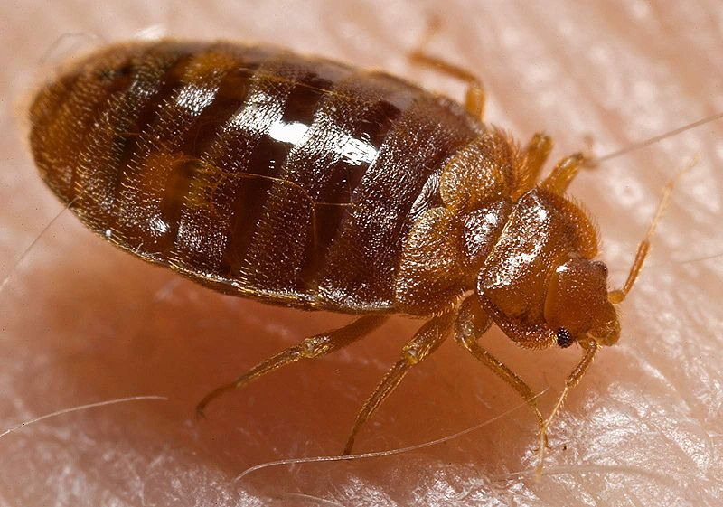
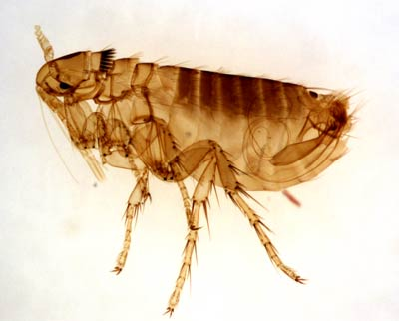
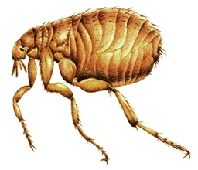
Flea & Bedbug
Amal Almuhanna
2012

Slide 2
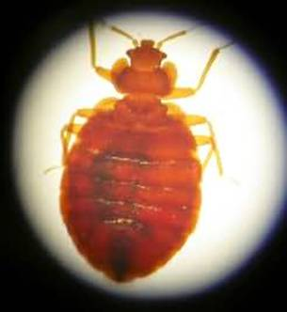
Bed bugs (Cimex lectularius)
Bedbugs are parasitic insects that feed on blood and prefer human blood, but will also feed on chickens and other animals.
Feeds on humans when they are sleeping or sitting still for long periods of time.
Their bite is painless.

Slide 3
Scientific classification
Kingdom:- Animalia
Phylum:- Arthropoda
Class:- Insecta
Order:- Hemiptera
Suborder:- Heteroptera
Family:- Cimicidae
ex: Cimex lectularius
Cimex lectularius

Slide 4
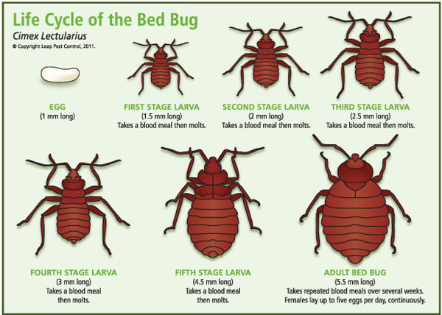
Life cycle of bed bug

Slide 5
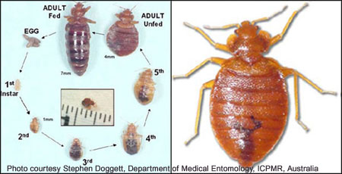
Life cycle

Slide 6
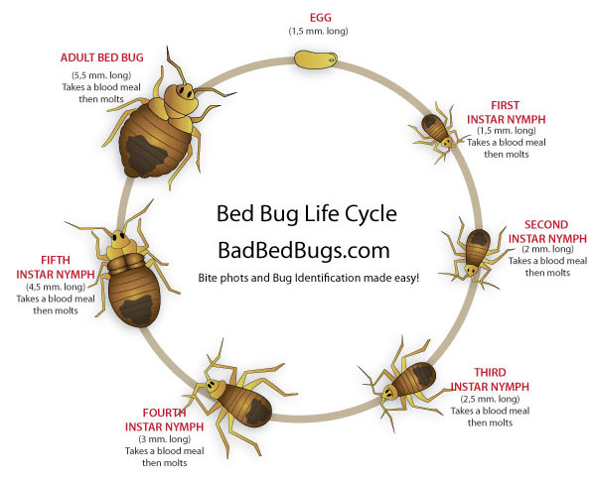
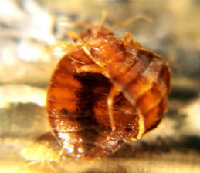
Photograph of bed bugs mating

Slide 7
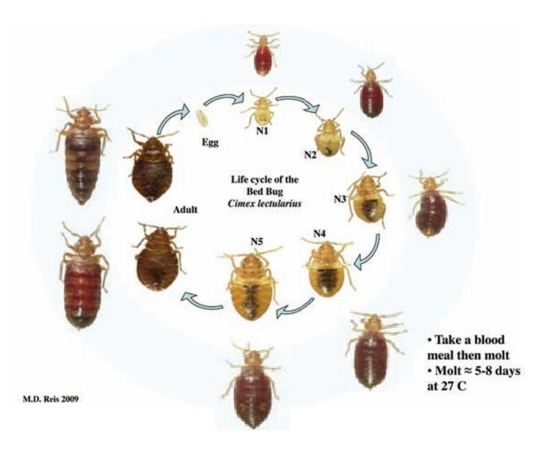
Life cycle

Slide 8
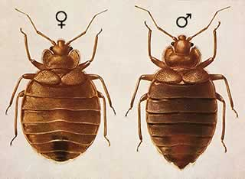
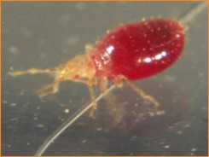
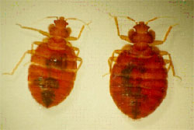
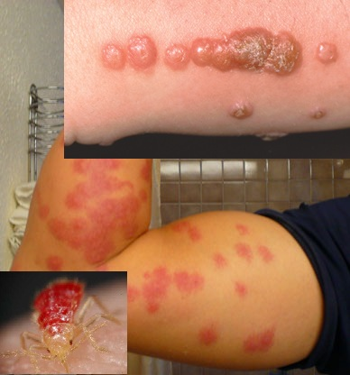
Bedbug
Nymph of bedbug
Bedbug bites on human

Slide 9
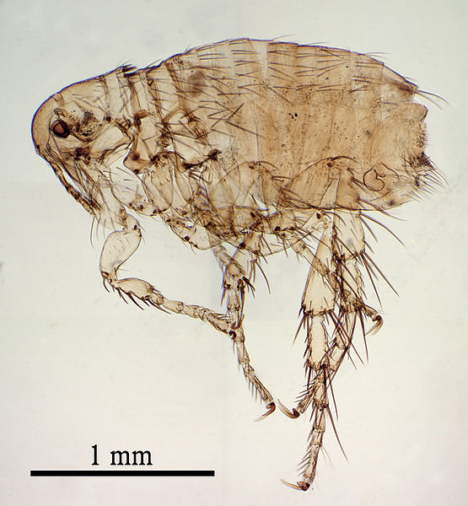
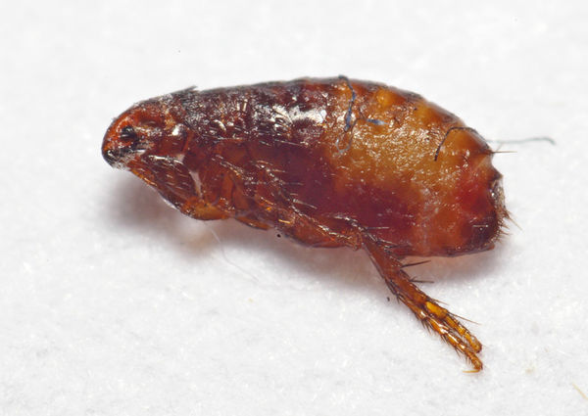
Dog flea (Ctenocephalides canis)
Is a species of flea (Siphonaptera) that lives primarily on the blood of dogs.
The dog flea is troublesome because it can spread Dipylidium caninum.
Although they feed on the blood of dogs and cats, they sometimes bite humans.
They can live without food for several months, but females must have a blood meal before they can produce eggs.

Slide 10
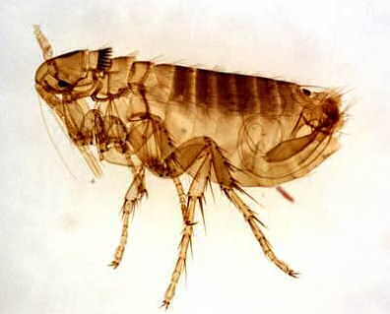
Scientific classification
Kingdom:- Animalia
Phylum:- Arthropoda
Class:- Insecta
Order:- Siphonaptera
Family:- Pulicidae
Genus:- Ctenocephalides
Ctenocephalides canis

Slide 11
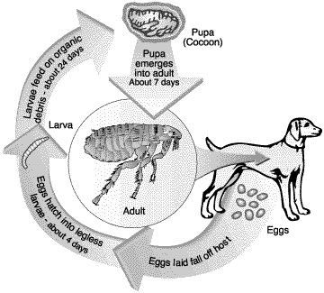
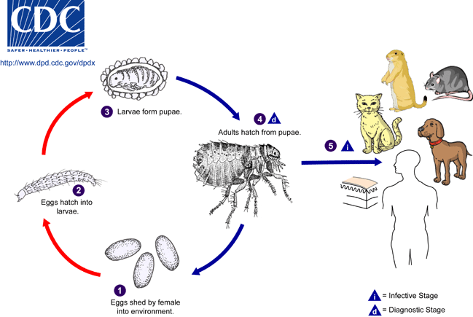
Life cycle

Slide 12
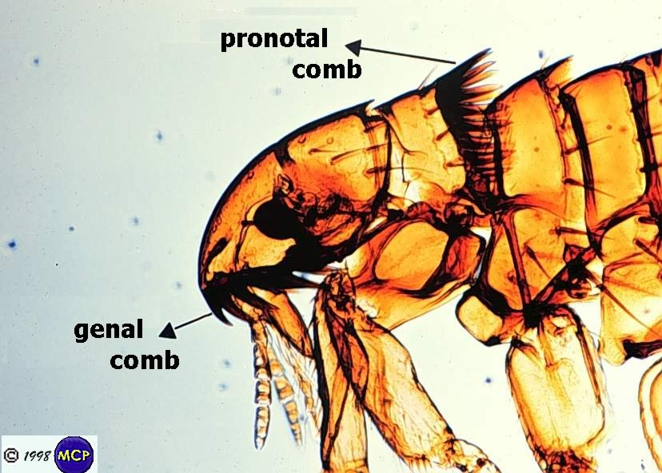
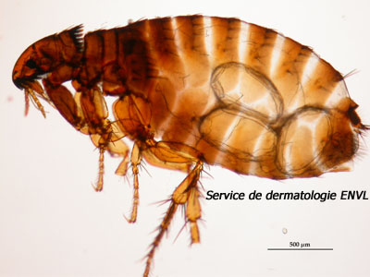
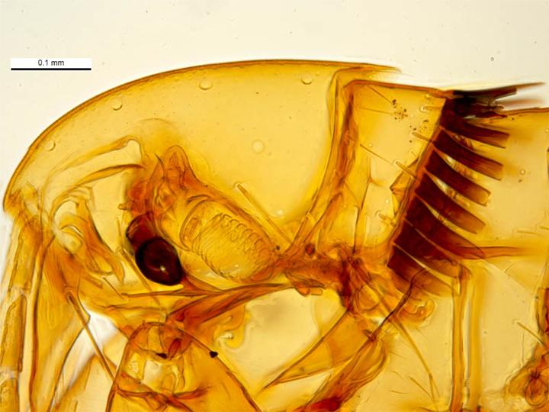
Under microscope

Slide 13
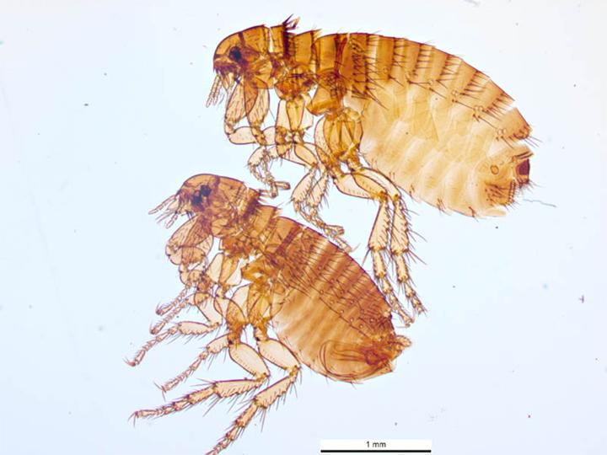
Female(top)& male(below)

Slide 14
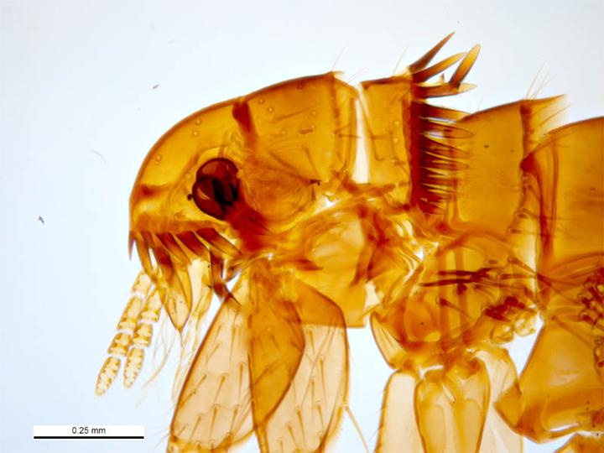
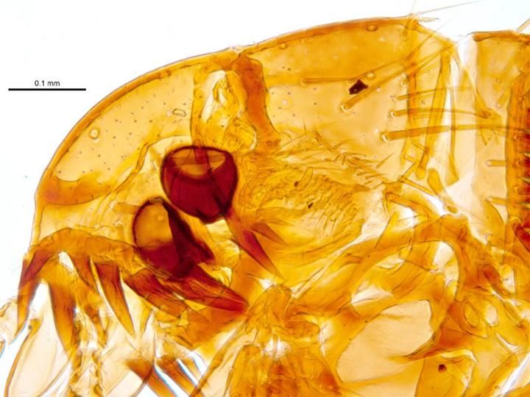
Head front
Female
Male

Slide 15
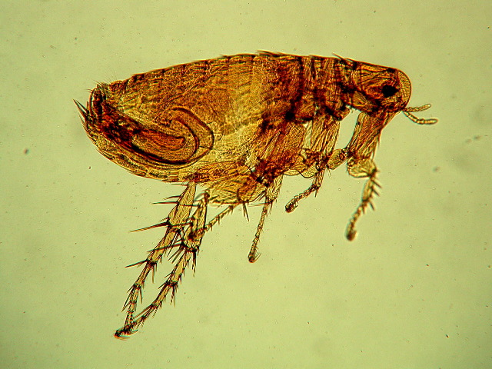
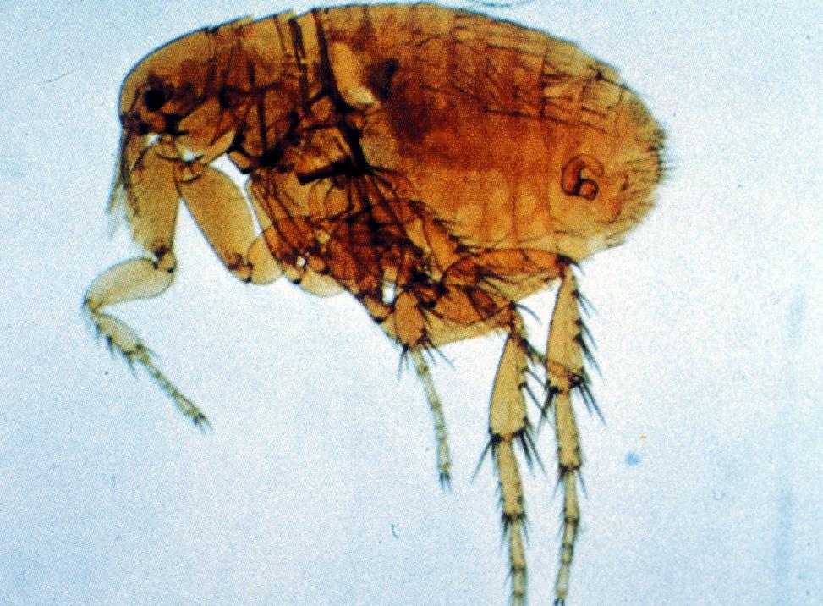
Rat Fleas
The rat flea is a minute parasite that feeds on the blood of rodents.
They are known carriers of a variety of diseases and are considered the cause for the spread of the bubonic plague.
Infection is transmitted after a flea feeds from an infected rodent and then bites a human.
Through biting, rats also transmit the diseases carried by rat fleas.

Slide 16
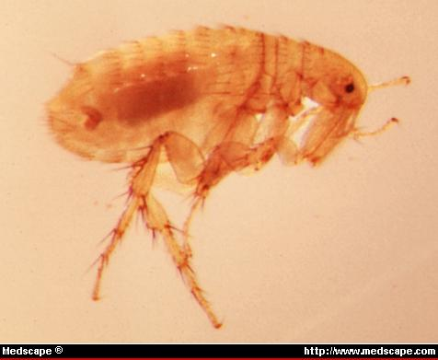
Scientific classification
Kingdom:- Animalia
Phylum:- Arthropoda
Class:- Insecta
Order:- Siphonaptera
Family:- Pulicidae
Genus:- Xenopsylla
Xenopsylla cheopis (Oriental Rat Flea)

Slide 17
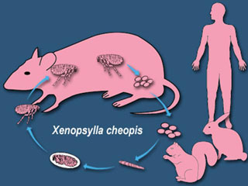
Life cycle

Slide 18
Life cycle

Slide 19
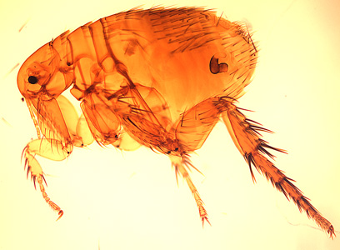
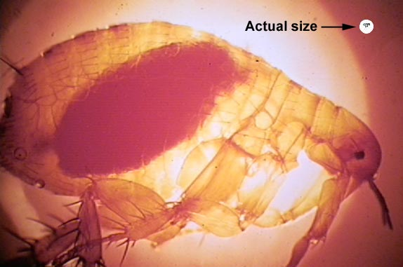
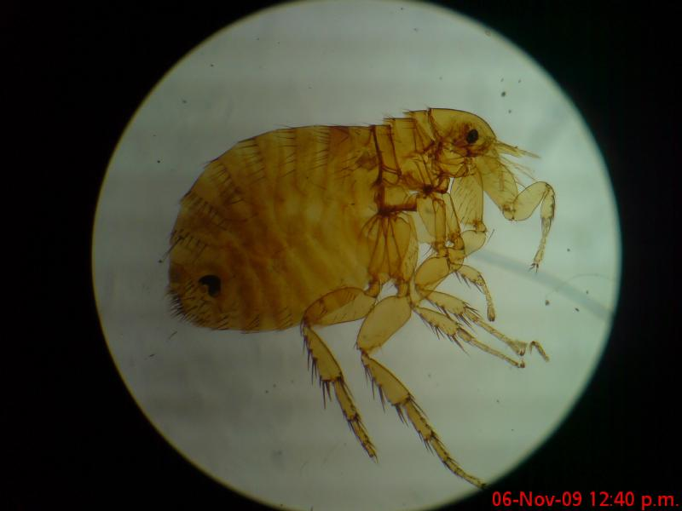
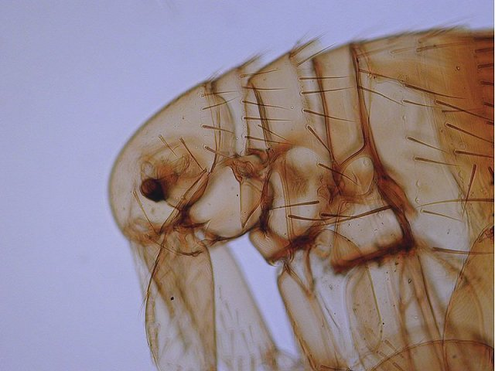
Xenopsylla cheopis (Oriental Rat Flea)

Slide 20
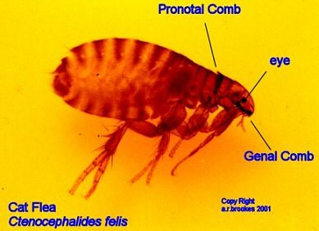
Cat flea
The cat flea, Ctenocephalides felis, is one of the most abundant and widespread species of flea on Earth.
The cat flea is a small, sucking, insect of the order Siphonoptera. The cat flea's primary host is the domestic cat, but the cat flea is also the primary flea infesting dogs in most of the world.
The cat flea can also maintain its life cycle on other carnivores and on omnivores.

Slide 21
Scientific classification
Kingdom:- Animalia
Phylum:- Arthropoda
Class:- Insecta
Order:- Siphonaptera
Family:- Pulicidae
Genus:- Ctenocephalides
Ctenocephalides felis

Slide 22
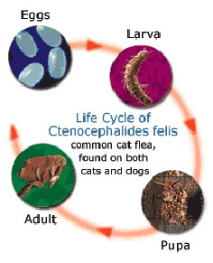
Life cycle

Slide 23
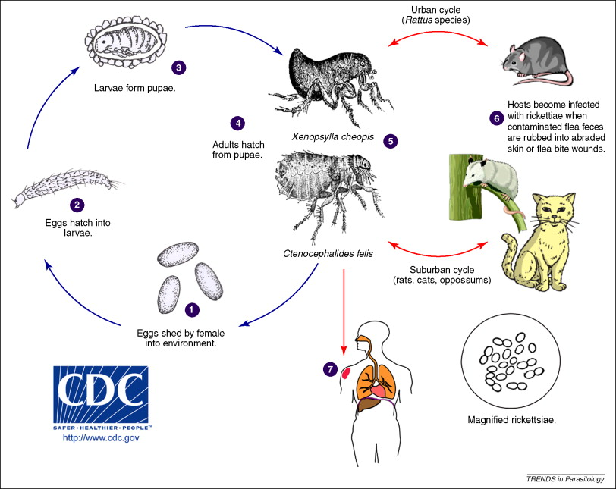
Life cycle

Slide 24
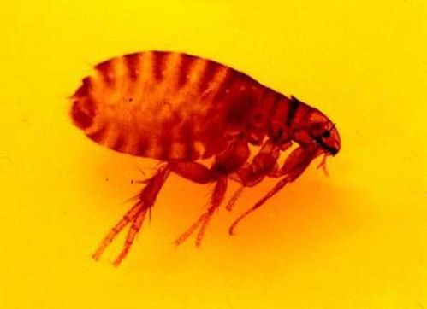
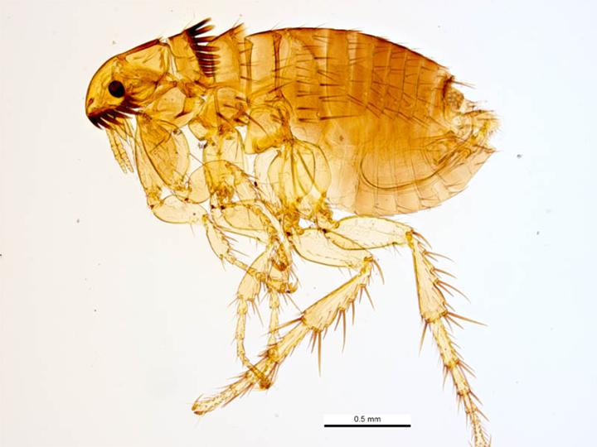
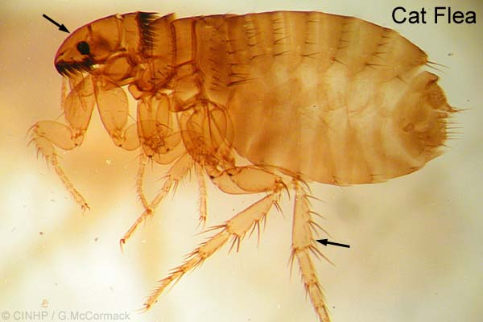
Ctenocephalides felis

Slide 25
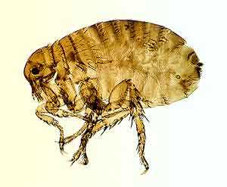
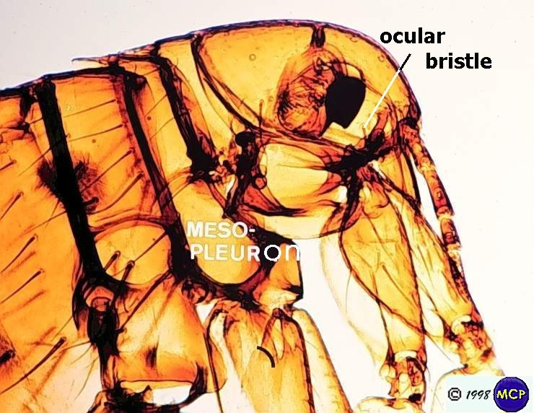
Human flea
The human flea, Pulex irritans, is a cosmopolitan flea species.
This species bites many species of mammals and birds, including domesticated ones.
Human blood is the preferred food of Pulex irritans, but it will feed on other mammals.

Slide 26
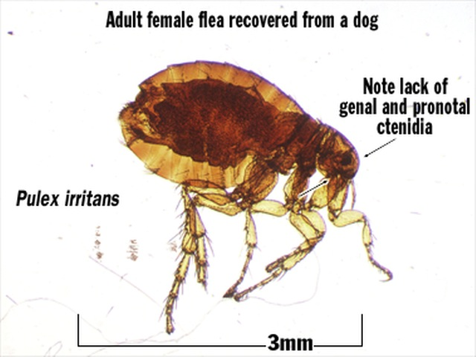
Scientific classification
Kingdom:- Animalia
Phylum:- Arthropoda
Class:- Insecta
Order:- Siphonaptera
Family:- Pulicidae
Genus:- Pulex
Pulex irritans

Slide 27
Life cycle

Slide 28
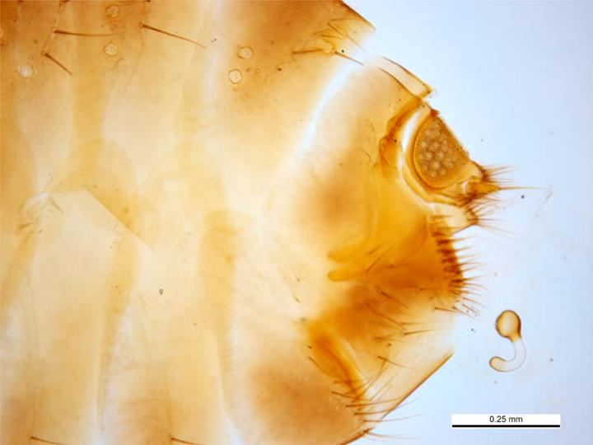
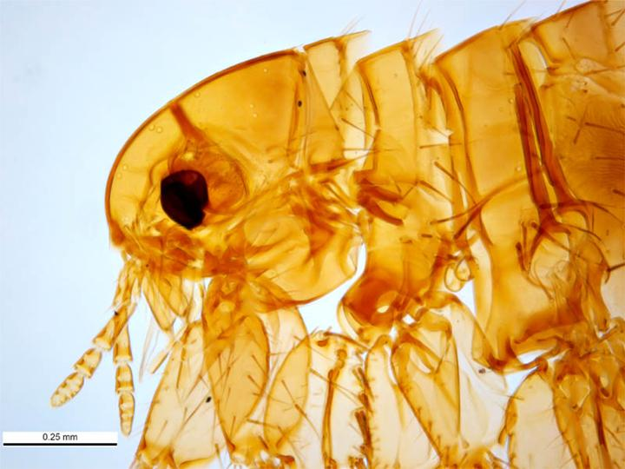
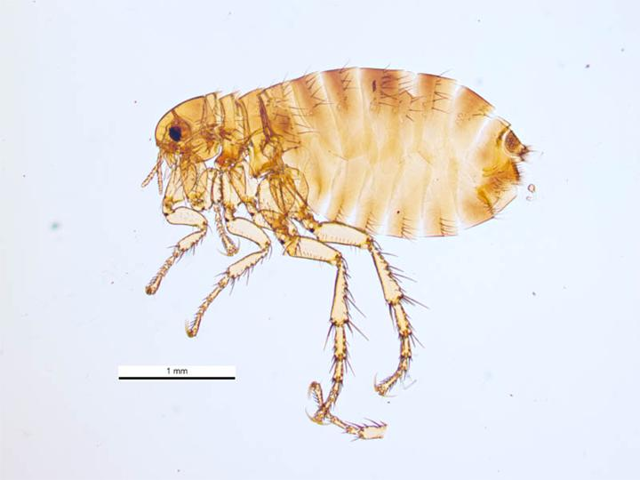
Pulex irritans
Abdomen of female
Head side
Female
Male

Slide 29
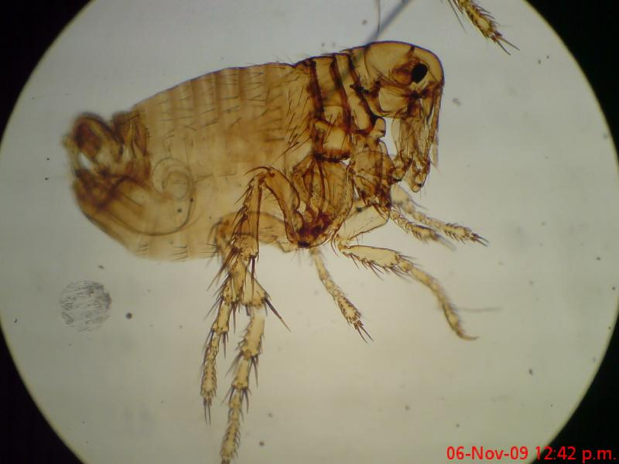
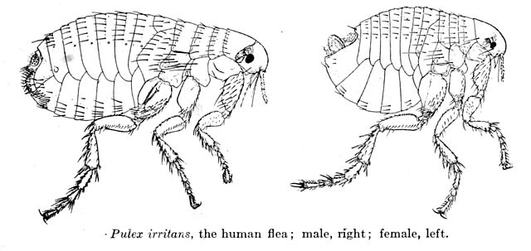
Pulex irritans

