Slide 1
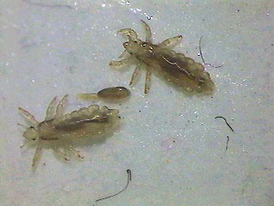
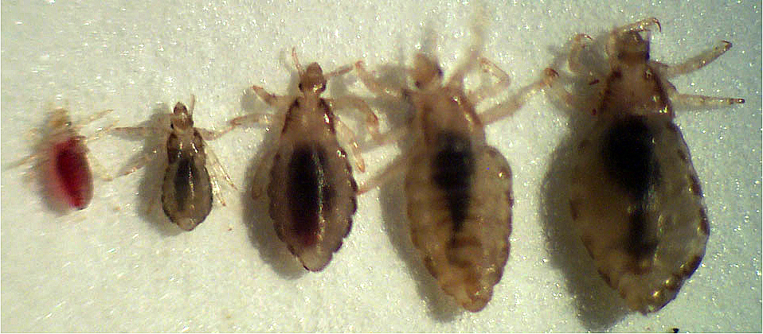
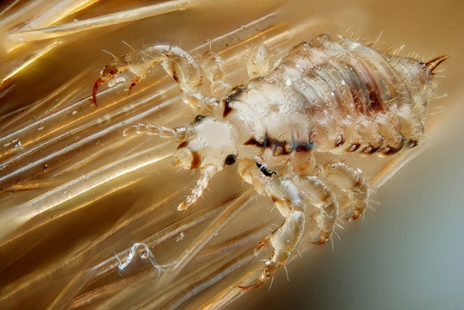
Lice
Amal Almuhanna
2012

Slide 2
Order :Phthiraptera (lice)
Identification
Small, flattened & wingless
Short stout legs; end in strong claws
Permanent ectoparasites on birds & mammals
Biting lice
Biting & chewing mouth parts
Head is as wide as or wider than thorax
Mostly associated with birds (also mammals)
Sucking lice
Piercing & sucking mouth parts
Head generally narrower than thorax
Suborder Anoplura
Associated with mammals (also humans)
↙
↙

Slide 4
Order :Phthiraptera (lice)
Biology
Entire life cycle occurs on host
Eggs (nits) are cemented onto host’s hair or feathers
All stages (nymphs & adults are blood sucking
Transmission via contact between hosts
Unable to survive for long when off hosts
Many species are host specific
Attack one or few related species
Live in specific region of host’s body
Identity often indicated by host
Only 3 species attack humans
Louse nit
Adults & nymphs

Slide 5
Suborder :Mallophaga(Biting lice)
Mostly associated with birds & don’t attack humans
Feed on feathers & mostly host specific
2 important families
Fam :Menoponidae (biting bird lice)
Antennae fold into grooves on side of head
Fam:Philopteridae (bird lice)
Largest family of lice
Antennae not concealed in grooves in head
Pests of poultry
Heavily infested birds become emaciated
May bite humans when infested birds nest in houses
Head of Menoponidae

Slide 6
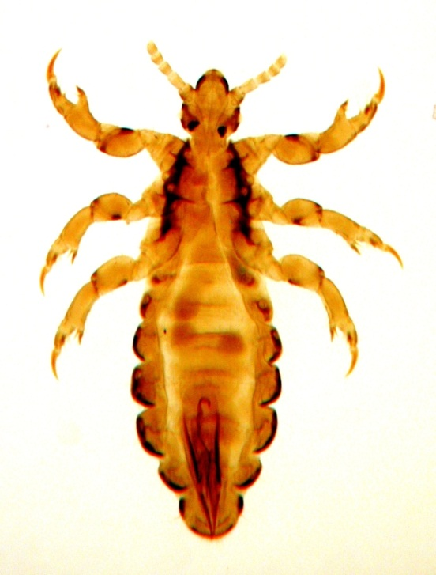
Head louse
The head louse (Pediculus humanus capitis) is an obligate ectoparasite of human.
Head lice are wingless insects spending their entire life on human scalp and feeding exclusively on human blood.
Humans are the only known host of this specific parasite.
Other species of lice infest most orders of mammals and all orders of birds.

Slide 7
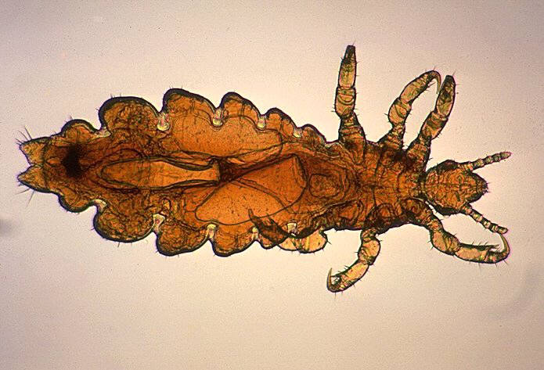
Classification
Kingdom:- Animalia
Phylum:- Arthropoda
Class:- Insecta
Order:- Phthiraptera
Family:- Pediculidae
Genus :- Pediculus
Species :- P. humanus
Subspecies:- P. h. capitis

Slide 8
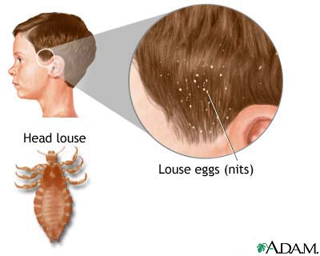
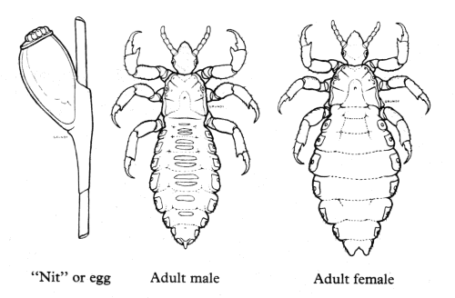
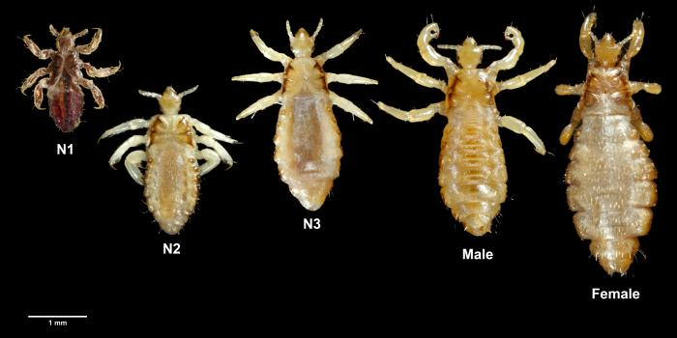
Male& female

Slide 9
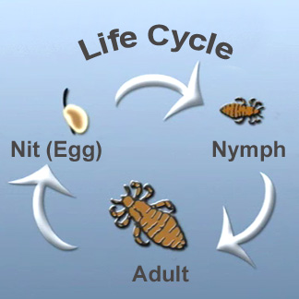

Slide 10
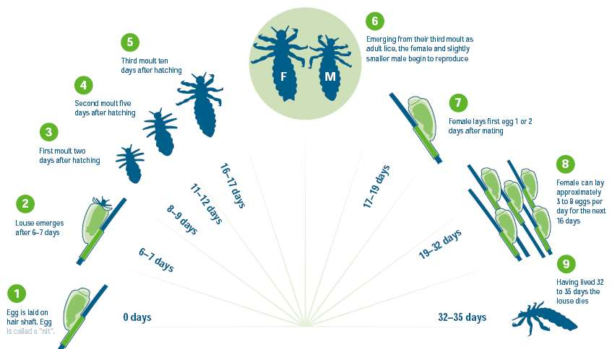
Life cycle

Slide 11
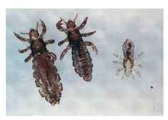
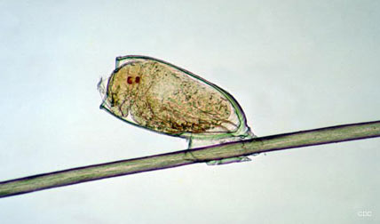
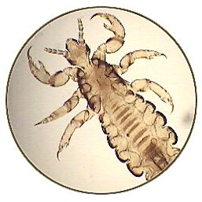
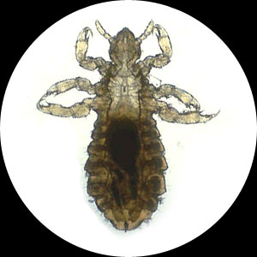
Under microscope

Slide 12
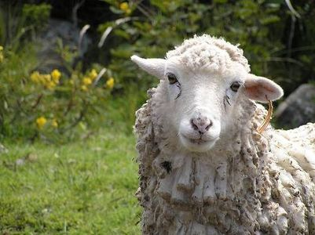
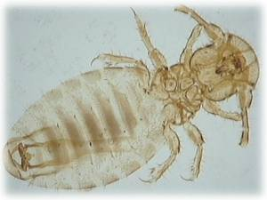
Sheep lice
Sheep lice are common parasites that can quickly spread from one sheep to an entire flock.
Adult lice are about 2 mm long, with a brownish head and creamy coloured abdomen.
There are two types of sheep lice - biting and sucking lice.
The most common one, which is a biting louse, is the sheep body louse (Bovicola ovis).
Adult sheep lice

Slide 13
Classification
Kingdom:- Animalia
Phylum:- Arthropoda
Class:- Insecta
Order:- Phthiraptera
Family:- Bovicoliidae
Genus:- Bovicola
Ex:- Bovicola ovis

Slide 14
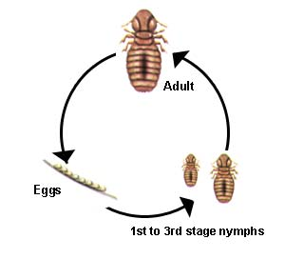
Life cycle of Bovicola ovis

Slide 15
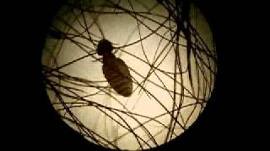
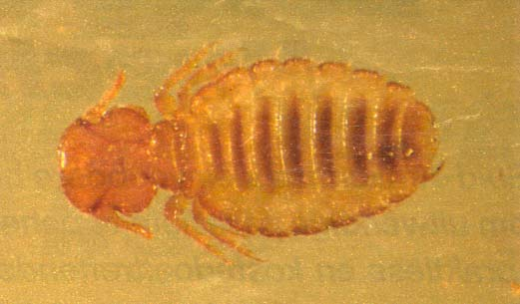
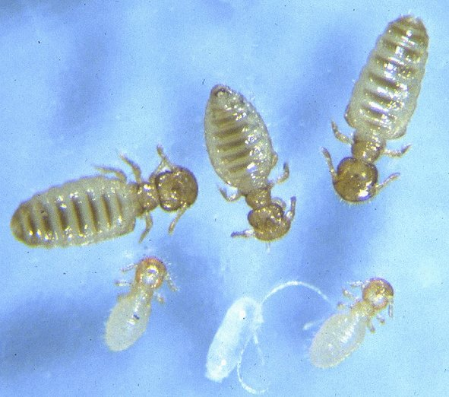
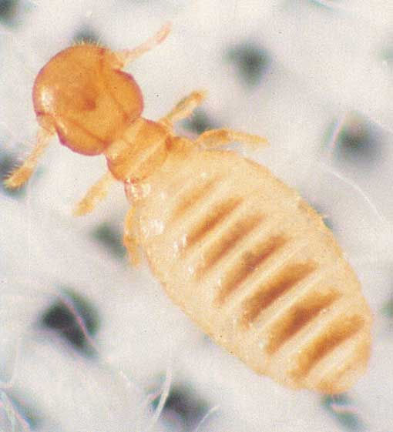
Bovicola ovis

Slide 16
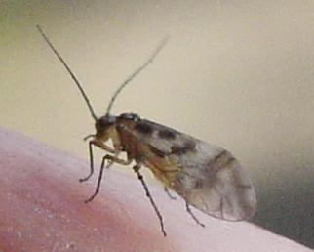
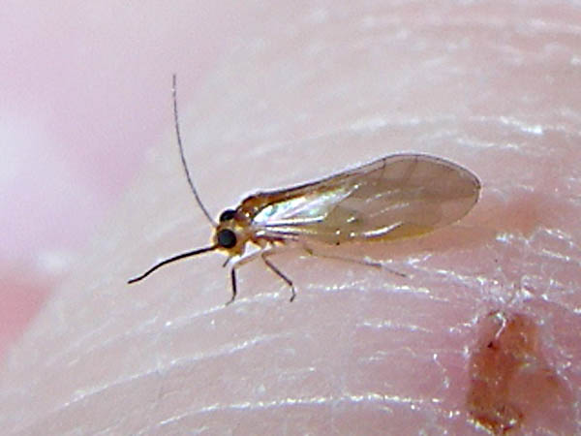
Psocoptera (booklice)
Psocoptera are an order of insects that are commonly known as booklice, barklice or barkflies.
There are more than 5,500 species in 41 families in three suborders.
The species known as booklice received their common name because they are commonly found amongst old books.
The barklice are found harmlessly on trees, feeding on algae and lichen .
They have two pairs of wings.

Slide 17
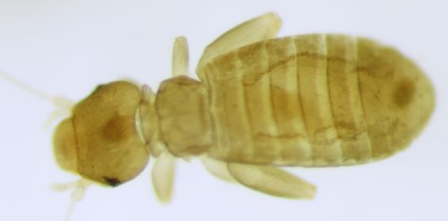
Classification
Kingdom:- Animalia
Phylum:- Arthropoda
Class:- Insecta
Super order:- Psocodea
Order:- Psocoptera
Suborders:-
1- Trogiomorpha (7 families)
2-Troctomorpha (9 families)
3- Psocomorpha (24 families)

Slide 18
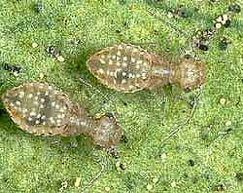
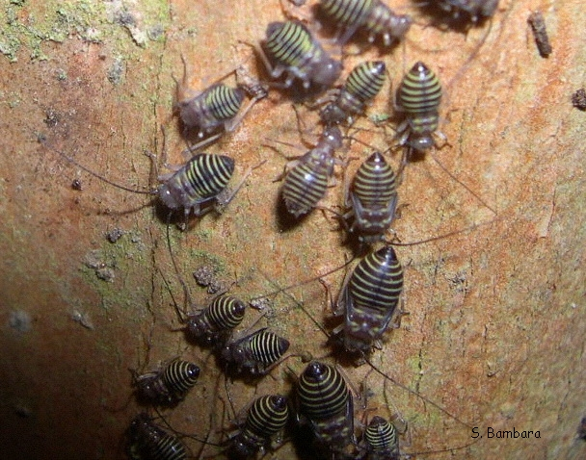
Life cycle
female booklice produce fewer eggs and the time required to complete their life cycle is over three months.
Females deposit their eggs singly and often conceal them by covering with debris.
Booklice undergo simple metamorphosis, that is their nymphs look just like adults except that they are much smaller and sexually immature.
The common house-infesting booklice normally have four nymphal stages.

Slide 19
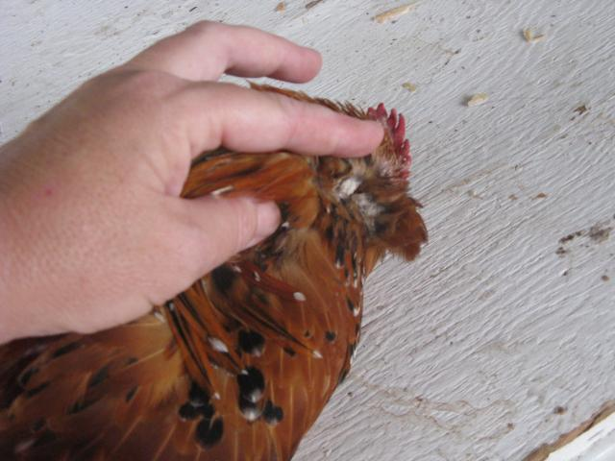
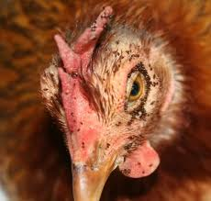
Chicken lice
There are several types of biting lice that affect chickens and other poultry.
These are known as ectoparasites or external parasites as they live on the outside of the bird.
On chickens it is usually Menopon gallinae which is a yellowish colour flat louse about 2mm long.

Slide 20
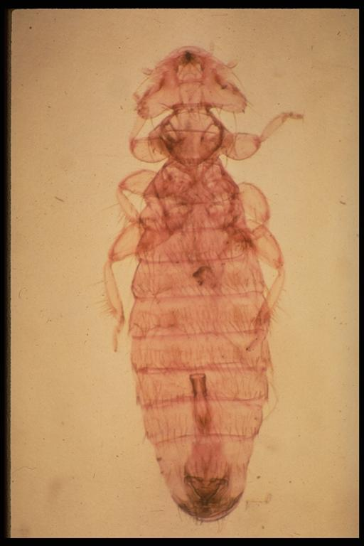
Classification
Phylum:- Arthropoda
Class:- Insecta
Order:- Mallophaga
Suborder:- Amblycera
Ex:- Menopon gallinae

Slide 21
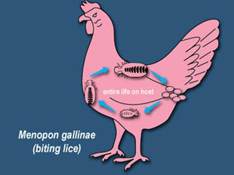
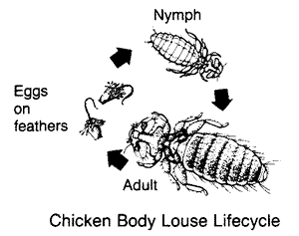
Life cycle of Menopon gallinae
A Lice undergo an incomplete metamorphosis which takes place entirely on the host within a period of 3-5 weeks.
The eggs, commonly called "nits", are glued to the feathers of the host.
The young lice develop through several nymphal stages, during which they look like small, pale adults.
Nymphs and adults are transmitted from one animal to another primarily by host contact.

Slide 22
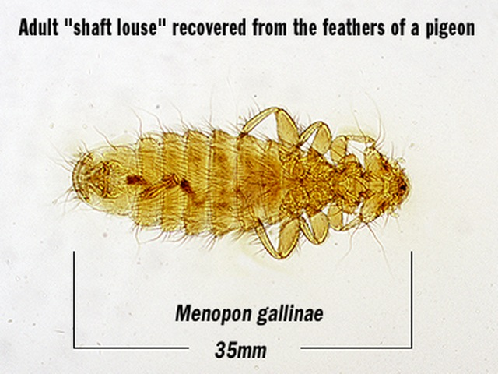
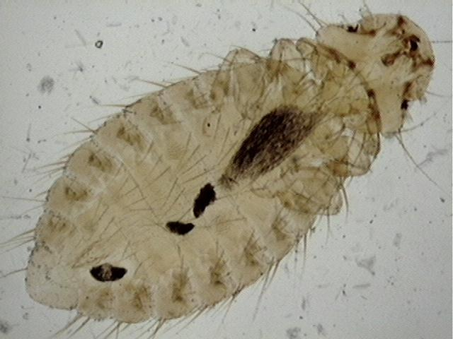
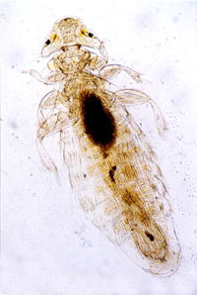
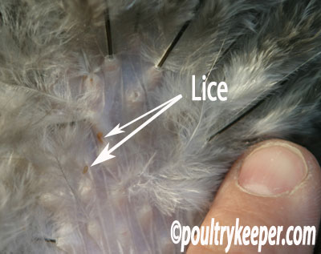
Menopon gallinae

Slide 23
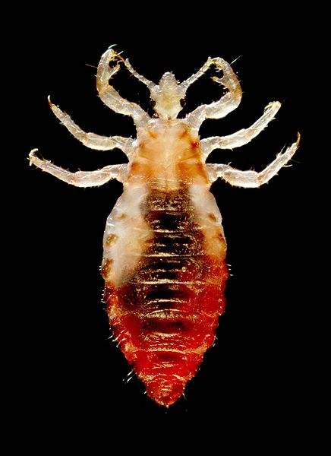
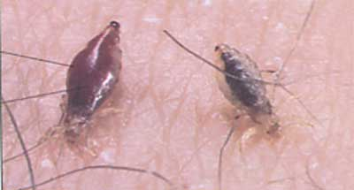
Body louse
The body louse (Pediculus humanus humanus, sometimes called Pediculus humanus corporis) is a louse which infests humans.
The condition of being infested with head lice, body lice, or pubic lice is known as pediculosis.

Slide 24
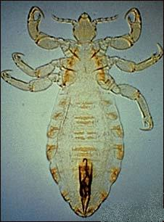
Classification
Kingdom:- Animalia
Phylum:- Arthropoda
Class:- Insecta
Order:- Phthiraptera
Suborder:- Anoplura
Family:- Pediculidae
Genus:- Pediculus
Species:- P. humanus
Subspecies:-P. h. humanus
Pediculus humanus humanus

Slide 25
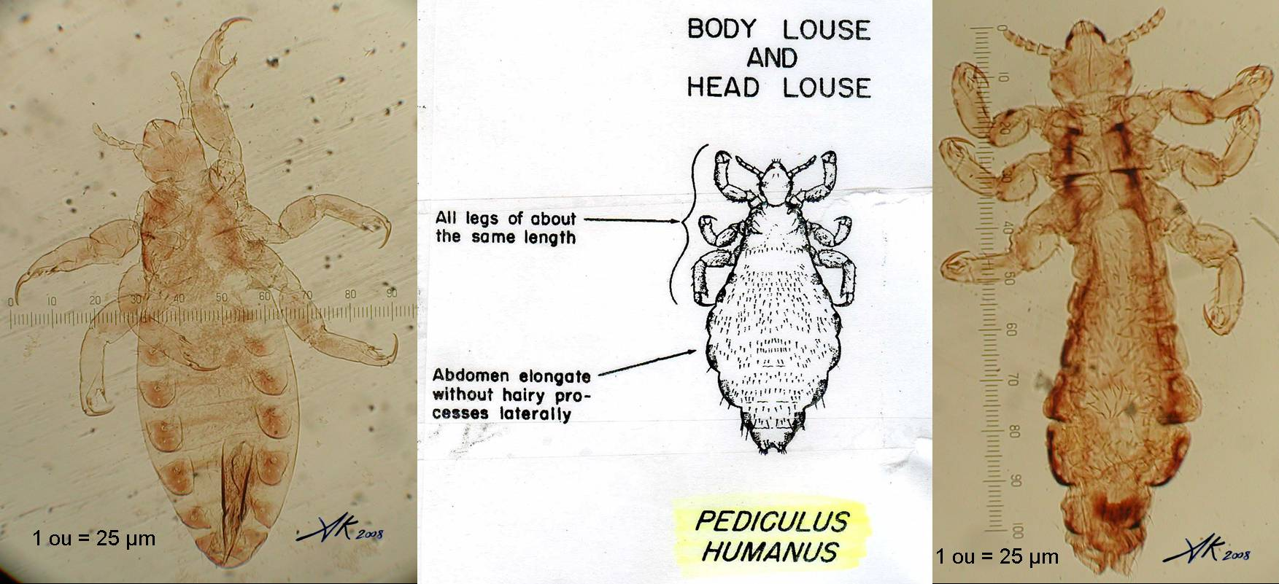
Body louse & head louse
Pediculus humanus corporis (left) and Pediculus humanus capitis (right)

Slide 26
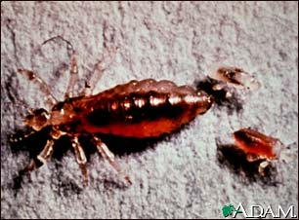
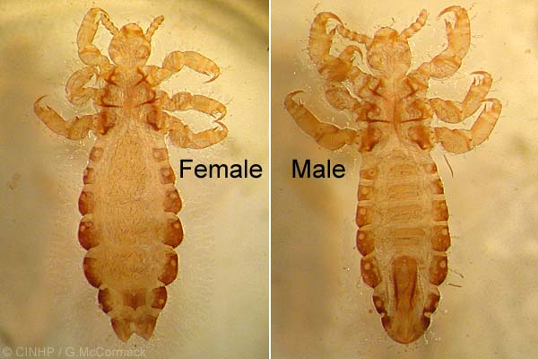
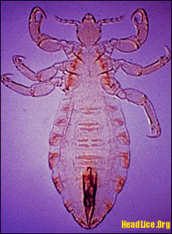
Body louse

Slide 27
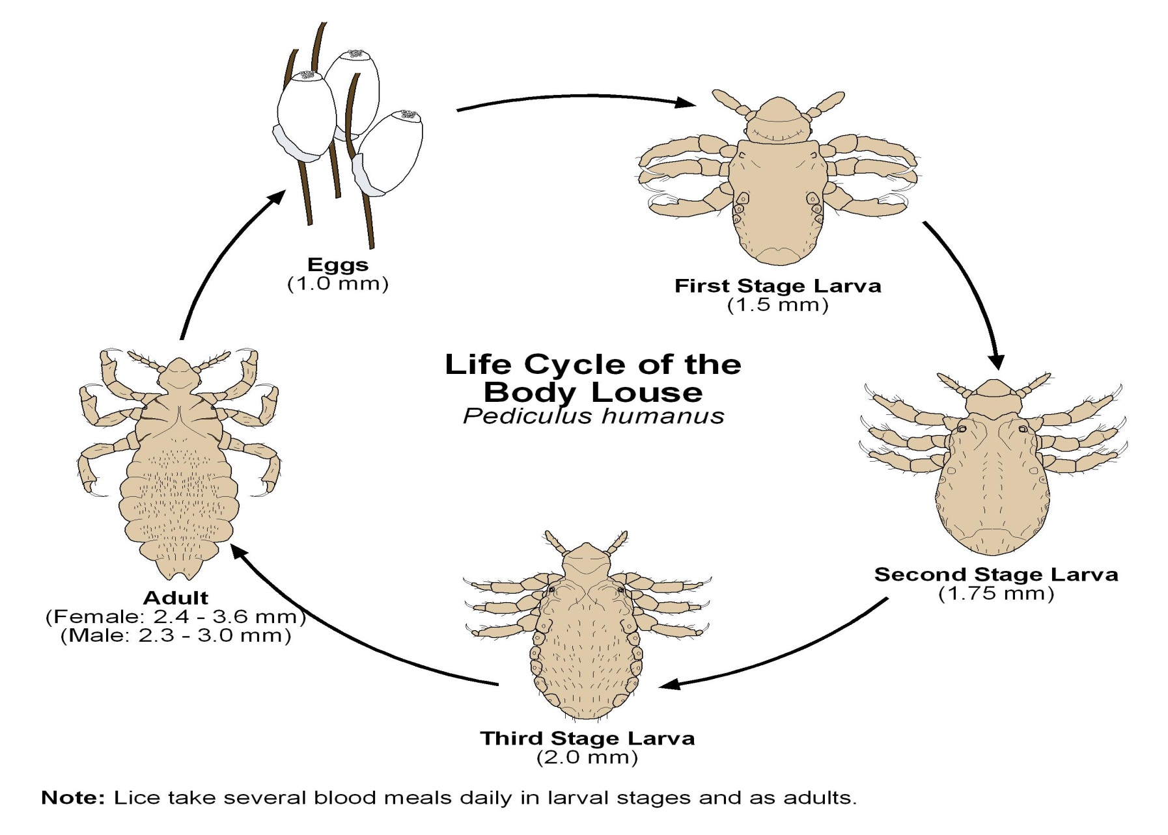
Life cycle

Slide 28
Life cycle
Body lice have three forms:
Nits are lice eggs. They are generally easy to see in the seams of an infested person’s clothing, particularly around the waistline and under armpits. Body lice nits occasionally also may be attached to body hair.
Nymph is an immature louse that hatches from the nit (egg). A nymph looks like an adult body louse, but is smaller.
To live, the nymph must feed on blood.
The adult body louse is about the size of a sesame seed, has 6 legs, and is tan to greyish-white.
Females lay eggs.
To live, lice must feed on blood.
If a louse is separated from its person, it dies at room temperature.

Slide 29
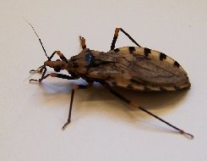
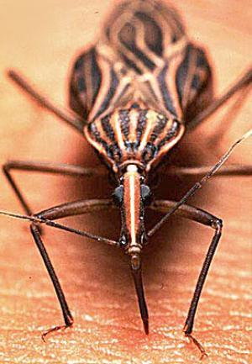
kissing bugs
The members of Triatominae are also known as conenose bugs, kissing bugs, assassin bugs, or triatomines.
All triatomine species are potential vectors of the Chagas disease parasite Trypanosoma cruzi.

Slide 30
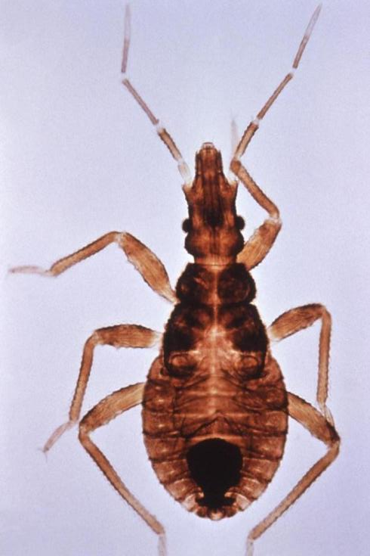
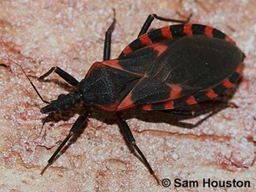
Classification
Kingdom:- Animalia
Phylum:- Arthropoda
Class:- Insecta
Order:- Hemiptera
Family: Reduviidae
Subfamily:-Triatominae
Triatoma recurva

Slide 31
Life cycle
Triatomines undergo incomplete metamorphosis.
A wingless first instar nymph hatches from an egg, about the size of the tip of a fork.
It passes successively through 2nd, 3rd, 4th, and 5th instars.
Finally, the fifth instar turns into an adult, acquiring two pairs of wings.

Slide 32
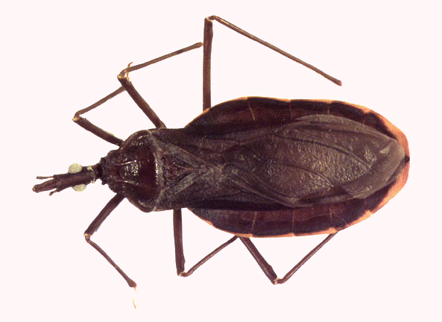
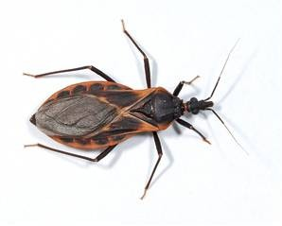
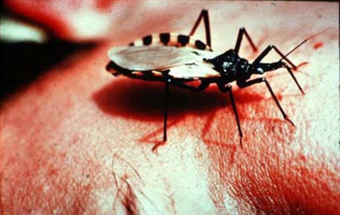
kissing bugs

