Slide 1
Distribution and Supply Chain Management

Slide 2
Supply Chain Strategy
Marketing Channels
An organized system of marketing institutions through which products, resources, information, funds, and/or product ownership flow from the point of production to the final user.
Physical Distribution
Coordinating the flow of information and products among members of the channel to ensure that products are available in the right places, in the right quantities, at the right times, and in a cost-efficient manner.
Supply Chain
The connection and integration of all members of the marketing channel

Slide 3
Supply Chain Integration
Connectivity
Informational and technological linkages among firms
Community
Compatible goals and objectives among firms
Collaboration
Recognition of mutual independence among firms
The most seamlessly integrated supply chains blur the boundaries between firms.

Slide 4
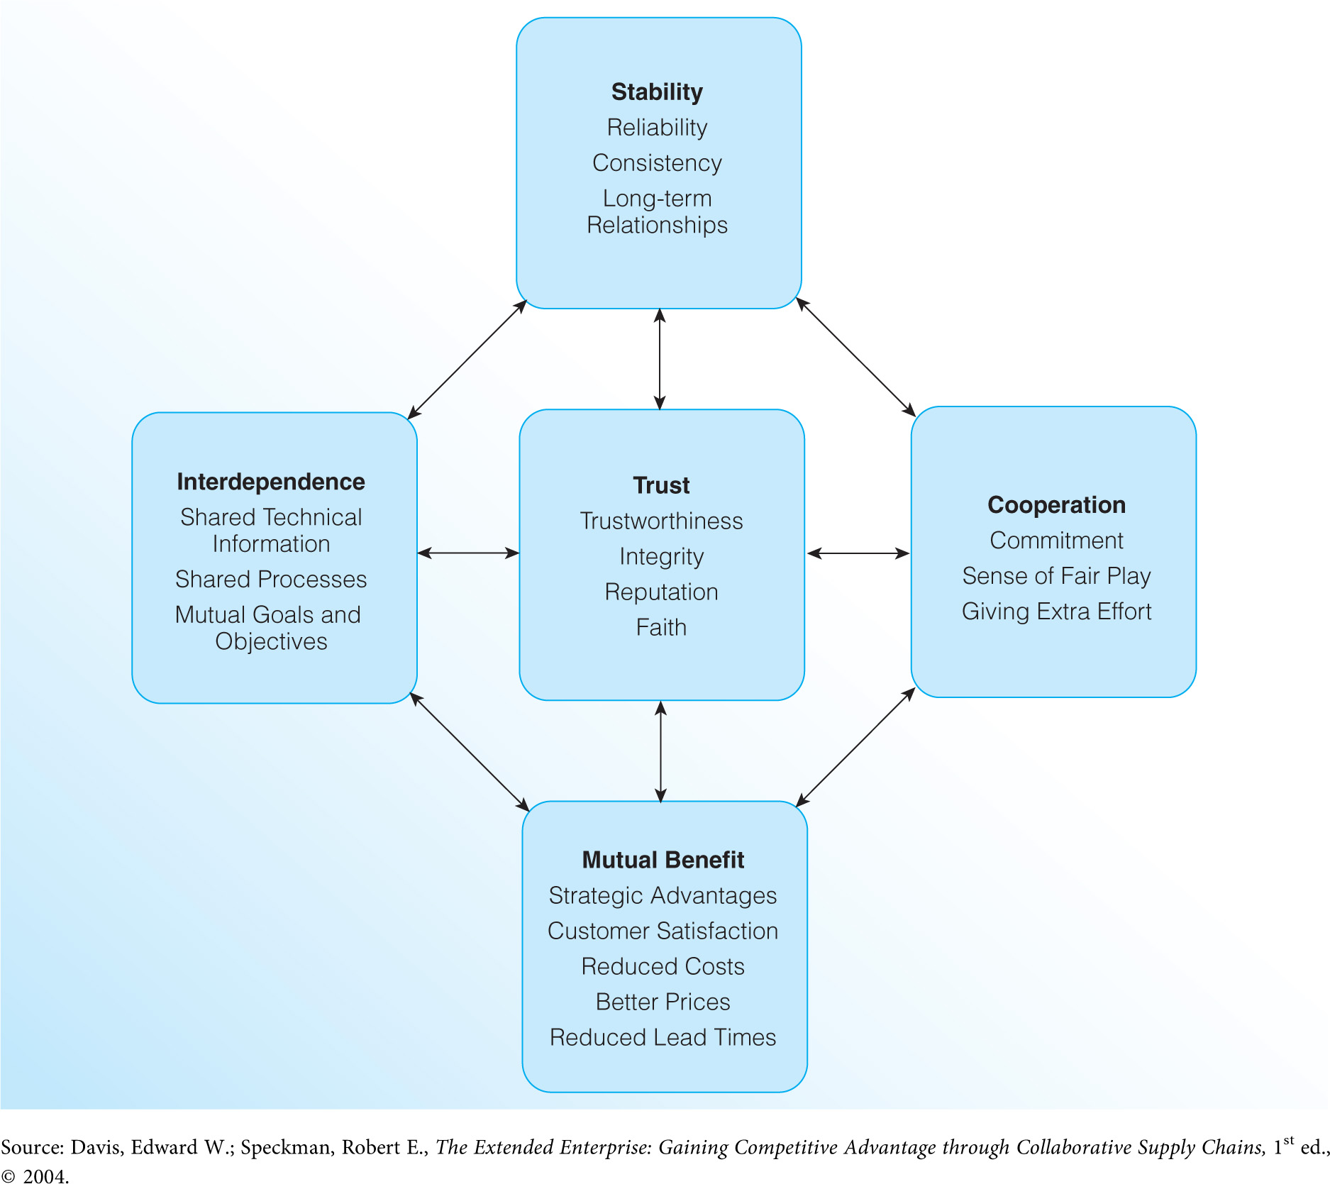
Factors in Successful Supply Chain Integration

Slide 5
Strategic Supply Chain Issues: Marketing Channel Functions
Contact Efficiency
Channel Functions
Sorting
Breaking bulk
Maintaining inventories
Maintaining convenient locations
Provide services
All channel functions must be performed regardless of who does them

Slide 6
Some manufacturers and retailers advertise that customers should buy from them because they “eliminate the middleman.” Evaluate this comment in light of the functions that must be performed in a marketing channel. Does a channel with fewer members always deliver products to customers at lower prices? Defend your position.

Slide 7
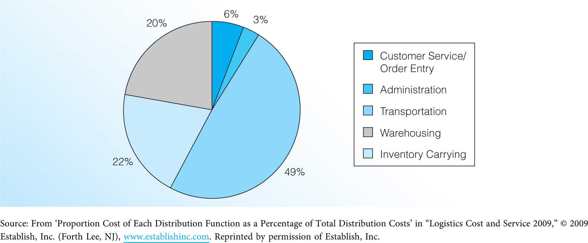
Breakdown of Total Distribution Costs

Slide 8
Strategic Supply Chain Issues: Marketing Channel Structure
Exclusive Distribution
Giving one merchant or outlet the sole right to sell a product within a defined geographic region
Selective Distribution
Giving several merchants or outlets the right to sell a product within a defined geographic region
Intensive Distribution
Making a product available in the maximum number of merchants or outlets to gain as much exposure and sales opportunities as possible

Slide 9
Strategic Supply Chain Issues: Power in the Supply Chain
The Basis of Conflict in the Supply Chain
Each firm is different, and has its own goals and objectives
Mutual interdependence goes against the natural tendency of firms to seek their own self-interests.
Sources of Power in a Supply Chain
Legitimate power
Reward power
Coercive power
Information power
Referent power

Slide 10
Trends in Supply Chain Strategy
Technological Improvements
E-commerce
Radio frequency identification (RFID)
Outsourcing Channel Functions
Outsourcing vs. offshoring
Growth of Non-Traditional Channels
Catalog and direct marketing
Direct selling
Home shopping networks
Vending
Direct response advertising

Slide 11
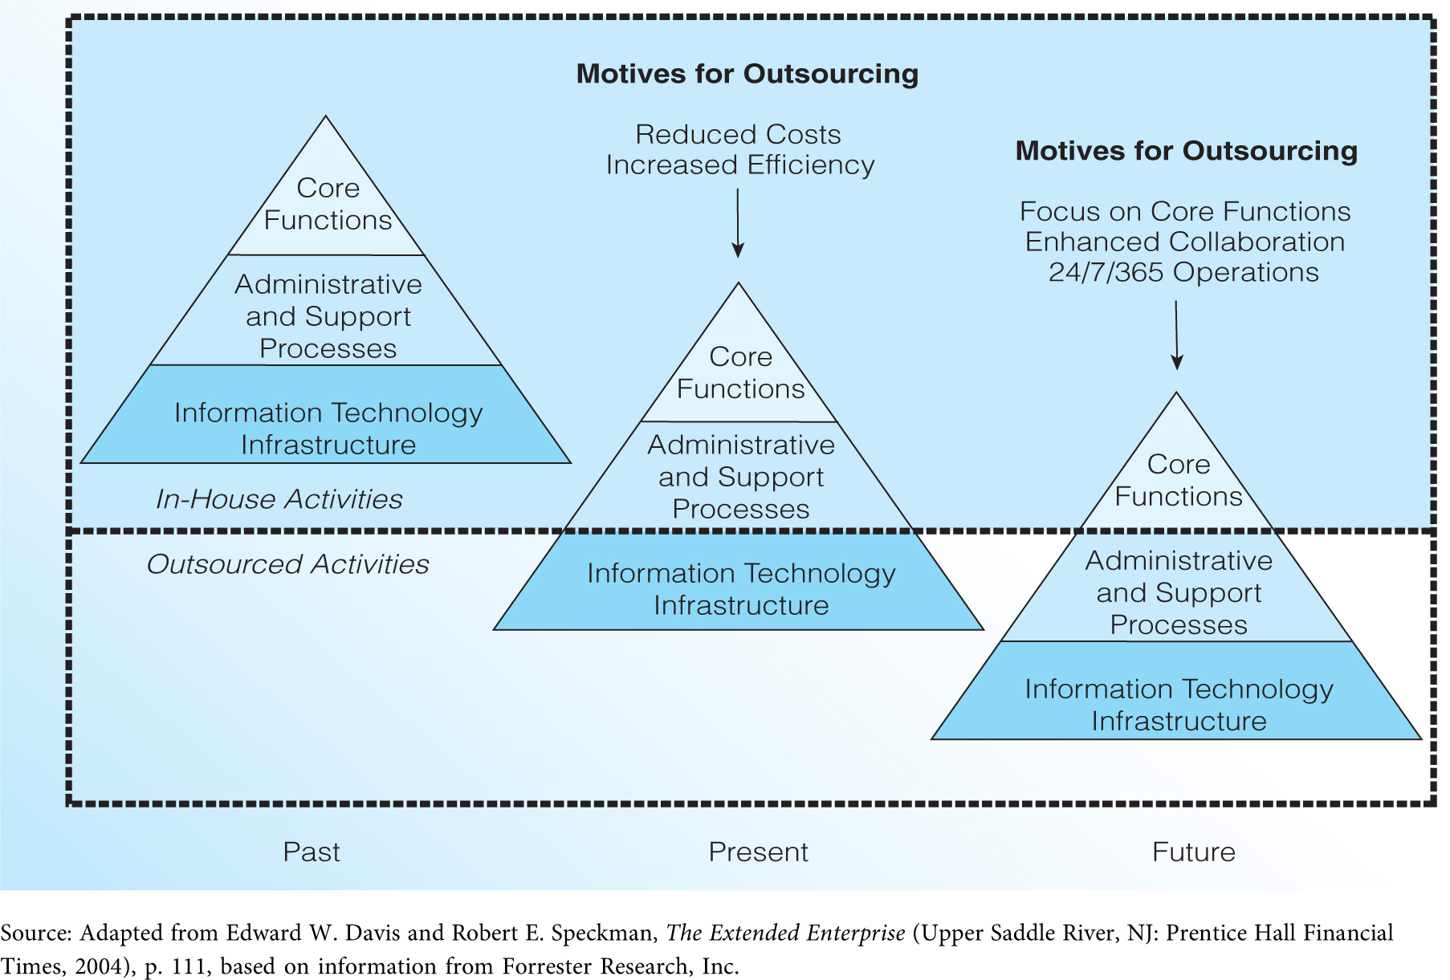
The Trend in Outsourcing

