Slide 1
Chapter 5
Developing Competitive Advantage and Strategic Focus

Slide 2
SWOT Analysis
A widely used framework for organizing and utilizing the pieces of data and information gained from the situation analysis
Encompasses both internal and external environments
One of the most effective tools in the analysis of environmental data and information

Slide 3
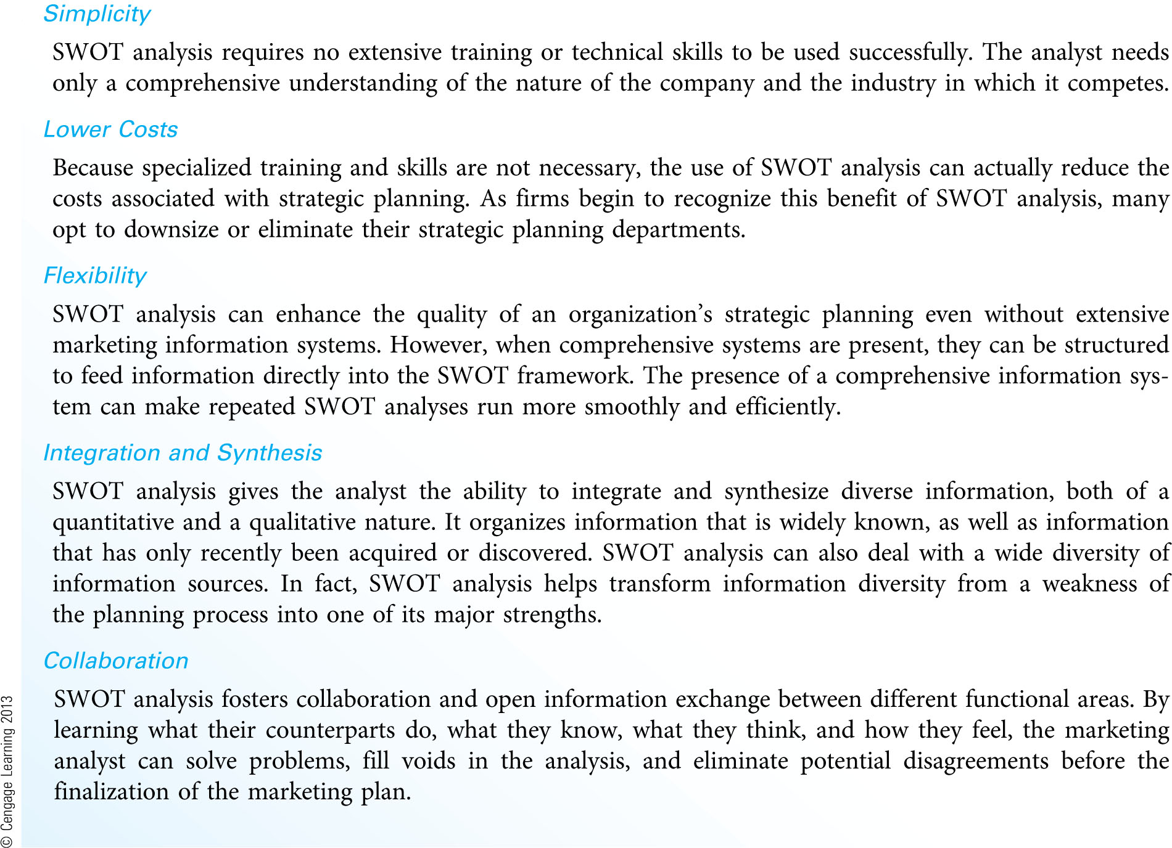
Major Benefits of SWOT Analysis (Exhibit 4.1)

Slide 4
Making SWOT Analysis Productive (Exhibit 4.2)
Stay Focused
It is a mistake to complete one generic SWOT analysis for the entire organization. SWOT analysis really means SWOT analyses.
Search Extensively for Competitors
Information on competitors is an important aspect of a SWOT analysis. All four types of competition are important.
Collaborate with other Functional Areas
Information generated from the SWOT analysis can be shared across functional areas.
SWOT analysis can generate communication between managers of different functions, creating an environment for creativity and innovation.

Slide 5
Making SWOT Analysis Productive (Exhibit 4.2) (continued)
Examine Issues from the Customers’ Perspective
What do customers (and noncustomers):
believe about us as a company?
think of our product quality, customer service, price, overall value, convenience, and promotional messages in comparison to competitors?
What is the relative importance of these issues as customers see them?
Look for Causes, Not Characteristics
Causes for each issue in a SWOT analysis can often be found in the firm’s and competitors’ resources.
Separate Internal Issues from External Issues
Failure to understand the difference between internal and external issues is a major reason for a poorly conducted SWOT analysis.

Slide 6
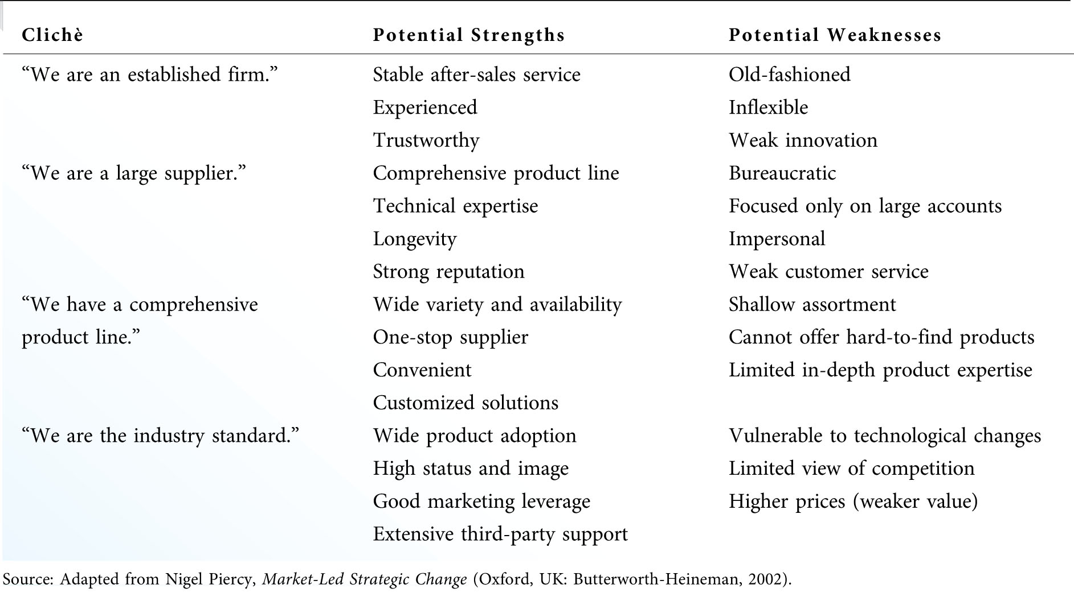
Breaking Down Managerial Clichés (Exhibit 4.3)

Slide 7
Potential Issues to Consider in a SWOT Analysis (Exhibit 4.4)
Strengths and Weaknesses
Presence or absence of scale and cost economies
Presence or absence of financial or human resources
Presence or absence of functional skills
Presence or absence of intellectual, legal or reputational resources
Opportunities and Threats
Conditions or changes in the customer environment
Conditions or changes in the competitive environment
Conditions or changes in the external environment

Slide 8
SWOT-Driven Strategic Planning
The assessment of strengths and weakness must look beyond the firm’s resources and product offerings to examine processes that meet customers’ needs. This entails offering solutions to customers’ problems, rather than specific products.
Achieving goals and objectives depends on creating capabilities by matching strengths with market opportunities.
Weaknesses can be converted into strengths with strategic investment. Threats can be converted into opportunities with the right resources.
Weaknesses that cannot be converted become limitations which must be minimized if obvious or meaningful to customers or other stakeholders.

Slide 9
The SWOT Matrix
A four-cell array used to categorize information at the conclusion of a SWOT analysis
Should be based on customer perceptions, not the perceptions of the manager or firm
Elements with the highest total ratings should have the greatest influence in developing the strategy.
Focus on competitive advantages by matching strengths with opportunities

Slide 10
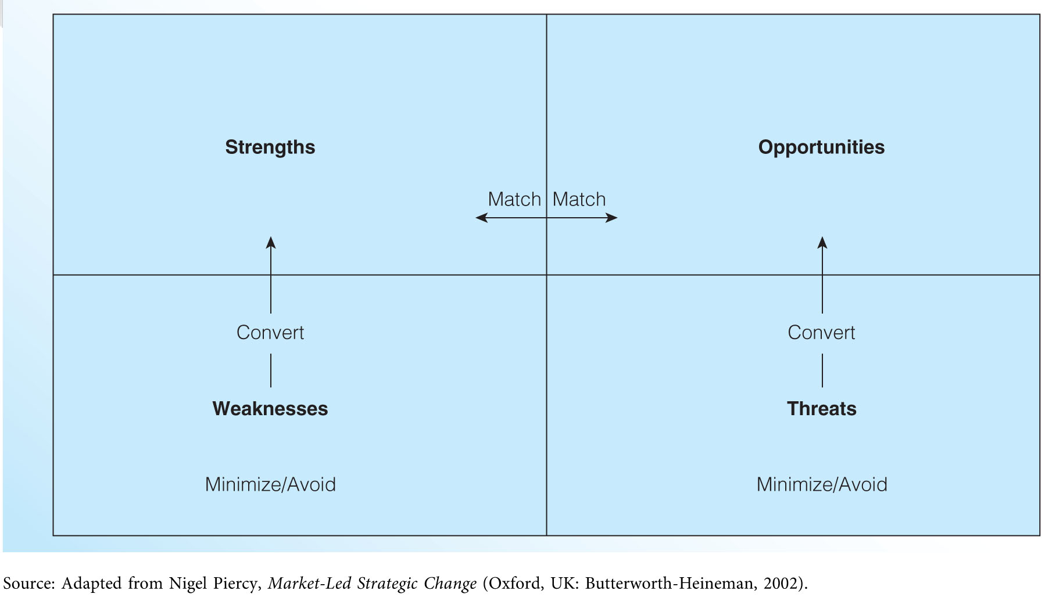
The SWOT Matrix (Exhibit 4.5)

Slide 11
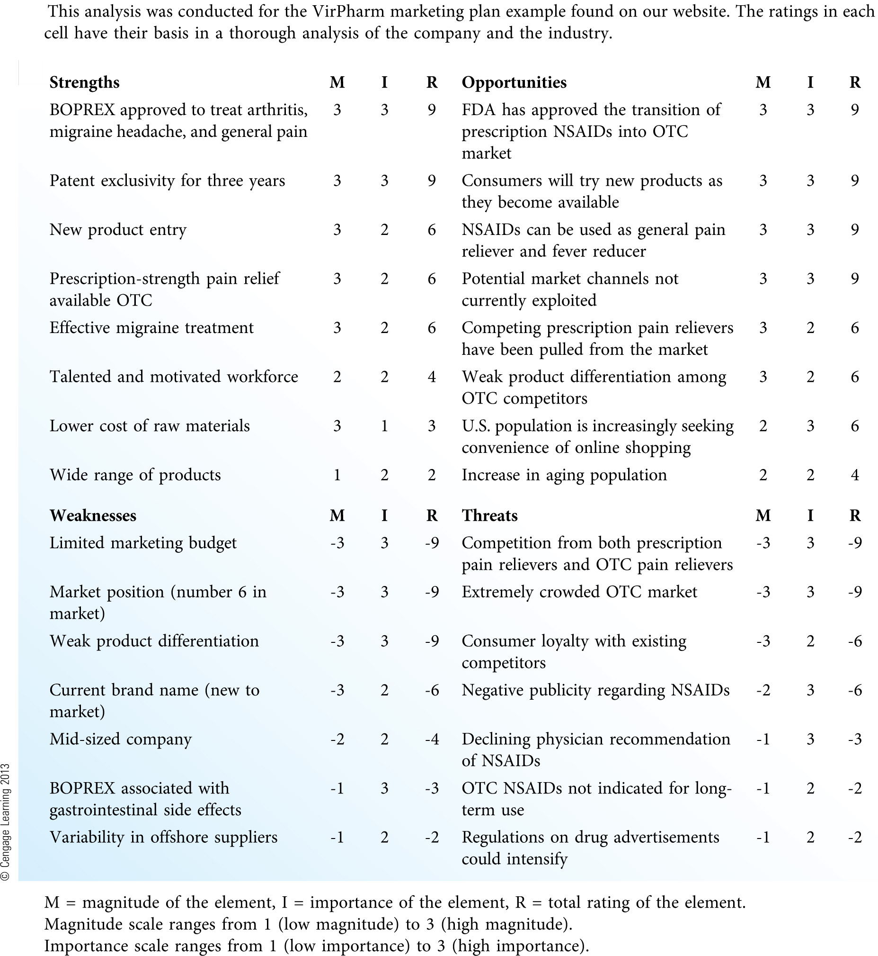
Quantitative Assessment of the SWOT Matrix (Exhibit 4.6)

Slide 12
Strengths, weaknesses, opportunities, and threats: Which is the most important? Why? How might your response change if you were the CEO of a corporation? What if you were a customer of the firm? An employee? A supplier?

Slide 13
Developing and Leveraging Competitive Advantages
Competitive advantages can arise from many internal and external sources (see Exhibit 4.7).
Competitive advantages refer to real differences between competing firms.
Competitive advantages can also be based more on perception than reality.
Capabilities or competitive advantages that do not translate into specific benefits for customers are of little use to a firm.

Slide 14
Competitive Advantage Strategies (Exhibit 4.8)
Operational Excellence
Focus on efficiency of operations and processes
Lower cost operations lead to lower prices for customers
Product Leadership
Excellence in technology and product development
Most advanced, highest quality product offering in the industry
Customer Intimacy
Understand customers better than the competition
Develop long-term customer relationships

Slide 15
Support or contradict this statement:
“Given the realities of today’s economy and the rapid changes occurring in business technology, all competitive advantages are short-lived. There is no such thing as a sustainable competitive advantage that lasts over the long term.” Defend your position.

Slide 16
Establishing a Strategic Focus
Four major directions for strategic efforts
Aggressive (many internal strengths / many external opportunities)
Diversification (many internal strengths / many external threats)
Turnaround (many internal weaknesses / many external opportunities)
Defensive (many internal weaknesses / many external threats)
These are the most common, but other combinations of strengths and weaknesses are possible.

Slide 17
Principles of Blue Ocean Strategy
Firms develop strategic focus by developing a strategy that stands apart from the competition.
Firms can visually identify their strategic focus through the use of the strategy canvas.
Firms can use the Four Actions Framework to reorient their strategic focus away from the competition.

Slide 18
Strategy Canvas
Identifies factors that the industry currently competes on and what customers receive from existing product offerings (captured by the horizontal axis)
Identifies the offering level received by buyers for each factor (captured by the vertical axis)
High levels mean that a company invests more and offers buyers more of that factor.
Identifies a company’s relative performance across its industry’s factors of competition (captured by the value curve)

Slide 19
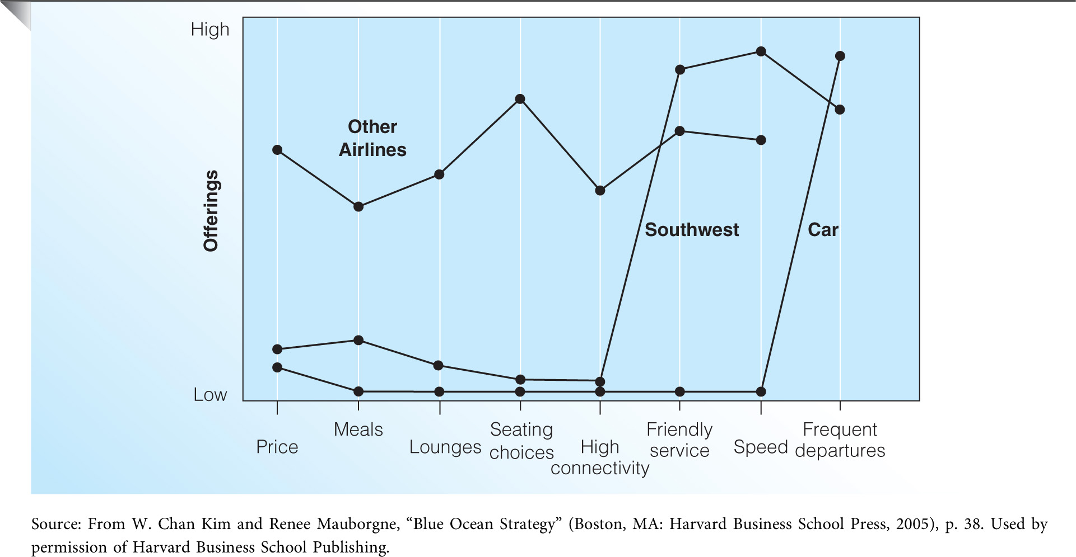
Strategy Canvas for Southwest Airlines (Exhibit 4.9)

Slide 20
The Four Actions Framework
Which factors that the industry takes for granted should be eliminated?
These factors may no longer have value for buyers.
Which factors should be reduced well below the industry’s standard?
Have products been over designed in a race to beat competition?
Which factors should be raised well above the industry’s standard?
Has the industry forced customers to make compromises?
Which factors should be created that the industry has never offered?
What are the potential new sources of value for buyers?

Slide 21
What Makes Good Strategy?
Good strategy is about matching the firm’s strengths to the available opportunities.
Blue Ocean Strategy defines good strategy as having these three characteristics:
Focus – Good strategy does not diffuse the company’s efforts across all key factors of competition (the value curve clearly shows focus in the strategy).
Divergence – Good strategy differs from other competitors in the market (the value curve is unique from competitors).
Compelling Tagline – Good strategy can be summarized in a clear-cut statement that delivers a clear, compelling message to customers.

Slide 22
Is it possible for an organization to be successful despite having a value curve that is not distinct from the competition? In other words, can an organization be successful by selling a me-too product (a product that offers no compelling differences when compared to the competition)? Explain.

Slide 23
Developing Marketing Goals and Objectives
Marketing Goals
Statements of broad, desired accomplishments
Attainability
Consistency
Comprehensiveness
Intangibility
Marketing Objectives
Specific, quantitative benchmarks used to measure progress toward the achievement of marketing goals
Attainability
Continuity
Time frame
Assignment of responsibility

Slide 24
Continuous versus Discontinuous Objectives
Continuous Objectives
Current objectives are similar to objectives set in the previous planning period.
Objectives that are only slightly modified over time do not need new strategies, increased effort, or better implementation to be achieved.
Discontinuous Objectives
Significantly elevate the level of performance on a given outcome factor
Typically require new strategies to achieve higher performance
Often a part of applying for the Malcolm Baldrige National Quality Award (see Exhibit 4.10).

