Slide 1
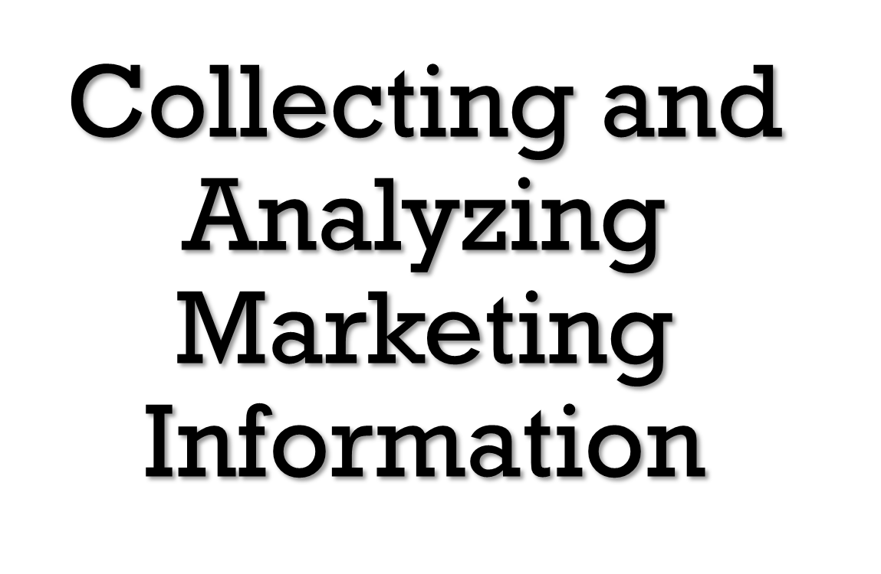
Chapter 4

Slide 2
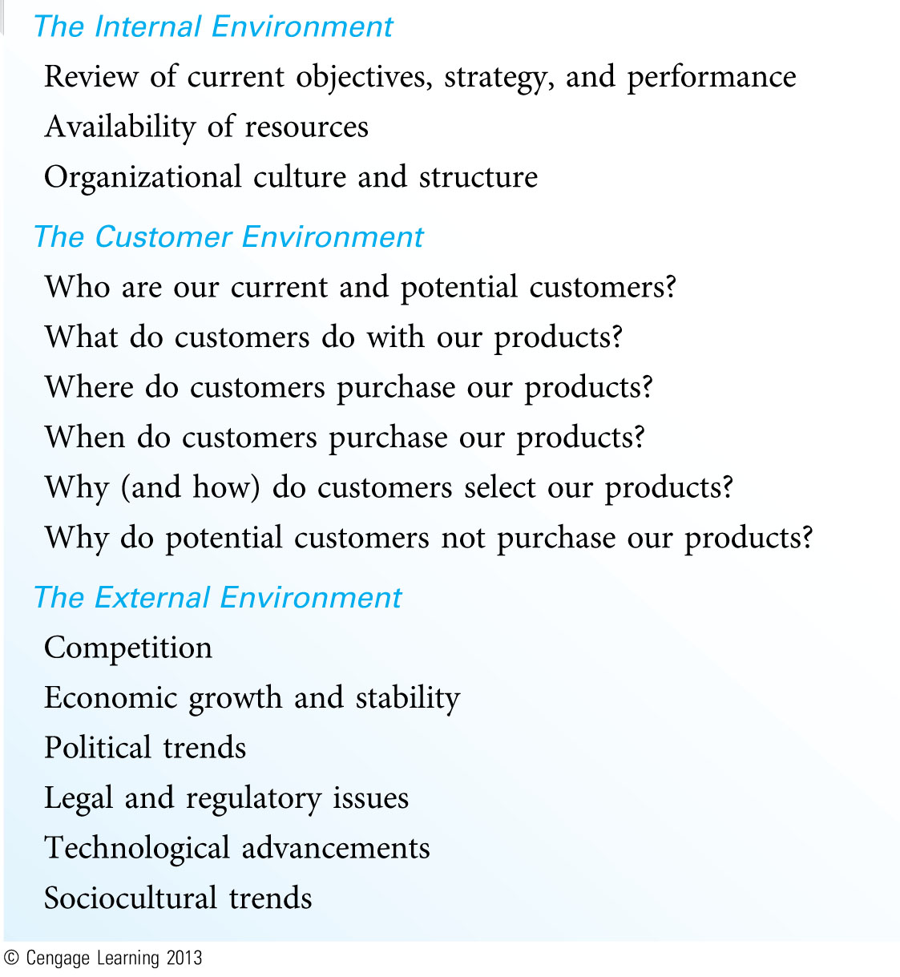
Issues to Be Considered in a Situation Analysis (Exhibit 3.1)

Slide 3
Conducting a Situation Analysis
Analysis Alone Is Not a Solution
Data Is Not the Same as Information
  Data – a collection of numbers or facts that have the potential to provide information
  Information – data that have been transformed or combined with other data in a manner that makes them useful to decision makers
The Benefits of Analysis Must Outweigh the Costs
Conducting a Situation Analysis is a Challenging Exercise
  Should provide a complete picture of three key environments: Internal, Customer, and External

Slide 4
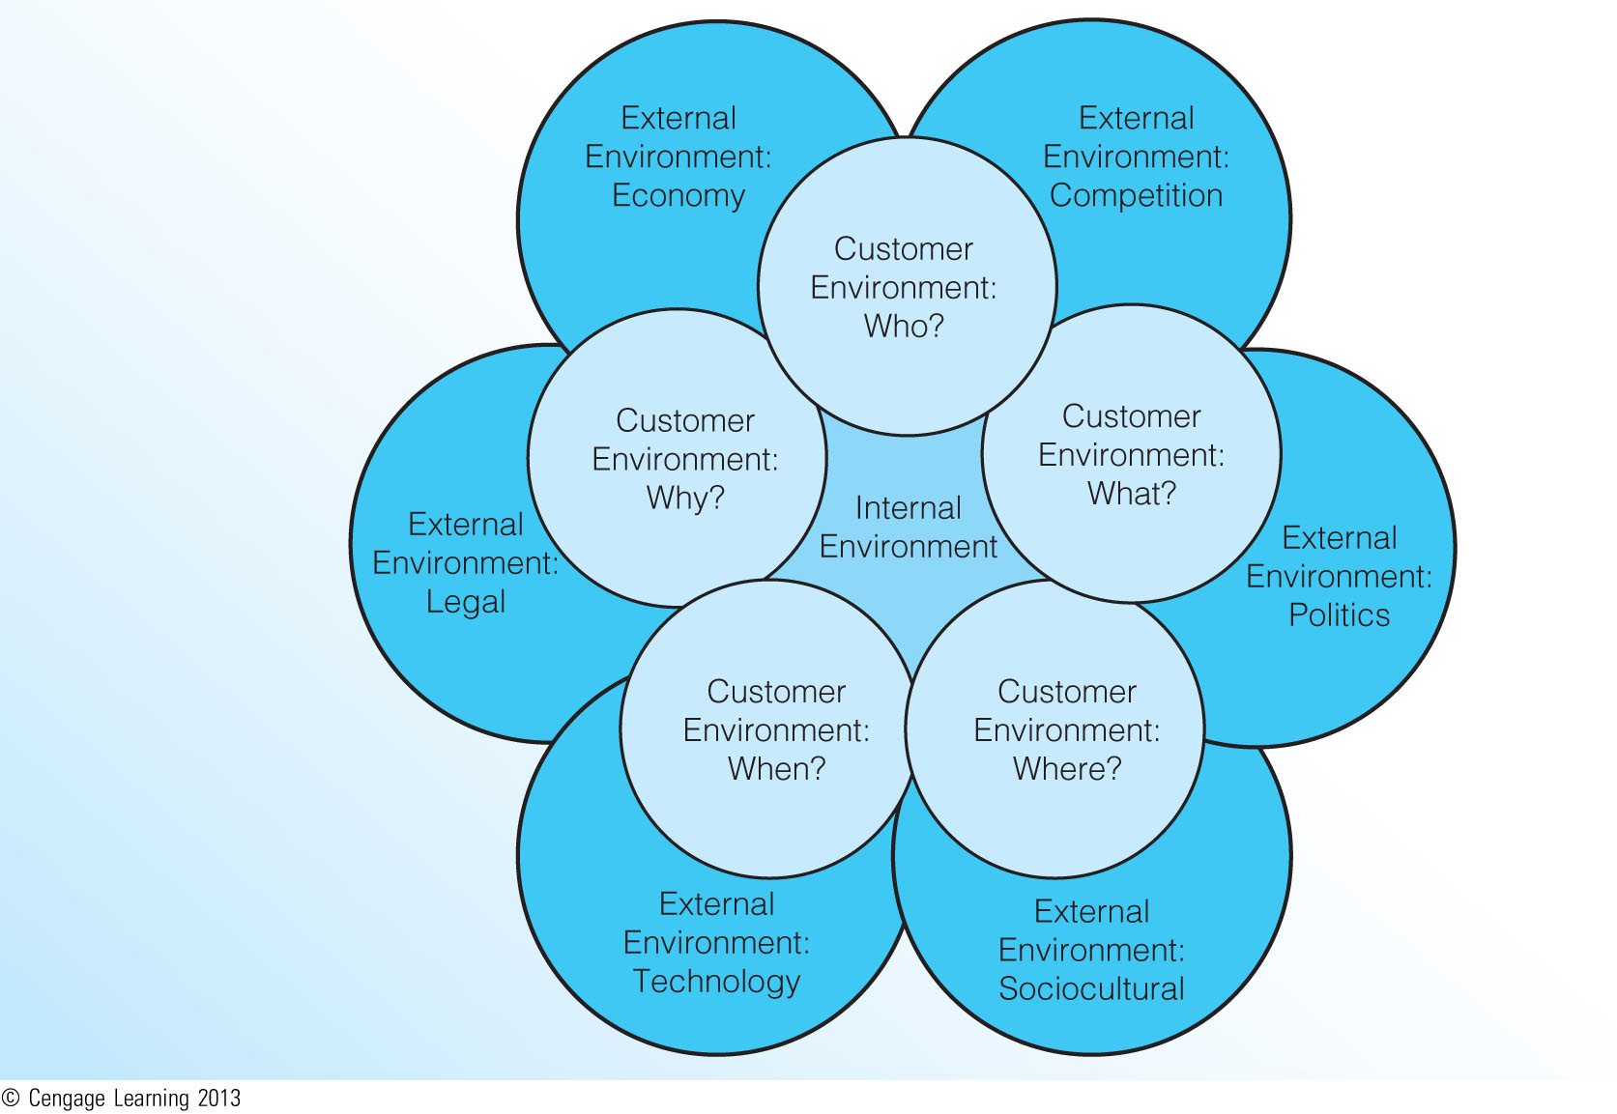
Internal, Customer, and External Environments (Exhibit 3.2)

Slide 5
Of the three major environments in a situation analysis (internal, customer, external), which do you think is the most important in a general sense? Why? What are some situations that would make one environment more important than the others?

Slide 6
The Internal Environment
(Exhibit 3.3)
Review of Current Objectives, Strategy and Performance
  An important input to later stages in the planning process
  Poor or declining performance must be the result of:
    Goals or objectives that are inconsistent with the customer or external environments
    Flawed marketing strategy
    Poor implementation
    Changes in the customer or external environments that are beyond the control of the firm

Slide 7
The Internal Environment
(Exhibit 3.3) (continued)
Availability of Resources
  Includes a review of financial, human, and experience resources, as well as resources from key relationships
  Financial resources tend to get most attention
Organizational Culture and Structure
  Problems can arise when marketing does not hold a prominent position in the organizational hierarchy
  Culture and structure are relatively stable but can be affected by mergers

Slide 8
The Customer Environment
(Exhibit 3.4)
Who are our Current and Potential Customers?
What do Customers do with our Products?
Where do Customers Purchase our Products?
When do Customers Purchase our Products?
Why (and How) do Customers Select our Products?
Why do Potential Customers not Purchase our Products?

Slide 9
Understanding the motivations of a firm’s noncustomers is often just as important as understanding its customers. Look again at the reasons why an individual would not purchase a firm’s products. How can a firm reach out to noncustomers and successfully convert them to customers?

Slide 10
The External Environment
(Exhibit 3.5)
Competition
Economic Growth and Stability
Political Trends
Legal and Regulatory Issues
Technological Advancements
Sociocultural Trends

Slide 11
The Competitive Environment
Brand Competitors
  Market products with similar features and benefits to the same customers at similar prices
Product Competitors
  Compete in the same product class, but with products that are different in features, benefits, and price
Generic Competitors
  Market very different products that solve the same problem or satisfy the same basic customer need
Total Budget Competitors
  Compete for the limited financial resources of the same customers

Slide 12
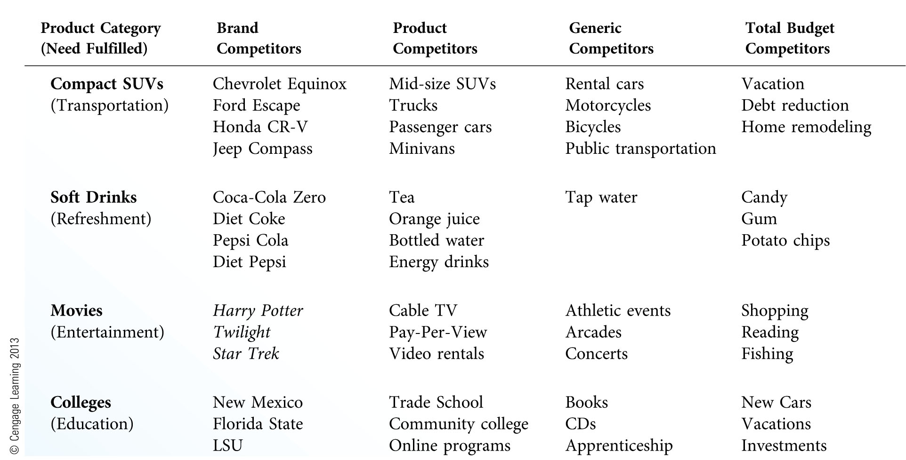
Major Types of Competition
(Exhibit 3.6)

Slide 13
Stages of Competitive Analysis
Identification
  Identify all current and potential competitors
Characteristics
  Assess key competitors’ size, strategy, profitability, markets, etc.
Assessment
  Assess key competitors’ strengths and weaknesses
Capabilities
  Focus the analysis on competitors’ marketing capabilities
Response
  Estimate competitors’ most likely strategies and responses under different environmental situations

Slide 14
Economic Growth and Stability
Economic change is inevitable and has a profound impact on marketing strategy.
General Economic Conditions
  Inflation, employment, income, interest rates, taxes, trade restrictions, tariffs, business cycle
Consumer Issues
  Willingness to spend, confidence, spending patterns
An Underreported Economy
  The U.S. economy is dominated by intangibles such as services and information.
  Innovation, creativity, and human assets are not counted in yearly GDP statistics.

Slide 15
Political, Legal, and Regulatory Issues
The views of elected officials can affect marketing strategy.
  Example hot-button issues: tobacco, immigration, taxes, retirement, healthcare
  Lobbying is vital to marketing strategy in highly regulated industries.
Firms must abide by the law, but many laws are vague and difficult to enforce.
  Example key issues: court decisions, corporate governance, trade agreements

Slide 16
Technological Advancements
Technology refers to the processes used to create “things” considered to be new.
Frontstage Technology
  Advances that are noticeable to customers…what customers think of when they think of technological advancements
  Examples: smartphones, GPS, microwave ovens
Backstage Technology
  Advances that are not noticeable to customers…these advances make marketing activities more efficient and effective
  Examples: computer technology, RFID, near-field communication

Slide 17
Sociocultural Trends
Social and cultural influences that cause changes in attitudes, beliefs, norms, customs, and lifestyles
Sociocultural forces can have a profound effect on the way customers live and buy products.
Changes in customer demographics and values have a considerable impact on marketing.

Slide 18
Example Trends in the U.S. Sociocultural Environment (Exhibit 3.7)
Demographic Trends
  Aging of the American population
  Population growth in Sun Belt states
  Increasing population diversity
Lifestyle Trends
  Many Americans are postponing retirement
  Clothing becoming more casual, especially at work
  Time spent watching television and reading newspapers has declined
Value Trends
  Greater focus on ethics and social responsibility
  Shorter attention spans and less tolerance for waiting
  Growing skepticism about business

Slide 19
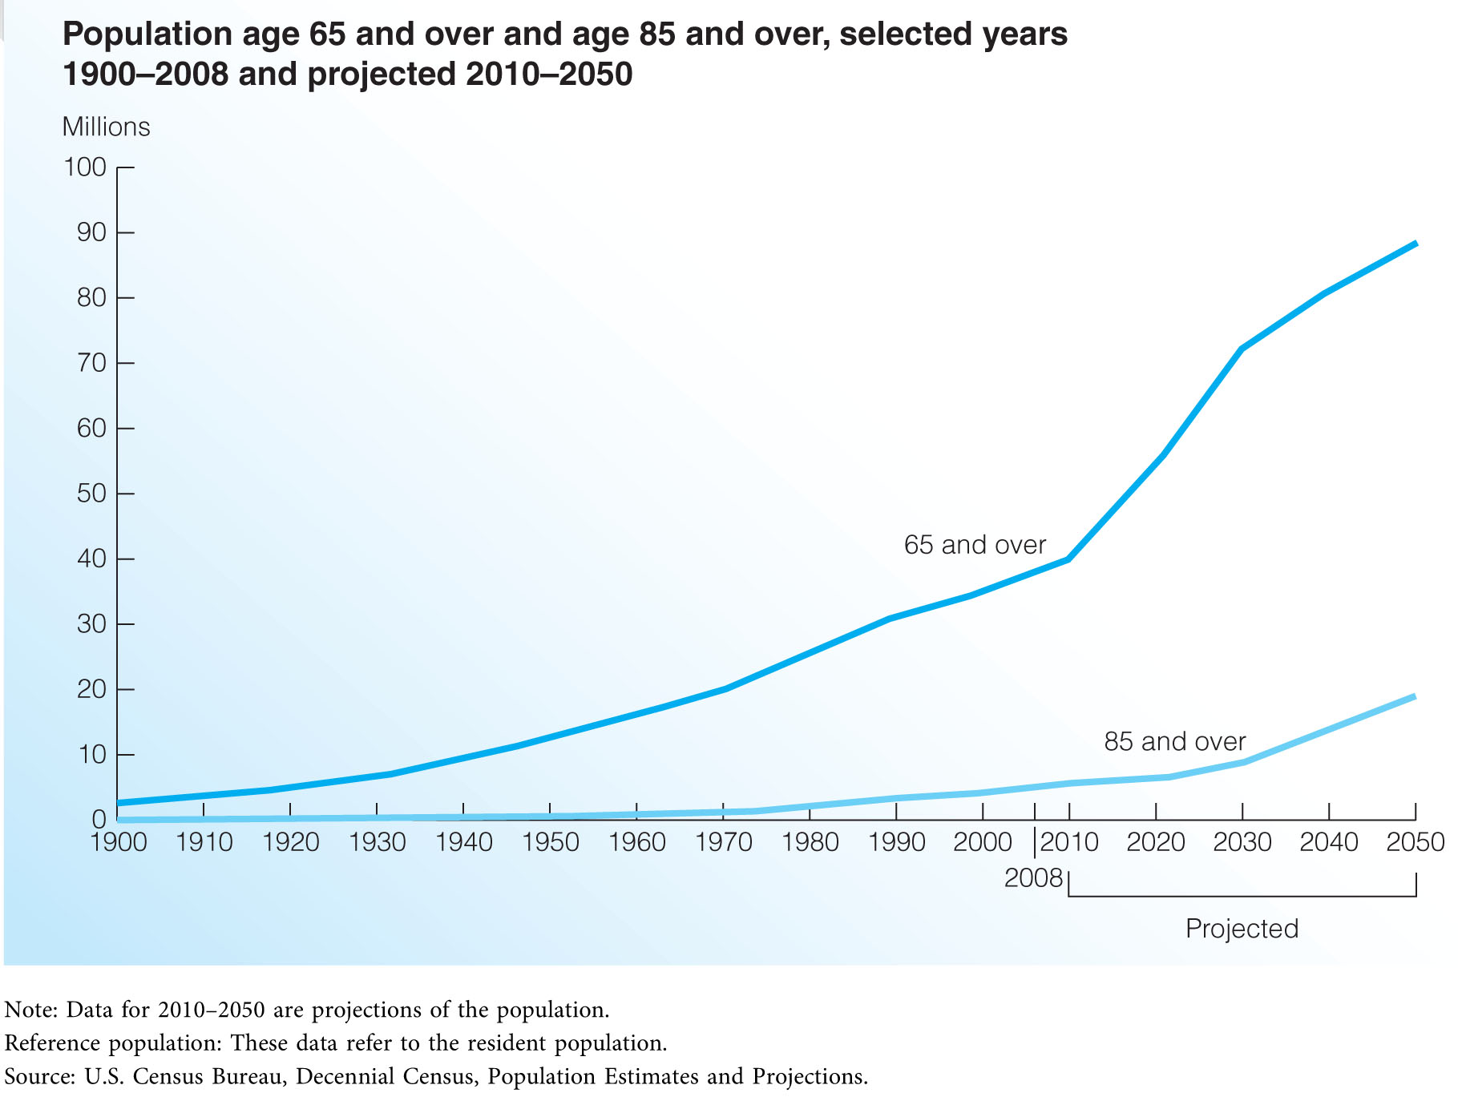
Growth in the Number of Older Americans (Exhibit 3.8)

Slide 20
The Growing Importance of Corporate Affairs
Many firms have corporate affairs specialists on staff to track emerging trends and develop strategies for dealing with external concerns.
Key Corporate Affairs Activities
  Corporate communication
  Government relations
  Investor relations
  Corporate philanthropy
  Corporate sustainability
  Policy analysis

Slide 21
Collecting Marketing Data and Information
Secondary Information Sources
  Internal data sources
  Government sources
  Book and periodical sources
  Commercial sources
Primary Data Collection
  Direct observation
  Focus groups
  Surveys
  Experiments

Slide 22
Typical Problems in Data Collection
Incomplete or inaccurate assessment of the situation that the data should address
Severe information overload
Time and expense of collecting data
Organizing the vast amount of data and information collected during the situation analysis

Slide 23
Do you think the Internet has made it easier or more difficult to collect marketing data and information? Why? How might the major data collection issues of today compare to the issues that occurred in the pre-Internet era?

