Slide 1
Strategic Marketing Planning

Slide 2
The Strategic Planning Process
Situation Analysis
An in-depth analysis of the organization’s internal and external environments
Marketing Plan
A written document that provides the blueprint or outline of the organization’s marketing activities, including the implementation, evaluation, and control of those activities
Explains how the organization will achieve its goals and objectives
Serves as a “road map” for implementing the marketing strategy
Instructs employees as to their roles and functions
Provides specifics regarding the allocation of resources, specific marketing tasks, responsibilities of individuals, and the timing of marketing activities

Slide 3
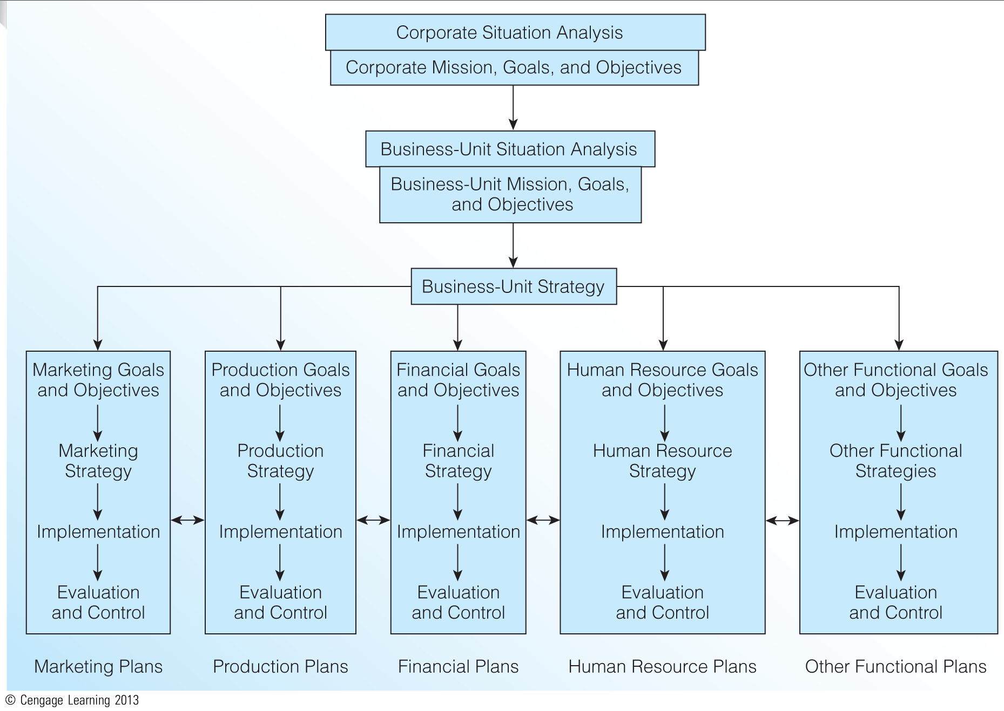
The Strategic Planning Process (Exhibit 2.1)

Slide 4
Organizational Mission versus Organizational Vision
Mission Statement
Answers… “What business are we in?”
Clear and concise
Explains the organization’s reason for existence
Vision Statement
Answers… “What do we want to become?”
Tends to be future oriented
Represents where the organization is headed

Slide 5
Elements of the Mission Statement
Five basic questions to be answered
Who are we?
Who are our customers?
What is our operating philosophy?
What are our core competencies or competitive advantages?
What are our responsibilities with respect to being a good steward of our human, financial, and environmental resources?
Mission Width and Stability
Width – too broad or too narrow?
Stability – frequency of modifications
Customer-Focused Mission Statements
Southwest Airlines
Ben and Jerry’s 3-Part Mission Statement
Tylenol
The American Red Cross

Slide 6
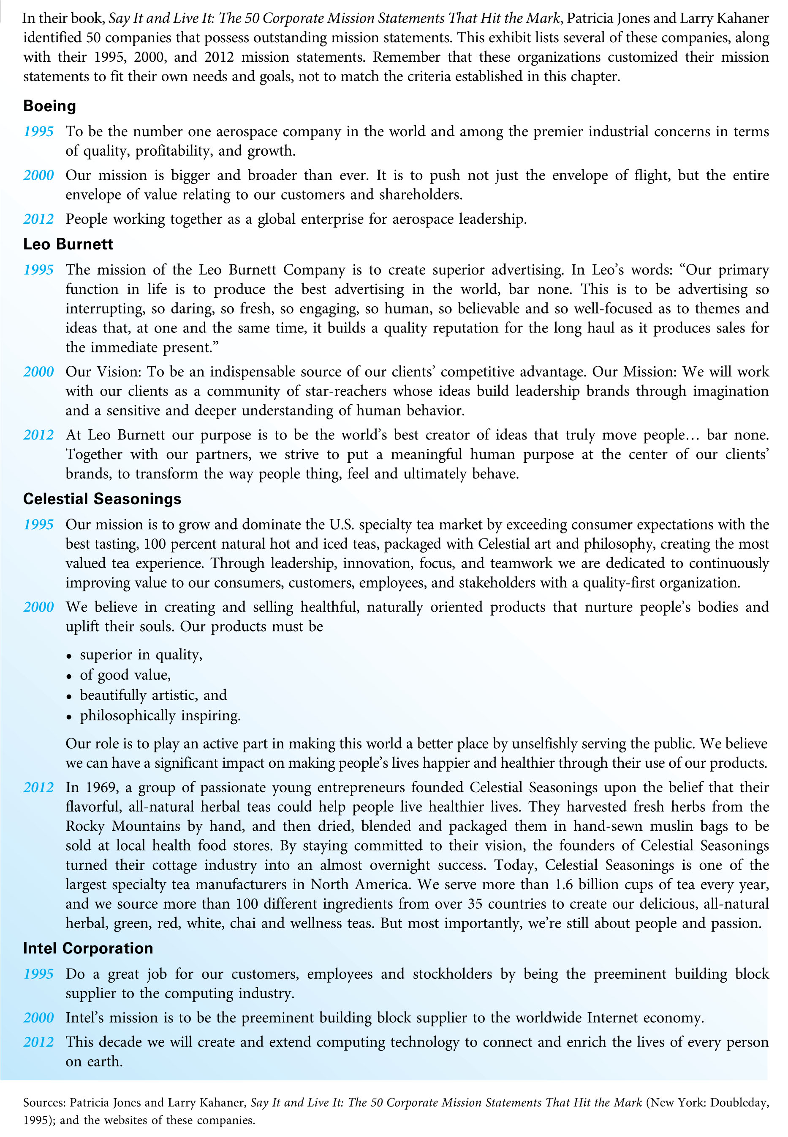
The Best Mission Statements (Exhibit 2.2)

Slide 7
Corporate or Business-Unit Strategy
The central means for:
Utilizing and integrating the organization’s resources
Carrying out the organization’s mission
Achieving the organization’s desired goals and objectives
Leverages the firm’s capabilities that give it a competitive, or differential, advantage
Determines the nature and future direction of each business unit
Essentially the same as corporate strategy in small businesses

Slide 8
Functional Goals and Objectives
All business functions must support the organization’s mission and goals.
Functional objectives should be expressed in clear, simple terms.
All functional objectives should be reconsidered for each planning period.

Slide 9
Functional Strategy
Functional strategies are designed to integrate efforts focused on achieving the area’s stated objectives.
The strategy must:
Fit the needs and purposes of the functional area
Be realistic with the organization’s resources and environment
Be consistent with the organization’s mission goals, and objectives.
The effects of each functional strategy must be evaluated.

Slide 10
Implementation
Involves activities that execute the functional strategy
Functional plans have two target markets:
External market
Internal market
A company must rely on its internal market – its employees – for a functional strategy to be implemented successfully.

Slide 11
Defend or contradict this statement:
Developing marketing strategy is more important than implementing marketing strategy because if the strategy is flawed, its implementation doesn’t matter.

Slide 12
Evaluation and Control
Designed to keep planned activities on target with goals and objectives
Coordination and open communication among functional areas are critical issues
Evaluation and control is both an ending and beginning
Occurs after a strategy has been implemented
Serves as the beginning point for planning in the next cycle

Slide 13
The Marketing Plan
Detailed formulation of the actions needed to carry out the marketing program; an action document – the handbook for marketing implementation, evaluation, and control
Not the same as a business plan
Requires a great deal of information from many different sources
Should be well organized. A good marketing plan outline is:
Comprehensive
Flexible
Consistent
Logical

Slide 14
Marketing Plan Structure (Exhibit 2.3)
Executive Summary
Synopsis of the major aspects of the marketing plan
Situation Analysis
Internal environment
Customer environment
External environment
SWOT Analysis
Strengths, weaknesses, opportunities, threats
Analysis of the SWOT matrix
Developing competitive advantages
Establishing a strategic focus

Slide 15
Marketing Plan Structure (Exhibit 2.3) (continued)
Marketing Goals and Objectives
Formal statements of desired and expected outcomes of the marketing plan
Goals
Broad, simple statements of what is to be accomplished
Objectives
More specific performance targets
Marketing Strategy
Primary (and secondary) target market
The marketing program
Branding and positioning strategy

Slide 16
Marketing Plan Structure (Exhibit 2.3) (continued)
Marketing Implementation
What specific marketing activities will be undertaken?
How will these activities be performed?
When will these activities be performed?
Who is responsible for the completion of these activities?
How will the completion of planned activities be monitored?
How much will these activities cost?
Evaluation and Control
Formal marketing control
Informal marketing control
Financial assessments

Slide 17
Tips for Using the Marketing Plan Structure
Plan ahead
Revise, then revise again
Be creative
Use common sense and judgment
Think ahead to implementation
Update regularly
Communicate to others

Slide 18
Purposes and Significance of the Marketing Plan
A good marketing plan will:
Explain both the present and future situations of the organization
Specify the outcomes that are expected
Describe the specific actions that are to take place
Identify the resources that will be needed
Permit the monitoring of each action and its results
Communicating the strategy to top executives is paramount.

Slide 19
In many organizations, marketing does not have a place of importance in the organizational hierarchy. Why do you think this happens? What are the consequences for a firm that gives little importance to marketing relative to other business functions?

Slide 20
Organizational Aspects of the Marketing Plan
Top managers ask two questions:
Will the marketing plan achieve the desired marketing, business unit, and corporate goals and objectives?
Are there alternative uses of resources that would better meet the firm’s objectives?
The marketing plan is most often prepared by the marketing manager, brand manager, or product manager.
The final approval of the marketing plan lies with the President, Chairperson, or CEO

Slide 21
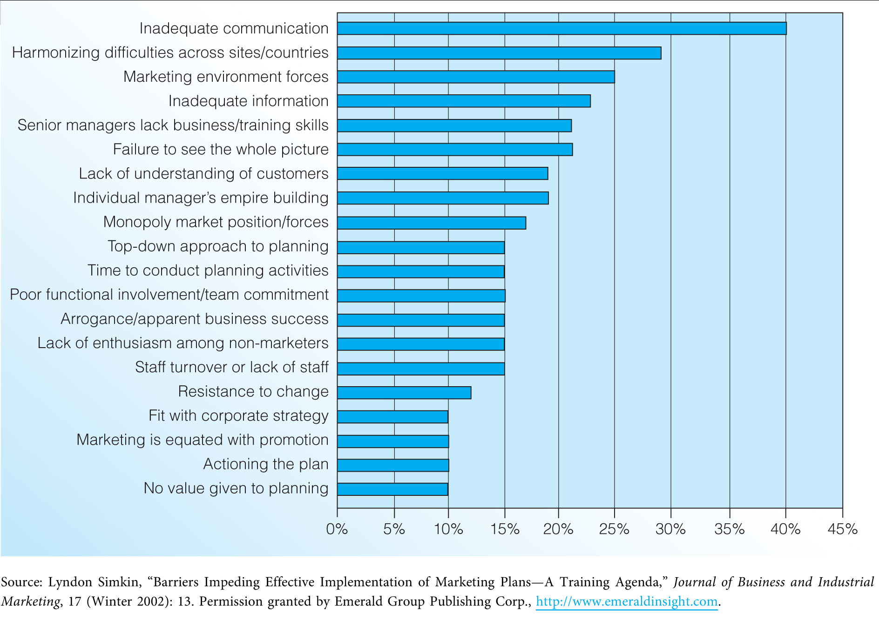
Obstacles to Developing Marketing Plans (Exhibit 2.4)

Slide 22
Maintaining Customer Focus and Balance in Strategic Planning
Changes in the focus and content of strategic plans over the last two decades:
Renewed emphasis on the customer
Advent of balanced strategic planning
These changes require a shift in focus
From products to the requirements of specific target market segments
From customer transactions to customer relationships
From competition to collaboration

Slide 23
Customer-Focused Strategic Planning
Puts customer needs and wants first
Focuses on long-term, value-added relationships
Focuses on understanding customers in ways that enhance sustainable competitive advantages
Instills a corporate culture that places customers at the top of the organizational hierarchy
Finds ways to cooperate with suppliers and competitors to serve customers more effectively and efficiently

Slide 24
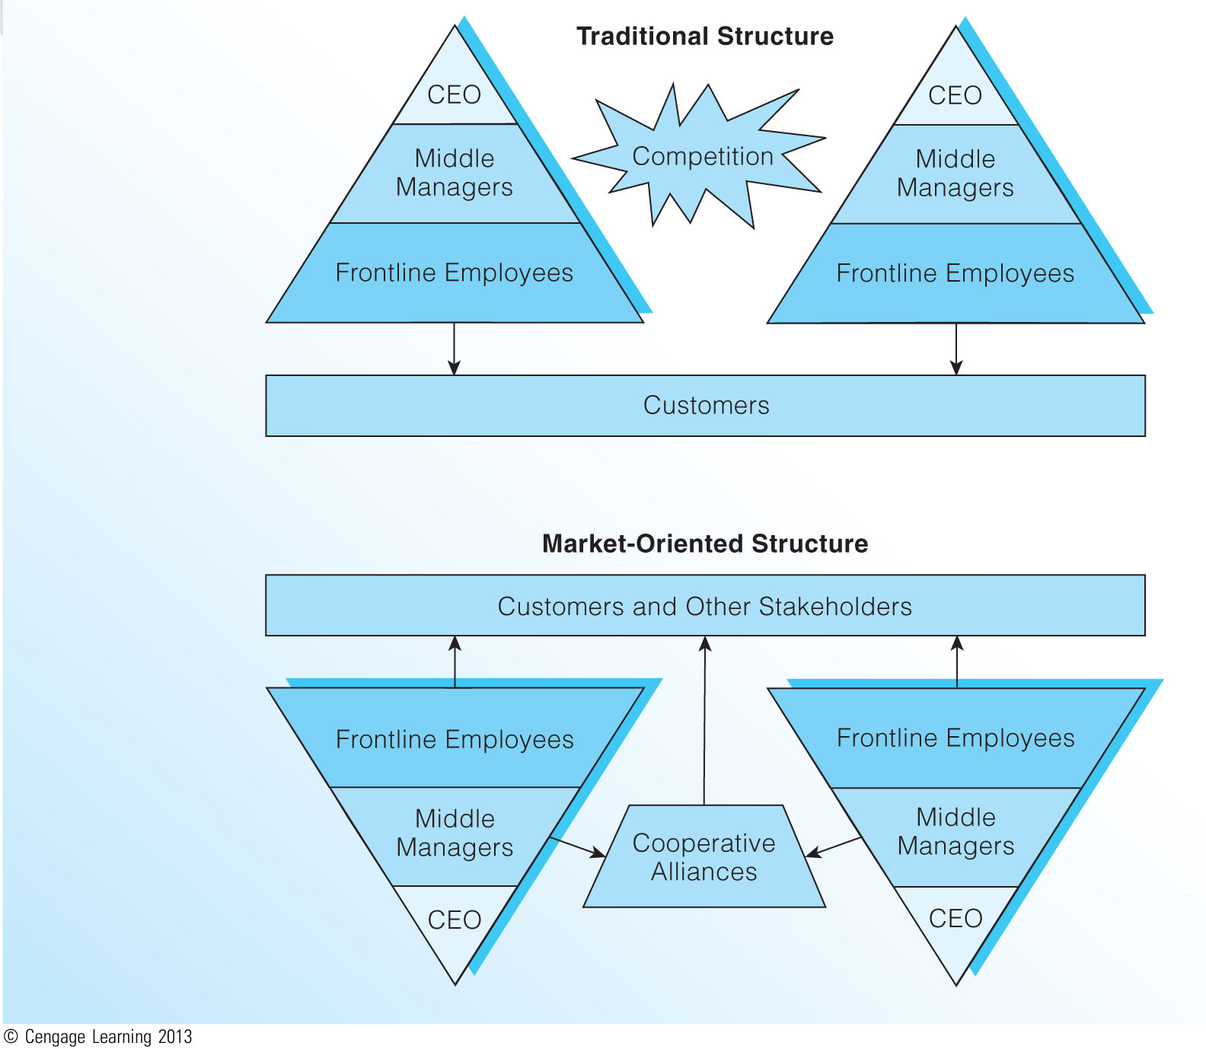
Traditional versus Market-Oriented Structures (Exhibit 2.5)

Slide 25
Balanced Strategic Planning
Traditional planning approaches do not capture value created by the organization’s intangible assets (relationships, processes, human resources, innovation, information)
Advocated strongly by Kaplan & Norton with their creation of the Balanced Performance Scorecard
Aligns four complementary perspectives
Financial indicators
Customers
Internal processes
Learning and growth

Slide 26
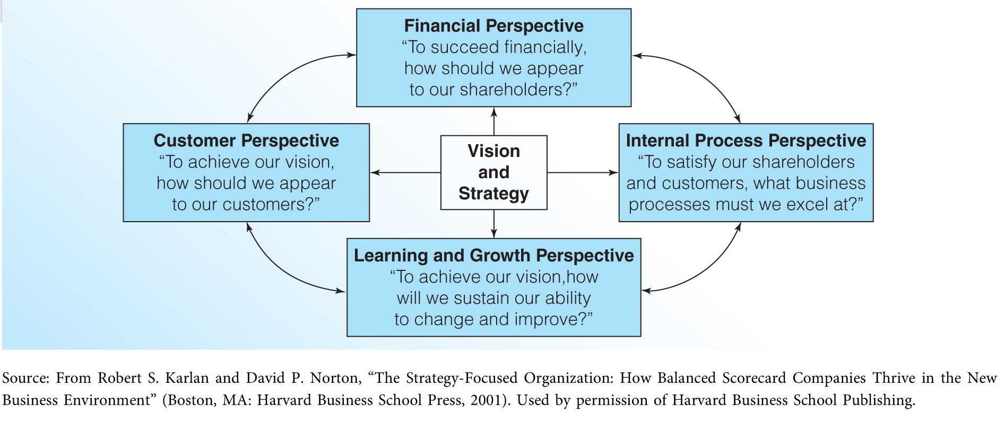
The Balanced Performance Scorecard (Exhibit 2.6)

Slide 27
How Successful Firms Use the Balanced Scorecard
Translate the Strategy into Operational Terms
Align the Organization to Strategy
Make Strategy Everyone’s Everyday Job
Make Strategy a Continual Process
Mobilize Change through Executive Leadership

Slide 28
What are some of the potential difficulties in approaching strategic planning from a balanced perspective? Isn’t financial performance still the most important perspective to take in planning? Explain.

