Slide 1
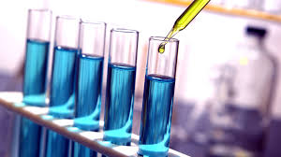
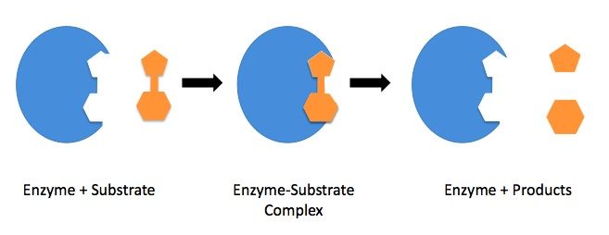
Introduction to Enzymology -Some factors Affecting polyphenol Oxidase Activity

Slide 2
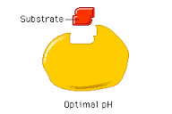
Important notes:
There are 3 terms for an enzymatic reaction to happen:
Presence of enzyme
Presence of substrate
Availability of appropriate conditions ( 37 C, pH 6.7)
→ If any of these terms are absent there will be no enzymatic reaction.
Enzyme
Optimal pH and Temperature

Slide 3
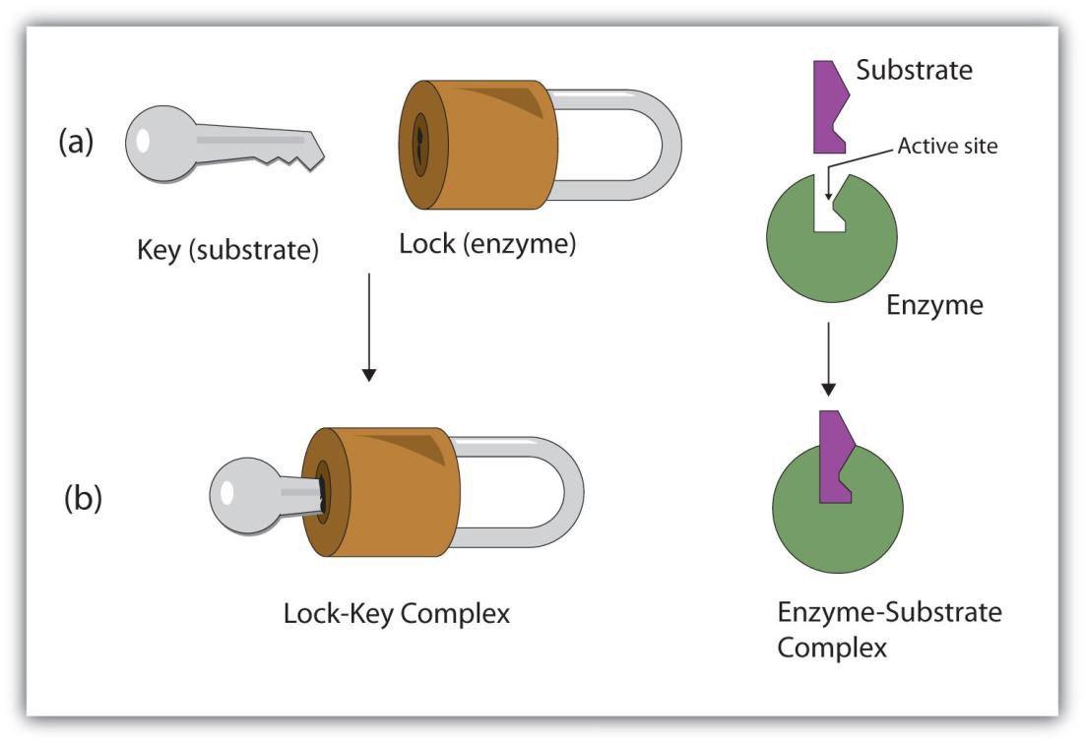
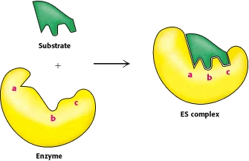
How can substrate bind to the Enzyme?
1- The Key and lock hypothesis
2- Induced fit model
Both the enzyme and the substrate possess specific complementary geometric shapes that fit exactly into one another
The substrate does not simply bind to a rigid active site; the amino acid side chains which make up the active site are molded into the precise positions that enable the enzyme to perform its catalytic function.

Slide 4
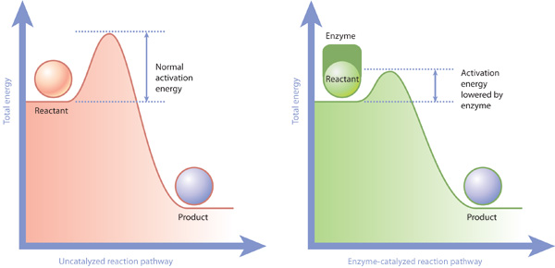
How can enzyme increase the rate of a biochemical reactions?
1. Lowering the activation energy
2. Reducing the chance in the collisions of molecules or ions
Activation energy : Is the energy that must be overcome in order for a chemical reaction to occur/the minimum energy required to start a chemical reaction ,given in units of kilojoules/mole.

Slide 5
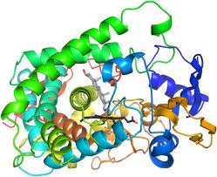
To detect and follow the progress of the reaction in this experiment a simple, qualitative method will be used.
More sophisticated, quantitative methods of following enzyme catalyzed reactions will be introduced later in the course.
In This Lab Polyphenol Oxidase will be studied as an example to understand factors that could affect enzymes
Because hundreds of reactions are simultaneously carried out in the living cell, it becomes difficult to study a single reaction in an intact living cell.
However, it is possible to extract enzymes from cells and thus study enzyme catalyzed reactions in a test tube. In this experiment, a crude extract of the enzyme polyphenol oxidase will be prepared from the potato.

Slide 6
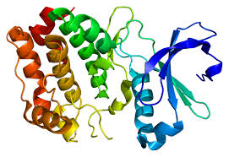
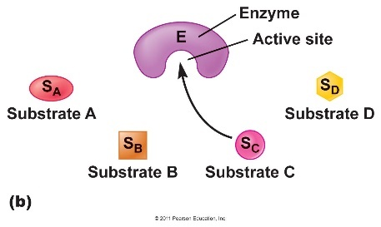
Objectives:
polyphenol oxidase in crude extract prepared from potato.
The effect of time
Chemical nature of this enzyme
Substrate Sepecifity
The effect of temperature
In this experiment you will notice the change qualitatively (change in the color only)

Slide 7
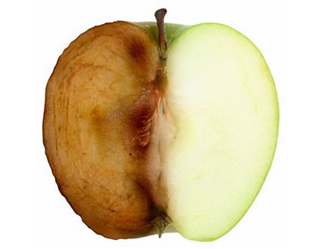
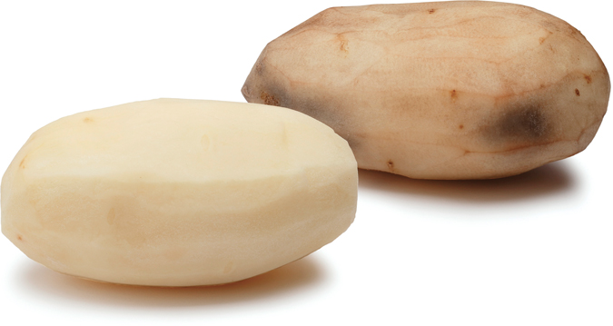
Polyphenol Oxidase:
Polyphenol oxidase (PPO):
Copper-containing enzyme with an optimum pH of 6.7. It mainly catalyses the oxidation of dihydroxy-and tri hyroxy phenol to the corresponding quinine.
This oxidation-reduction reaction is accompanied by a color change
This reaction commonly occurs in nature and accounts for the "browning" of peeled potatoes and bruised fruits.
You will familiarize yourself with the reaction catalyzed by the enzyme polyphenol oxidase, as it occurs removed from the intact living cell, i.e. in a test tube.
Enzymatic Browning
O2 +

Slide 8
1-Time course study of enzymatic Activity:
Principle:
In this reaction we are looking for enzyme substrate reaction in general
In this experiment you will notice the change qualitatively (change in the color).
The intensity of this color (brown) will be proportional to the enzyme’s activity in the tube under observation.
You must notice the color change with the time..
S + E ES P + E
enzyme-substrate complex

Slide 9
Time course study of enzymatic Activity:
Label three clean test tubes A, B and C.
Prepare each tube as follows:
c. Place all three tubes in a water bath at 37 ºC.
d. Shake each tube every 5 minutes to aerate, thereby adding oxygen to the solution.
e. Every 5 minutes, after shaking, hold the tubes up to the light and examine.
Tube | Addition
TUBE A | 15 drops of enzyme extract. 15 drops of 0.01M catechol solution
TUBE B | 15 drops of enzyme extract. 15 drops of distilled water.
TUBE C | 15 drops of 0.0M catechol solution. 15 drops of distilled water

Slide 10
Results:
1-Enzymic activity: Record the color in each tube, according to the scheme described in this page, in the table in the "Results" section. Continue for 25 minutes.
Incubation time (minutes) | Degree of color intensity (Symbol: −, +, ++ or +++)
 | TUBE A | TUBE B | TUBE C
0
5
10
15
20
25

Slide 11
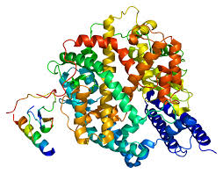
2-CHEMICAL NATURE OF POLYPHENOL OXIDASE:
Majority of enzymes are proteins. Some are made of RNA
The nature of polyphenol oxidase will be examined wither is it protein or not
Protein (Enzyme) RNA(catalytic)

Slide 12
Chemical nature of polyphenol oxidase:
a. Label four clean test tubes A, B, C and D.
b. Prepare, and teat, each tube as follows:
Tube | (1) | (2) | (3)
TUBE A | 15 drops of enzyme extract. 15 drops of 0.01M catechol solution | Shake tube and place in water bath at 37 ºC for 10 minutes. As a Control!
TUBE B | 10 drops of enzyme extract. 10 drops of 5% trypsin solution. | Shake tube thoroughly. Place tube in a water bath at 37 ºC for 10 minutes. | Add 10 drops of 0.01M catechol solution. Place in water bath at 37 ºC for 10 minutes

Slide 13
TUBE C | Add 10 drops of enzyme extract. Add 10 drops of 5% trichloroacetic acid. | Shake tube thoroughly and wait 5 minutes. | Add 10 drops of 0.01M catechol solution. Place in water bath at 37 ºC for 10 minutes
TUBE D | Add 15 drops of enzyme extract. Add a few crystals of phenylthiourea | Shake tube thoroughly and continue shaking it frequently during a period of 5 minutes. | Then add 15 drops of 0.01M catechol solution. Place in water bath at 37 ºC for 10 minutes
Examine and compare with tube A.
Record your observations in the table in the "Results" section.

Slide 14
Results:
2-Chemical nature of polyphenol oxidase
Tube | Treatment | Degree of color intensity (Symbol: −, +, ++ or +++)
A | Control
B | Trypsin
C | TCA
D | Phenylthiourea
Trypsin: a proteolytic enzyme
TCA: an acid( low pH) that precipitate and denature proteins
Phenylthiourea: Phenylthiourea has a very strong chemical affinity for the element copper.

Slide 15
3- Substrate specificity:
The substrate binds to the enzyme at the active site. Since enzymes are proteins, this site is composed of a unique combination of amino acid residues (side chains or R groups). Which play a role in the specifity of the enzyme toward substrate

Slide 16
Types of Enzyme Specificity
There are four distinct types of specificity:
Absolute specificity - the enzyme will catalyze only one reaction.
Group specificity - the enzyme will act only on molecules that have specific functional groups, such as amino, phosphate and methyl groups.
Linkage specificity - the enzyme will act on a particular type of chemical bond regardless of the rest of the molecular structure.
Stereochemical specificity - the enzyme will act on a particular steric or optical isomer.

Slide 17
3-Substrate specificity:
The three compounds used as substrates in this part of the experiment are structurally related (mono-and di-hydroxyl phenol)

Slide 18
3-Substrate specificity:
Label three clean test tubes A, B and C.
Shake the tubes gently and place them in a water bath at 37 ºC.
Examine the tubes after 5 minutes and after 10 minutes. Record the color in each tube, in the table in the "Results" section.
The three compounds used as substrates in this part of the experiment are structurally related, as shown in the figure below. Each is capable of reacting with oxygen to form various colored products.
Tube | (1) | (2)
TUBE A | 15 drops of enzyme extract. | Add 15 drops of 0.01M catechol solution
TUBE B | 15 drops of enzyme extract. | Add 15 drops of 0.01M phenol solution
TUBE C | 15 drops of enzyme extract. | 15 drops of 0.01M hydroquinone

Slide 19
Results:
Substrate specificity:
Substrate | Degree of color intensity (Symbol: −, +, ++ or +++)
 | 5 minutes | 10 minutes
Catechol
Phenol
Hydroquinone

Slide 20
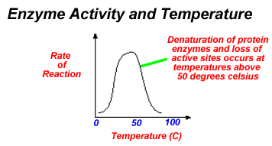
4-Temperature and enzymatic activity:
Optimum Tm:
is that Tm at which the activity of the enzyme is maximum

Slide 21
4-Temperature and enzymatic activtiy:
Label three clean test tubes A, B and C.
Shake each tube gently and quickly return it to its proper temperature condition.
Wait for 15 minutes. After this time, examine each tube, without removing it from its temperature condition, and record the color in each tube, according to the scheme described on page 3, in the table in the "Results" section.
Tube | (1) | (2) Incubate At: | (3)
TUBE A | Add 15 drops of enzyme extract to each tube. | 0 ºC | Add 15 drops of 0.01M catechol solution to each tube.
TUBE B | Add 15 drops of enzyme extract to each tube. | 37 ºC. | Add 15 drops of 0.01M catechol solution to each tube.
TUBE C | Add 15 drops of enzyme extract to each tube. | 70 ºC. | Add 15 drops of 0.01M catechol solution to each tube.

Slide 22
4-Temperature and enzymatic activity
Temperature (ºC) | Degree of color intensity (Symbol: −, +, ++ or +++)
0
37
70

Slide 23
Discussion
Discuss in each experiment what you observing and the reasons behind the findings

