Slide 1
Lab 6 Quantitative determination of protein by the Lowry method
Daheeya Alenazi
1442
CLS 282

Slide 2
Methods of protein determination:
There are many methods, and the common methods are:
Kjeldahl method ( for total nitrogen)
Biuret assay ( using known protein to establish a standard curve)
Lowry assay ( based on the presence of tyrosine and tryptophan in a protein)
** Lowry is more sensitive than biuret method).
** The method was first proposed by Lowry in 1951.

Slide 3
Principle (2 steps)
A)reaction of peptide bonds of the protein with cupric copper under alkaline conditions and
CU⁺² + peptide bonds Alkaline PH reactivity of the peptide nitrogen[s] with the copper [II] ions ( pink-violet colored complex )
B)reduction of phosphomolybdic acid by tyrosine and tryptophan (aromatic aminoacids) residues of the protein→ Blue color because of folins reagent(heteropolymolybdenum)
The color shows a maximum absorption at 720 nm.

Slide 4
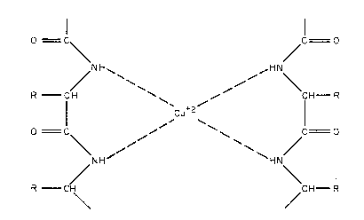
Cu²⁺ - peptide complex

Slide 5
Assay sensitivity and objective:
To determine the concentration of the protein.(0.01-2mg/ml)
To construct standard graph on paper by using several dilutions.

Slide 6
Procedure:C1-0.2 mg/ml,V2-1,C2-?
 | Blank | Std1 | Std2 | Std3 | Std4 | Std5 | Unknown sample
Concentration of standard protein (mg/ml) | - | ? | ? | ? | ? | ? | -
Volume of protein standard (ml)(V1) | - | 0.2 | 0.4 | 0.6 | 0.8 | 1
Volume of unknown (ml) | - | - | - | - | - | - | 1
Distilled water (ml) | 1 | 0.8 | 0.6 | 0.4 | 0.2 | - | -
Alkaline solution (ml) CuSO4 | 5 | 5 | 5 | 5 | 5 | 5 | 5
Mix and incubate at 37º C for 10 minutes. | Mix and incubate at 37º C for 10 minutes.
Folins Reagent (ml) heteropolymolybdenum Blue | 0.5 | 0.5 | 0.5 | 0.5 | 0.5 | 0.5 | 0.5
Mix and incubate at 37º C for 30 minutes and Read absorbance of standards and unknown at wavelength 720nm against the blank using the spectrophotometer. | Mix and incubate at 37º C for 30 minutes and Read absorbance of standards and unknown at wavelength 720nm against the blank using the spectrophotometer.

Slide 7
Calculating concentration of standard
Use formula C1V1=C2V2
C1=0.2mg/ml
V1=Volume of protein standard
V2=1ml
C2=?
*Make Standard Curve.

