Slide 1
Cls 282 haifa altwaijry Daheeya Alenazi
Effect of bile salts on pancreatic lipase activity

Slide 2
Introduction
Pancreatic lipase, is secreted from the pancreas, that hydrolyzes dietary fat molecules in the human digestive system, converting triglyceride substrates found in ingested oils to monoglycerides and free fatty acids.

Slide 3
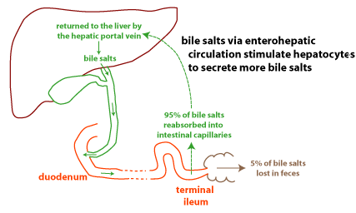
Introduction:
.

Slide 4
Bile consists of watery mixture of organic and inorganic compounds.
Bile can either pass directly from the liver where it is synthesized into the duodenum through the common bile duct where they coat and emulsify large fat droplets into smaller droplets, thus increasing the overall surface area of the fat.

Slide 5
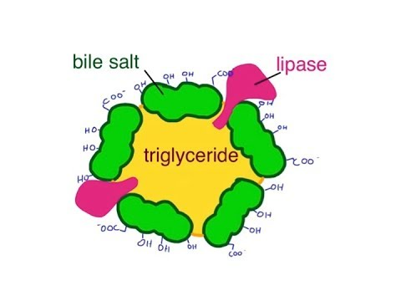
which allows the lipase to break apart the fat more effectively,
or bile stored in the gallbladder when not immediately needed for digestion

Slide 6
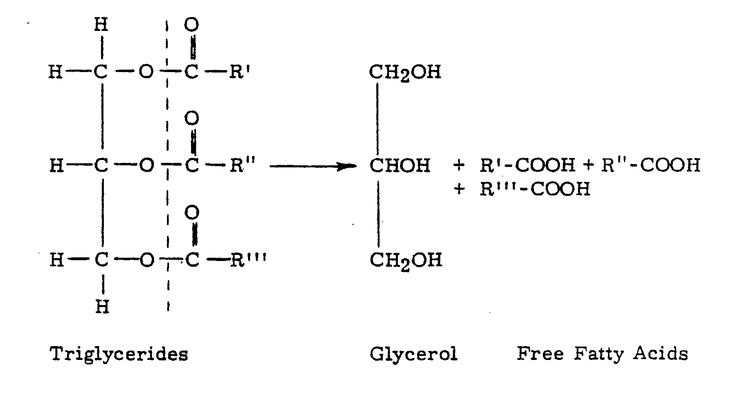
Principle of lipid hydrolysis
Pancreatic Lipase

Slide 7
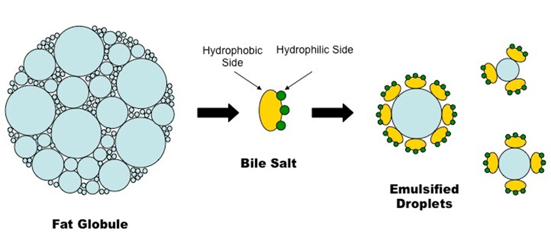
Bile Salts Function
*In digestion, lipids start out as large globs that are hard for enzymes to get to and for the body to absorb. The bile salts aid in emulsification, meaning that they break down the big glob into smaller ones. This way, the lipases have more surface area to work on.
*Bile salts hasten the hydrolysis by increased enzyme catalysis.

Slide 8
So, they are important in digestion of fats.
Because they lower tension of fatty materials which enable them to emulsified in an aqueous medium.
That mean increases the surface area of fat, making it available for digestion by lipases, which cannot access the inside of lipid droplets .

Slide 9
Examples of bile salts:
Sodium glycocholate and sodium taurocholate are examples of bile salts.
Potassium and calcium bile salts are also common.
Deoxycholic acid.
Glycocholic acid (cholylglycine).

Slide 10
Method
A
B(control)
0.5ml Vegetable oil
+2.0 ml Sodium cholate(as bile salts)
+4ml Pancreatin solution
0.5ml Vegetable oil
+2.0 ml H2O
+4 ml Pancreatin solution
Mix and cover the flasks,
then incubate in hot plate or water bath at 45C for 90 min.
Shake by rotation each of flasks at 15min intervals

Slide 11
Then add 8 drops of phenolphthalein indicator to both flasks.
Titrate against 0.05 N sodium hydroxide NaOH to a distinctly permanent pink (30 sec at least)end point.
Record the titration volumes and calculate the conc. free fatty acids produced with and without presence of bile salts.
Use peer’s Low (C1xV1=C2xV2)

Slide 12
Calculation
C1 X V1 = C2 X V2
C1=NaOH conc.=0.05
V1=Volume from titration
V2=Oil volume=0.5 ml
C2= Calculation??
Flask A:
0.05 X V1(NaOH) = C2 X 0.5
Blank flask B:
0.05 X V1 = C2 X 0.5
1(sample) – 2(blank) =Net free fatty acid in 0.5ml of fat

Slide 13
Results
Both flasks give Pink color
Because of lipase enzyme add and hydrolyzed oil.
The difference between them is the presence of bile salts:
If there are bile salts in flask A , it will take more volume of NaOH to reach equilibrium point.

