Slide 1
The Evolutionary History and Phylogeny of Turtles
Nasser Ben Qasem
503-Biology
WIU

Slide 2
Introduction
Turtles are reptiles of the order Testudines characterized by a special bony or cartilaginous shell.
The order Testudines includes both extant (living) and extinct species. The earliest known members of this group date from more than 200 million years ago, making turtles one of the oldest reptile groups and a more ancient group than snakes or crocodilians (Joyce, 2007).
Of the 327 known species alive today, some are highly endangered (Vitt et al, 2013).
Turtles are classified as amniotes along with other reptiles, birds, and mammals. Like other amniotes, turtles breathe air and do not lay eggs underwater, although many species live in or around water.

Slide 3
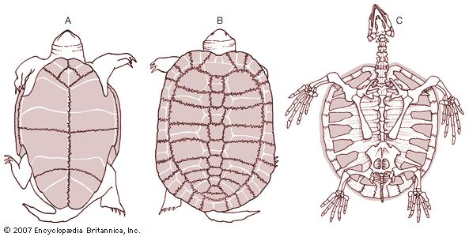
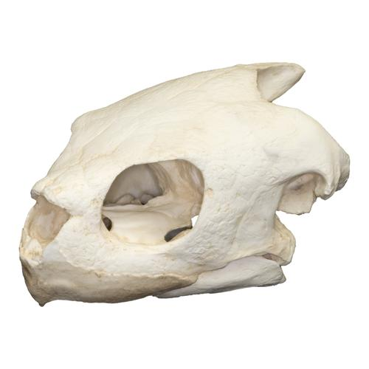
The Characteristics Of Turtles
The turtle skeleton :
The embryonic origin of the turtle shell has been debated with competing hypotheses proposing that :
It is derived from dermal bone (like osteoderms).
It is from the elements of endochondral bone that form the axial skeleton and long bones of tetrapods.
The turtle shell :
The turtle shell has two parts :
A dorsal carapace
A ventral plastron
https://www.britannica.com/science/plastron
The skull of turtles :
Among extant amniotes, only the turtles have anapsid skull condition.
https://www.skullsunlimited.com/products/replica-olive-ridley-sea-turtle-skull-tq-178

Slide 4
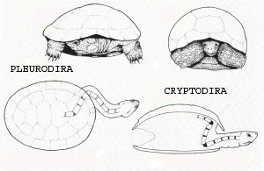
Classification of Turtles
All extant turtles belong to one of two clades , the Pleurodira and Cryptodira.
The 14 extant turtle families contain approximately 341 species
Pleurodira includes the extant 3 freshwater families.
http://www.sulisuli.com/rettili/cheloniCHISONO.htm
Cryptodira includes the extant 11 families, which may be freshwater, marine, or terrestrial.
Although both clades are supported by numerous skeletal characters, they are most easily identified by their mode of neck retraction.

Slide 5
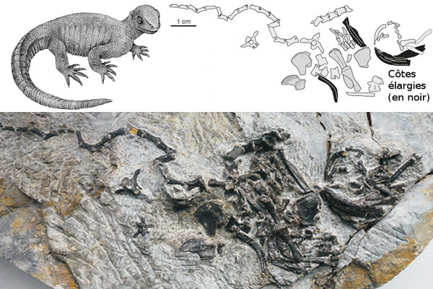
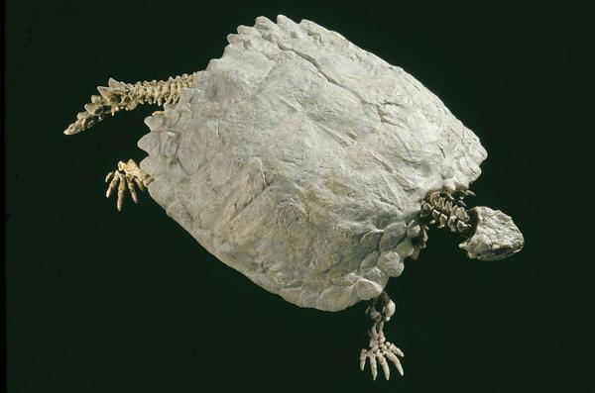
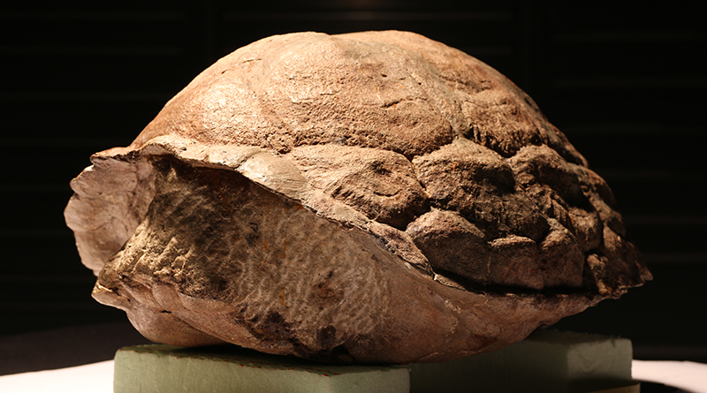
Evolutionary History of Turtles
Fossil record
Turtles have the most complete fossil record of any extant reptiles because of their heavy, bony skeletons and their aquatic or marine habits.
The earliest-known turtle fossils are from the Middle Triassic , Pappochelys rosinae (Schoch and Sues, 2015).
https://www.lafermetropicale.com/decouverte-pappochelys-rosinae-une-forme-intermediaire-entre-tortue-et-lezard/
The oldest Cryptodire, Kayentachelys aprix, is known from the Early Jurassic Kayenta Formation of Arizona (Joyce and Sterli 2012).
It lived in an environment dominated by streams and dunts.
The oldest Pleurodire is the Late Triassic Proterochersis ( Gaffney et al. 2006).
It was an early terrestrial turtle that lived in Europe.
https://reptilis.net/2010/06/26/t-u-r-t-l-e-power-part-2-the-weird-and-wacky-origin-of-turtles
http://www.wildprehistory.com/gallery/picture-of-the-day/picture-proterochersis-robusta/

Slide 6
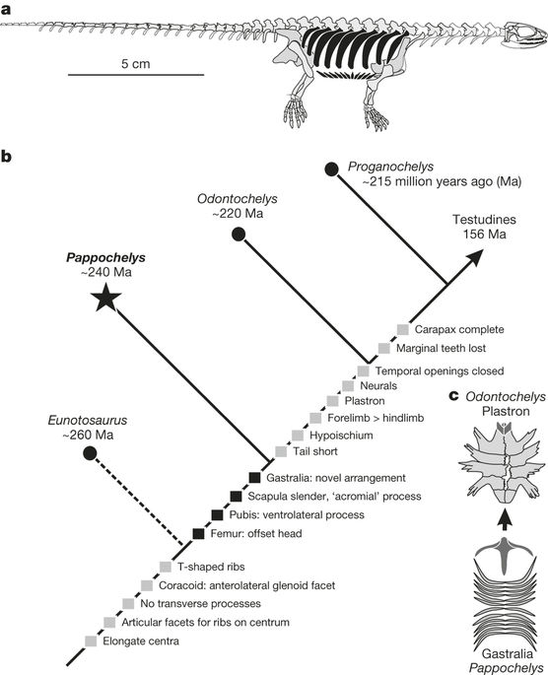
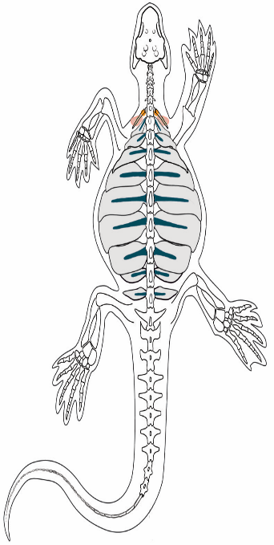
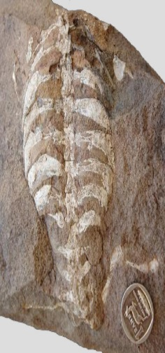
The Timeline of Evolution In Turtles
Eunotosaurus
(Seeley, 1892)
From the late Middle Permian, South Africa.
Anatomical studies and phylogenetic analysis suggest that Eunotosaurus is a parareptile (Benton, 2016).
The skull is short and wide
It had very wide dorsal ribs which contacted each other, this proves point for powerful leg muscles for digging.
Elongated vertebra.
It lacked the intercostal muscles on its vertebrae that turtles do possess.
(Schoch and Sues , 2015)
(Schoch and Sues , 2015)

Slide 7
The Timeline of Evolution In Turtles
Pappochelys (Schoch and Sues, 2015).
From the Middle Triassic ( 240 million years ago), Germany.
It is structurally and chronologically the intermediate form between Eunotosaurus and Odontochelys.
It was a small, flattened, elongate animal about 20 cm in length.
The gastralia are tightly packed and occasionally fused together, forming a structure similar to the plastron of turtles.
Its skull has small upper and ventrally open lower temporal fenestrae supporting diapsid hypothesis of turtles.
Unlike turtles, it has teeth in its jaws and lacks a beak.
(Schoch and Sues, 2015)

Slide 8
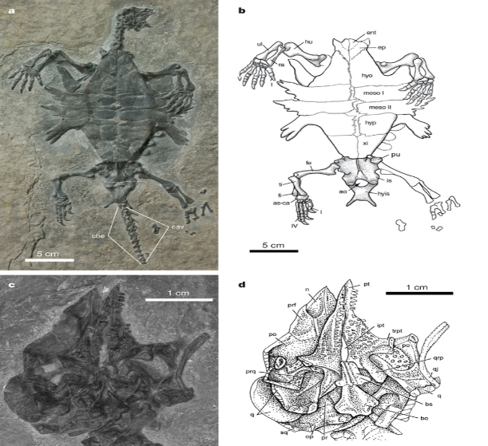
The Timeline of Evolution In Turtles
Odontochelys
(Li et al, 2008)
"toothed turtle with a half-shell"
From the Late Triassic , China.
It is the first Turtles with an incomplete shell.
Odontochelys only possessed the bottom portion which is plastron which is evidence that Odontochelys were marine creatures.
It had teeth in their upper and lower jaws, in contrast, modern turtles have a horny beak without teeth in their mouth.
(Schoch and Sues, 2015)
It did not yet have a solid carapace as most other turtles.
Instead of a solid carapace, it possessed broadened ribs like those of modern turtles embryos that still have not started developing the ossified plates of a carapace.
(Li et al, 2008)

Slide 9
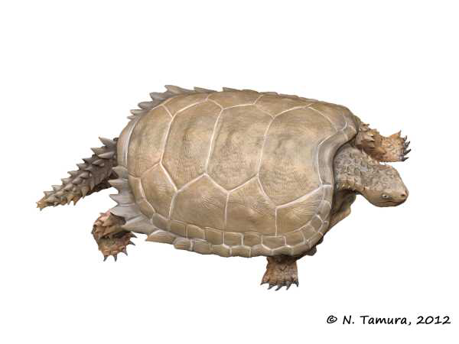
The Timeline of Evolution In Turtles
Proganochelys
(Baur, 1887)
From Late Triassic
Its overall appearance resembled modern turtles :
It lacked teeth.
It had a developed carapace and plastron, shows adaptation for moving to the land.
Some differences from modern turtles:
(Schoch and Sues, 2015)
It had long tail which was covered with spikes and ended with clubbed tip.
Spines protecting in its neck.
Teeth-like scales on its palate.
(Schoch and Sues, 2015)

Slide 10
The phylogeny Of Turtles
The origin and early evolution of turtles have long been major contentious issues in vertebrate zoology.
So, there are three hypothesis of turtles origins :
1. Anapsid hypothesis
2. Lepidosaur hypothesis
3. Archosaur hypothesis

Slide 11
The phylogeny Of Turtles
Anapsid Hypothesis
The anapsid hypothesis is the traditional arrangement.
Turtles lack temporal fenestrae (anapsid condition) and are most closely related to a group of reptiles that share and that diverged before the origin of diapside.
The morphological data support this hypothesis.
No modern phylogeny based on molecular data upholds this relationship.
(Pough, 2016)
(Crawford, 2012)

Slide 12
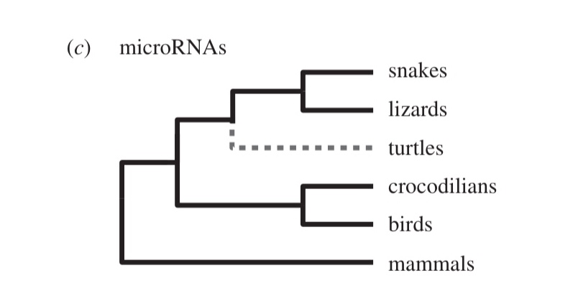
The phylogeny Of Turtles
Lepidosaur Hypothesis
The hypothesis that turtles are diapsids and the sister lineage to Lepidosaur.
It supported by some morphological data.
Molecular data supported this hypothesis by using microRNA
Is not widely accepted.
(Lyson, 2012)
(Lyson, 2012)

Slide 13
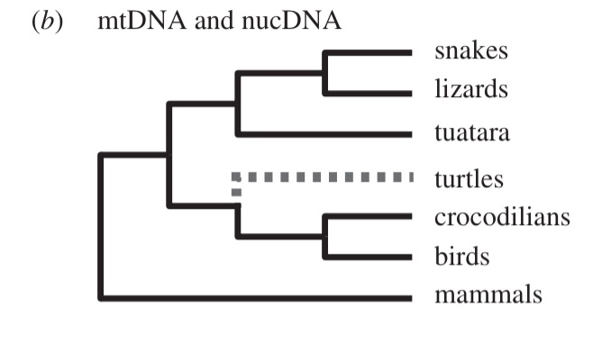
The phylogeny Of Turtles
Archosaur Hypothesis
The hypothesis is that turtles are diapsids and the sister lineage to extant archosaurs.
The hypothesis supported by almost all phylogenetic analysis of DNA data :
Gene as characters and parsimony analysis ( Lu, 2013).
Mitochondria DNA ( Janke, 2012).
Nuclear DNA (Katsu, 2009).
Ultraconserved elements their variable flanking DNA ( Crawford, 2012).

Slide 14
Discussion
The three taxa ( Eunotosaurus, Pappochelys, and Odontochelys ) share anteroposteriorly broad trunk ribs that are vertebrae, and modified limb girdles.
Pappochelys provides new evidence that the plastron partly formed through serial fusion of gastralia.
Using molecular data are considered a powerful approach for testing different hypothesis that focused on the origin of turtles.
The resulting phylogeny of molecular data provides overwhelming support for the hypothesis that turtles evolved from a common ancestor of birds and crocodilians, rejecting the hypothesized relationship between turtles and lepidosaurs.
(Lyson,2012) (Lu et al, 2013) (Schoch and Sues, 2015) (Fong et al, 2012)

Slide 15
References
1. Crawford, N. G, Brant, C. F, John, E. M, Robb, T. B, Kevin, W, and Travis, C. G. 2012. More than 1000
ultraconserved elements provide evidence that turtles are the sister group of archosaurs. Biol. Lett. 8:783-786.
2. Lu, B, Weizhao, Y, Qiang, D, and Jinzhong, F. 2013. Using genes as characters and a parsimony analysis to
explore the phylogenetic position of turtles. POLS ONE 8(11): e79348. doi:10.1371/journal.pone.0079348.
3. Schoch, R. R, and Sues, and H. D. 2015. A Middle Triassic stem-turtles and evolution of the turtle body plan. Natural 584(523): doi:10.1038/nature14472.
4. Bever, G. S, Lyson, T. R, Field, D. J, and Bhullar, B. A. S. 2015. Evolutionary origin of the turtle skull. Natural 239(525): doi:10.1038/natural14900.
5. Joyce, W. G. 2015. The origin of turtles: A paleontological perspective. J. Exp. Zool (Mol. Dev. Evol.)
324(B):181-193.
6. Font, J. J, Brown, J. M, Fujita, M. K, and Boussau, B. 2012. A phylogenomic approach to vertebrate phylogeny supports a Turtle-Archosaur affinity and a possible paraphyletic lissaphibia. PLOS ONE 7(11).
7. Rice, R, A. Kallonen, J. C. Thomas, and S. F. Gilbert. 2016. Development of the turtle plastron, the order-
defining skeletal structure. PNAS 113(19): 5317-5322.

