Slide 1
Estimation of Serum Urea

Slide 2
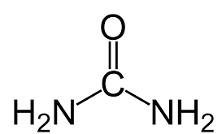
-Urea:
Urea is the highest non-protein nitrogen compound in the blood.
Urea is the major excretory product of protein metabolism.
It is formed by urea cycle in the liver from free ammonia generated during protein catabolism.
Since historic assays for urea were based on measurement of nitrogen, the term blood urea nitrogen (BUN) has been used to refer to urea determination.

Slide 3
-Urea synthesis:
Protein metabolism produces amino acids that can be oxidized.
This results in the release of ammonia which is converted to urea (via urea cycle) and excreted as a waste product.
Following synthesis in the liver, urea is carried out in the blood to the kidney which is readily filtered from the plasma by glomerulus.
Most of the urea in the glomerular filtrate excreted in the urine, and some urea is reabsorbed through the renal tubules.
The amount reabsorbed depends on urine flow rate and extent of hydration (the amount of urea reabsorbed increases with dehydration).
Notes:
Urine flow rate (or urinary flow rate, uroflowmetry) is a measure of the quantity of urine excreted in a specified period of time.
Dehydration will reduce blood volume and concentrate blood solutes including urea. Therefore, dehydration can be a cause of elevated BUN.

Slide 4
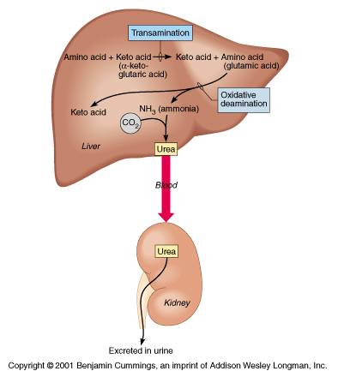
-Urea synthesis:
Notes:
- Urine flow rate (or urinary flow rate, uroflowmetry) is a measure of the quantity of urine excreted in a specified period of time.

Slide 5
- Clinical Application:
Measurement of urea used in :
Evaluate renal function.
To assess hydration status.
To determine nitrogen balance.
To aid in the diagnosis of renal diseases.
Check a person's protein balance.
Notes:
- Urine flow rate (or urinary flow rate, uroflowmetry) is a measure of the quantity of urine excreted in a specified period of time.

Slide 6
1-Plasma urea Concentration:
Measurement of Blood Urea Nitrogen (BUN) alone is less useful in diagnosing kidney diseases because it’s blood level is influenced by dietary protein and hepatic function.
 | Type | Cause | Note
High urea (High urea concentration in plasma is called azotemia) | Pre-renal | Cognitive heart failure. Dehydration. High protein diet. Increased protein catabolism. | Caused by reduced renal blood flow, less blood is delivered to kidney, then less urea is filtered.
 | Renal | Renal failure .
 | Post-renal | Urinary tract obstruction.
Low urea |  | Low protein intake. Liver disease. Pregnancy.
Notes:
Urine flow rate (or urinary flow rate, uroflowmetry) is a measure of the quantity of urine excreted in a specified period of time.
in postrenal azotemia is initially >15. The increased nephron tubular pressure (due to fluid back-up) causes increased reabsorption of urea, elevating it abnormally relative to creatinine.[
Prerenal azotemia is the most common form of kidney failure in hospitalized people. Any condition that reduces blood flow to the kidney
Pregnancy-The glomerular filtration rate increases 50% with subsequent decrease in serum creatinine, urea, and uric acid values.

Slide 7
Practical Part

Slide 8
-Objective:
Estimation of Blood urea nitrogen (BUN).
The Reagent used contains: Urease, Glutamate Dehydrogenase, NADH, α-ketoglutaric acid, buffers and stabilizers .
Reaction one: Urea is hydrolysed in the presence of urease enzyme and water to yield ammonia and carbon dioxide.
NH2 - CO -NH2 + H2O 2NH3 + CO2
Second reaction: The ammonia reacts with α-ketoglutaric acid and reduced nicotinamide adenine dinucleotide (NADH) in the presence of glutamate dehydrogenase (GLDH) to yield glutamic acid and nicotinamide adenine dinucleotide (NAD).
NH3 +HOOC-(CH2)2-CO-COOH+NADH+H ⁺ HOOC-(CH2)2-CH(NH2) COOH+NAD⁺+H2O
-Principle (of the kit used):
Urease
Urea
GLDH
α-KETOGLUTARIC ACID
GLUTAMIC ACID
Notes:
- Urine flow rate (or urinary flow rate, uroflowmetry) is a measure of the quantity of urine excreted in a specified period of time.

Slide 9
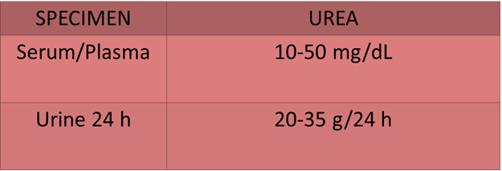
-Reference Value:
Notes:
- Urine flow rate (or urinary flow rate, uroflowmetry) is a measure of the quantity of urine excreted in a specified period of time.

Slide 10
-Materials:
BUN-ZYME Reagent: UREASE, GLDH, NADH, α-KETOGLUTARIC ACID , buffers and stabilizers.
BUN-ZYME Standard solution 25 mg/dl ( nitrogen = 53.57 mg/dl).
BUN-ZYME Serum sample.
Notes:
- Urine flow rate (or urinary flow rate, uroflowmetry) is a measure of the quantity of urine excreted in a specified period of time.

Slide 11
-Method:
 | Standard | Serum
Reconstituted Reagent | 3ml | 3ml
Pre-warm at 37ᵒC for 2 min. and add:
Standard | 0.025/25µl | -
Serum | - | 0.025/25µl
After exactly 30 seconds . read and record absorbance A1 against distilled water at 340 nm.
At exactly 60 seconds after A1, read and record the absorbance A2 and determine ∆A (A1-A2).
Notes:
- Urine flow rate (or urinary flow rate, uroflowmetry) is a measure of the quantity of urine excreted in a specified period of time.

Slide 12
-Discussion:
-Calculations of the Results :
- Concentration of urea in serum sample:
- Standard concentration= 53.57 mg/dl
- Urea (mg/dL) = Δ A (Sample) x 53.57
ΔA (Standard)
Comment on the level of Urea in serum .
Notes:
- Urine flow rate (or urinary flow rate, uroflowmetry) is a measure of the quantity of urine excreted in a specified period of time.

Slide 13
Estimation Of Arginase Activity In Liver Extract

Slide 14
- Introduction:
Ammonia product by oxidative deamination of amino acid. It is toxic in even small amount and must be removed from the body.
Arginase is one of the important enzymes in urea cycle which is the major disposal form of amino groups derived from amino acids.
Urea cycle catalyzed by a set of enzymes ( Five enzymes) present in the liver ,and then is transported in the blood to the kidneys for excretion.

Slide 15
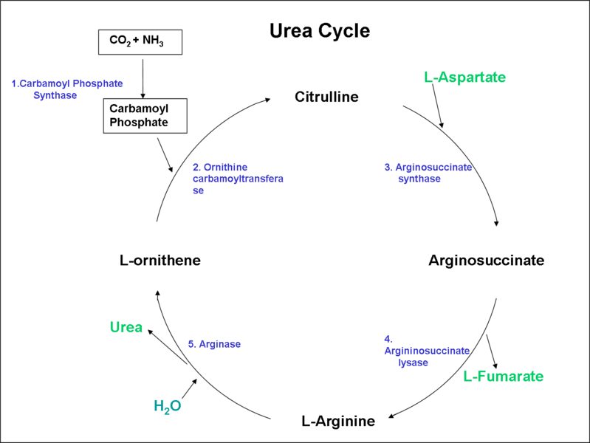

Slide 16
- Principle:
- The arginase enzyme catalyzes the fifth reaction in the urea cycle, the enzyme is present exclusively in the liver.
- Arginase catalyzes the hydrolytic cleavage of the guanidine group of Arginine to regenerate ornithine and urea.
Arginine ↔ Urea + Ornithine
- Arginase is present exclusively in liver (Cytoplasm).
- Two isozyme of this Enzyme exist , First ; Arginase I (In cytoplasm) , Second; Arginase II Regulation of the arginine/ornithine concentration in the cell (In mitochanderia).
- Arginase requires a two-molecules metal of Co²⁺ and Mn²⁺ for it’s activation while ornithine and lysine are potent inhibitors.
Notes:
Cobalt

Slide 17
- The activity of the enzyme is determined by measuring the amount of urea produced, urea is reacted with the reagent isonitrosopropiophenone and heated in boiling water, leading to the production of a red color compound which is measured spectrophotometrically at 520nm.

Slide 18
- Question:
- What are the causes of high blood ammonia level?

