Slide 1
Lab# 8
BCH 220
Erythrocyte Sedimentation Rate (ESR) and Hematocrit (HCT)

Slide 2
Objectives:
.
Determination of erythrocyte sedimentation rate (ESR).
Determination of hematocrit (HCT).
To assess the condition of a patient by such tests.

Slide 3
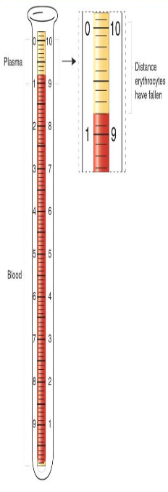
Erythrocyte Sedimentation Rate (ESR)
ESR is s the rate at which red blood cells sediment in a period of one hour..
It is used clinically as a non-specific screening test to:
detect the presence of infection in the body in general.
monitor the status of chronic inflammatory disease such as rheumatoid arthritis.
ESR is not diagnostic of any particular disease, but rather is an indication that a disease process is ongoing and must be investigated.

Slide 4
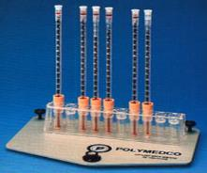
Principle
In this technique, anticoagulated whole blood are allowed to sediment under the effect of gravity, using a narrow vertical tube called Westergren’s tube.
This test is based on the fact that inflammatory and necrotic processes cause an alteration in blood proteins, resulting in an aggregation of RBCs, which make them heavier and more likely to fall rapidly when placed in a special vertical tube.
The length of the column of clear plasma at the top is noted at the end of 1 hour.

Slide 5
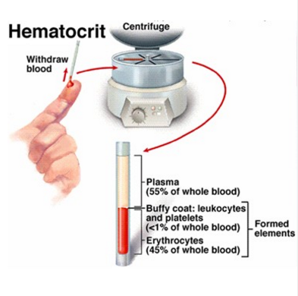
Hematocrit (HCT):
HCT or packed cell volume (PCV) is the volume percentage (%) of RBCs in blood.
Or the volume of red blood cells to the total volume of blood.
It is used as a simple screening test for anemia.
Blood is collected in heparinized capillary tube, which is then sealed, centrifuged and the red cell volume expressed as a percentage of the whole blood.

Slide 6
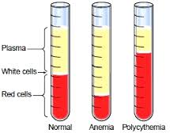
Calculation:
HCT= Length of column of RBC x 100
Total length of blood component
Normal ranges:
Male: 40.7 - 50.3% Female: 36.1 - 44.3%
LOW
HIGH
Leukemia
Dehydration
Living in high altitude

