Slide 1
Epidemiology of infectious disease
Sahar alhogail CLS 416

Slide 2
ILO of Epidemiology of infectious diseases:
Terminology, disease reservoirs
modes of transmission
public health measures for the control of epidemics

Slide 3
Difference between pathology and epidemiology
Pathology : study of disease
Pathologist : studies the structural and functional manifestation of the disease and is involved n diagnosing disease in individuals
Epidemiology studies the factor that determine the frequancy, distribution , and determinant of the disease in human poplulation
It has several factors : over crowded, lack immunization, nutritional status, inadequate sanitization ……

Slide 4
WHO
WHAT
WHERE
WHEN
WHY

Slide 5
Epidemiologic terminology
Infectious disease: Infection are a disease caused by pathogens.
Communicable and contagious disease:
Are infectious disease that can be transmitted from one human to another ( person to person)
Contagious disease:
Communicable disease that are easily transmitted from one person to another.
Zoonic disease:
Infectious disease that human acquired from animal source
Incidence and Morbidity Rate: Number of new cases of that disease in a definde population during a specific time.

Slide 6
Epidemiologic terminology
Prevalence:
They are two types :
Period prevalence: is the number of cases of the disease existing in a given population during a specific time period .
Point prevalence: is the number of cases of the disease existing in a given population at a particular moment in time.
Mortality Rate: is the ratio of the number of people who died of a particular disease during a specific time period per a specified population.
Sporadic disease: it is a disease that occur only occasionally within the population of a particular geographic area.( cholera, gas gangrene, plague, tetanus, typhoid fever)
Endemic disease: is a disease that are always present within the population of a particular geographic area.(T.B, gonorrhoea, syphilis, chicken pox…etc)
Epidemic disease: are diseases that occur in a greater than usual number of cases in a particular region and usually occur within a relatively short period of time. food poisoning
pandemic: a disease or condition that spreads across regions.
rate: number of cases occurring during a specific period; always dependent on the size of the population during that period.

Slide 8
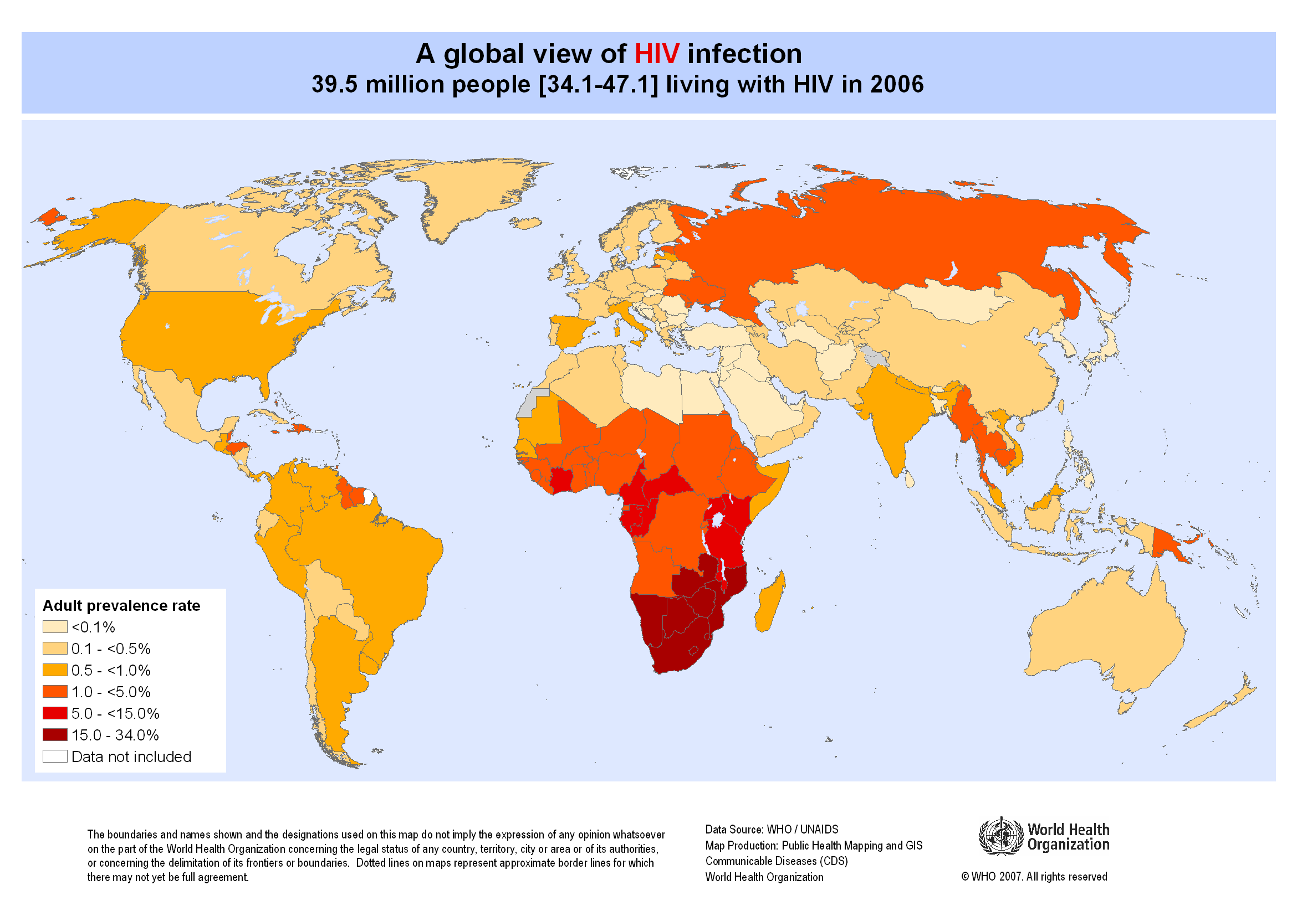
Epidemiologic terminology
Pandemic disease : is a disease that is occurring in epidemic proportions in many countries simultaneously some times world wide:
HIV/AIDS

Slide 9
Pandemic disease

Slide 10
Pandemic disease

Slide 11
Reservoirs of infection:
Living hosts
Human carriers
Animals
Non-living hosts
air
Soil
arthropods
Dust
Food
Milk
Water
fomites

Slide 12
Reservoirs of infection:
Human Carriers:
Carriers: is a person who is colonized with a particular pathogen. ( no disease currently)
Passive carriers: carry the pathogen without ever having had the disease.
Incubatory carrier: is a person who is capable of transmitting a pathogen during the incubation period of a particular infectious disease.
Convalescent carriers : harbour and can transmit a pathogen while recovering from an infectious disease
Active carrier: have completely recovered from the disease, but continue to harbour the pathogen indefinitely. Staphylococcus, streptococcus, hepatitis, diphteria, dysentery, meningitis and STDs.

Slide 13
The chain of infection

Slide 20
Public Health Core Sciences
Notes:
To implement the public health approach, practitioners use and apply scientific methods. These methods come from a series of core sciences that provide the foundation.
These sciences include Public Health Surveillance, which we use to monitor a public health situation.
Epidemiology enables us to determine where diseases originate, how or why they move through populations, and how we can prevent them. We’ll learn more about epidemiology during today’s course.
Public Health Laboratories support public health by performing tests to confirm disease diagnoses. Laboratories also support public health by conducting research and training.
As we continue to move from the use of paper documents to electronic health records, Public Health Informatics continues to increase in importance. Informatics deals with the methods for collecting, compiling, and presenting health information. It enables us to use electronic data effectively when addressing a public health situation.
Prevention Effectiveness is closely linked to public health policy. Prevention effectiveness studies provide important economic information for decision makers to help them choose the best option available.
Together, these five core sciences can help us protect and promote the public’s health by giving public health practitioners the answers they need. Public health is better able to respond to the situation by using contributions from each of these sciences. One science alone cannot answer the questions and provide a solution; it is the application of these core sciences together.
<OPTIONAL, IF TIME PERMITS, SAY>
For example, let’s look at the public health challenge of influenza. Public health surveillance can monitor when and where cases of influenza occur each year. Professionals can use the science of epidemiology to understand why different populations choose to get vaccinated against influenza. They can use the science of informatics to receive and analyze electronic information from health care institutions (e.g., doctors’ offices and hospitals) to determine whether persons who get influenza go to see a doctor and whether they get well or die. Public health practitioners can use laboratory science to determine whether persons with fever and cough have influenza or a different infection, and they can use prevention effectiveness to show that influenza vaccination campaigns that might cost $200,000 can prevent $1 million in medical costs, lost wages, and other costs.
GO to next slide.

