Slide 1
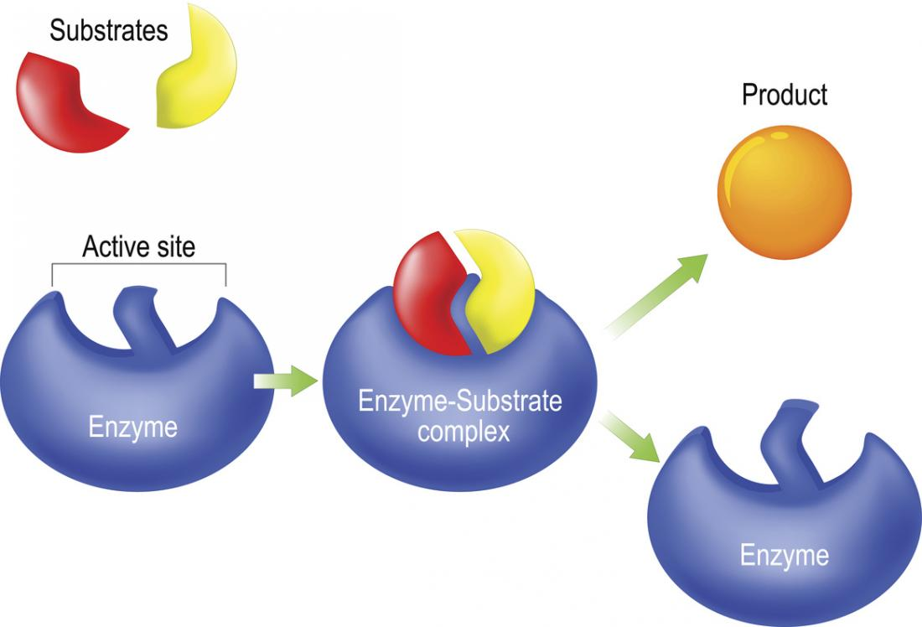
Enzymes
https://www.youtube.com/watch?v=V4OPO6JQLOE
https://www.youtube.com/watch?v=ueup2PTkFW8

Slide 2

Enzymes
Enzymes:
are specific protein catalysts that increase the rate of reaction without being changed in the overall process. (Enzymes are not consumed during the reaction).
Enzymes (E) act on certain substances which are known
as substrate (S) they form an enzyme – substrate
complex (ES) which is broken to give the product (P).

Slide 3
Nomenclature of enzymes:
Each enzyme is assigned two names:
A) Recommended name:
i) Many enzymes have been named by adding the suffix ‘ase’
a) to the name of the substrate
Maltase
(e.g., Maltose Glucose + Glucose
b) or to a word
describing their
action or activity.
ii) Some enzymes given trivial names.
(e.g., pepsin, trypsin)

Slide 4
B) Systematic name:
The international union of Biochemistry developed a system
of nomenclature.
i) This system divide enzymes into six major classes:
1. Oxidoreductases
2.Transferases
3. Hydrolases
4.Lyases
5.Isomerases
6.Ligases

Slide 5
ii) The enzyme name has 2 parts:
The first name the substrate or substrates.
The second, ending in –ase, indicates the type of reaction
catalyzed.
iii) This system give each enzyme a code number (EC) and it
contains 4 digits separated by points.
first digit: Class
second digit: sub-class
third digit: sub-sub-class
fourth digit: serial number of the enzyme.

Slide 6
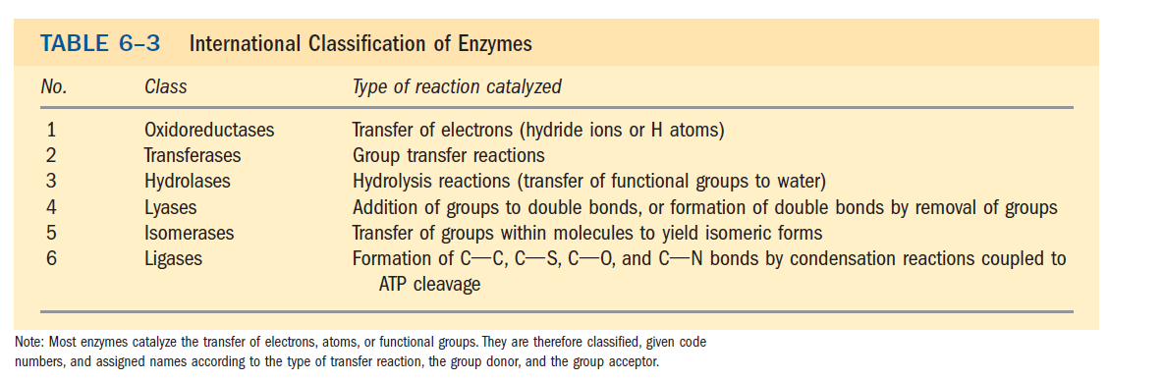

Slide 8
General characterestices of enzymes:
1)They are proteins.
2) High molecular weight proteins.
3) They act at specific PH and temperature.
4) Active site:
Enzyme molecule contain a special pocket or cleft called the
active site.
(active site is relatively small portion of the total volume of
an enzyme that bind the substrate).
-The active site contains amino acid side chains that
participate in substrate binding and catalysis.

Slide 10
5) Cofactors:
Some enzymes depend for activity only on
their structure as proteins (simple proteins)
Enzymes
While other enzymes require one or more
non-protein component known as the
cofactor (these are conjugated proteins).

Slide 11
Inorganic ( metal ions e.g., Zn⁺², Fe⁺²)
Cofactor OR
Organic molecule called coenzymes
( Coenzymes are derivatives of vitamins)
example of coenzymes: NAD⁺, FAD

Slide 13
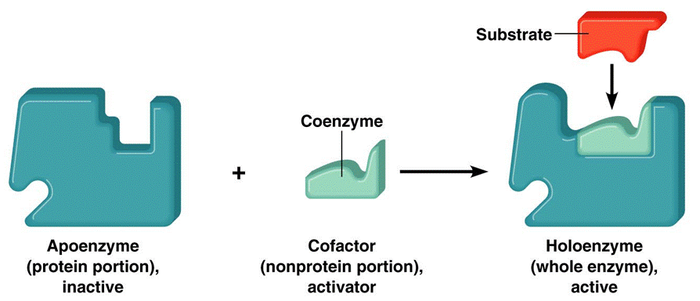
Holoenzyme: A complete, catalytically active enzyme
together with its non- protein component
(coenzyme or metal ion).
Apoenzyme: The protein part of an enzyme.( enzyme without
its non-protein moeity).
Apoenzyme + cofactor Holoenzyme
(catalytically (active enzyme)
inactive)

Slide 14
6) Specificity:
- Enzymes are highly specific, interacting with one or a few specific substrates and catalyzing only one type of chemical reaction.
Specificity Absolute specificity:
(the enzyme can act only on one substrate)
Group specificity:
(the enzyme can act on a group of related
substrates).

Slide 15
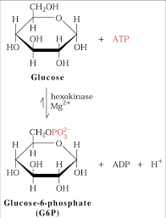
7) Enzyme inhibitors:
Some substances combine with the enzyme and reduce its
activity These are known as inhibitors.
8) Enzyme activator:
Some substances combine with the enzyme and increase its
activity These are known as activators.
- Activators include:
a) Metal ions
b) HCl HCl
Pepsinogen Pepsin
(inactive enzyme) (active enzyme)
c) Enzymes
enterokinase
Trypsinogen Trypsin
(inactive enzyme) (active enzyme)

Slide 16
How do enzymes increase the rate of a reaction?
Enzymes increase rate of reaction by decreasing energy of activation (ΔG҂) .
Enzymes do not change ΔG ͦ (standard free energy
change).
Transition state:
An unstable state in which new bonds are formed and
old bonds are broken.

Slide 17
Activation energy (ΔG҂) :
Difference in the energy level of S (or P) and the transition
state.
ΔG ͦ (standard free energy change):
It is energy difference between substrate and product.

Slide 18
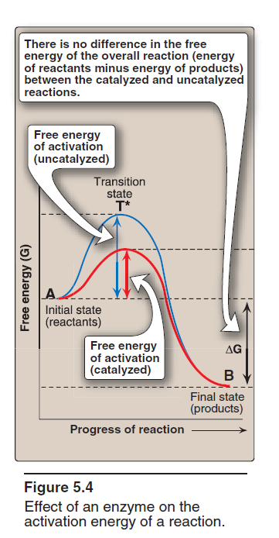

Slide 19
Enzyme mechanism:
During enzyme action, there is a temporary combination
between enzyme and its substrate forming enzyme-substrate
complex (ES complex).
- This is followed by dissociation of this complex into enzyme
and product.

Slide 20
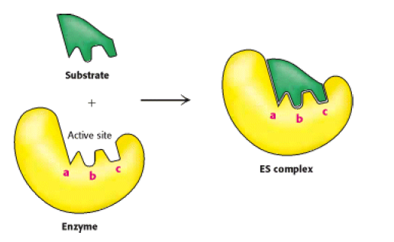
Models to explain enzyme specificity towards substrate:
a) Lock and key model of enzyme-substrate binding:
The active site of the unbound enzyme is complementary in
shape to the substrate.

Slide 21
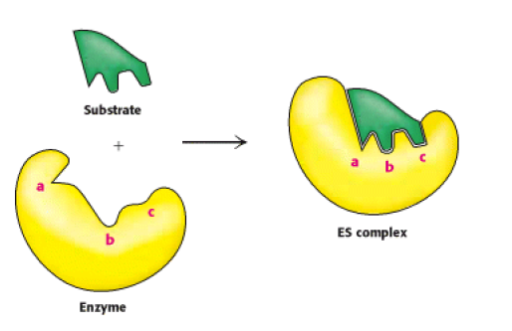
b) Induced-fit model of enzyme-substrate binding:
The enzyme change shape on the substrate binding.
- The active site forms a shape complementary to the substrate
only after the substrate has been bound.

Slide 22
Factors affecting reaction velocity of enzymes:
1) substrate concentration
2) Enzyme concentration
3) pH
4) temperature
5) Inhibitors
6) Activators

Slide 23
1) Effect of substrate concentration:
- velocity is usually expressed as μmol of product formed per
minute.
- The rate of an enzyme-catalyzed reaction increases
with substrate concentration until a maximal velocity (Vmax)
is reached.
- Increased substrate concentration after this point (Vmax) will
not increase the rate.
[The leveling off of the reaction rate at high substrate
concentrations reflects the saturation with substrate of all
available binding sites on the enzyme molecules present].

Slide 24
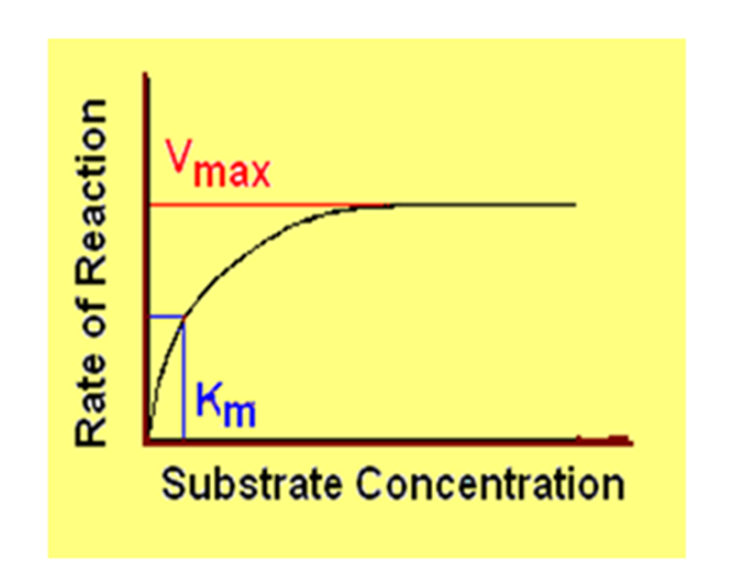
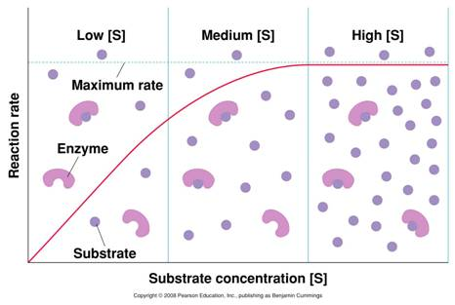
i.e., At low substrate concentrations, an increase in
substrate concentration increases the rate of reaction because
there are many active sites available to be occupied.
At high substrate concentrations, the reaction rate levels
off because most of the active sites are occupied.
Michaelis-Menten plot

Slide 25
- Vmax is the maximum reaction rate ( maximum velocity).
- The Michaelis-Menton constant , Km is the substrate
concentration when the rate is ½ Vmax .
- Most enzymes show Michaelis-Menten kinetics.
- In Michaelis-Menten model, the enzyme reversibly
combines with its substrate to form an ES complex that
subsequently yields product, regenerating the free
enzyme.
where S is the substrate
E is the enzyme
ES is the enzyme–substrate complex
P is the product

Slide 26
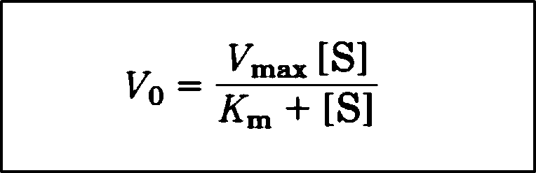
In Michaelis-Menten kinetics, the plot of initial reaction
velocity (v_{o}) against substrate concentration ([S]), is
hyperbolic.
Michaelis-Menten equation:
where vo = initial reaction velocity
Vmax = maximal velocity
Km = Michaelis constant
[S] = substrate concentration

Slide 27

The Double-Reciprocal Plot (Lineweaver-Burk plot):
Transformations of the Michaelis-Menten equation give
Lineweaver-Burk equation.
- Michaelis-Menten equation can be algebraically transformed
into equations that are more useful in plotting experimental
data.
One common transformation is derived simply by taking
the reciprocal of both sides of the Michaelis-Menten equation

Slide 28

- Separating the components of the numerator on the
right side of the equation gives
which simplifies to:
-This equation is called the Lineweaver-Burk equation.

Slide 29
A plot of 1/V₀ versus 1/[S] yields a straight line.
This line has a slope of Km/Vmax, an intercept of 1/Vmax
on the 1/V₀ axis, and an intercept of -1/Km on the 1/[S]
axis.

Slide 30
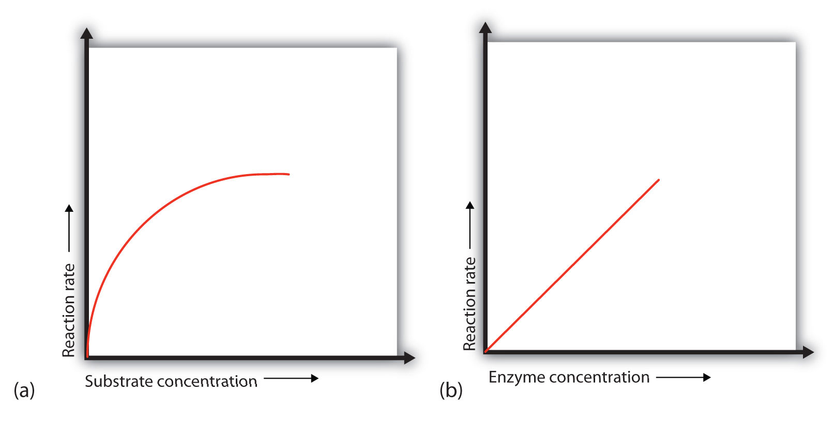
2) Effect of enzyme concentration:

Slide 31
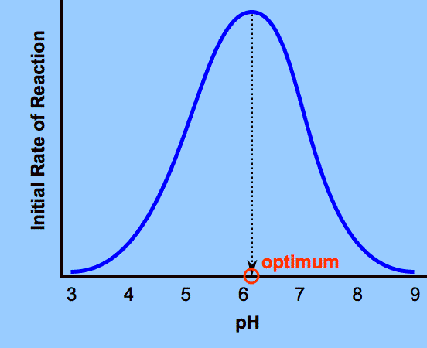
3) Effect of PH:

Slide 32
Optimum PH:
It is the PH at which the enzyme has its maximum activity.
-Each enzyme has an optimal pH at which it is most efficient.
- The optimum pH varies for different enzymes.
For example, pepsin, a digestive enzyme in the stomach, is
maximally active at pH 2, whereas other enzymes, designed
to work at neutral pH, are denatured by such an acidic
environment.

Slide 33
A change in pH can alter the ionization of the groups of the amino acids.
Extremes of pH can lead to denaturation of the enzyme,

Slide 34
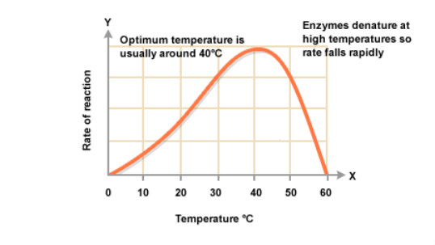
4) Effect of temperature:

Slide 35
- The reaction velocity increases with temperature until a peak
velocity is reached.
Optimum temperature:
It is the temperature at which the enzyme has its maximum
activity.
- Further elevation of the temperature results in a decrease in
reaction velocity as a result of temperature-induced
denaturation of the enzyme.
- Most enzymes are fully denatured at 70°C.

Slide 36
5) Effect of inhibitors:
Inhibitors: are chemicals that reduce the rate of enzymic
reactions.
-Enzyme inhibitors are among the most important
pharmaceutical agents.
There are two broad classes of enzyme inhibitors:
A) Irreversible inhibitors.
B) Reversible inhibitors

Slide 37
A) Irreversible inhibitors:
• Combine with the functional groups of the enzyme in the
active site, irreversibly (combine covalently to enzyme so as
to permanently inactivate it).
• Most of enzymes bind to a functional group in active site of enzyme to block that site.
Example:
Diisopropyl fluorophosphate (DFP) binds covalently to
serine in serine proteases & acetylcholinesterase .

Slide 38
B) Reversible inhibitors:
Types of reversible inhibitors:
a) Competitive inhibitors
b) Noncompetitive inhibitors
c) Uncompetitive inhibitor
- The two most commonly encountered types of reversible
inhibition are:
a) Competitive inhibition
b) Noncompetitive inhibition

Slide 39
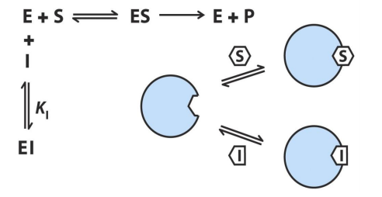
a) Competitive inhibition:
The inhibitor compete with the substrate to bind the active
site.
-Competitive inhibitor structure usually resemble substrate.
The competitive inhibitor’s action is proportional to its
concentration. (The effect of a competitive inhibitor is
reversed by increasing [S]).
Effect of competitive inhibitor on Km and V_{max}:
- Same Vmax
- increase Km

Slide 41
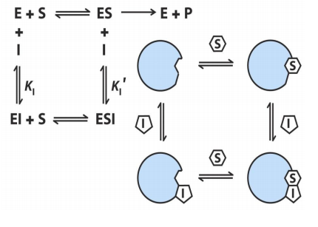
b) Noncompetitive inhibition:
-The inhibitor bind the enzyme at a site other than the active
site.
- The noncompetitive inhibitor can bind either free enzyme or
the ES complex.
-This type of inhibition not affected by the concentration of
the substrate.
Effect of non-competitive inhibitor on Km and Vmax:
- decrease Vmax
- Same Km

Slide 43
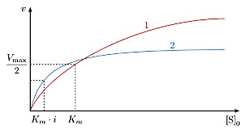
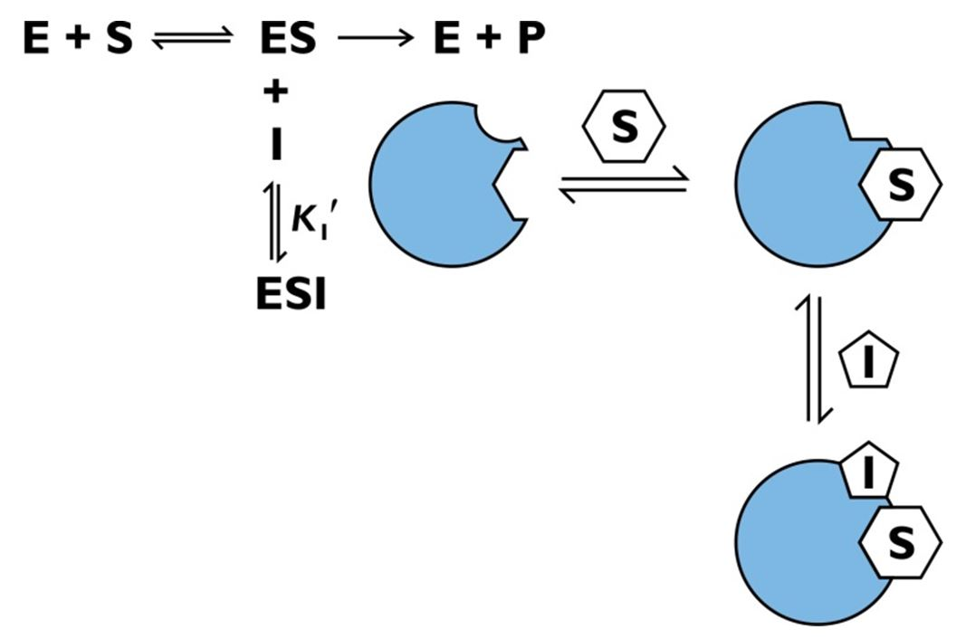
C) Uncompetitive inhibitors
The inhibitor binds only to the substrate-enzyme complex
Both Vmax and Km are low (with I)

