Slide 1
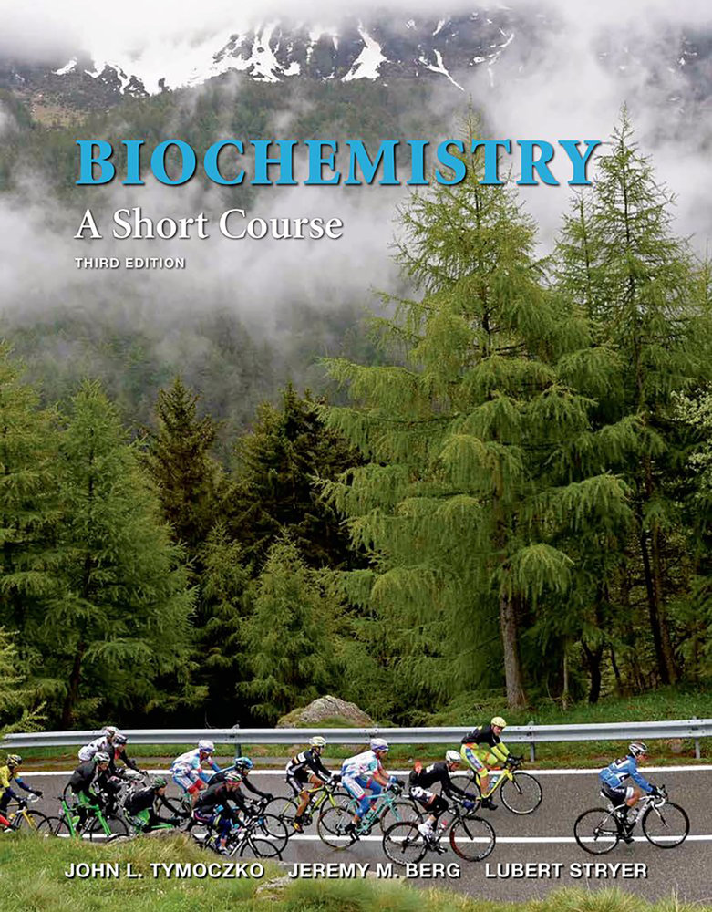
Tymoczko • Berg • Stryer
Biochemistry:
A Short Course
Third Edition
CHAPTER 8
Mechanisms and
Inhibitors
© 2015 W. H. Freeman and Company

Slide 2
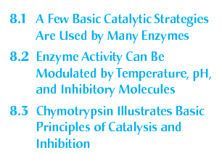
Chapter 8 Outline

Slide 3
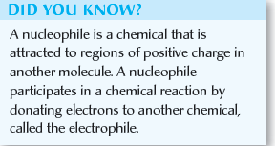
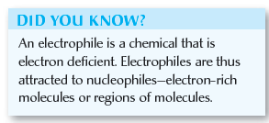
Common catalytic strategies include:
Covalent catalysis: The active site contains a nucleophile that is briefly covalently modified.
General acid-base catalysis: A molecule other than water donates or accepts a proton.
Metal ion catalysis: Metal ions function in a number of ways including serving as an electrophilic catalyst.
Catalysis by approximation and orientation: The enzyme brings two substrates together in an orientation that facilitates catalysis.

Slide 5
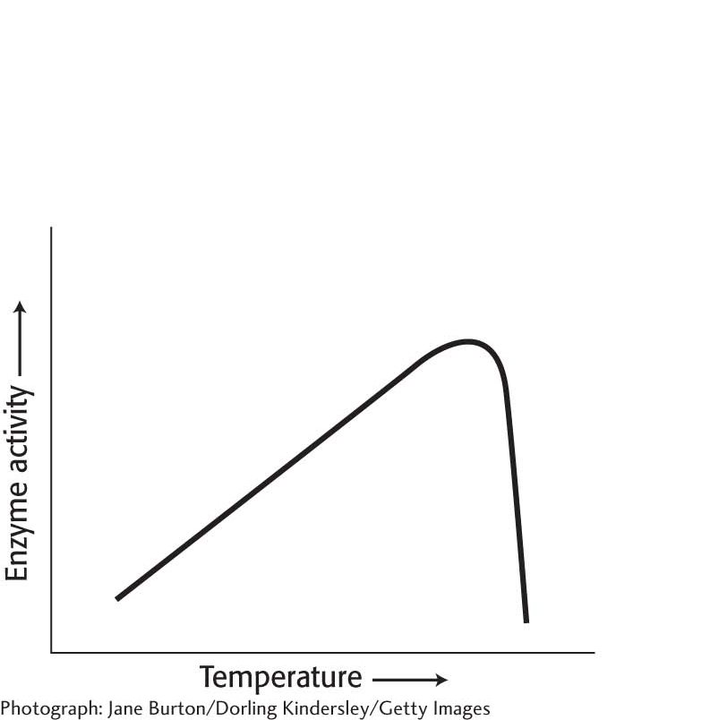
Notes:
Figure 8.1 The effect of heat on enzyme activity. The enzyme tyrosinase, which is part of the pathway that synthesizes the pigment that results in dark fur, has a low tolerance for heat in Siamese cats. It is inactive at normal body temperatures but functional at slightly lower temperatures. The extremities of a Siamese cat are cool enough for tyrosinase to gain function and produce pigment. [Photograph: Jane Burton/Getty.]

Slide 6
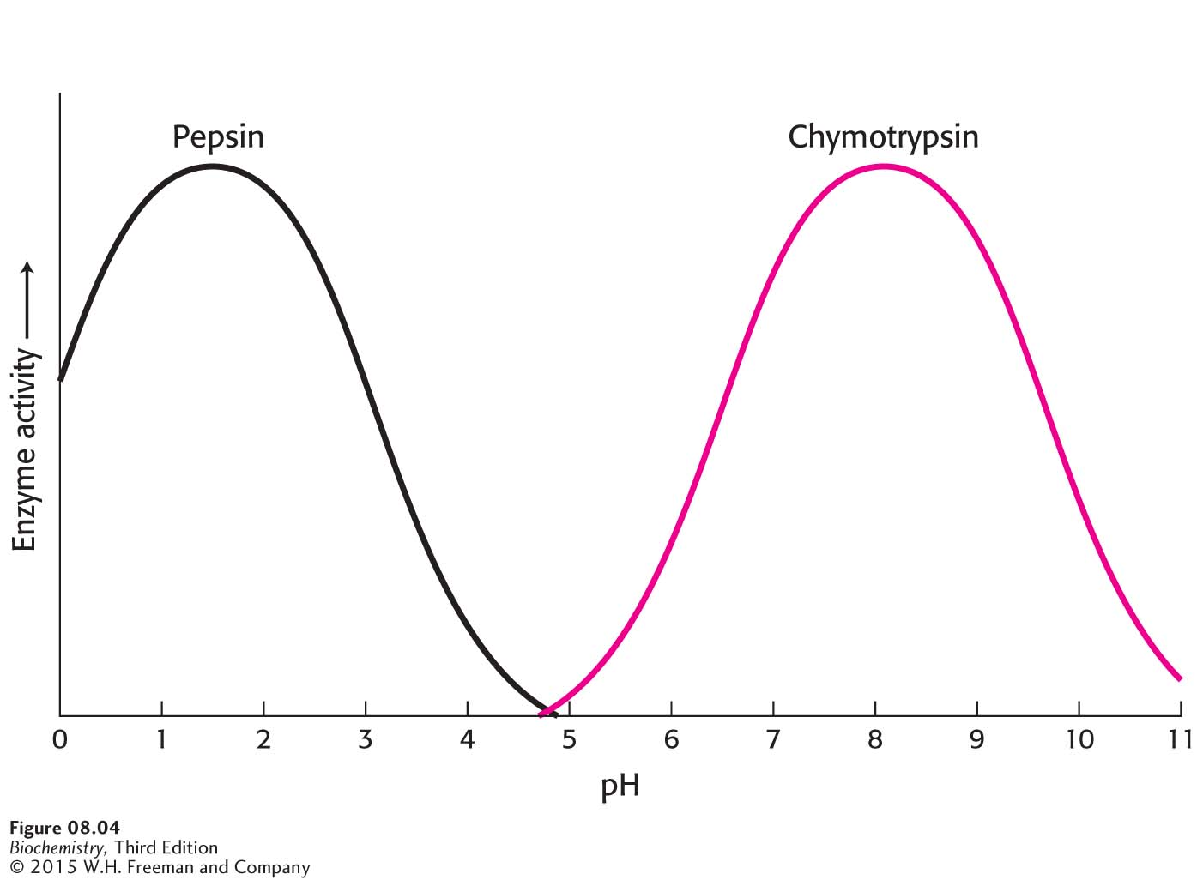
Notes:
Figure 8.4 The pH dependence of the activity of the enzymes pepsin and chymotrypsin. Chymotrypsin and pepsin have different optimal pH values. The optimal pH for pepsin is noteworthy. Most proteins would be denatured at this acidic pH.

Slide 7
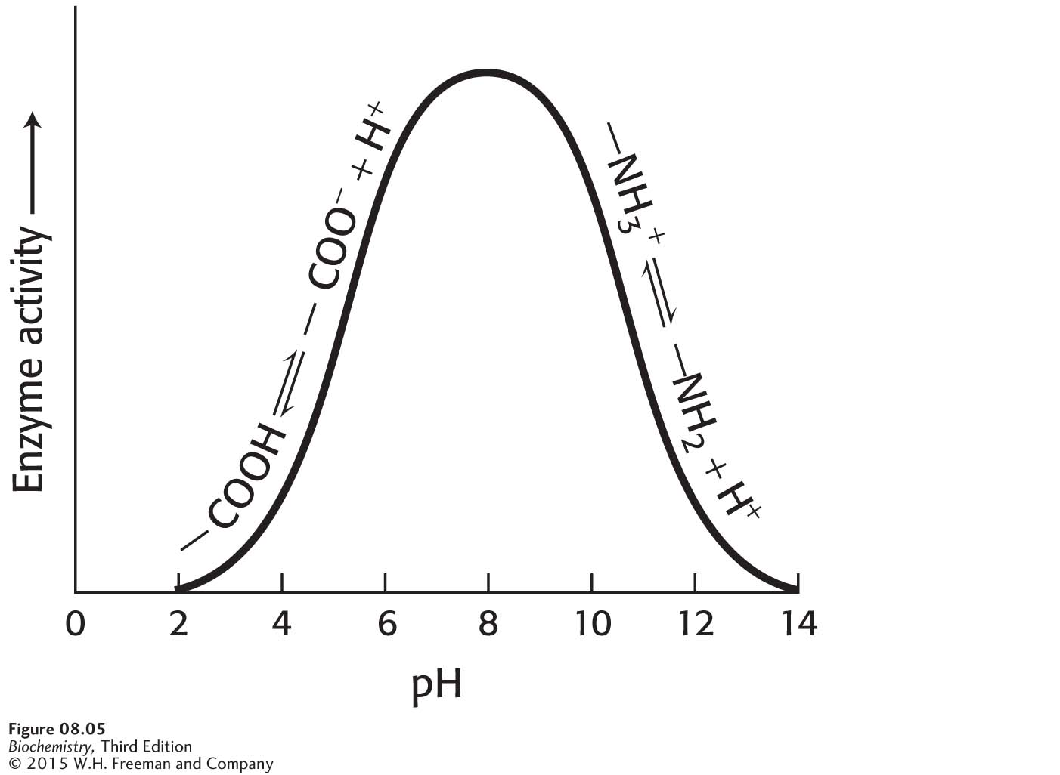
Notes:
Figure 8.5 A pH profile for a hypothetical enzyme. The pH dependence of enzymes is due to the presence of ionizable R groups.

Slide 8
There are three common types of reversible inhibition:
Competitive inhibition: The inhibitor is structurally similar to the substrate and can bind to the active site, preventing the actual substrate from binding.
Uncompetitive inhibition: The inhibitor binds only to the enzyme-substrate complex.
Noncompetitive inhibition: The inhibitor binds either the enzyme or enzyme-substrate complex.

Slide 9
Notes:
Figure 8.6 Reversible inhibitors. (A) Substrate binds to an enzyme’s active site to form an enzyme–substrate complex. (B) A competitive inhibitor binds at the active site and thus prevents the substrate from binding. (C) An uncompetitive inhibitor binds only to the enzyme–substrate complex. (D) A noncompetitive inhibitor does not prevent the substrate from binding.

Slide 10
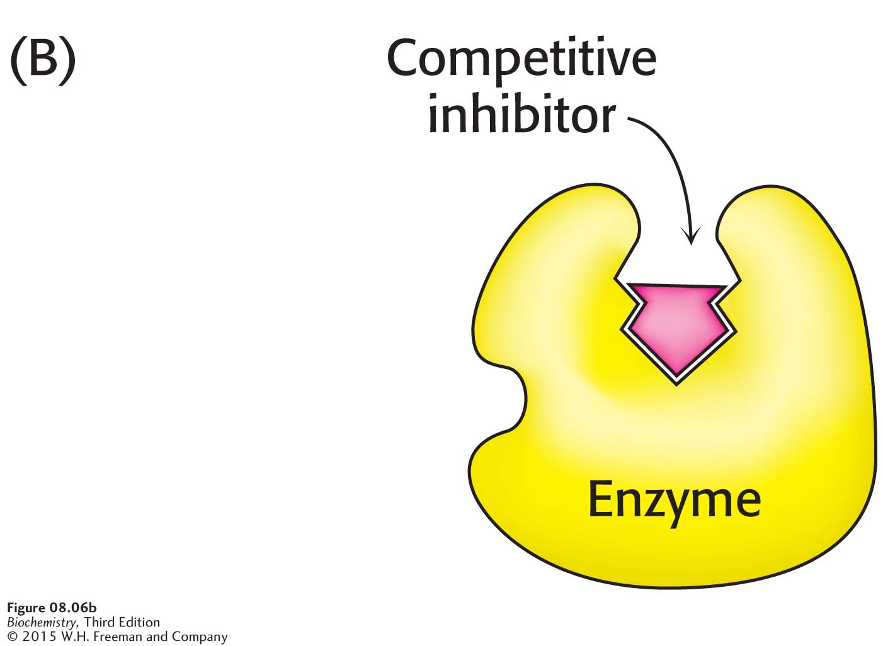

Slide 11
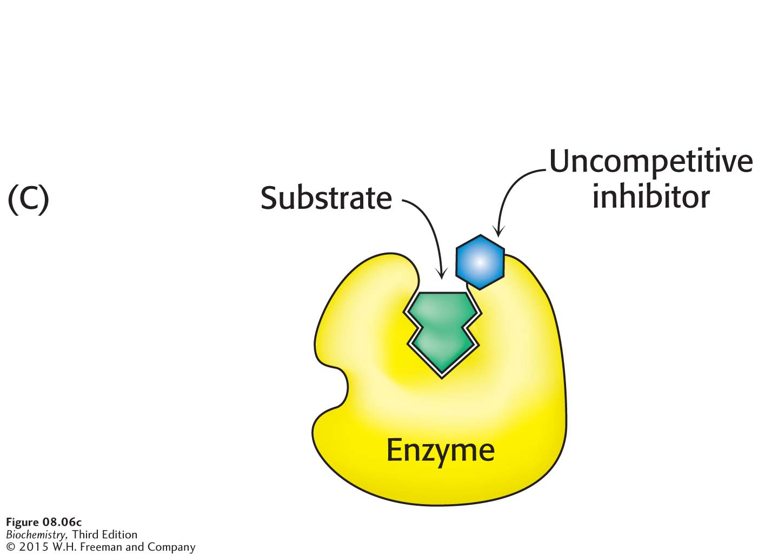

Slide 12
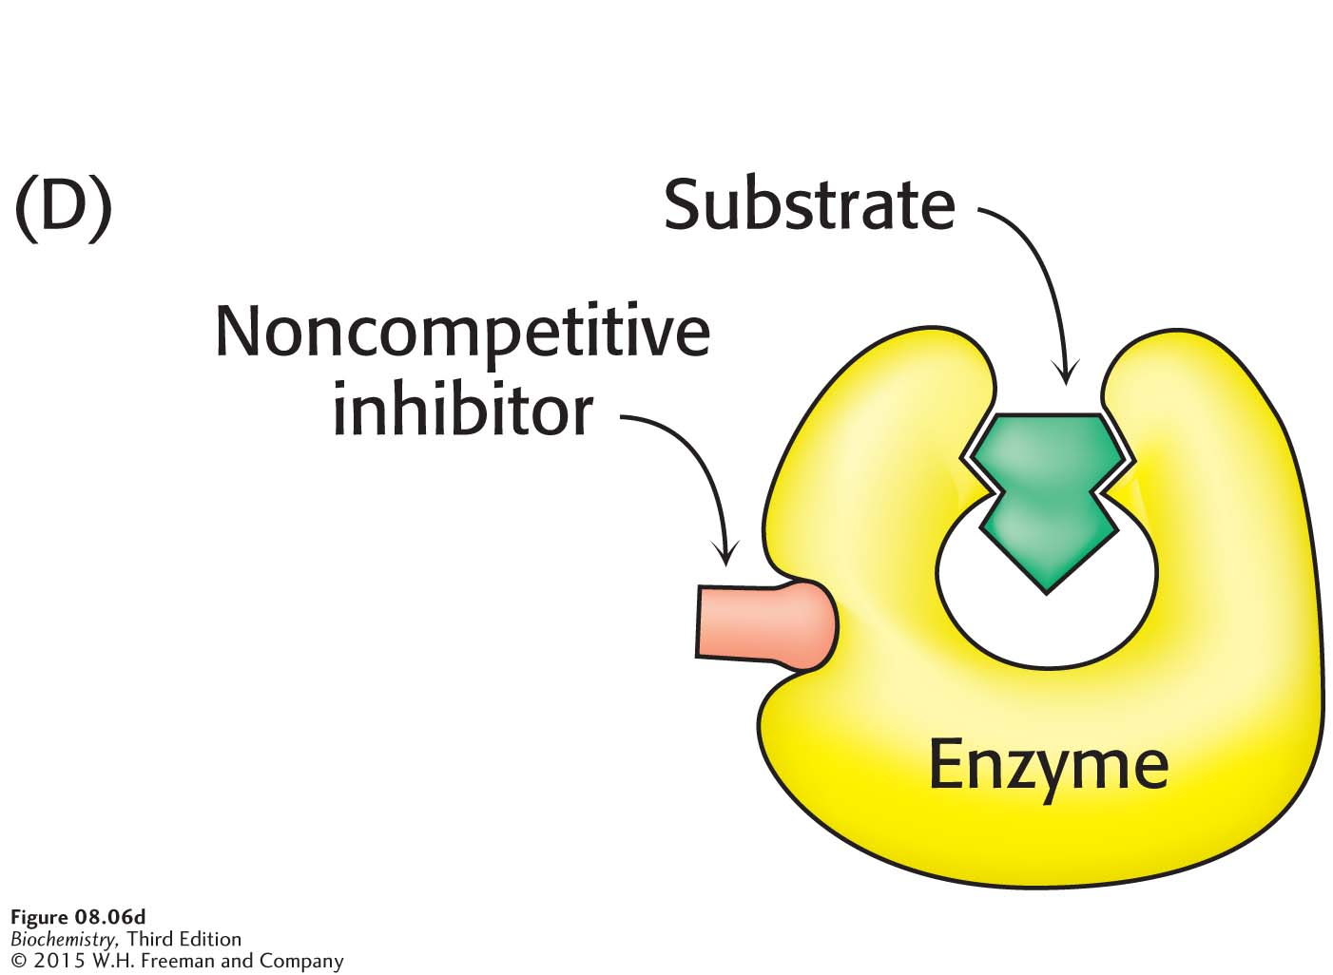

Slide 13
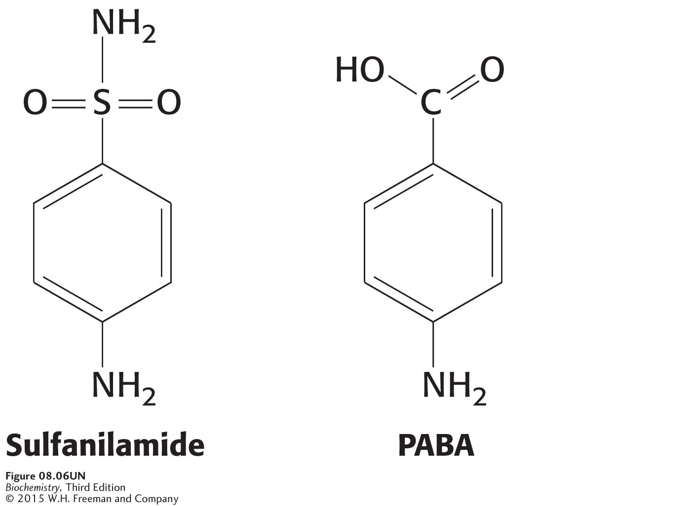
In competitive inhibition, V_{max} of the enzyme is unchanged because the inhibition can be overcome by a sufficiently high concentration of substrate.
However, the apparent value of K_{M} is increased in the presence of inhibitor.
Sulfanilamide is sulfa drug, a class of antibiotic containing a sulfur atom. It is structurally similar to
p-aminobenzoic acid (PABA), a substrate for folic acid synthesis in bacteria.

Slide 14
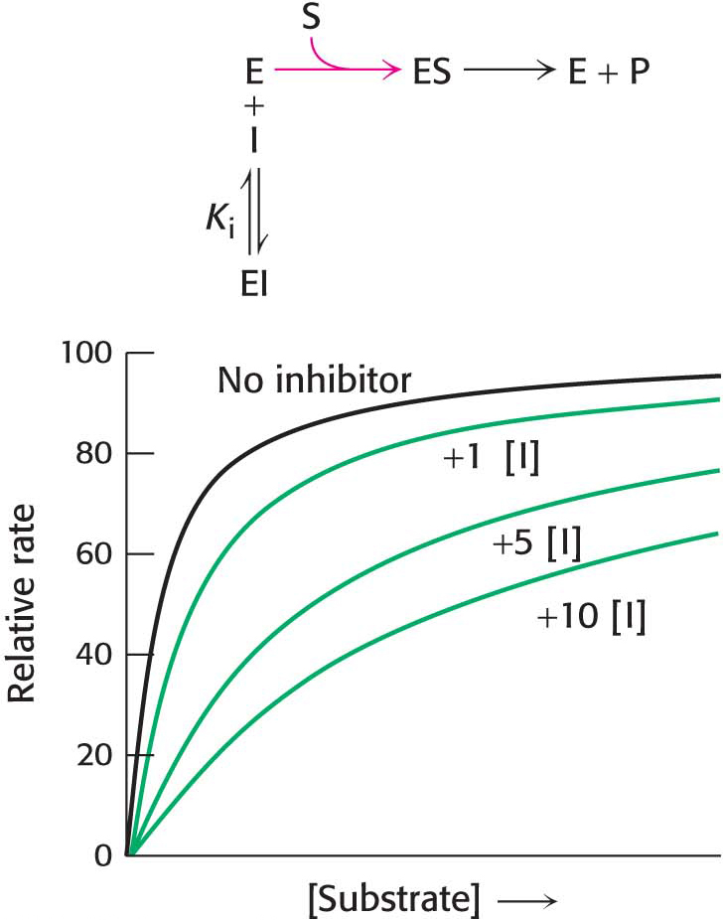
Notes:
Figure 8.7 Kinetics of a competitive inhibitor. As the concentration of a competitive inhibitor increases, higher concentrations of substrate are required to attain a particular reaction velocity. The reaction pathway suggests how sufficiently high concentrations of substrate can completely relieve competitive inhibition.

Slide 15
In uncompetitive inhibition, the enzyme-inhibitor-substrate complex does not form product. Consequently, V_{max} is lower in the presence of inhibitor.
The K_{M} is also lower.
Uncompetitive inhibition cannot be overcome by the addition of excess substrate.

Slide 16
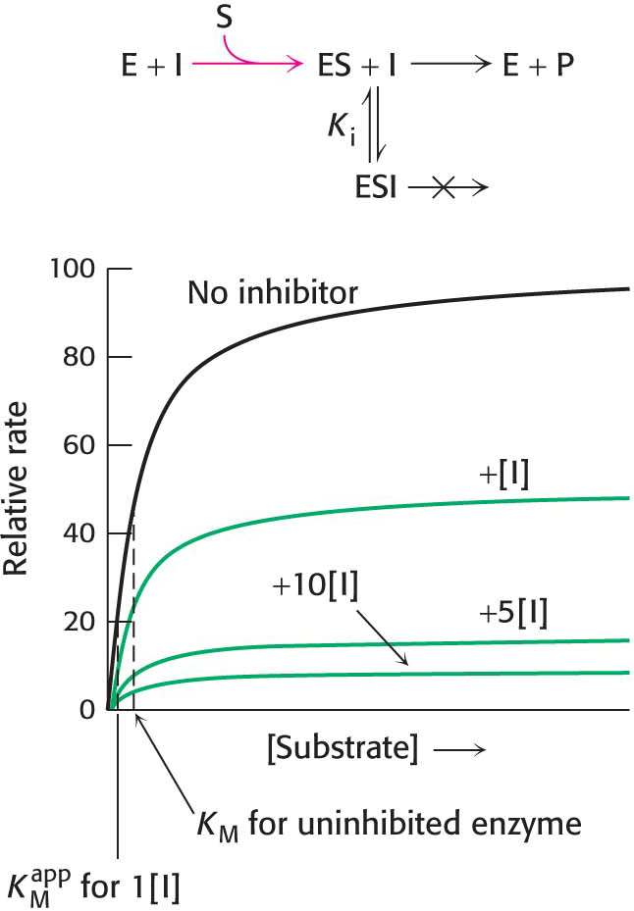
Notes:
Figure 8.8 Kinetics of an uncompetitive inhibitor. The reaction pathway shows that the inhibitor binds only to the enzyme–substrate complex. Consequently, V_{max} cannot be attained, even at high substrate concentrations. Notice that the apparent value for K_{M} (K_{M}^{app}) is lowered, becoming smaller as more inhibitor is added.

Slide 17
In noncompetitive inhibition, the inhibitor can bind to free enzyme or to the enzyme-substrate complex. In either case, the binding of inhibitor prevents the formation of product.
V_{max} is lower in the presence of a noncompetitive inhibitor.
K_{M} is not changed by the presence of a noncompetitive inhibitor.
Noncompetitive inhibition cannot be overcome by increasing substrate concentration.

Slide 18
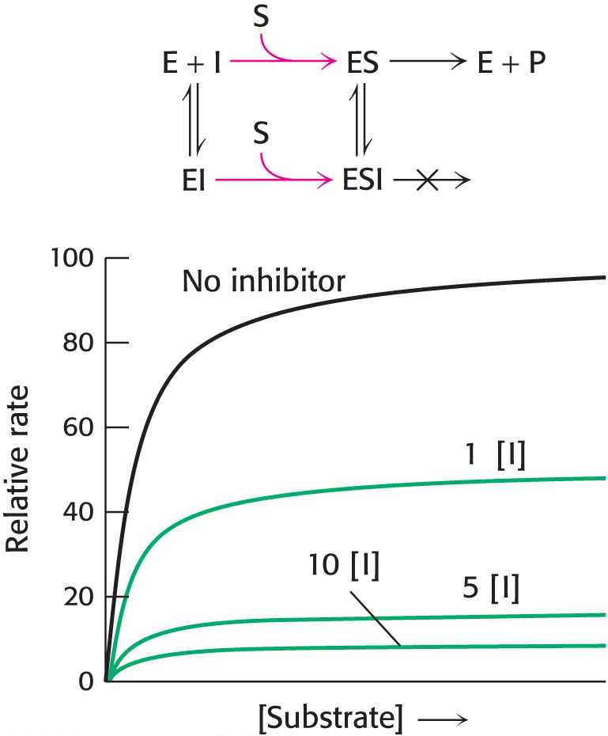
Notes:
Figure 8.9 Kinetics of a noncompetitive inhibitor. The reaction pathway shows that the inhibitor binds both to free enzyme and to the enzyme–substrate complex. Consequently, as with uncompetitive competition, V_{max} cannot be attained. K_{M} remains unchanged, and so the reaction rate increases more slowly at low substrate concentrations than is the case for uncompetitive competition.

Slide 19
Double reciprocal plots highlight the differences in the types of reversible inhibition.

Slide 20
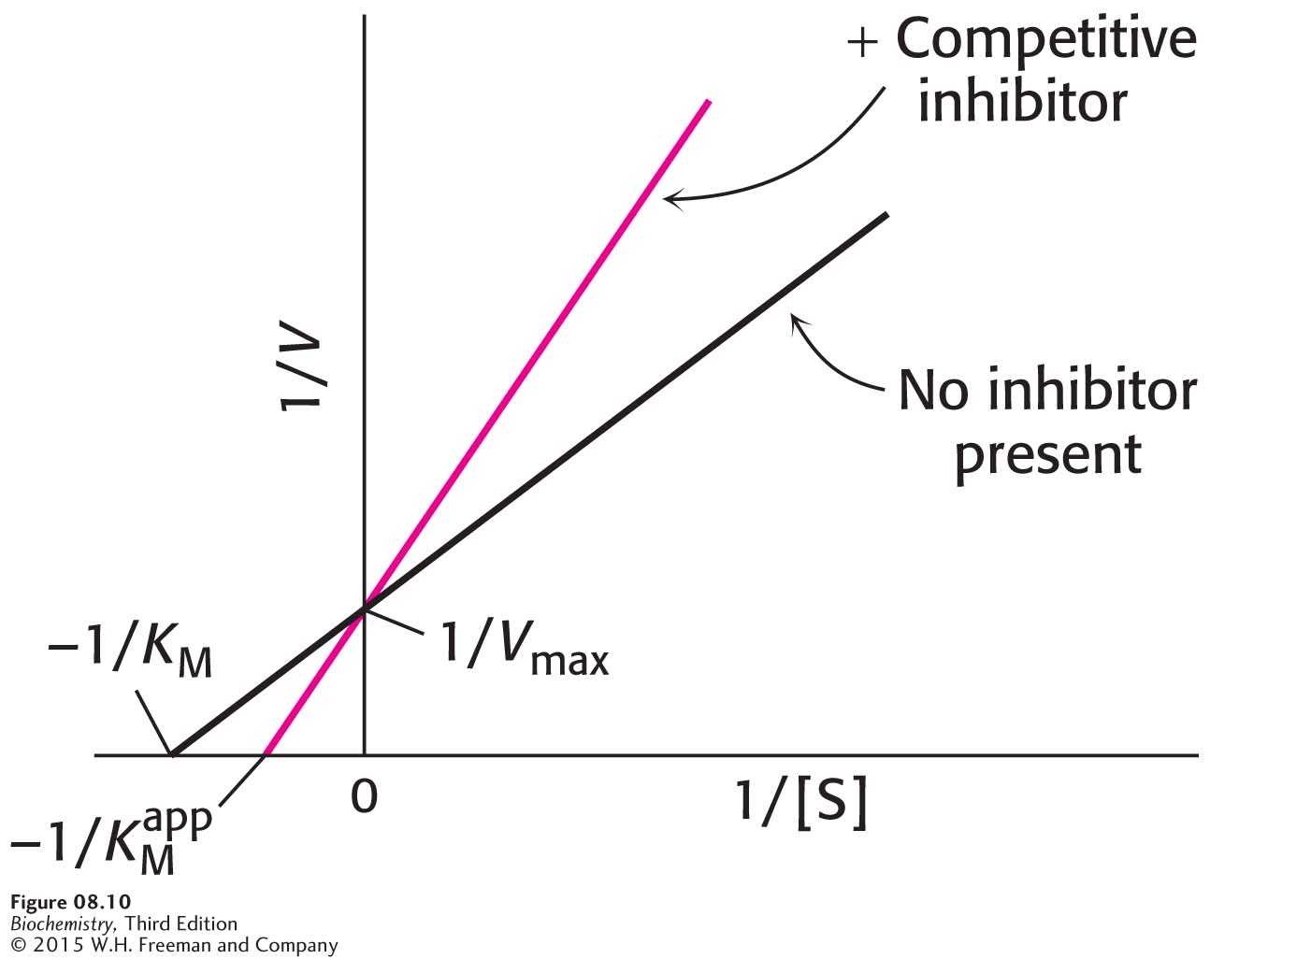
Notes:
Figure 8.10 Competitive inhibition illustrated on a double-reciprocal plot. A double-reciprocal plot of enzyme kinetics in the presence and absence of a competitive inhibitor illustrates that the inhibitor has no effect on V_{max} but increases K_{M}.

Slide 21
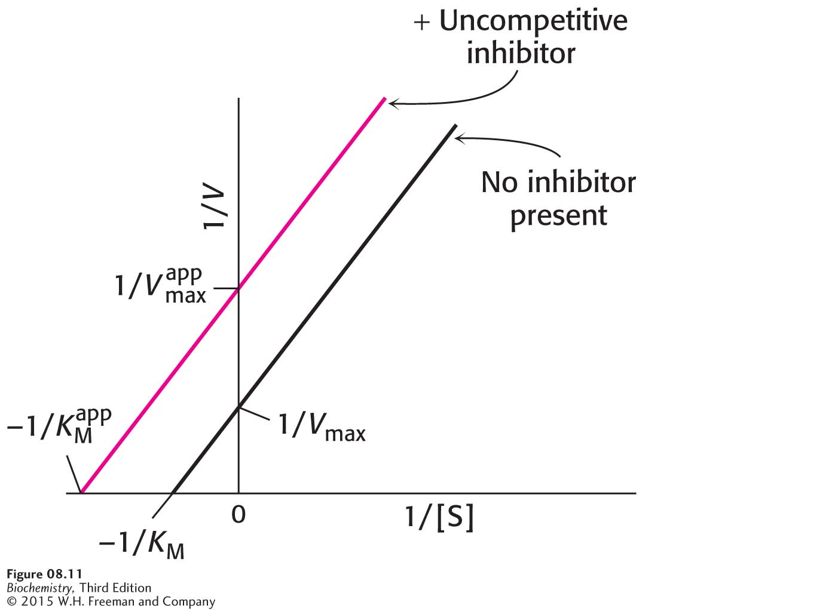
Notes:
Figure 8.11 Uncompetitive inhibition illustrated on a double-reciprocal plot. An uncompetitive inhibitor does not affect the slope of the double-reciprocal plot. V_{max} and K_{M} are reduced by equivalent amounts.

Slide 22
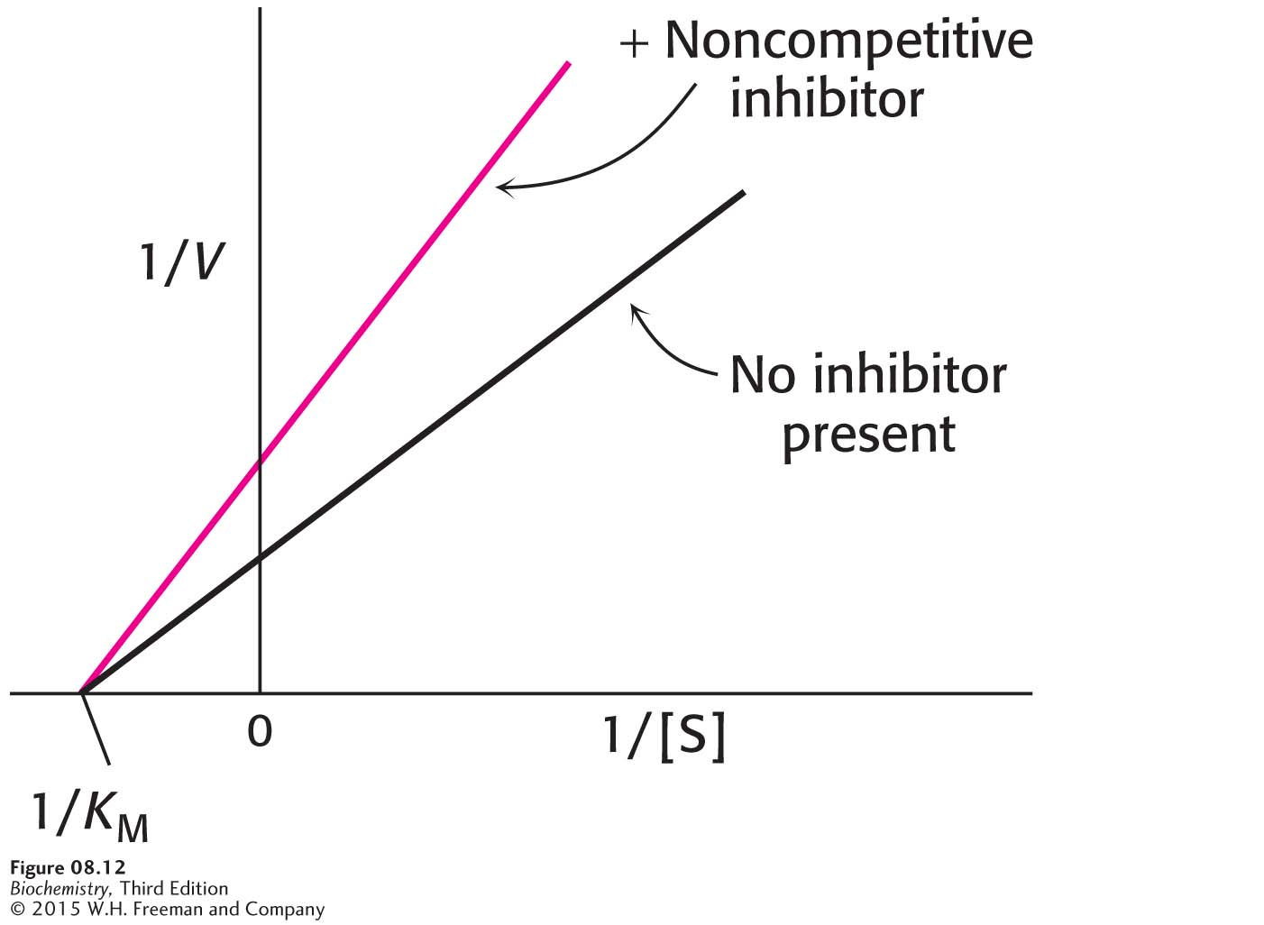
Notes:
Figure 8.12 Noncompetitive inhibition illustrated on a double-reciprocal plot. A double-reciprocal plot of enzyme kinetics in the presence and absence of a noncompetitive inhibitor shows that K_{M} is unaltered and V_{max} is decreased.

Slide 23
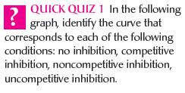
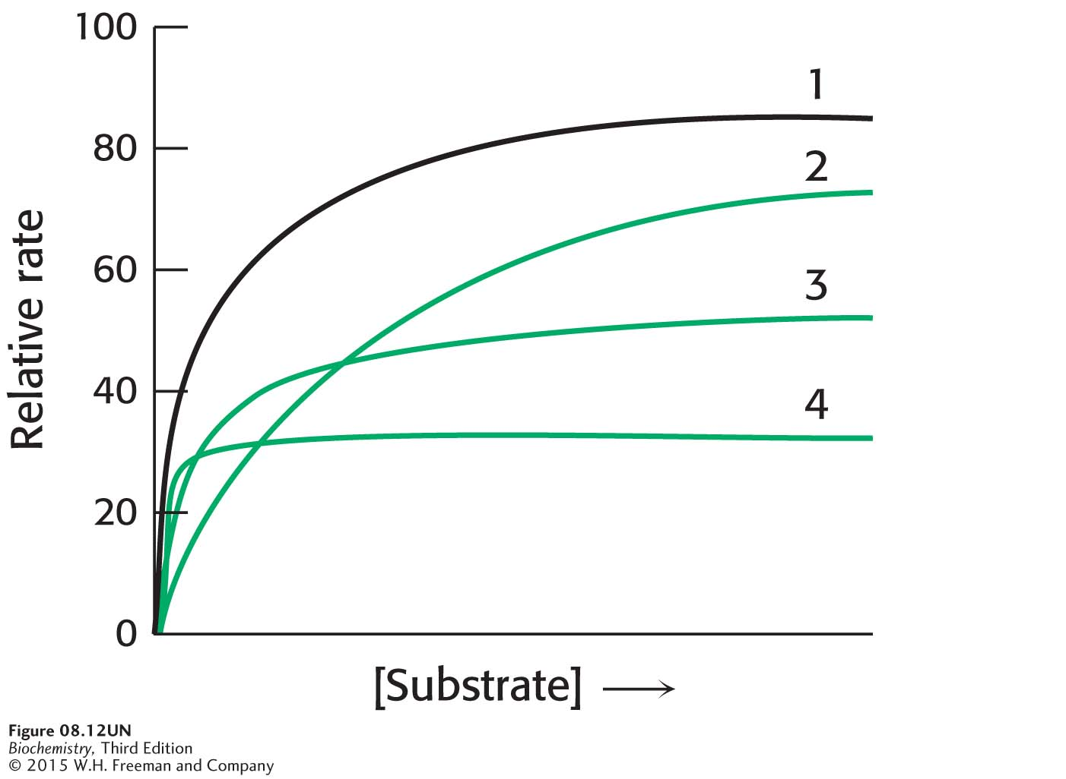

Slide 24
Irreversible inhibitors bind very tightly to enzymes.
Irreversible inhibitors that bind the enzyme covalently are powerful tools for elucidating the mechanisms of enzyme action.

Slide 25
Group specific reagents react with R-groups of specific amino acids.

Slide 26
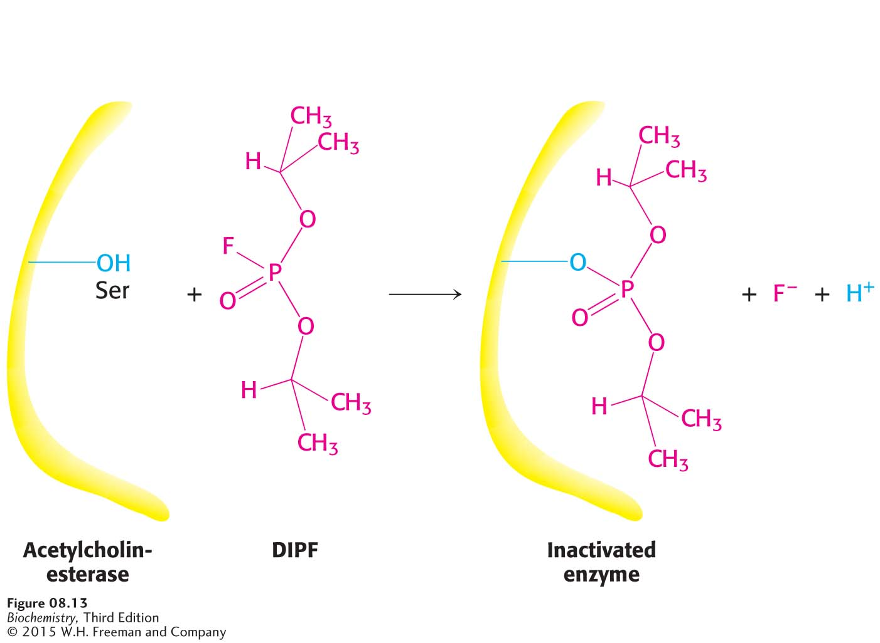
Notes:
Figure 8.13 Enzyme inhibition by diisopropylphosphofluoridate (DIPF), a group-specific reagent. DIPF can inhibit an enzyme by covalently modifying a crucial serine residue.

Slide 27
Affinity labels or substrate analogs are structurally similar to the enzyme’s substrate but inhibit the enzyme by covalently modifying an amino acid in the active site.

Slide 28
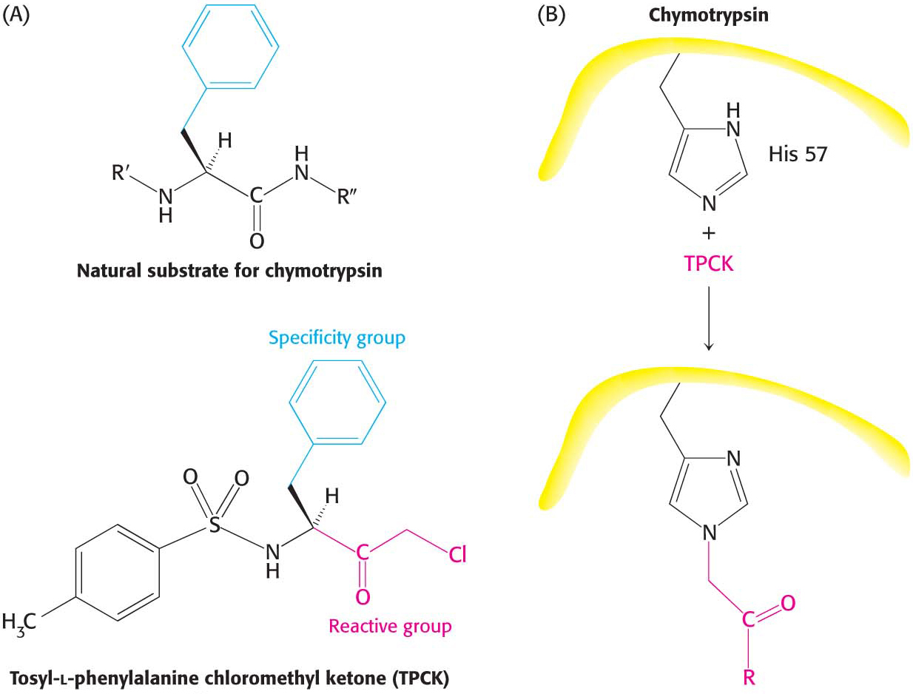
Notes:
Figure 8.14 Affinity labeling. (A) Tosyl-l-phenylalanine chloromethyl ketone (TPCK) is a reactive analog of the normal substrate for the enzyme chymotrypsin. (B) TPCK binds at the chymotrypsin active site and modifies an essential histidine residue.

Slide 30
Suicide inhibitors or mechanism-based inhibitors bind to the enzyme as a substrate. As catalysis occurs, the enzyme modifies the substrate, converting it into an irreversible inhibitor.

Slide 31
Penicillin is an antibiotic that consists of thiazolidine ring fused to a very reactive β-lactam ring.
Penicillin inhibits the formation of cell walls in certain bacteria such as S. aureus.

Slide 32
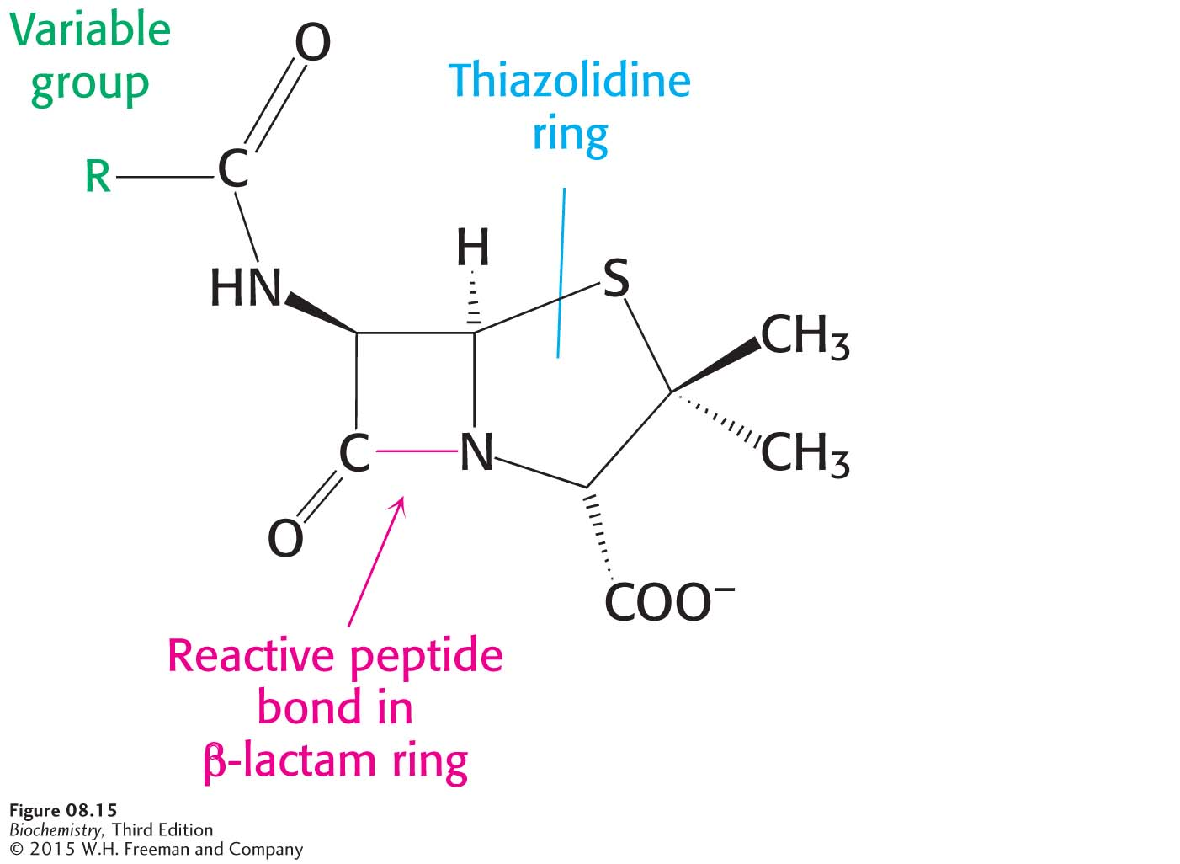
Notes:
Figure 8.15 The structure of penicillin. The reactive site of penicillin is the peptide bond of its β-lactam ring.

Slide 33
The cell wall of S. aureus is constructed from the molecule peptidoglycan, which is a linear polysaccharide chain cross-linked by short peptides.
Glycopeptide transpeptidase catalyzes the peptide cross-links.
The transpeptidase reaction proceeds through an acyl-enzyme intermediate.

Slide 34
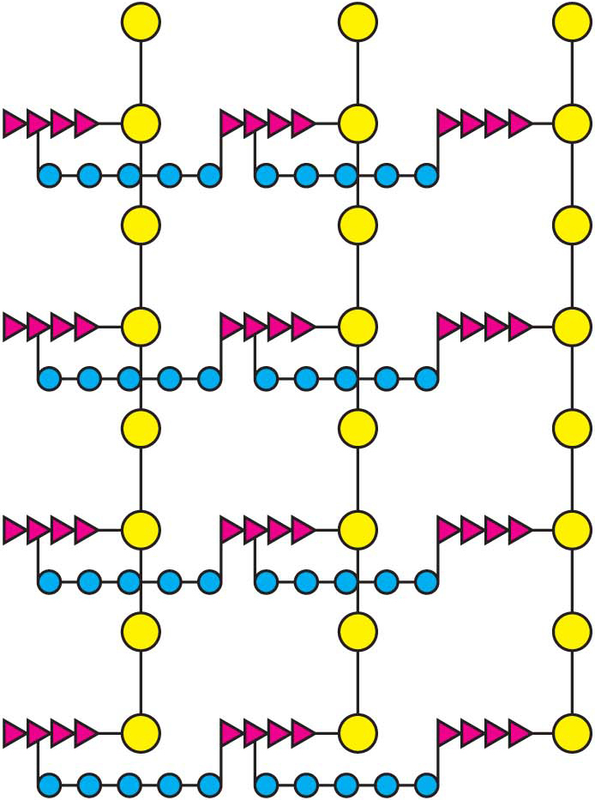
Notes:
Figure 8.16 A schematic representation of the peptidoglycan in Staphylococcus aureus. The sugars are shown in yellow, the tetrapeptides in red, and the pentaglycine bridges in blue. The cell wall is a single, enormous, bag-shaped macromolecule because of extensive cross-linking.

Slide 35
Notes:
Figure 8.17 The formation of cross-links in S. aureus peptidoglycan. The terminal amino group of the pentaglycine bridge in the cell wall attacks the peptide bond between two d-alanine residues to form a cross-link.

Slide 36
Notes:
Figure 8.18 A transpeptidation reaction. An acyl-enzyme intermediate is formed in the transpeptidation reaction leading to cross-link formation.

Slide 37
When penicillin binds to the peptidase, a serine residue at the active site attacks the carbonyl carbon of the lactam ring as if penicillin were a substrate.
A pencinillinoyl-serine derivative is formed which is inactive and very stable.

Slide 38
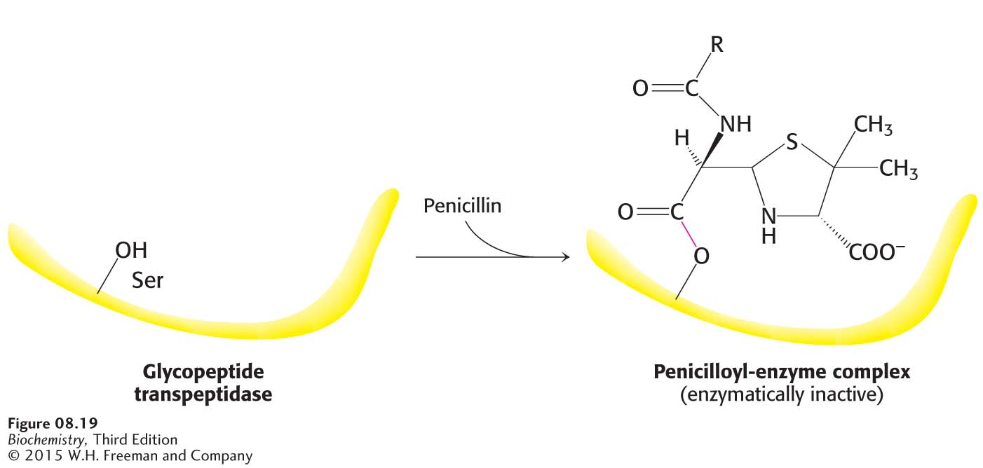
Notes:
Figure 8.19 The formation of a penicilloyl-enzyme complex. Penicillin reacts with the transpeptidase to form an inactive complex, which is indefinitely stable.

Slide 39
Chymotrypsin is a proteolytic enzyme secreted by the pancreas that hydrolyzes peptide bonds selectively on the carboxyl side of large hydrophobic amino acids.

Slide 40
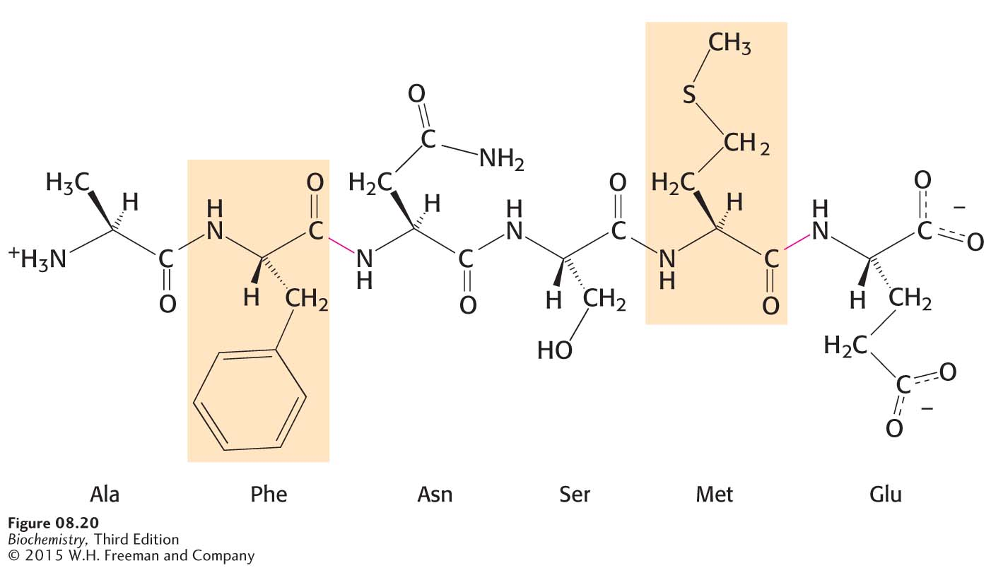
Notes:
Figure 8.20 The specificity of chymotrypsin. Chymotrypsin cleaves proteins on the carboxyl side of aromatic or large hydrophobic amino acids (shaded orange). The red bonds indicate where chymotrypsin most likely acts.

Slide 41
In the process of catalysis, serine 195 becomes a nucleophile that attacks the carbonyl group of protein substrate.
The group-specific reagent diisopropylphosphofluoridate (DIFP) modifies only serine 195, one of 28 serine residues in chymotrypsin, and inhibits the enzyme.

Slide 42
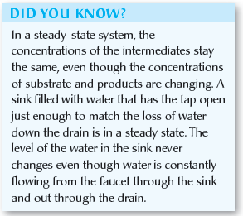
Chromogenic substrates generate colored products, facilitating enzymatic studies.
N-Acetyl-l-phenylalanine p-nitrophenyl ester is a chromogenic substrate for chymotrypsin.
Studies with the chromogenic substrate reveal that catalysis by chymotrypsin occurs in two stages: a rapid step (pre-steady state) and a slower step (steady state).

Slide 43
Notes:
Figure 8.21 A chromogenic substrate. N-Acetyl-l-phenylalanine p-nitrophenyl ester yields a yellow product, p-nitrophenolate, on cleavage by chymotrypsin. p-Nitrophenolate forms by deprotonation of p-nitrophenol at pH 7.

Slide 44
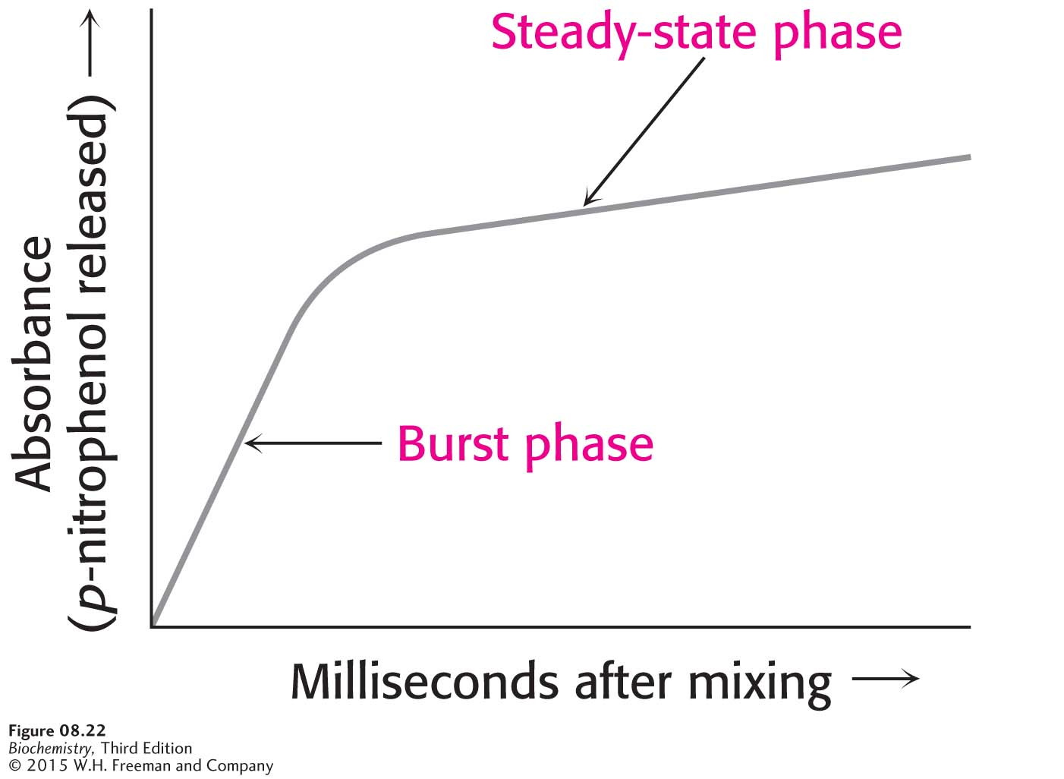
Notes:
Figure 8.22 Kinetics of chymotrypsin catalysis. Two stages are evident in the cleaving of N-acetyl-l-phenylalanine p-nitrophenyl ester by chymotrypsin: a rapid burst phase (pre-steady state) and a steady-state phase.

Slide 45
The steps in catalysis are explained by the rapid formation of an acyl-enzyme intermediate and a slower release of the acyl component to regenerate free enzyme.

Slide 46
Notes:
Figure 8.23 Covalent catalysis. Hydrolysis by chymotrypsin takes place in two stages: (A) acylation to form the acyl-enzyme intermediate followed by (B) deacylation to regenerate the free enzyme.

Slide 47
The affinity label tosyl-l-phenylalanine chloromethyl ketone(TPCK) covalently modifies histidine 57 in chymotrypsin, leading to a loss of enzyme activity.

Slide 48
Histidine removes a proton from serine 195, generating a highly reactive alkoxide ion.
The alkoxide ion attacks the peptide bond of the substrate.
Aspartate orients the histidine and renders it a better proton acceptor.

Slide 49
Notes:
Figure 8.24 The catalytic triad. The catalytic triad, shown on the left, converts serine 195 into a potent nucleophile, as illustrated on the right.

Slide 50
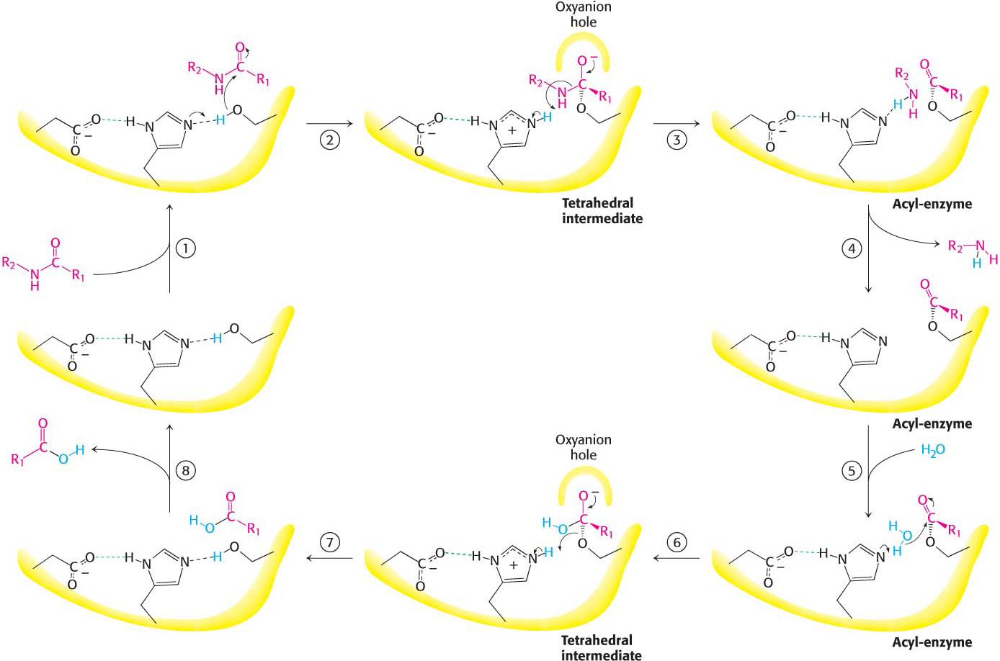
Notes:
Figure 8.25 Peptide hydrolysis by chymotrypsin. The mechanism of peptide hydrolysis illustrates the principles of covalent and acid–base catalysis. The reaction proceeds in eight steps: (1) substrate binding, (2) serine’s nucleophilic attack on the peptide carbonyl group, (3) collapse of the tetrahedral intermediate, (4) release of the amine component, (5) water binding, (6) water’s nucleophilic attack on the acyl-enzyme intermediate, (7) collapse of the tetrahedral intermediate, and (8) release of the carboxylic acid component. The dashed green lines represent hydrogen bonds.

Slide 51
The oxyanion hole, a region of the active site, stabilizes the tetrahedral reaction intermediate.

Slide 52
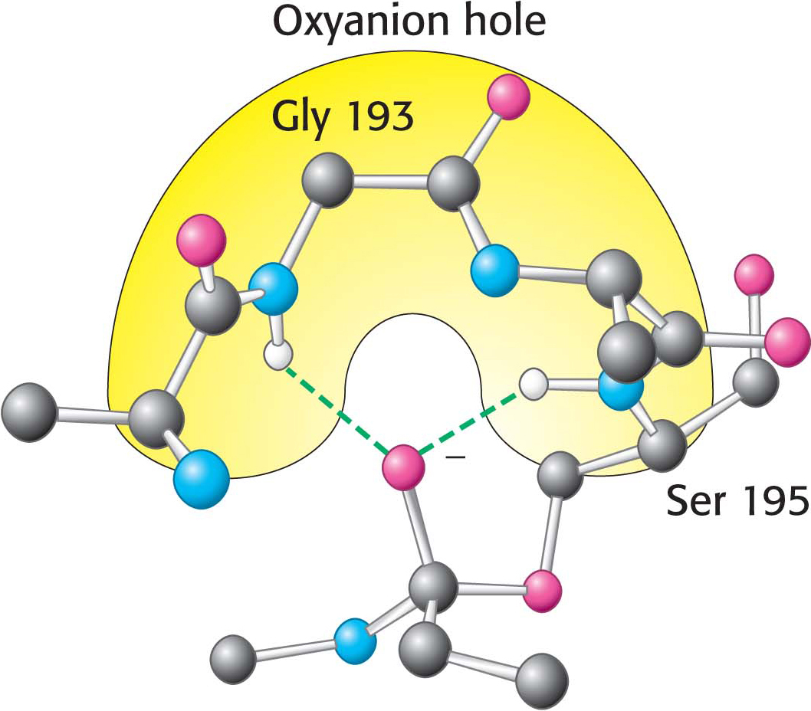
Notes:
Figure 8.26 The oxyanion hole. The structure stabilizes the tetrahedral intermediate of the chymotrypsin reaction. Notice that hydrogen bonds (shown in green) link peptide NH groups and the negatively charged oxygen atom of the intermediate.

Slide 53
The specificity of chymotrypsin is accounted for by the S1 pocket, a hydrophobic pocket that binds a hydrophobic residue on the substrate and positions the adjacent peptide bond for cleavage.

Slide 54
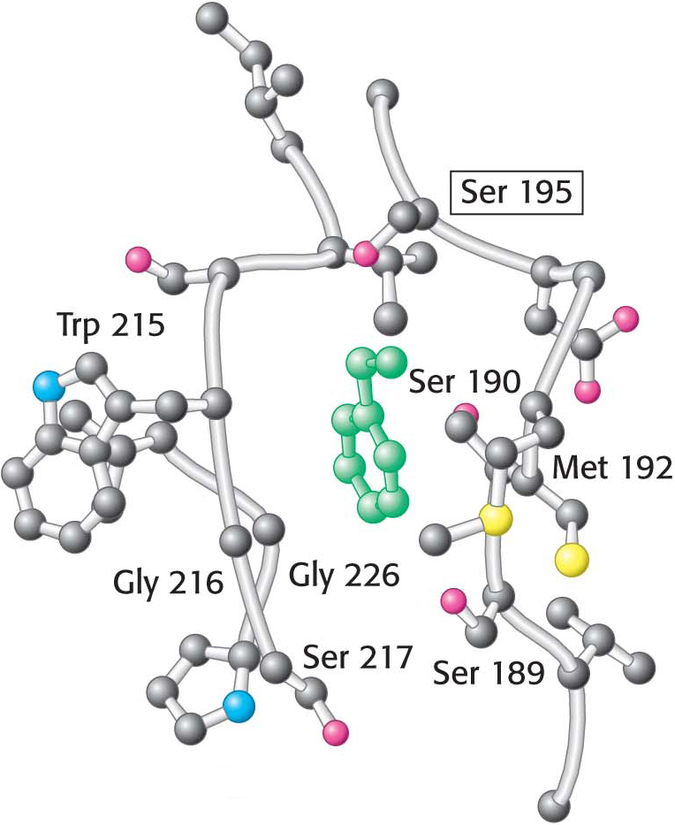
Notes:
Figure 8.27 The specificity pocket of chymotrypsin. Notice that many hydrophobic groups line the deep specificity pocket. The structure of the pocket favors the binding of residues with long hydrophobic side chains such as phenylalanine (shown in green). Also notice that the active-site serine residue (serine 195) is positioned to cleave the peptide backbone between the residue bound in the pocket and the next residue in the sequence. The key amino acids that constitute the binding site are identified.

