Slide 1
Practical 3 Environmental Sampling of Surfaces

Slide 2
Things to Consider Prior to Surface Sampling
Background – literature and present activities
Preliminary results from epidemiological investigation
Locations to sample
Collection method and equipment
Number of replicate samples needed
Are controls or comparisons needed?
Parameters for assay; qualitative, quantitative, or both?
Estimate of maximum allowable microbial numbers or types on surface(s) sampled
Some anticipation of a plan of action based on results

Slide 3
Things to Consider Before Conducting Surface Sampling
Asepsis is critical
Sterilized sampling materials
Aseptic technique
Document the circumstances of sampling
State of the surface and its preparation, if any, prior to sampling
Prepare a sampling strategy or plan that ensures the validity of the results and is appropriate for the organism(s) being sampled

Slide 4
Environmental Surface Sampling
Disinfectant neutralizers may be needed
Major methods include:
RODAC plate (direct surface sampling)
Swab method
Wipe method

Slide 5
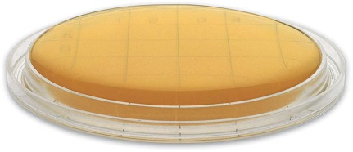
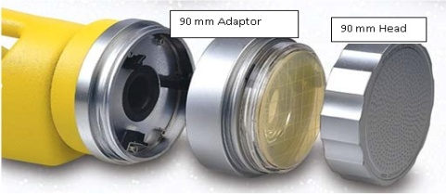
RODAC Plate Sampling Method
Materials used:
RODAC plate : agar medium is overfilled to give a convex surface(Replicate organism detection and counting)
Used to sample cleaned flat surfaces; not suitable for visibly dirty or irregular surfaces
Neutralizers can be incorporated into the medium if surface disinfectant residuals are present
Press the convex medium onto the surface; do not twist or move the plate around

Slide 6
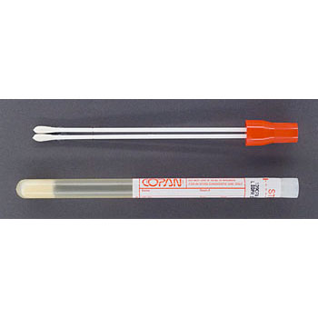
Swab Sampling Procedure
Materials used:
Sterile items: gloves, sample containers (e.g., large tubes), wrapped non-cotton swabs, wetting solution, scissors, sealable plastic bags, markers, tags
Wet the swab and wipe using an S-shaped pattern (vertically & horizontally), rolling the swab over the surface
Place the swab aseptically in a sample tube; label

Slide 7
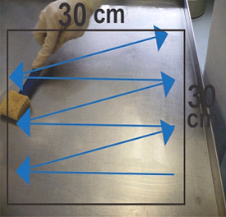
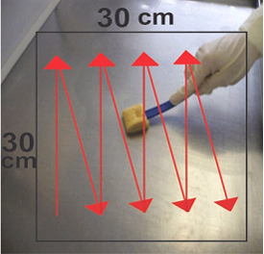
How to swab a surface

Slide 8
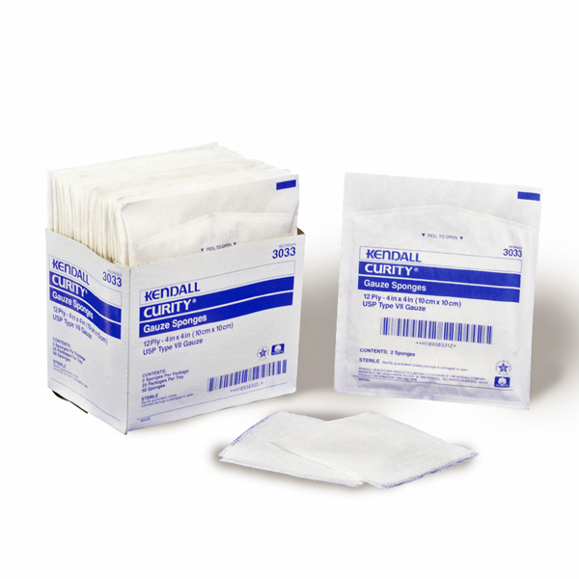
Wipe Method
Materials used:
Sterile gloves, sterile sample containers, sterile wrapped 2x2 gauze sponge pads, sterile water or saline, plastic bags, tags
Aseptically wet the gauze with fluid and thoroughly wipe the area within the template
Fold the gauze so the exposed
side is inward and place in
sample container; label

Slide 9
Compare and Contrast Surface Sampling Methods
Sample Type | Description | Target | Uses | Biological Agents
Wipe | Sterile 2 x 2 non-cotton gauze, moistened; wipe area of known size | Nonporous surfaces, usually small in area | Screening small nonporous surfaces extent of contamination decontamination effectiveness | Bacteria, fungi, biological toxins
Swab | Sterile non-cotton swab, individually wrapped, then moistened with sterile solution; wipe area of known size | Nonporous surfaces, usually very small in area, complex surfaces with crevices, corners
RODAC | Convex agar surface in culture dish, press onto surface, incubate | Nonporous surfaces, relatively small area ,f lat |  | Bacteria, fungi

Slide 10
Other Methods of Sampling
1-Direct Microscopic Examination
A direct microscopic examination of a surface shows exactly what is there, without being affected by an organism's ability to compete and grow on sampling media.
Advantages of direct microscopic test
is inexpensive and may be analyzed immediately.
shows exactly what is there without being affected by an organism's ability to compete and grow on sampling media..
may reveal indoor reservoirs of spores of fungi which have not yet become airborne.

Slide 11
2-Tape Sample
Use a piece of absolutely clear tape that is one or two inches in length. Handle it by the ends only.
Position the adhesive side of the tape over the suspect area and press firmly, do not rub the tape back and forth.
Remove the tape from the surface and place it onto a clean microscope slide, then place the microscope slides into a slide box or other protective container. If microscope slides aren't available, tape the tape sample directly onto a plastic bag adhesive side down.
Do not fold the tape onto itself.

Slide 12
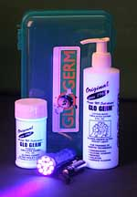
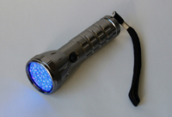
Visual Methods Currently Used to Teach and Evaluate Cleaning Practices
Application of clear chemicals that fluoresce under UV light : GLO Germ
The GLO Germ Kit contains a bottle of liquid or gel, a bottle of powder, and an ultra-violet lamp. The liquid or gel and the powder contain the plastic simulated germs, and the lamp illuminates them to test the effectiveness of cleaning practices.

Slide 13
GLO Germ
GLO Germ is the world leader in demonstrating cross-contamination issues in food service, health care and educational markets.
GLO Germ stands out as an effective way to show just how easy it is to overlook proper hand washing and cleaning. Not enough can be said about how important cleanliness and proper hand washing are to keep infections from being spread.

Slide 14
Practical work
Each 3 students will have 3 PCA plates
Label plates as clean , moderate , dirty , student name ,name of surface.
Swab surface with sterile swab after pre wetting in S.Saline, by rubbing slowly firmly back and forth at 3 times over a certain area.
Inoculate the labeled plate with swab.
Incubate plates 48hours at 37 c
Read results with instructor.

Slide 15
Reading of results
Determine the type and number of organisms
An accountable plate is one which contains from 30-300 colonies
An acceptable plate is one containing less than 100 colonies for moderate and dirty surfaces and sanitation is said to be acceptable. For clean surfaces account of less than 20 colonies is said to acceptable.
If a there is a Predominant organism , this is not normal .It needs investigation.

Slide 16
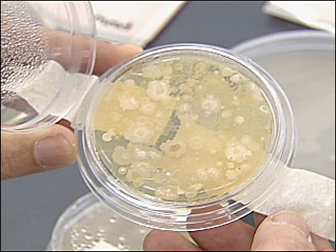
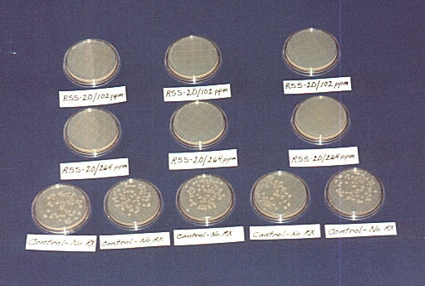
RODAC/ PCA plates after sampling

