Slide 1
EndNote

Slide 2
What is EndNote?
EndNote is referencing software that enables you to create a database of references from your readings.

Slide 3
The main functions of such programs are:
Maintenance of a personal database of references.
Downloading references from other databases.
Using the personal database to insert references in word-processed documents.
Generating a bibliography in many different styles, such as Harvard, APA, or Vancouver.

Slide 4
Opening EndNote
To create a new library:
File menu / New / Enter a name to identify your new library
To open an exiting library:
File menu / Open library.

Slide 5
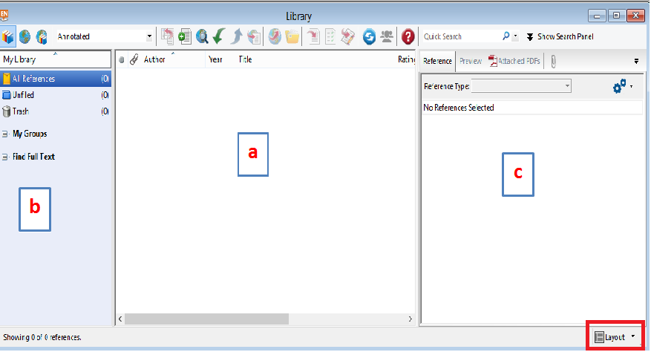
The EndNote Library screen is split into three panes: a Reference List pane, a Groups pane, and a Tab pane .
We can change the layout by click the layout button and select what you need.

Slide 6
A- The Reference List Pane:
This shows a list of all your references, each displayed as a single line.
You can sort the references by clicking on a column heading.
B- The Groups Pane:
These are subsets (or folders) of references saved for easy retrieval. Click on the title of a group to see its contents displayed in the Reference List pane.

Slide 7
C- Tabs Panel displays:
A Reference tab for editing a reference
A Preview tab for viewing formatted references
An Attached PDFs tab for viewing PDF files
A paper clip icon for attaching files to a reference

Slide 8
More about EndNote libraries
The file extension .enl stands for EndNote Library. A library is just a file like any other file. It can be copied, renamed, deleted, moved to another folder or compressed.
When EndNote creates the library, it will also create a .DATA folder which contains various files connected with the library .

Slide 9
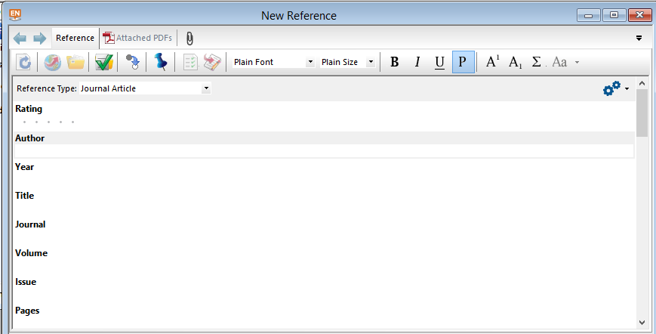
Inputting References Manually
Click on the New Reference button on the library toolbar. You should now see a New Reference window
Note that Journal Article is the default Reference Type

Slide 10
Author & Editor names
If there is more than one author, each author must be entered on a separate line. (Use Enter button to start new line).
Personal authors & editor
- Author names should be entered with the last name followed by a comma and the first name (or initials), e.g. Smith, John .
- You must type capital letters where required, e.g. Smith, John (not smith, john) .
When entering corporate authors (companies, institutions, organizations, etc.), put a comma after the name, for example: University of Salford,
If your corporate author name includes a comma in the name itself, use two commas in place of the first comma, for example: Institute for Social Research,, University of Salford
Use the URL field to link to an electronic version of the document on the web.
Use the File Attachments field to link to a PDF version of the document stored on your own computer.

Slide 11
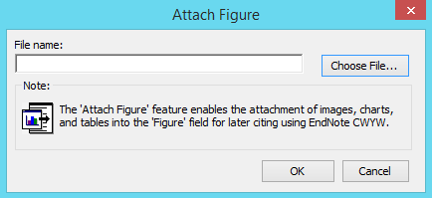
Attaching Images

Slide 12
Editing References
In the library window, double-click on one of the references that you have entered.
OR
Highlight the reference you would like to edit.
Then select Reference from the Preview Pane at the right.
You can change any of the details .

Slide 13
Delete a Reference from your library
Select the reference you want to delete, then go to the References option on the menu bar, and select Move References to Trash.
OR
Right click on the reference that you want to delete ..and select Move References to Trash

Slide 14
Output Styles
An EndNote output style is a piece of software that will convert the data in your library into formatted references that correspond to the bibliographical styles used by journal publishers or specified in style manuals .
A range of output styles is supplied with the software, and hundreds more styles can be downloaded from the EndNote website, so there is a good chance that you will find one suitable for your needs. If not, EndNote allows you to create your own output styles or edit an existing output style.

Slide 16
Grouping References
Groups on the menu bar / Create Group
To add a reference to a group
Select All References in the Groups Pane.
Highlight the reference in the library window.
Click on Groups on the top menu bar,
Click on Add References To from the drop-down menu, and then select the name of the group.

Slide 18
Direct Export
When you are searching certain databases via the web, you will find that they allow you to select records and then send them directly to your EndNote library. This is called "direct export".

Slide 19
Export from Google Scholar to EndNote
Go to the Google Scholar homepage (via Library homepage). Conduct a search.
http://scholar.google.com/
Look for ‘Cite’ under the record.

Slide 20
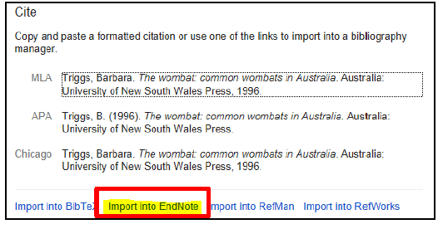
Now Import into Endnote.

Slide 21
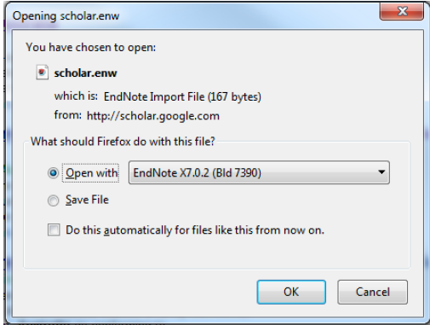
Click on open

Slide 22
Producing a Bibliography
Click on the Export button on the library toolbar.

Slide 23
Using EndNote with a Word Processor
If you have a compatible version of Microsoft Word (Windows or Macintosh) installed on your computer, the EndNote installation will insert extra files into your word processing software. These files make up the Cite While You Write add-in.

Slide 24
Open your Word document.
First you need to select the output style. To change style, go to the styles manager on the ribbon and choose Select Another Style

Slide 26
In EndNote:
Click once to highlight the reference you want to use.
Click the Insert Citation button.
Return to your Word document. You should see a citation

Slide 27
Direct quotations and page numbers
Many referencing styles require that a citation for a direct quote must include the page number where you found it.
Click the Edit & Manage Citation(s)

Slide 29
Changing the citation format
- Right-click on the citation you have just inserted,
- go to Edit Citation(s)
- select Display as: Year …..etc

Slide 30
Deleting citations
Click on the citation , then click the Edit & Manage Citations button.

Slide 31
Formatting References in a Numbered Style
Use the Styles Manager to select Numbered style:

