Slide 1
King Saud University
College of Medicine
Refractive Surgery
Abdulrahman Al-Muammar, MD, FRCSC

Slide 2
REFRACTIVE SURGERY
In the last 50 years, refractive surgery has evolved dramatically with improving outcome
Radial keratectomy became popular in the late 1970s and early 1980s for the treatment of myopia
Photorefractive keratectomy (PRK) using the excimer laser, introduced in 1987, and laser-assisted in situ keratomileusis (LASIK), introduced in 1990
The use of laser to correct refractive errors has been the most popular.

Slide 3
REFRACTIVE SURGERY
Excimer laser
Surface ablation
PRK
LASEK
Epi-LASIK
LASIK
Femtosecond assisted LASIK
Intrastromal ring
Thermal
Intraocular
Clear lens extraction
Phakic IOLs

Slide 4
PATIENT ELIGIBILITY
Patient selection and evaluation are the most important aspects of elective refractive surgery.
Patient information and education.
Patient and Dr. must have the same expectation.
Patient must understand the risks and benefits.
Patient follow-up and recovery must be outlined.

Slide 5
Age
Age should be 21 years (at least18 years)
Stable refractive error.
Progression of myopia < 0.5 D / yr.

Slide 6
DETAILED HISTORY
Past and present medical history:
Pregnancy
DM
Connective tissue diseases
Immunocompromised

Slide 7
REFRACTIVE SURGERY
Refractive errors are some of the most common ophthalmic abnormalities worldwide.
For young population, there are prevalence of 37%, and 44% for hyperopia and myopia respectively.
The prevalence of refractive error among population age 43 to 84 years was 49%, and 26% for hyperopia and myopia respectively.
In North America 40% of people have some degree of myopia and almost 50% have hyperopia.

Slide 8
DETAILED HISTORY
Past and present ocular history:
Unstable refractive error.
Glaucoma.
HSV.
Uveitis.
Previous surgery.
Contact lenses.

Slide 9
DETAILED HISTORY
Family history.
Medications:
Amiodarone.
Isotretinoin.
Topical or oral steroid.
Social history.
Occupational history.

Slide 10
PREOPERATIVE EVALUATION
IOP
Dilated fundus exam
Optic nerve
Macula
Peripheral tear or holes
Eye dominance
For monovision

Slide 11
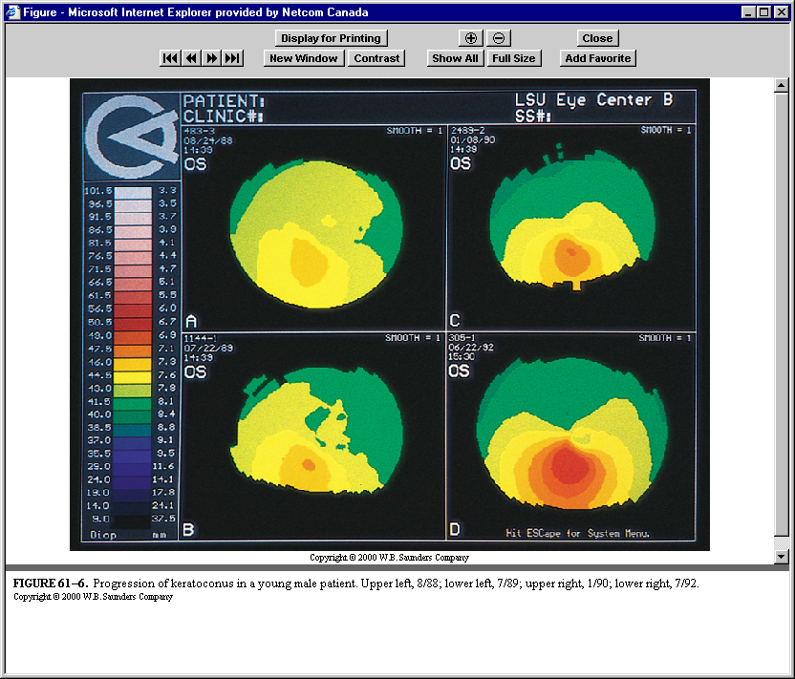

Slide 14
PRK

Slide 15
INDICATION OF PRK
Patient preference:
fear of incision – safetys.
Low refractive error.
myopia -1 to -6 D.
Contact sport.
RCES or EBMD.
Thin corneas < 500 µm or residual bed <250-300 µm.
Steep K > 48D or flat K <38 D.

Slide 16
INDICATION OF PRK
Dry eye syndrome.
Asymmetric astigmatism.
Poor exposure-deep orbit.
Retreatment after previous surgery.

Slide 17
LASIK

Slide 18
INDICATION OF LASIK
To circumvent problems with PRK:
Pain in the first few days.
Prolonged wound healing.
Prolonged visual rehabilitation.
Follow-up.
Stromal haze.
Side effects from the use of topical steroid.

Slide 19
LASEK

Slide 22
LASEK
Theoretical advantage of:
Less pain (no difference)
Faster visual rehabilitation
Less stromal haze (maybe)

Slide 23
INTACS
INTACS is an option in correcting myopic refractive errors of less than -3.00 D .
During this procedure, the ophthalmologist places a PMMA ring into the periphery of the cornea at about two thirds of its depth.
The ring causes the cornea to flatten, thus correcting the refractive error.

Slide 24
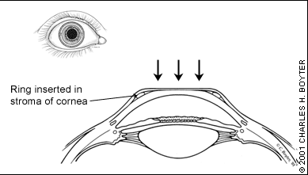
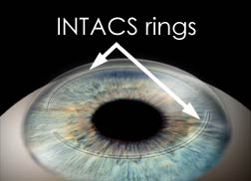
INTACS

Slide 25
INTACS
The benefits of the INTACS include rapid vision recovery following placement (because surgical manipulation does not occur over the central cornea/visual axis).
Safe and predictable.
An added benefit is that the device can be removed at any time.
Risks include infection, abnormal wound healing and irregular astigmatism.

Slide 26
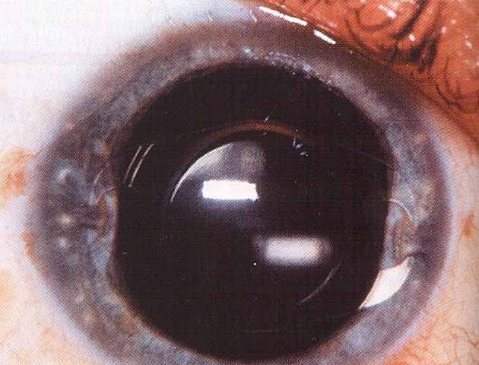
PHAKIC IOL IMPLANTATION
- Phakic intraocular lens:
Anterior chamber lenses.
angle supported.
iris stroma fixated – Artisan .
Posterior chamber - ICL – STAAR.
- Available for high myopia and hyperopia.
- Avoid in monocular patient, glaucoma, cataract, uveitis, and low endothelial cell count.

Slide 27
PHAKIC IOL IMPLANTATION
ADVANTAGES
Maintains asphericity and prolate cornea.
No corneal weakening or risk of ectasia.
Maintain accommodation in pre-presbyopes.
Stability of refractive result.
Wider range of correction.

Slide 28
PHAKIC IOL IMPLANTATION
DISADVANTAGES
Technically more difficult.
Enclavement challenging for iris claw lenses.
Risks of intraocular surgery – endophthalmitis, endothelial damage, pupil distortion, CME.
Concern over long-term complications:
Cataract formation.
Endothelial loss.

Slide 29
CLEAR LENS EXTRACTION
Effective for high myopia and hyperopia.
Patients > 50.
Accurate, stable, inexpensive.
Mean UCVA 20/25-20/40.

Slide 30
CLEAR LENS EXTRACTION
Invasive procedure, loss of accommodation.
Small risk of RD.
YAG capsulotomy 18-33%.

Slide 31
THERMOKERATOPLASTY
THANK YOU

