Slide 1
EIGRP

Slide 2
EIGRP
EIGRP Stands for Enhanced Interior Gateway Routing Protocol
It is a Cisco proprietary routing protocol loosely based on their original IGRP.
EIGRP is an advanced distance-vector routing protocol.
It can only use it in an all-Cisco network.

Slide 3
EIGRP is based on a distance vector algorithm that determines the best path to a destination But EIGRP uses a more complex metric than RIP's simple hop count.
EIGRP operates very efficiently over large networks.
The rest of the time, routers only exchange small "Hello" packets to verify that routing peers are still available.

Slide 5
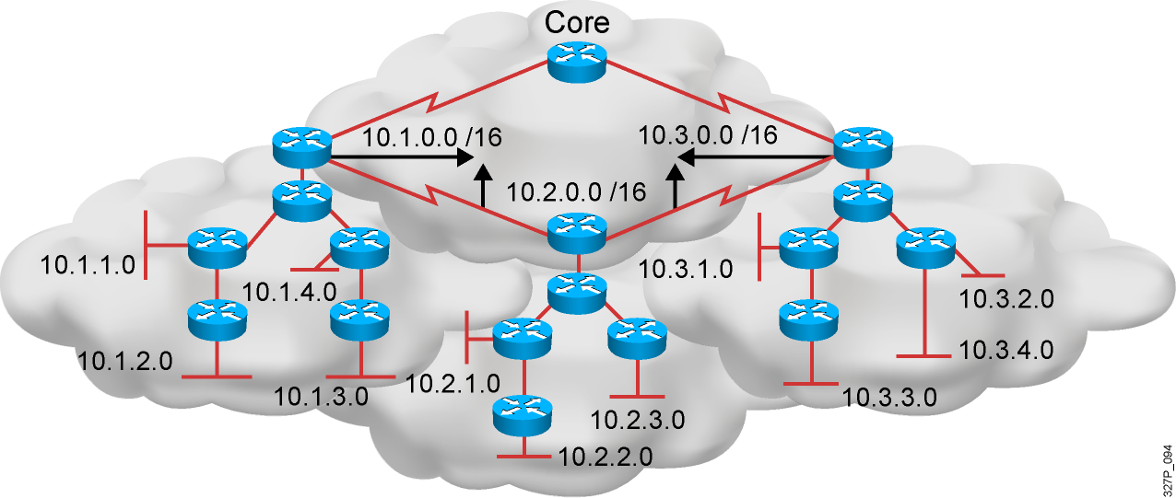
EIGRP Features
Advanced distance vector
Rapid convergence
100% loop-free classless routing
Easy configuration
Incremental updates
Load balancing across equal- and unequal-cost pathways
Flexible network design
Multicast and unicast instead of broadcast address
Support for VLSM and discontiguous subnets
Manual summarization at any point in the internetwork
Support for multiple network layer protocols

Slide 6
The criteria that EIGRP uses by default to calculate its metric: Bandwidth Delay The optional criteria that EIGRP can be configured to use when calculating its metric: Reliability Load

Slide 7
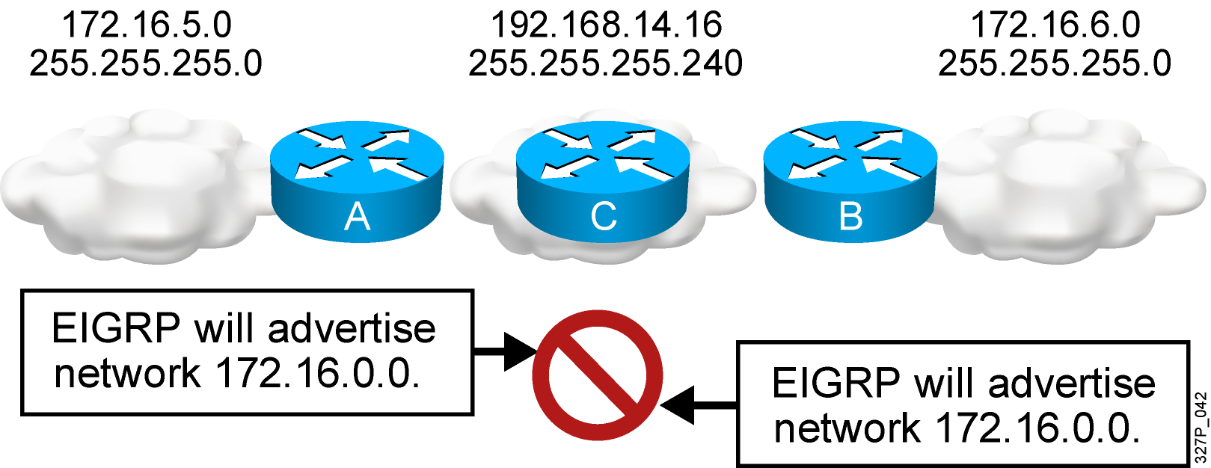
EIGRP, by default, does not advertise subnets and, therefore, cannot support discontiguous subnets.

Slide 8
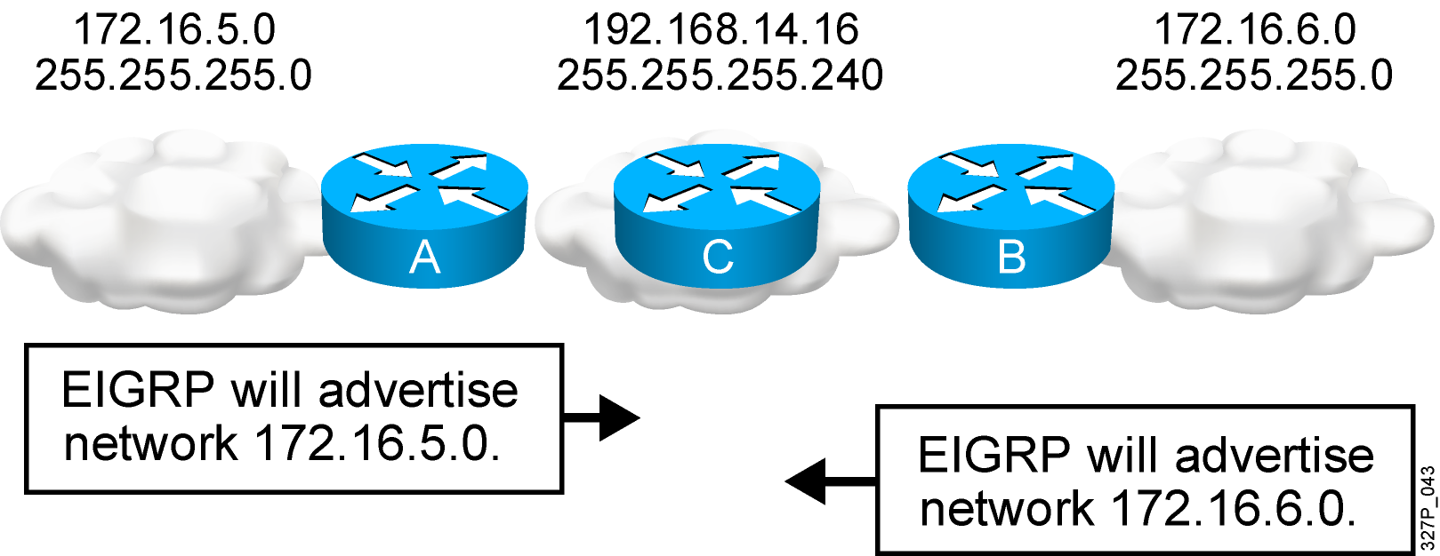
EIGRP with the no auto-summary parameter can advertise subnets and, therefore, can support discontiguous subnets.

Slide 9
Configuration

Slide 10
Router1>enable Router1# Configure terminal Router1(config)# Router eigrp 1 Router1(config-Router)#network 192.168.10.0 0.0.0.255 Router1(config-Router)#network 192.168.20.0 0.0.0.3 end

Slide 11
Router2>enable Router2# Configure terminal Router2(config)# Router eigrp 1 Router2(config-Router)#network 192.168.30.0 0.0.0.255 Router2(config-Router)#network 192.168.20.0 0.0.0.3 Router2(config-Router)#network 192.168.40.0 0.0.0.3 end

Slide 12
Router3>enable Router3# Configure terminal Router3(config)# Router eigrp 1 Router3(config-Router)#network 192.168.50.0 0.0.0.255 Router3(config-Router)#network 192.168.40.0 0.0.0.3 end

