Slide 1
EIGRP
(Enhanced Interior Gateway Routing Protocol)

Slide 2
What is EIGRP ?
EIGRP (Enhanced Interior Gateway Routing Protocol) is a network protocol that lets routers exchange information more efficiently than with earlier network protocols.
EIGRP evolved from IGRP (Interior Gateway Routing Protocol) and routers using either EIGRP and IGRP can interoperate because the metric (criteria used for selecting a route) used with one protocol can be translated into the metrics of the other protocol. EIGRP can be used not only for Internet Protocol (IP) networks but also for AppleTalk and Novell NetWare networks.

Slide 3
EIGRP Metrics
EIGRP scales IGRP’s metrics by a factor of 256
  IGRP metric = 24 bits; EIGRP metric = 32 bits
  Bandwidth and Delay are equally weighted
  Reliability, Load, and MTU are off by default
  Hop count limited to 224 (IGRP’s limit is 255)
To remember of metric EIGRP components:
  Big = Bandwidth
  Dogs = Delay
  Really = Reliability
  Like = Load
  Me = MTU

Slide 4
EIGRP for IP
No updates. Route updates sent only when a change occurs
Hello messages sent to neighbors every 5 seconds (60 seconds in most WANs)
Enhanced IGRP
EIGRP
EIGRP

Slide 5
Configuring EIGRP for IP
AS=10
A
C
10.110.1.0
B
172.16.10.0
192.168.0.0
Router(config)#router eigrp 10
Router(config-router)#network 10.0.0.0
Router(config-router)#network 172.16.0.0
Enable EIGRP
Assign networks
If you use the same AS number for EIGRP as IGRP, EIGRP will automatically redistribute IGRP into EIGRP

Slide 6
EIGRP Metrics (4)
The table in the figure shows the default delay values for various interfaces.
Notice that the default value is 20,000 microseconds for Serial interfaces and 100 microseconds for FastEthernet interfaces.

Slide 7
Comparing between EIGRP & IGRP
IGRP | EIGRP
Classful Routing Protocol | Classless Routing Protocol VLSM, CIDR
bandwidth = (10,000,000/bandwidth kbps) delay = delay/10 24 bit metric for bandwidth and delay | bandwidth = (10,000,000/bandwidth kbps) * 256 delay = (delay/10) * 256 32 bit metric for bandwidth and delay
Maximum Hop Count = 255 | Maximum Hop Count = 224
No differentiation between internal and external routes. | Outside routes (redistributed) are tagged as external routes.
Automatic redistribution between IGRP and EIGRP as long as “AS” numbers are the same.

Slide 8
Displaying Interface Values
R1> show interface fa0/0
Ethernet0 is up, line protocol is up
Hardware is Lance, address is 0010.7b3a.cf84 (bia 0010.7b3a.cf84)
MTU 1500 bytes, BW 100000 Kbit, DLY 100 usec,
rely 255/255, load 1/255
<output omitted>
R3> show interface s0/0
Serial0/0 is up, line protocol is up
Hardware is QUICC Serial
Description: Out to R1
Internet address is 192.168.64.5/30
MTU 1500 bytes, BW 1544 Kbit, DLY 20000 usec,
rely 255/255, load 246/255
<output omitted>

Slide 9
Determining the Bandwidth between R1 & R2
Bandwidth = (10,000,000/bandwidth kbps) * 256
FastEthernet
= (10,000,000/100,000) * 256
= 25,600
T1
= (10,000,000/1544) * 256
= 1,657,856
Delay = 2,560
Fa0/0 192.168.72.1/24
Bandwidth = 25,600
R1
S0/0 192.168.64.2/30
S0/1 192.168.64.6/30
Delay = 512,000
S0/0 192.168.64.1/30
S0/0 192.168.64.5/30
Fa0/0 192.168.1.2/24
Bandwidth = 1,657,856
R3
R2
Fa0/0 192.168.1.1/24
EIGRP AS 100

Slide 10
Determining the Delay between R1 & R2
Delay = (delay/10) * 256
Delay = 2,560
FastEthernet
= (100/10) * 256
= 2,560
T1
= (20,000/10) * 256
= 512,000
Fa0/0 192.168.72.1/24
Bandwidth = 25,600
R1
S0/0 192.168.64.2/30
S0/1 192.168.64.6/30
Delay = 512,000
S0/0 192.168.64.1/30
S0/0 192.168.64.5/30
Fa0/0 192.168.1.2/24
Bandwidth = 1,657,856
R3
R2
Fa0/0 192.168.1.1/24
EIGRP AS 100

Slide 11
Determining the cost between R1 & R2
What is the cost (metric) for 192.168.72.0/24 from R2?
Delay = 2,560
Cost: Slowest bandwidth
+ sum of delays
Fa0/0 192.168.72.1/24
1,657,856512,000 2,560 --------------2,172,416
Bandwidth = 25,600
R1
S0/0 192.168.64.2/30
S0/1 192.168.64.6/30
The cost!
Delay = 512,000
S0/0 192.168.64.1/30
S0/0 192.168.64.5/30
Fa0/0 192.168.1.2/24
Bandwidth = 1,657,856
R3
R2
Slowest!
Fa0/0 192.168.1.1/24
bandwidth = (10,000,000/bandwidth kbps) * 256
delay = (delay/10) * 256
EIGRP AS 100

Slide 12
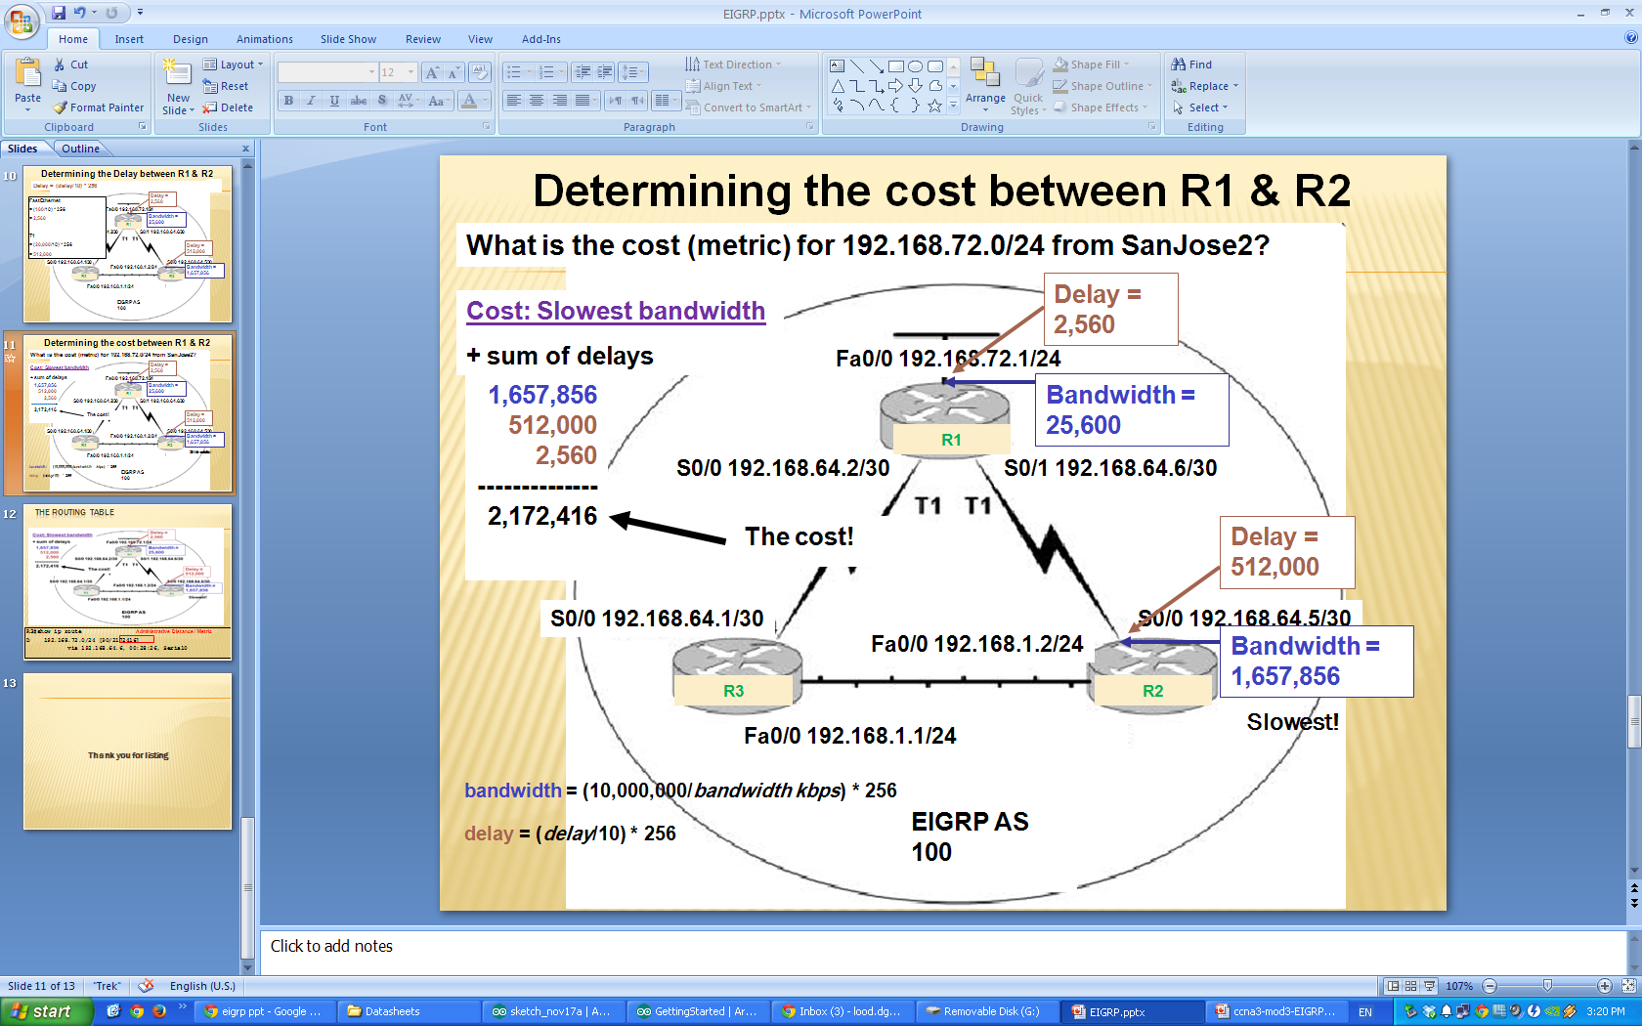
The Routing Table
R3#show ip route
D 192.168.72.0/24 [90/2172416]
via 192.168.64.6, 00:28:26, Serial0
Administrative Distance / Metric

Slide 13
Thank you for listing

