Slide 1
Education

Slide 2
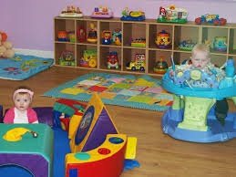
Stages in a person’s education (UK system)
Crèche.

Slide 3
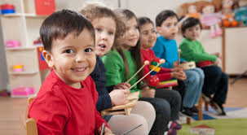
2. Nursery school.
Normally for children between the ages of 3-5.

Slide 4
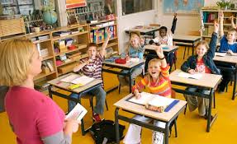
3. Primary school.
- learn the basics of reading, writing, arithmetic,etc.

Slide 5
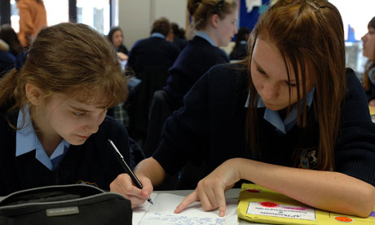
4. Secondary school.
-for children between 11-16.
-Primary and secondary education is mandatory in the UK; after age 16, education is optional.

Slide 6
compehensive school:
-It is a type of secondary school that does not select its intake on the basis of academic achievement, qualifications or the wealth of the parents of the children it accepts.
- A secondary school for children of all abilities from the same district.
-About 90% of British pupils attend comprehensive schools.

Slide 7
Grammar school:
-A state secondary school to which pupils are admitted on the basis of ability.
-A secondary school in which Latin and Greek are among the principal subjects taught.

Slide 8
Sixth form college:
-sixth form represents the final two years of secondary education, where students (typically between sixteen and eighteen years of age) prepare for their A-level (or equivalent) examinations.

Slide 9
Types of classes in higher education
Lecture: large classes listening to the teacher and taking notes.
seminar: 10-20 students actively taking part in discussion etc.
workshop: a meeting at which a group of people engage in intensive discussion and activity on a particular subject or project.
Tutorial: one student or a small group, working closely with a teacher.

Slide 10
-A wiki is a Web site that allows users to add and update content on the site using their own Web browser. This is made possible by Wiki software that runs on the Web server.
-A great example of a large wiki is the Wikipedia, a free encyclopedia in many languages that anyone can edit.
-The term "wiki" comes from the Hawaiian phrase, "wiki wiki," which means "super fast”.

