Slide 1
Entrepreneurship,
New Ventures, and
Business Ownership
3

Slide 2
Introduction
In this chapter, we examine
  converting a great business idea into a profitable enterprise
  assessing the market potential for new and up-and-coming businesses
  the business plan, reasons for success and failure
  advantages and disadvantages of different kinds of ownership

Slide 3
Define small business, discuss its importance to the U.S. economy, and explain popular areas of small business.
Explain entrepreneurship and describe some key characteristics of entrepreneurial personalities and activities.
Describe distinctive competence, the business plan, and the start-up decisions made by small businesses and identify sources of financial aid available to such enterprises.

Slide 4
Discuss the trends in small business start-ups and identify the main reasons for success and failure among small businesses.
Explain sole proprietorships, partnerships, and cooperatives and discuss the advantages and disadvantages of each.
Describe corporations, discuss their advantages and disadvantages, and identify different kinds of corporations; explain the basic issues involved in managing a corporation and discuss special issues related to corporate ownership.

Slide 5
What Is a “Small” Business?
Small business
  one that is independent (not part of a larger business) and that has relatively little influence in its market
Small Business Administration (SBA)
  government agency charged with assisting small businesses
Notes:
The U.S. Department of Commerce considers a business “small” if it has fewer than 500 employees. The U.S. Small Business Administration (SBA), a government agency that assists small businesses, regards some companies with as many as 1,500 employees as small, but only if the business has relatively low annual revenues. Because strict numerical terms sometimes lead to contradictory classifications, we will consider a small business to be one that is independent (that is, not part of a larger business) and that has relatively little influence in its market.

Slide 6
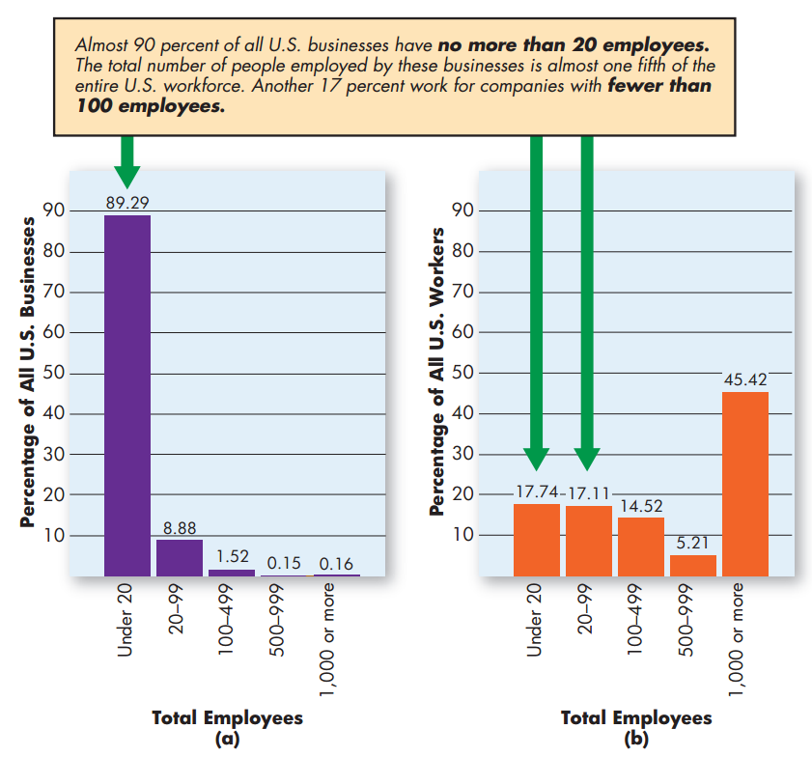
The Importance of Small Business in the
United States
Notes:
As Figure 3.1 shows, most U.S. businesses employ fewer than 100 people, and most U.S. workers are employed by small business. Moreover, this same pattern exists across most free market economies.

Slide 7
The Importance of Small Business in the U.S. Economy (cont.)
Job creation
Innovation
Contributions to big business

Slide 8
Job Creation
Small businesses have accounted for about 40 percent of all new jobs in high-technology sectors of the economy
Small businesses are generally the first to hire in times of economic recovery

Slide 9
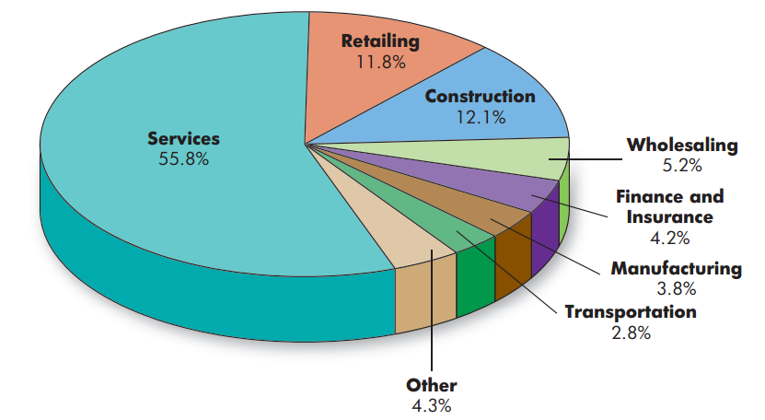
Popular Areas of Small-Business Enterprise
Notes:
Figure 3.2 shows the distribution of all U.S. businesses employing fewer than 20 people across industry groups.

Slide 10
Entrepreneurship
Entrepreneur
  businessperson who accepts both the risks and the opportunities involved in creating and operating a new business venture
Entrepreneurship
  the process of seeking business opportunities under conditions of risk
Notes:
People may decide to pursue entrepreneurship for a variety of different reasons. Many entrepreneurs seek to launch a new business with the goal of independence—independence from working for someone else coupled with some reasonable degree of financial security. Such entrepreneurs want to achieve a safe and secure financial future for themselves and their families but do not aspire to grow their business beyond their capacity to run it.

Slide 11
Entrepreneurial Characteristics
Resourcefulness
Concern for good, personal customer relations
Strong desire to be their own bosses
Deal with uncertainty and risk
Notes:
Regardless of their goals, many successful entrepreneurs share certain characteristics. Among these characteristics are resourcefulness and a concern for good, often personal, customer relations. Most of them also have a strong desire to be their own bosses.

Slide 12
Understanding Distinctive Competencies
Established Market
  one in which many firms compete according to relatively well-defined criteria
Niche
  a segment of a market that is not currently being exploited
Notes:
An established market is one in which many firms compete according to relatively well-defined criteria.
A niche is simply a segment of a market that is not currently being exploited. In general, small entrepreneurial businesses are better at discovering these niches than are larger organizations.

Slide 13
First-Mover Advantages
First-mover advantage
  is any advantage that comes to a firm because it exploits an opportunity before any other firm does
Notes:
A first-mover advantage is any advantage that comes to a firm because it exploits an opportunity before any other firm does. Sometimes large firms discover niches within existing markets or new markets at just about the same time small entrepreneurial firms do, but are not able to move as
quickly as small companies to take advantage of these opportunities. Many of the “app” developers for smartphones are exploiting first-mover advantage.

Slide 14
Starting and Operating a New Business
Business plan
  Document in which the entrepreneur describes her or his business strategy for the new venture and demonstrates how it will be implemented
Notes:
A real benefit of a business plan is the fact that in the act of preparing it, the would-be entrepreneur must develop the business idea on paper and firm up his or her thinking about how to launch it before investing time and money in it.

Slide 15
Crafting a Business Plan
Setting Goals and Objectives
Sales Forecasting
Financial Planning
Notes:
The entrepreneur must demonstrate an understanding of the current market, of the strengths and weaknesses of existing firms, and of the means by which the new venture will compete.

Slide 16
Starting the Small Business
Buying an Existing Business
Franchising
Starting from Scratch

Slide 17
Starting a Small Business
Franchise
  arrangement in which a buyer (franchisee) purchases the right to sell the good or service of the seller (franchiser)
Notes:
Most McDonald’s, Subway, 7 Eleven, RE/Max, Ramada, and Dunkin’ Donuts outlets are franchises operating under licenses issued by parent companies to local owners. A franchise agreement involves two parties, a franchisee (the local owner) and a franchiser (the parent company).

Slide 18
Franchising
Advantages
  Proven business opportunity
  Access to management expertise
Disadvantages
  Start-up costs
  Ongoing payments
  Management rules and restrictions

Slide 19
Starting from Scratch
Who and where are my customers?
How much will those customers pay for my product?
How much of my product can I expect to sell?
Who are my competitors?
Why will customers buy my product rather than the product of my competitors?

Slide 20
Financing a Small Business
Personal resources
Loans from family and friends
Bank loans
Venture capital companies
Small-Business Investment Companies (SBICs)
Minority Enterprise Small-Business Investment Companies (MESBICs)
SBA financial programs

Slide 21
Financing a Small Business (cont.)
Venture Capital Company
  group of small investors who invest money in companies with rapid growth potential
Small-Business Investment Company (SBIC)
  government-regulated investment company that borrows money from the SBA to invest in or lend to a small business
Notes:
Venture capital companies are groups of small investors seeking to make profits on companies with rapid growth potential. Most of these firms do not lend money. They invest it, supplying capital in return for partial ownership (like stocks, discussed later in this chapter)
Small business investment companies (SBICs) also invest in companies with potential for rapid growth. They are federally licensed to borrow money from the SBA and to invest it in or lend it to small businesses, and they are themselves investments for their shareholders. Past beneficiaries of SBIC capital include Apple Computer, Intel, and FedEx.

Slide 22
Trends in Small-Business Start-Ups
Emergence of E-Commerce
  The Internet provides fundamentally new ways of doing business
Crossovers from Big Business
  More businesses are being started by people who have opted to leave big corporations and put their experience to work for themselves
Opportunities for Minorities and Women
  More small businesses are also being started by minorities and women.
Notes:
The most significant recent trend is the rapid emergence of e-commerce. Because the Internet provides fundamentally new ways of doing business, savvy entrepreneurs have created and expanded new businesses faster and easier than ever before.
More businesses are being started by people who have opted to leave big corporations and put their experience to work for themselves. In some cases, they see great new ideas that they want to develop. Others get burned out in the corporate world. Some have lost their jobs, only to discover that working for themselves was a better idea anyway
More small businesses are also being started by minorities and women.18 The number of businesses owned by African Americans increased by 60 percent during the most recent five-year period for which data are available and now totals about 2 million. The number of Hispanic-owned businesses has grown 44 percent and now totals about 2.25 million. Ownership among Asians has increased 1 percent and among Pacific Islanders 35 percent.

Slide 23
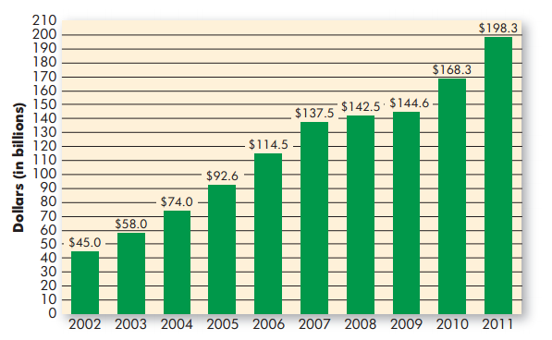
Emergence of E-commerce

Slide 24
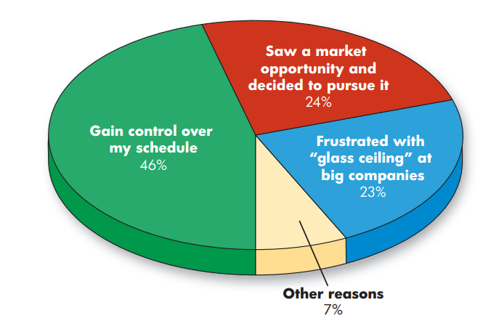
Reasons Women
Give for Starting Businesses
Notes:
Almost 8 million businesses are now owned by women, and they generate a combined $200 trillion in revenue a year and employ about 13 million workers. Figure 3.4 shows some of the reasons women cite for starting their own businesses.

Slide 25
Trends in Small-Business Start-Ups
Global Opportunities
  Many entrepreneurs are also finding new opportunities in foreign markets
Better Survival Rates
  Today, 44 percent of new start-ups can expect to survive for at least four years
Notes:
Many entrepreneurs are also finding new opportunities in foreign markets.
More people are encouraged to test their skills as entrepreneurs because the small business failure rate has declined. During the 1960s and 1970s, less than half of all new start-ups survived more than 18 months; only one in five lasted 10 years. Now, however, 44 percent can expect to survive for at least four years.

Slide 26
Reasons for Failure
Managerial incompetence or inexperience
Neglect
Weak control systems
Insufficient capital
Notes:
1 Managerial incompetence or inexperience. Some entrepreneurs put too much faith in common sense, overestimate their own managerial skills,
or believe that hard work alone ensures success.
2 Neglect. Some entrepreneurs try to launch ventures in their spare time, and others devote only limited time to new businesses.
But starting a small business demands an overwhelming time commitment.
3 Weak control systems. Effective control systems keep a business on track and alert managers to potential trouble. If your control systems
don’t signal impending problems, you may be in serious trouble before you spot more obvious difficulties.
4 Insufficient capital. Some entrepreneurs are overly optimistic about how soon they’ll start earning profits. In most cases, it takes months or even years.

Slide 27
Reasons for Success
Hard work, drive, and dedication
Market demand for the products or services being provided
Managerial competence
Luck
Notes:
1 Hard work, drive, and dedication. Small-business owners must be committed to succeeding and willing to spend the time and effort to make it happen.
2 Market demand for the products or services being provided. Careful analysis of market conditions can help small-business owners assess
the probable reception of their products.
3 Managerial competence. Successful owners may acquire competence through training or experience or by drawing on the expertise of others.
4 Luck.

Slide 28
Noncorporate Business Ownership
Sole Proprietorship
  business owned and usually operated by one person who is responsible for all of its debts
General Partnership
  business with two or more owners who share in both the operation of the firm and the financial responsibility for its debts
Notes:
The sole proprietorship is owned and usually operated by one person. About 74 percent of all U.S. businesses are sole proprietorships; however, they account for only about 4 percent of total business revenues. Though usually small, they may be as large as steel mills or department stores..
The most common type of partnership, the general partnership, is similar to a sole proprietorship but is owned by more than one person. Partners may invest equal or unequal sums of money. In most cases, partners share the profits equally or in proportion to their investment. In certain cases, though, the distribution of profits may be based on other things.

Slide 29
Sole Proprietorship
Advantages
  Freedom
  Simple to form
  Low start-up costs
  Tax benefits
Disadvantage
  Unlimited liability
  Limited resources
  Limited fundraising capability
  Lack of continuity

Slide 30
Partnerships
Advantages
  More talent and money
  More fundraising capability
  Relatively easy to form
  Limited liability for limited partners
  Tax benefits
Disadvantages
  Unlimited liability for general partners
  Disagreements among partners
  Lack of continuity

Slide 31
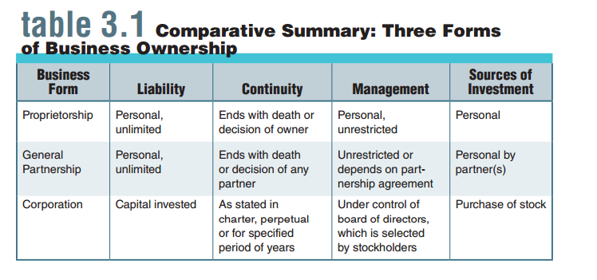
Comparative Summary:
Three Forms of Business

Slide 32
Alternatives to General Partnerships
Limited Partnership
  Allows for limited partners who invest money but are liable for debts only to the extent of their investments
  General (or active) partners run the business
Master Limited Partnership
  Master partner has majority ownership and runs the business; minority partners have no management voice
Notes:
Limited Partnership
Allows for limited partners who invest money but are liable for debts only to the extent of their investments.
General (or active) partner (or partners) run the business.
Master Limited Partnership
Organization sells shares (partnership interests) to investors on public exchange; investors paid back from profits.
Master partner has majority ownership and runs the business; minority partners have no management voice.

Slide 33
Cooperatives
Combine the freedom of sole proprietorships with the financial power of corporations
Groups of sole proprietorships or partnerships agree to work together for their common benefit

Slide 34
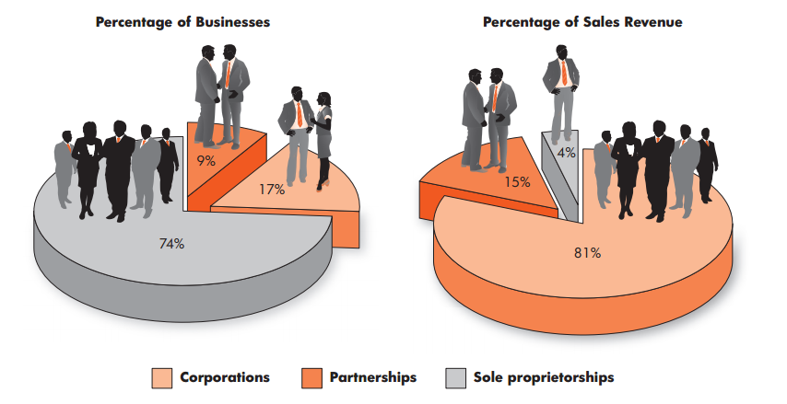
Proportions of U.S. Firms in Terms of
Organization Type and Sales Revenue
Notes:
There are about 5.8 million corporations in the United States. As you can see from Figure 3.5, they account for about 17 percent of all U.S. businesses but generate about 81 percent of all sales revenues.

Slide 35
The Corporate Entity
Corporation
  business that is legally considered an entity separate from its owners and is liable for its own debts; owners’ liability extends to the limits of their investments
Notes:
When you think of corporations, you probably think of giant operations such as General Motors and IBM. The very word corporation inspires images of size and power. In reality, however, your corner newsstand has as much right to incorporate as a giant automaker. Moreover, the newsstand and GM would share the characteristics of all corporations: legal status as separate entities, property rights and obligations, and indefinite life spans.

Slide 36
Corporations
Advantages
  Limited liability
  Continuity
  Stronger fundraising capability
Disadvantages
  Can be taken over against the will of its management
  Double taxation of profits
  Complicated and expensive to form

Slide 37
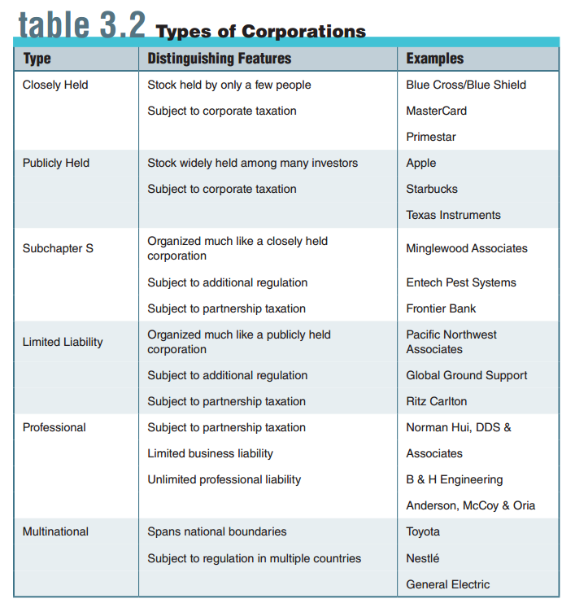
Types of Corporations
Notes:
We can classify corporations as either public or private. But within these broad categories, we can identify several specific types of corporations, some of which are summarized in Table 3.2

Slide 38
Types of Corporations (cont.)
Closely Held (or Private) Corporation
  a corporation whose stock is held by only a few people and is not available for sale to the general public
Publicly Held (or Public) Corporation
  A corporation whose stock is widely held and available for sale to the general public
S Corporation
  a hybrid of a closely held corporation and a partnership, organized and operated like a corporation but treated as a partnership for tax purposes
Notes:
The most common form of U.S. corporation is the closely held (or private) corporation. Stock is held by only a few people and is not available for sale to the public. The controlling group of stockholders may be a family, a management group, or even the firm’s employees. Most smaller corporations fit this profile.
When shares are publicly issued, the firm becomes a publicly held (or public) corporation. Stock is widely held and available for sale to the public. Many large businesses are of this type.
The S corporation (more fully called the Subchapter S corporation) is a hybrid of a closely held corporation and a partnership. It is organized and operates like a corporation, but it is treated like a partnership for tax purposes.

Slide 39
Types of Corporations (cont.)
Limited Liability Corporation (LLC)
  hybrid of a publicly held corporation and a partnership in which owners are taxed as partners but enjoy the benefits of limited liability
Professional Corporation
  form of ownership allowing professionals to take advantage of corporate benefits while granting them limited business liability and unlimited professional liability
Notes:
Another hybrid is the limited liability corporation (LLC). Owners are taxed like partners, each paying personal taxes only. However, they also enjoy the benefits of limited liability accorded to publicly held corporations.
Professional corporations are most likely composed of doctors, lawyers, accountants, or other professionals. Although the corporate structure protects from unlimited financial liability, members are not immune from unlimited liability. Professional negligence by a member can entail personal liability on the individual’s part.

Slide 40
Types of Corporations (cont.)
Multinational (or Transnational) Corporation
  form of corporation spanning national boundaries
Notes:
As the term implies, the multinational (or transnational) corporation spans national boundaries. Stock may be traded on the exchanges of several countries, and managers are likely to be of different nationalities.

Slide 41
Managing a Corporation
Corporate Governance
  roles of shareholders, directors, and other managers in corporate decision making and accountability
Notes:
Once the corporate entity comes into existence, it must be managed by people who understand the principles of corporate governance, the roles of shareholders, directors, and other managers in corporate decision making and accountability.

Slide 42
Corporate Governance
Stockholder (or Shareholder)
  owner of shares of stock in a corporation
Board of Directors
  governing body of a corporation that reports to its shareholders and delegates power to run its day-to-day operations while remaining responsible for sustaining its assets
Officers
  top management team of a corporation
Notes:
Corporate governance is established by the firm’s bylaws and usually involves three distinct bodies. Stockholders (or shareholders) are the owners of a corporation, investors who buy ownership shares in the form of stock. The board of directors is a group elected by stockholders to oversee corporate management.
Corporate officers are top managers hired by the board to run the corporation on a day-to-day basis.
Although board members oversee operations, most do not participate in day-to-day management. Rather, they hire a team of managers to run the firm.
This team, called officers, is usually headed by the firm’s chief executive officer (CEO), who is responsible for overall performance. Other officers typically include a president, who is responsible for internal management, and vice-presidents, who oversee various functional areas such as marketing and operations.

Slide 43
Special Issues in Corporate Ownership
Joint Ventures and Strategic Alliances
Employee Stock Ownership Plans
Institutional Ownership
Mergers, Acquisitions, Divestitures, and Spin-Offs
Notes:
Joint Venture – strategic alliance in which the collaboration involves joint ownership of the new venture.
Employee Stock Ownership Plan (ESOP) – arrangement in which a corporation holds its own stock in trust for its employees,
who gradually receive ownership of the stock and control its voting rights.
Institutional Investor – large investor such as a mutual fund or a pension fund that purchases large blocks of corporate stock.
Merger – the union of two corporations to form a new corporation.
Acquisition – the purchase of one company by another.
Divestiture – strategy whereby a firm sells one or more of its business units.
Spin-Off – strategy of setting up one or more corporate units as new, independent corporations.

Slide 44
Applying What You’ve Learned
Define small business, discuss its importance to the U.S. economy, and explain popular areas of small business.
Explain entrepreneurship and describe some key characteristics of entrepreneurial personalities and activities.
Describe distinctive competence, the business plan, and the start-up decisions made by small businesses and identify sources of financial aid available to such enterprises.

Slide 45
Applying What You’ve Learned (cont.)
Discuss the trends in small business start-ups and identify the main reasons for success and failure among small businesses.
Explain sole proprietorships, partnerships, and cooperatives and discuss the advantages and disadvantages of each.
Describe corporations, discuss their advantages and disadvantages, and identify different kinds of corporations; explain the basic issues involved in managing a corporation and discuss special issues related to corporate ownership.

