Slide 1
Z - Transform
The z-transform is a very important tool in describing and analyzing digital systems.
It offers the techniques for digital filter design and frequency analysis of digital signals.
Definition of z-transform:
Where z is a complex variable
For causal sequence, x(n) = 0, n < 0:
All the values of z that make the summation to exist form a region of convergence.

Slide 2
Example 1
Problem:
Given the sequence,
find the z transform of x(n).
Solution:
We know,
Therefore,
Region of convergence
When,

Slide 3
Example 2
Problem:
Given the sequence,
find the z transform of x(n).
Solution:
Therefore,
Region of convergence
When,

Slide 4
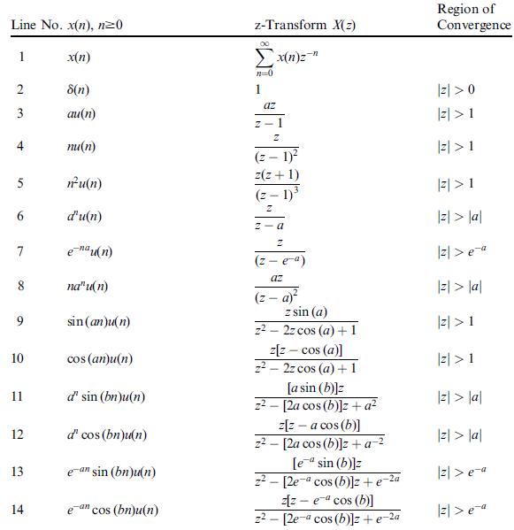
Z-Transform Table

Slide 5
Example 3
Problem:
Find z-transform of the following sequences.
a.
b.
Solution:
a.
From line 9 of the Table:
b.
From line 14 of the Table:

Slide 6
Z- Transform Properties (1)
Linearity:
a and b are arbitrary constants.
Example 4
Problem:
Find z- transform of
Solution:
Line 3
Using z- transform table:
Line 6
Therefore, we get

Slide 7
Z- Transform Properties (2)
Shift Theorem:
Verification:
n = m
Since x(n) is assumed to be causal:
Then we achieve,

Slide 8
Example 5
Problem:
Find z- transform of
Solution:
Using shift theorem,
Using z- transform table, line 6:

Slide 9
Z- Transform Properties (3)
Convolution
In time domain,
Eq. (1)
In z- transform domain,
Verification:
Using z- transform in Eq. (1)

Slide 10
Example 6
Problem:
Given the sequences,
Find the z-transform of their convolution.
Solution:
Applying z-transform on the two sequences,
From the table, line 2
Therefore we get,

Slide 11
Inverse z- Transform: Examples
Find inverse z-transform of
Example 7
We get,
Using table,
Find inverse z-transform of
Example 8
We get,
Using table,

Slide 12
Inverse z- Transform: Examples
Find inverse z-transform of
Example 9
Since,
By coefficient matching,
Therefore,
Find inverse z-transform of
Example 10

Slide 13
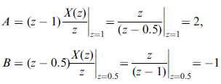
Inverse z-Transform: Using Partial Fraction
Problem:
Find inverse z-transform of
Example 11
Solution:
First eliminate the negative power of z.
Dividing both sides by z:
Finding the constants:
Therefore, inverse z-transform is:

Slide 14
Inverse z-Transform: Using Partial Fraction
Problem:
Example 12
Solution:
Dividing both sides by z:
We first find B:
Next find A:

Slide 15
Example 12 – contd.
Using polar form
Now we have:
Therefore, the inverse z-transform is:

Slide 16
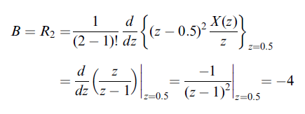
Inverse z-Transform: Using Partial Fraction
Problem:
Example 13
Solution:
Dividing both sides by z:
m = 2, p = 0.5

Slide 17
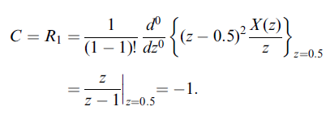
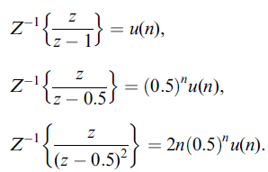
Example 13 – contd.
From Table:
Finally we get,

Slide 18
Partial Function Expansion Using MATLAB
Problem:
Example 14
Solution:
The denominator polynomial can be found using MATLAB:
Therefore,
The solution is:

Slide 19
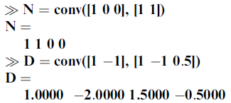
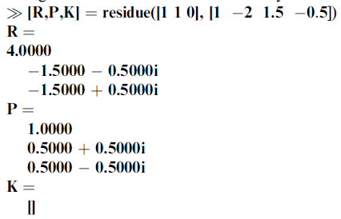
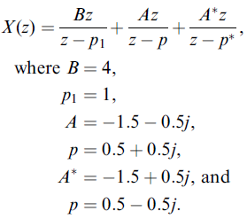
Partial Function Expansion Using MATLAB
Problem:
Example 15
Solution:

Slide 20
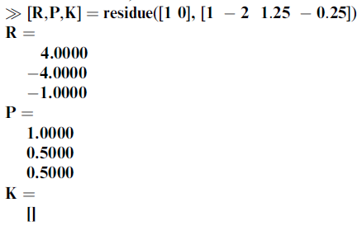
Partial Function Expansion Using MATLAB
Problem:
Example 16
Solution:

Slide 21
Difference Equation Using Z-Transform
The procedure to solve difference equation using z-transform:
Apply z-transform to the difference equation.
2. Substitute the initial conditions.
3. Solve for the difference equation in z-transform domain.
4. Find the solution in time domain by applying the inverse z-transform.

Slide 22
Example 17
Problem:
Solve the difference equation when the initial condition is
Solution:
Taking z-transform on both sides:
Substituting the initial condition and z-transform on right hand side using Table:
Arranging Y(z) on left hand side:

Slide 23
Example 17 – contd.
Solving for A and B:
Therefore,
Taking inverse z-transform, we get the solution:

Slide 24
Example 18
Problem:
A DSP system is described by the following differential equation with zero initial condition:
Determine the impulse response y(n) due to the impulse sequence x(n) = δ(n).
b. Determine system response y(n) due to the unit step function excitation, where u(n) = 1 for n ≥ 0.
Solution:
Taking z-transform on both sides:
a.
Applying
on right side

Slide 25
Example 18 – contd.
We multiply the numerator and denominator by z²
Solving for A and B:
Therefore,
Hnece the impulse response:

Slide 26
Example 18 – contd.
b.
The input is step unit function:
Corresponding z-transform:
[Slide 24]
Do the middle steps by yourself!

