Slide 1
Chapter 8
Event Handling

Slide 2
Event Handling
An action involving a GUI object, such as clicking a button, is called an event.
The mechanism to process events is called event handling.
Event handling is implemented by two types of objects:
event source objects
event listener objects
Notes:
JButton and other GUI objects are event source objects. Any object can be designated as event listener objects.

Slide 3
Event Source and Event Listeners Objects
An event source is a GUI object where an event occurs. We say an event source generates events.
Buttons, text boxes, list boxes, and menus are common event sources in GUI-based applications.
An event listener object is an object that includes a method that gets executed in response to the generated events.
A listener must be associated, or registered, to a source, so it can be notified when the source generates events.
Notes:
A single event source can generate more than one type of events. When an event is generated, a corresponding event listener is notified. Whether there is a designated listener or not, event sources generates events. If there's a no matching listeners, generated events are simply ignored.

Slide 4
Connecting Source and Listener
event source
event listener
notify
JButton
Handler
register
A listener must be registered to a event source. Once
registered, it will get notified when the event source
generates events.
Notes:
This diagram shows the relationship between the event source and listener. First we register a listener to an event source. Once registered, whenever an event is generated, the event source will notify the listener.

Slide 5
Event Types
There are different event types and event listeners
Mouse events are handled by mouse listeners
Item selection events are handled by Item listeners
and so forth
Among the different types of events, the action event is the most common.
Clicking on a button generates an action event
Selecting a menu item generates an action event
and so forth
Action events are generated by action event sources and handled by action event listeners.
Notes:
There are different types of events. Some event sources generate only one type of events, while others generate three or four different types of events. For example, a button can generate an action event, a change event, and a item event. The most common type of event we are interested in processing for various types of GUI components is the action event.

Slide 6
Handling Action Events
action event source
actionPerformed
action event listener
JButton
Button Handler
addActionListener
JButton button = new JButton("OK");
ButtonHandler handler = new ButtonHandler( );
button.addActionListener(handler);
Notes:
This code shows how we register an action event listener to a button. The object we register as an action listener must be an instance of a class that implements the ActionListener interface. The class must define a method named actionPerformed. This is the method executed in response to the generated action events.

Slide 7
What does an Event Handler require?
It just looks for 3 pieces of code!
First, in the declaration of the event handler class, one line of code must specify that the class implements either a listener interface or extends a class that implements a listener interface.
public class DemoClass implements ActionListener {

Slide 8
What does an Event Handler require?
Second, it looks for a line of code which registers an instance of the event handler class as a listener of one or more components because, as mentioned earlier, the object must be registered as an event listener.
anyComponent.addActionListener(instanceOf DemoClass);

Slide 9
What does an Event Handler require?
Third, the event handler must have a piece of code that implements the methods in the listener interface.
public void actionPerformed(ActionEvent e) {
...//code that reacts to the action...
}

Slide 10
ActionListener Interface
When we call the addActionListener method of an event source, we must pass an instance of a class that implements the ActionListener interface.
The ActionListener interface includes one method named actionPerformed.
A class that implements the ActionListener interface must therefore provide the method body of actionPerformed.
Since actionPerformed is the method that will be called when an action event is generated, this is the place where we put a code we want to be executed in response to the generated events.

Slide 11
The ButtonHandler Class
import javax.swing.*;
import java.awt.*;
import java.awt.event.*;
class ButtonHandler implements ActionListener {
. . .
public void actionPerformed(ActionEvent event) {
// code to be executed in response to the generated events
. . .
}
}
Notes:
This actionPerformed method is programmed to change the title of the frame to 'You clicked OK' or 'You clicked Cancel'. The actionPerformed method accepts one parameter of type ActionEvent. The getSource method of ActionEvent returns the event source source object. Because the object can be of any type, we type cast it to JButton. The next two statements are necessary to get a frame object that contains this event source. Once we have a reference to this frame object, we call its setTitle method to change the frame's title. More discussion on this actionPerformed method is presented on page 397 of the textbook.

Slide 12
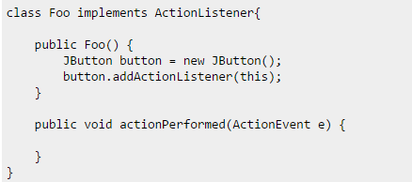

Slide 13
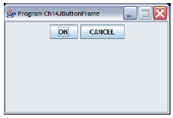
Container as Event Listener
Instead of defining a separate event listener such as ButtonHandler, it is much more common to have an object that contains the event sources be a listener.
Example: We make this frame a listener of the action events of the buttons it contains.
event listener
event source
Notes:
Because ActionListener is a Java interface and not a class, action event listener objects are not limited to instances of fixed classes. Any class can implement the ActionListener interface, so any object from a class that implements this interface can be an action event listener. This adds flexibility as this example illustrates.
Instead of using a ButtonHandler object, we can make the frame object itself to be an action event listener.

Slide 14
JButtonFrameHandler (complete program-1)
import javax.swing.*; import java.awt.*; import java.awt.event.*; class JButtonFrameHandler extends JFrame implements ActionListener { private static final int FRAME_WIDTH = 300; private static final int FRAME_HEIGHT = 200; private static final int FRAME_X_ORIGIN = 150; private static final int FRAME_Y_ORIGIN = 250; private JButton cancelButton;
private JButton okButton;

Slide 15
JButtonFrameHandler (complete program-2)
public JButtonFrameHandler() { Container contentPane = getContentPane( ); setSize (FRAME_WIDTH, FRAME_HEIGHT); setResizable (false); setTitle ("Program Ch14JButtonFrameHandler"); setLocation (FRAME_X_ORIGIN, FRAME_Y_ORIGIN); contentPane.setLayout(new FlowLayout()); okButton = new JButton("OK"); contentPane.add(okButton); cancelButton = new JButton("CANCEL"); contentPane.add(cancelButton); //registering this frame as an action listener of the two buttons cancelButton.addActionListener(this); okButton.addActionListener(this); setDefaultCloseOperation( EXIT_ON_CLOSE ); }

Slide 16
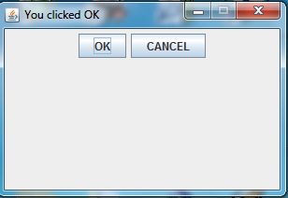
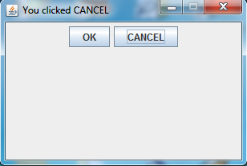
JButtonFrameHandler (complete program-3)
public void actionPerformed(ActionEvent event) { JButton clickedButton = (JButton) event.getSource(); String buttonText = clickedButton.getText(); this.setTitle("You clicked " + buttonText); }
public static void main(String[] args) { JButtonFrameHandler frame = new JButtonFrameHandler(); frame.setVisible(true); }
}

Slide 17
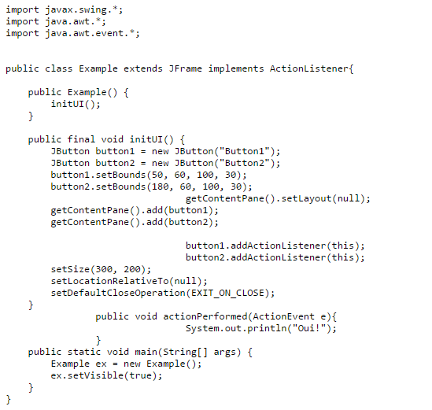
Example

Slide 18
JTextField

Slide 19
JTextField
We use a JTextField object to accept a single line to text from a user. An action event is generated when the user presses the ENTER key.
The getText method of JTextField is used to retrieve the text that the user entered.
JTextField input = new JTextField( );
contentPane.add(input);
input.addActionListener(eventListener);
Notes:
The getText method is most commonly used inside the actionPerformed method of an action listener.

Slide 20
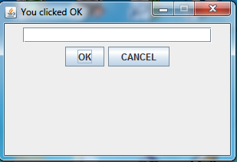
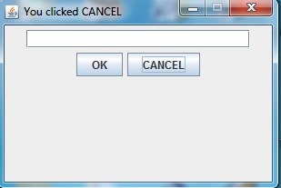
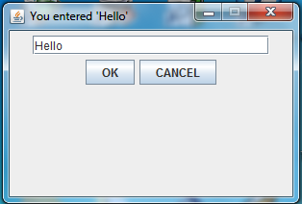
JTextField
We want to write a program that displays the text of the clicked button (OK or CANCEL), or the text entered in the text field

Slide 21
import javax.swing.*; import java.awt.*; import java.awt.event.*; class Ch14TextFrame1 extends JFrame implements ActionListener { private static final int FRAME_WIDTH = 300; private static final int FRAME_HEIGHT = 200; private static final int FRAME_X_ORIGIN = 150; private static final int FRAME_Y_ORIGIN = 250; private JButton cancelButton; private JButton okButton; private JTextField inputLine;
public static void main(String[] args) { Ch14TextFrame1 frame = new Ch14TextFrame1(); frame.setVisible(true); }
public Ch14TextFrame1() { Container contentPane; setSize (FRAME_WIDTH, FRAME_HEIGHT); setResizable (false); setTitle ("Program Ch14TextFrame1"); setLocation (FRAME_X_ORIGIN, FRAME_Y_ORIGIN); contentPane = getContentPane( ); contentPane.setLayout(new FlowLayout());

Slide 22
JTextField
inputLine = new JTextField();
inputLine.setColumns(22); inputLine.setFont(new Font("Courier", Font.PLAIN, 14)); contentPane.add(inputLine); inputLine.addActionListener(this); okButton = new JButton("OK"); contentPane.add(okButton); cancelButton = new JButton("CANCEL"); contentPane.add(cancelButton); //register this frame as an action listener of the two buttons cancelButton.addActionListener(this); okButton.addActionListener(this); //register 'Exit upon closing' as a default close operation setDefaultCloseOperation( EXIT_ON_CLOSE ); }

Slide 23
public void actionPerformed(ActionEvent event) {
if (event.getSource() instanceof JButton) { JButton clickedButton = (JButton) event.getSource(); String buttonText = clickedButton.getText(); setTitle("You clicked " + buttonText);
}
else { //the event source is inputLine
setTitle("You entered '" + inputLine.getText() + "'"); }
}
}

Slide 24
JLabel

Slide 25
JLabel
We use a JLabel object to display a label.
A label can be a text or an image.
When creating an image label, we pass ImageIcon object instead of a string.
JLabel textLabel = new JLabel();
textLabel.setText("Please enter your name");
textLabel.setSize(150,25);
contentPane.add(textLabel);
//we can also set the text at the time of object creation.
JLabel Prompt = new JLabel ("Please enter your age");
...
Notes:
A JLabel is strictly for displaying noneditable text or image. A JLabel object does not generate any events.

Slide 26
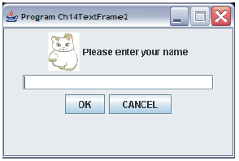
JLabel with an Image
JLabel imgLabel = new JLabel(new ImageIcon("cat.gif"));
contentPane.add(imgLabel);
JLabel
(with a text)
JLabel
(with an image)
JTextField
Notes:
The sample Ch7TextFrame2 class includes five GUI components: two JLabel objects, one JTextField object, and two JButton objects.

Slide 27
JTextArea

Slide 28
JTextArea
We use a JTextArea object to display or allow the user to enter multiple lines of text.
The setText method assigns the text to a JTextArea, replacing the current content.
The append method appends the text to the current text.
JTextArea textArea
= new JTextArea( );
. . .
textArea.setText("Hello\n");
textArea.append("the lost ");
textArea.append("world");
Hello
the lost world
JTextArea
Notes:
Notice how the append method works. If you want to place the text to be appended on a new line, you have ouput the newline control character \n at the appropriate point.

Slide 29
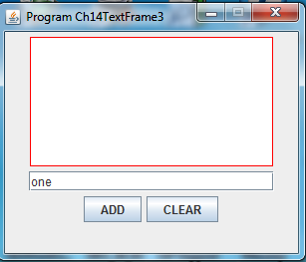
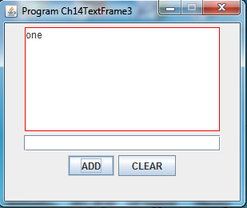
JTextArea
We want to create a frame with a JTextField and a JTextArea
When the user enters a text in the JTextField, and then presses Enter or clicks the ADD button,the entered text will be appended to the JTextArea
When the user clicks CLEAR the text in the JTextArea will be cleared
JTextArea
JTextField

Slide 30
import javax.swing.*; import java.awt.*; import java.awt.event.*; class Ch14TextFrame3 extends JFrame implements ActionListener { private static final int FRAME_WIDTH = 300; private static final int FRAME_HEIGHT = 250; private static final int FRAME_X_ORIGIN = 150; private static final int FRAME_Y_ORIGIN = 250; private static final String EMPTY_STRING = ""; private static final String NEWLINE = "\n"; private JButton clearButton; private JButton addButton; private JTextField inputLine; private JTextArea textArea; public static void main(String[] args) { Ch14TextFrame3 frame = new Ch14TextFrame3(); frame.setVisible(true); }

Slide 31
public Ch14TextFrame3() {
Container contentPane;
setSize (FRAME_WIDTH, FRAME_HEIGHT);
setResizable (false);
setTitle ("Program Ch14TextFrame3");
setLocation (FRAME_X_ORIGIN, FRAME_Y_ORIGIN);
contentPane = getContentPane( );
contentPane.setLayout(new FlowLayout());
textArea = new JTextArea();
textArea.setColumns(22);
textArea.setRows(8);
textArea.setBorder(BorderFactory.createLineBorder(Color.red));
textArea.setEditable(false);
contentPane.add(textArea);

Slide 32
inputLine = new JTextField();
inputLine.setColumns(22);
contentPane.add(inputLine);
inputLine.addActionListener(this);
//create and place two buttons on the frame addButton = new JButton("ADD"); contentPane.add(addButton); addButton.addActionListener(this); clearButton = new JButton("CLEAR"); contentPane.add(clearButton); clearButton.addActionListener(this); //register 'Exit upon closing' as a default close operation setDefaultCloseOperation( EXIT_ON_CLOSE ); }

Slide 33
JTextArea
public void actionPerformed(ActionEvent event) {
if (event.getSource() instanceof JButton) { JButton clickedButton = (JButton) event.getSource(); if (clickedButton == addButton) { addText(inputLine.getText()); }
else { clearText( ); } }
else { //the event source is inputLine addText(inputLine.getText()); } } //------------------------------------------------------- private void addText(String userInput) { textArea.append(userInput + NEWLINE); inputLine.setText(EMPTY_STRING); } //--------------------------------------------------------- private void clearText( ) { textArea.setText(EMPTY_STRING); inputLine.setText(EMPTY_STRING); } }

