Slide 1
Inheritance
CT1513

Slide 2
Introduction
Inheritance
Software reusability
Create new class from existing class
Absorb existing class’s data and behaviors
Enhance with new capabilities
Subclass extends superclass
Subclass
More specialized group of objects
Behaviors inherited from superclass
Can customize
Additional behaviors

Slide 3
Introduction (Cont.)
Class hierarchy
Direct superclass
Inherited explicitly (one level up hierarchy)
Indirect superclass
Inherited two or more levels up hierarchy
Single inheritance
Inherits from one superclass
Multiple inheritance
Inherits from multiple superclasses
Java does not support multiple inheritance

Slide 4
Superclasses and subclasses
Superclasses and subclasses
Object of one class “is an” object of another class
Example: mustang is car.
Class mustang inherits from class car
car: superclass
mustang : subclass
Superclass typically represents larger set of objects than subclasses
Example:
superclass: Vehicle
Cars, trucks, boats, bicycles, …
subclass: Car
Smaller, more-specific subset of vehicles

Slide 5
Examples

Slide 6
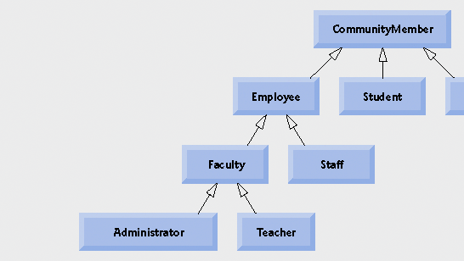
Fig. 9.2 | Inheritance hierarchy for university CommunityMembers

Slide 7
Fig. 9.3 | Inheritance hierarchy for Shapes.

Slide 8
Modifiers in inheritance
Protected (#) makes a data member or method visible and accessible to the instances of the class and the descendant classes (subclasses).
Public (+) data members and methods are accessible to everyone.
Private(-) data members and methods are accessible only to instances of the class.

Slide 9
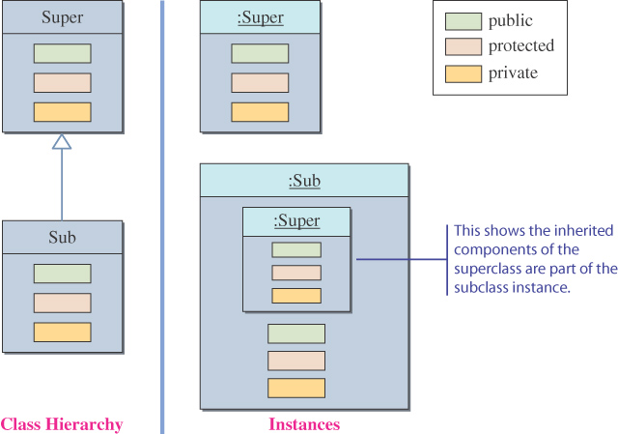
Inheritance and Member Accessibility
We use the following visual representation of inheritance to illustrate data member accessibility.

Slide 10
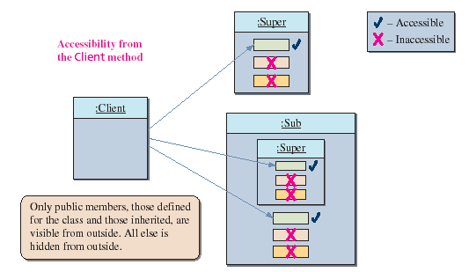
The Effect of Three Visibility Modifiers

Slide 11
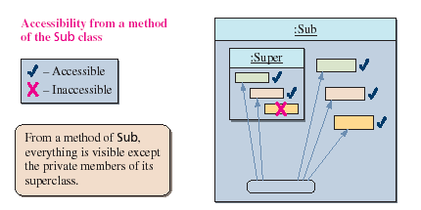
Accessibility of Super from Sub
Everything except the private members of the Super class is visible from a method of the Sub class.

Slide 12
Accessibility from Unrelated Class
class Super {
public int pub_Super_Field;
protected int pro_Super_Field;
private int pri_Super_Field;
public Super () {
pub_Super_Field = 10;
pro_Super_Field = 20;
pri_Super_Field = 30;
}
}
class Sub extends Super {
public int pub_Sub_Field;
protected int pro_Sub_Field;
private int pri_Sub_Field;
public Sub () {
pub_Sub_Field = 100;
pro_Sub_Field = 200;
pri_Sub_Field = 300;
}
}
class Client {
public void main (String [] args) {
Super mySuper = new Super();
Sub mySub = new Sub();
int i = mySuper.pub_Super_Field;
int j = mySub.pub_Super_Field; // inherited
int k = mySub.pub_Sub_Field;
}
}
:Super

VALID
:Sub
:Client

Slide 13
Accessibility from Unrelated Class
class Super {
public int pub_Super_Field;
protected int pro_Super_Field;
private int pri_Super_Field;
public Super() {
pub_Super_Field = 10;
pro_Super_Field = 20;
pri_Super_Field = 30;
}
}
class Sub extends Super {
public int pub_Sub_Field;
protected int pro_Sub_Field;
private int pri_Sub_Field;
public Sub() {
pub_Sub_Field = 100;
pro_Sub_Field = 200;
pri_Sub_Field = 300;
}
}
class Client {
public void main (String [] args) {
Super mySuper = new Super();
Sub mySub = new Sub();
int l = mySuper.pri_Super_Field;
int m = mySub.pri_Sub_Field;
int n = mySub.pri_Super_Field;
}
}
:Super

NOT VALID
:Sub
:Client

Slide 14
Accessibility from Unrelated Class
class Super {
public int pub_Super_Field;
protected int pro_Super_Field;
private int pri_Super_Field;
public Super() {
pub_Super_Field = 10;
pro_Super_Field = 20;
pri_Super_Field = 30;
}
}
class Sub extends Super {
public int pub_Sub_Field;
protected int pro_Sub_Field;
private int pri_Sub_Field;
public Sub() {
pub_Sub_Field = 100;
pro_Sub_Field = 200;
pri_Sub_Field = 300;
}
}
class Client {
public void main (String [] args) {
Super mySuper = new Super();
Sub mySub = new Sub();
int o = mySuper.pro_Super_Field;
int p = mySub.pro_Sub_Field;
int q = mySub.pro_Super_Field;
}
}
:Super

NOT VALID
:Sub
:Client

Slide 15
Accessibility of Super from Super
class Super {
public void superToSuper(Super anotherSuper) {
int i = anotherSuper.pub_Super_Field;
int j = anotherSuper.pro_Super_Field;
int k = anotherSuper.pri_Super_Field;
}
}

VALID
anotherSuper
:Super
:Super

Slide 16
Accessibility of Sub from Sub
class Sub extends Super {
public void subToSub(Sub anotherSub) {
int i = anotherSub.pub_Sub_Field;
int j = anotherSub.pro_Sub_Field;
int k = anotherSub.pri_Sub_Field;
int l = anotherSub.pub_Super_Field; //inherited
int m = anotherSub.pro_Super_Field;
int n = anotherSub.pri_Super_Field;
}
}

VALID

VALID

NOT VALID
anotherSub
:Sub
:Sub

Slide 17
Accessibility of Sub from Super
class Super {
public void superToSub(Sub sub) {
int i = sub.pub_Sub_Field;
int j = sub.pro_Sub_Field;
int k = sub.pri_Sub_Field;
}
}

VALID

NOT VALID
sub
:Super
:Sub

Slide 18
Accessibility of Super from Sub
class Sub extends Super {
public void subToSuper(Super mySuper) {
int i = mySuper.pub_Super_Field;
int j = mySuper.pro_Super_Field;
int k = mySuper.pri_Super_Field;
}
}

VALID

NOT VALID
mySuper
:Sub
:Super

Slide 19
Inheritance and Constructors
Unlike members of a superclass, constructors of a superclass are not inherited by its subclasses!!
You must define a constructor for a class or use the default constructor added by the compiler.
A subclass uses a constructor from the base class to initialize all the data inherited from the base class

Slide 20
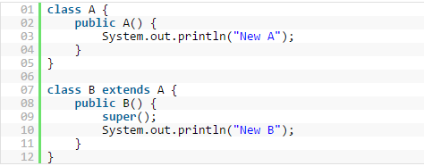
Inheritance and Constructors
In order to invoke a constructor from the base class, it uses a special syntax:
**the call of the super constructor must be the first statement.

Slide 21
Using super methods
In subclass you can override (or redefine) a method That is already existed in super class.
If there is no override you can call a public method of a superclass by its name and appropriate parameter list.
If the sub override the super method you should call it by using the reserved key word super.methodsName()

Slide 22
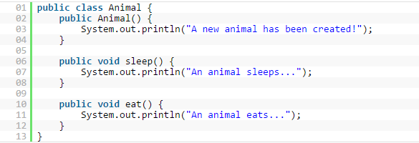
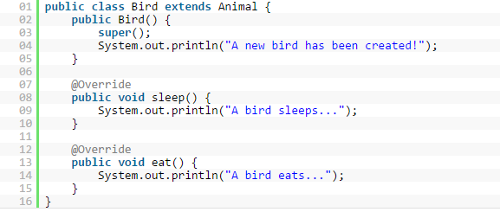
Animal Example

Slide 23
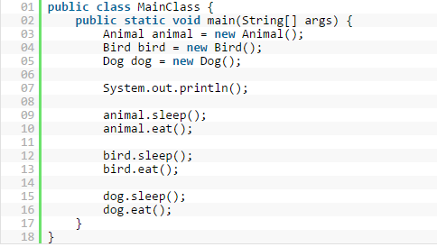
Animal Example

Slide 24
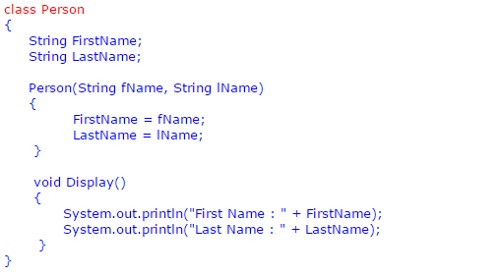
Example person

Slide 25
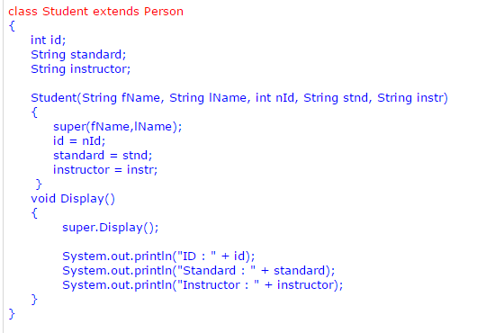
Example person

Slide 26
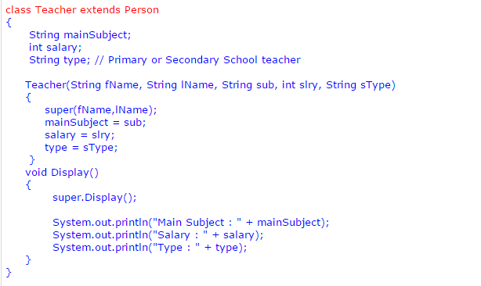
Example person

Slide 27
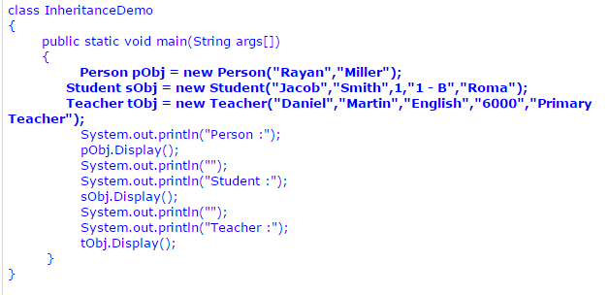
Example person

