Slide 1
Virtual Private Networks (VPN)

Slide 2
A virtual private network (VPN)
A virtual private network (VPN) is a technology that creates a safe and encrypted connection over a less secure network, such as the internet.
developed as a way to allow remote users and branch offices to securely access corporate applications and other resources.

Slide 3
Advantages of VPN
Employees can access the network (Intranet) from remote locations.
Cost Savings.
it ensures the appropriate level of security to the connected systems when the underlying network infrastructure alone cannot provide it.

Slide 4
Disadvantages of VPN
VPN performance can be affected by a variety of factors:
The speed of users' internet connections.
The types of protocols an internet service provider may use.
The type of encryption the VPN uses.
Poor quality of service and conditions that are outside the control of IT.

Slide 5
Brief Overview of How it Works
Two connections; one is made to the Internet and the second is made to the VPN.
Datagrams ; contains data, destination and source information.
Firewalls; VPNs allow authorized users to pass through the firewalls.
Protocols; protocols create the VPN tunnels.

Slide 6
Tunneling
- A virtual point-to-point connection made through a public network.
- It transports encapsulated datagrams.
Original Datagram
Encrypted Inner Datagram
Datagram Header Outer Datagram Data Area
Data Encapsulation

Slide 7
Encryption
Encryption: is a method of “scrambling” data before transmitting it onto the Internet.
Public Key Encryption Technique.
Digital signature for authentication.

Slide 8
VPN protocols
There are several different protocols used to secure and encrypt users and corporate data:
- IP security (IPsec). - Secure Sockets Layer (SSL) and Transport Layer Security (TLS). - Point-To-Point Tunneling Protocol (PPTP). - Layer 2 Tunneling Protocol (L2TP). - OpenVPN.

Slide 9
Types of VPNs
Remote-access VPN
Site-to-site VPN

Slide 10
Remote-access VPN
uses a public telecommunication infrastructure like the internet to provide remote users secure access to their organization's network.
Relies on either IPsec or Secure Sockets Layer (SSL).

Slide 11
Remote-access VPN
A VPN client on the remote user's computer or mobile device connects to a VPN gateway on the organization's network.
The gateway typically requires the device to authenticate its identity.
Then, it creates a network link back to the device that allows it to reach internal network resources -- e.g., file servers, printers and intranets -- as though it was on that network locally.

Slide 12
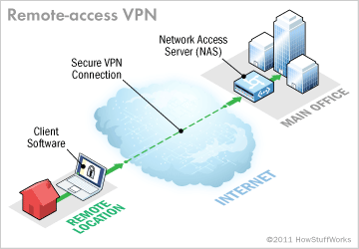
Remote-access VPN
A remote-access VPN connection allows an individual user to connect to a private business network from a remote location using a laptop or desktop computer connected to the Internet.

Slide 13
Site-to-site VPN
allows offices in multiple fixed locations to establish secure connections with each other over a public network such as the Internet.
Extends the company's network, making computer resources from one location available to employees at other locations.

Slide 14
Site-to-site VPN
An example of a company that needs a site-to-site VPN is a growing corporation with dozens of branch offices around the world.
This saves the company hardware and management expenses.
Most site-to-site VPNs connecting over the internet use IPsec.

Slide 15
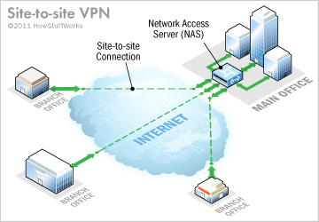
Site-to-site VPN
A site-to-site VPN connection lets branch offices use the Internet as a conduit for accessing the main office's intranet.

Slide 16
Industries That May Use a VPN
Healthcare: enables the transferring of confidential patient information within the medical facilities & health care provider.
Manufacturing: allow suppliers to view inventory & allow clients to purchase online safely.
Retail: able to securely transfer sales data or customer info between stores & the headquarters.
Banking/Financial: enables account information to be transferred safely within departments & branches.
General Business: communication between remote employees can be securely exchanged

