Slide 1
Orientation
CSC215
Lecture

Slide 2
Course Information
Name | Procedural Programming
Code | CSC215
Credits | 3 hours
Style (weekly) | 2H Lecture ( Su Tu ) 2H Lab ( Mo )
Grade | 100
Participation & Quizzes (6) | Pop quizzes | 5
Assignments (12) | Due on Friday | 5
Midterm 1 |  | 10
Midterm 2 |  | 10
Lab |  | 30
Final Exam |  | 40
Home assignments are given on Tuesdays and returned by Fridays.
Quizzes can happen anytime, so be always ready.
KSU's Learning Management System will be used to host all course materials, so make sure that you have an account o it and have access to the course pages: http://lms.ksu.edu.sa

Slide 3
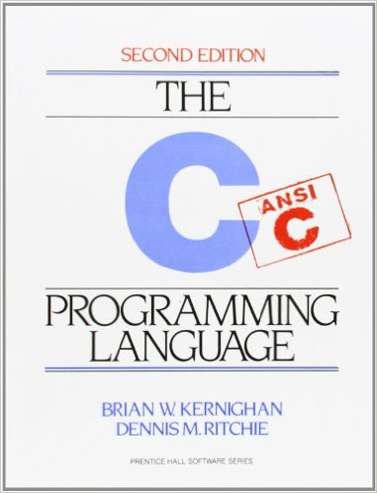
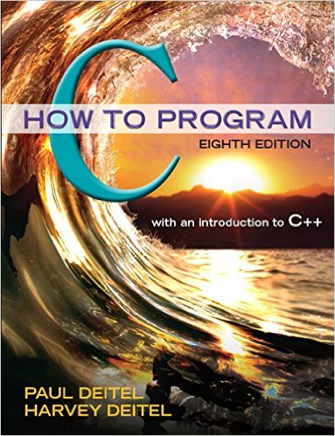
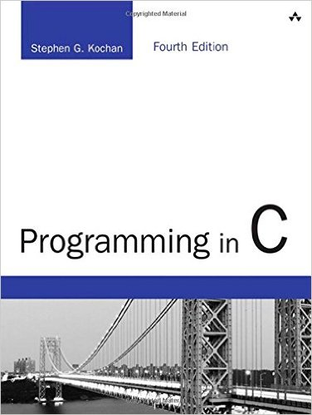
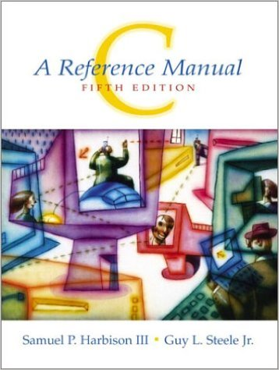
Course Information
Textbooks, any of the following books:
The C Programming Language
Brian W. Kernighan & Dennis M. Ritchie
2nd edition, Prentice Hall
C How to Program
Paul Deitel & Harvey Deitel
8th edition, Pearson
Programming in C
Stephen G. Kochan
4th edition, Addison-Wesley Professional
C: A Reference Manual
Samuel P. Harbison & Guy L. Steele Jr.
5th edition, Pearson

Slide 4
Course Information
Free books and references:
The C Book
an online version of the popular introduction and reference on the ANSI Standard C programming language
GBDirect Publications
http://publications.gbdirect.co.uk/c_book/
Frequently Asked Questions
comp.lang.c
http://c-faq.com/
The C Book
FAQs comp.lang.c
C Programming
WikiBook
http://en.wikibooks.org/wiki/C_Programming
C Programming

Slide 5
Instructor's Information
Lectures
Lab
Name | Ahmad J. AlShibli
Email | alshibli+csc215@ccis.edu.sa
Office | Bld. 31 Rm 2184
Office hours | Su 09:00-11:00 (OH) Mo 10:00-12:00 (OH) We 10:00-12:00 (AOH)
Name | Ahmad J. AlShibli
Email | alshibli+csc215@ccis.edu.sa
Office | Bld. 31 Rm 2184
Office hours | Su 09:00-11:00 (OH) Mo 10:00-12:00 (OH) We 10:00-12:00 (AOH)

Slide 6
Course Topics
2 | Types, Operators, and Expressions | MT1 | MT2 | FE
3 | Control Flow | MT1 | MT2 | FE
4 | Functions and Program Structure | MT1 | MT2 | FE
5 | Pointers and Arrays | MT1 | MT2 | FE
6 | Memory Management | MT1 | MT2 | FE
8 | Structures |  | MT2 | FE
9 | Input and Output |  | MT2 | FE
10 | String operations Exercise |  | MT2 | FE
12 | Math Operations |  |  | FE
13 | Linked Lists |  |  | FE
14 | Sorting and Searching |  |  | FE

Slide 7
How To Study CSC215
Review CSC111, CSC113 thoroughly. You are expected to be excellent in all of their topics.
Attend lectures and labs
Arrive on time
Pay attention, ask questions and take notes
Study what you have learned on the same day
Read slides, notes and optionally the textbook
Redo the examples by yourself
Apply on a computer
Use my office hours. I'm getting paid for them, they are free for you.
Do all of your homework assignments
Spend enough time thinking
Implement and run your solutions
Submit in a timely manner
Look for examples, exercises, problems to solve and previous exams.
Discuss with your colleagues, but never ask for ready solutions, and submit your own work.

Slide 8
New Attendance Policy
❝II. With regard to student attendance (please note the following changes that we would like to implement as a college starting this Semester):
Anyone with absence of 25% or more will be barred from entering the final exam, NO EXCEPTIONS will be made (even if the student is in his/her final Semester).
NO medical excuses should be accepted as a way for deducting the number of absence days (25% of allowed absence in a Semester is actually there for the purpose of such health or other emergency circumstances).
A medical excuse may only be used in the case that a student misses an exam (to allow for a make-up exam), however, the absence should still be counted.
Please make sure you inform the students about these absence policies and that the college will be very strict in applying them starting this Semester.
Please make sure to give students continuous updates and warnings about their absence percentage.
Attendance is a University requirement, and as a faculty member, even if you do not think that attendance is important, it is important that you uphold the University policy and take attendance (I recommend reading the names out loud and making sure you see the student answering you, it is a good way to get to know your students - don't just treat your students as numbers).
It is also important to allow students to enter the classroom, even if they are late to arrive, the student has the right to learn! Even if he/she gets to hear and participate in the last few minutes of the class, it should be of some value to that student.
You may set a policy that after 15-20 minutes (as an example) of being late, that you will consider the student to be absent (if you think that will help them be on time). Many times the students may be coming from a different building that is far away, or, may have been held-up by the faculty teaching the previous course.❞

