Slide 1
Chapter 9
SQL: Data Manipulation
Chapter #6 in the textbook
Pearson Education © 2009

Slide 2
Chapter 9 - Objectives
Purpose and importance of SQL.
How to retrieve data from database using SELECT.
How to update database using INSERT, UPDATE, and DELETE.
Pearson Education © 2009

Slide 3
Objectives of SQL
Ideally, database language should allow user to:
Create the database and relation structures;
Perform insertion, modification, deletion of data from relations;
Perform simple and complex queries.
SQL is a transform-oriented language with 2 major components:
A DDL for defining database structure.
A DML for retrieving and updating data.
Pearson Education © 2009

Slide 4
Objectives of SQL
SQL is relatively easy to learn:
it is non-procedural - you specify what information you require, rather than how to get it
it is essentially free-format - some sentences do not have to be in particular location
Pearson Education © 2009

Slide 5
Writing SQL Commands
Most components of an SQL statement are case insensitive, except for literal character data.
Use extended form of BNF notation:
- Upper-case letters represent reserved words.
- Lower-case letters represent user-defined words.
- | indicates a choice among alternatives.
- Curly braces { } indicate a required element.
- Square brackets [ ] indicate an optional element.
- … indicates optional repetition (0 or more).
Pearson Education © 2009

Slide 6
Literals
Literals are constants used in SQL statements.
All non-numeric literals must be enclosed in single quotes. e.g. ‘London’
All numeric literals must not be enclosed in quotes e.g. 650.00
Pearson Education © 2009

Slide 7
SELECT Statement
SELECT [DISTINCT | ALL]
{* | [columnExpression [AS newName]] [,...] }
FROM TableName [alias] [, ...]
[WHERE condition]
[GROUP BY columnList] [HAVING condition]
[ORDER BY columnList]
FROM Specifies table(s) to be used.
WHERE Filters rows.
GROUP BY Forms groups of rows with same column value.
HAVING Filters groups subject to some condition.
SELECT Specifies which columns are to appear in output.
ORDER BY Specifies the order of the output.
Order of the clauses cannot be changed.
Only SELECT and FROM are mandatory
Pearson Education © 2009

Slide 8
Example 6.1 All Columns, All Rows
List full details of all staff.
SELECT staffNo, fName, lName, address,
position, sex, DOB, salary, branchNo
FROM Staff;
Can use * as an abbreviation for ‘all columns’:
SELECT *
FROM Staff;
Pearson Education © 2009

Slide 9
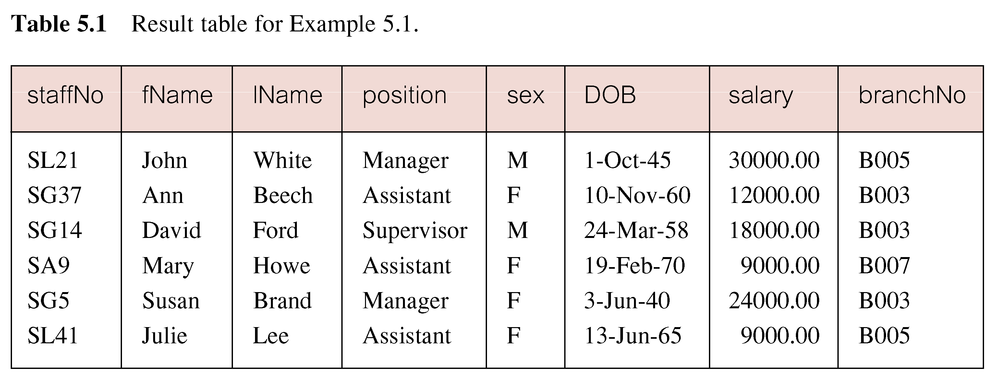
Example 6.1 All Columns, All Rows
Pearson Education © 2009

Slide 10
Example 6.2 Specific Columns, All Rows
Produce a list of salaries for all staff, showing only staff number, first and last names, and salary.
SELECT staffNo, fName, lName, salary
FROM Staff;
Pearson Education © 2009

Slide 11
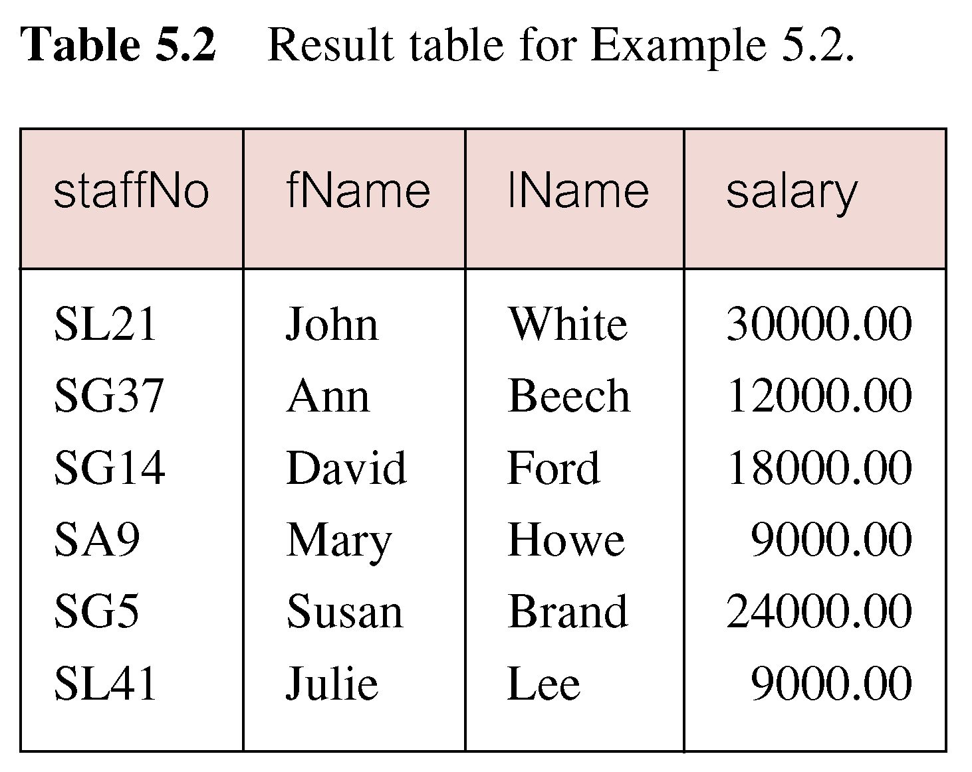
Example 6.2 Specific Columns, All Rows
Pearson Education © 2009

Slide 12
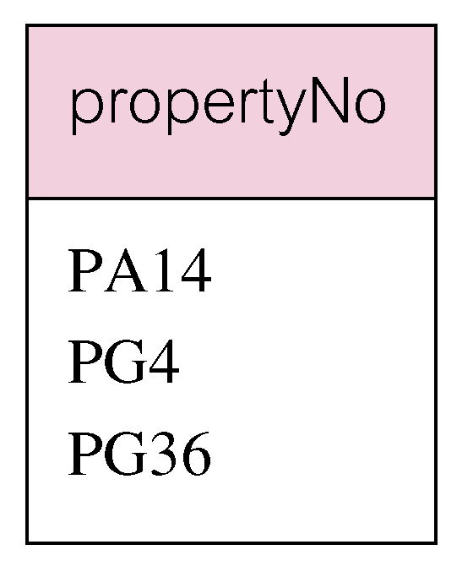
Example 6.3 Use of DISTINCT
Use DISTINCT to eliminate duplicates:
SELECT DISTINCT propertyNo
FROM Viewing;
Pearson Education © 2009

Slide 13
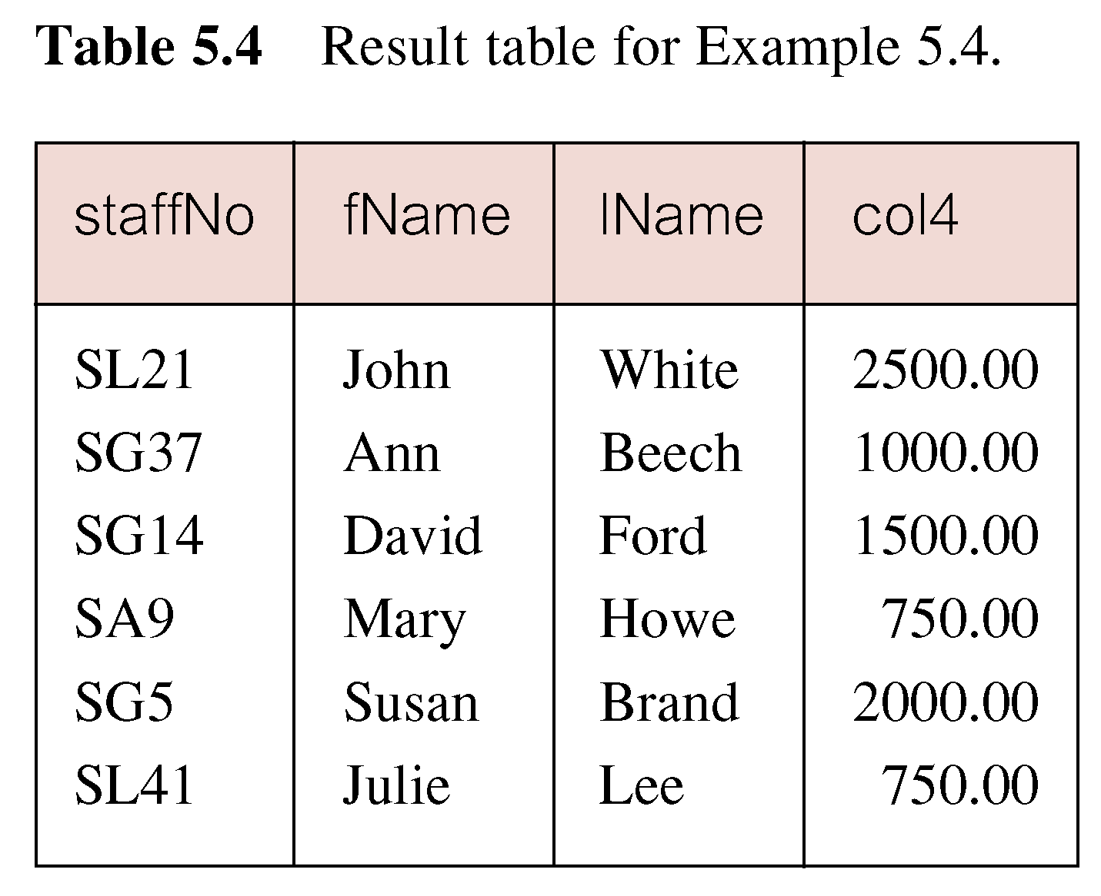
Example 6.4 Calculated Fields
Produce list of monthly salaries for all staff, showing staff number, first/last name, and salary.
SELECT staffNo, fName, lName, salary/12
FROM Staff;
Pearson Education © 2009

Slide 14
Example 6.4 Calculated Fields
To name column, use AS clause:
SELECT staffNo, fName, lName, salary/12
AS monthlySalary
FROM Staff;
The SQL expression in the SELECT list can specify a derived or calculated field.
Columns referenced in the arithmetic expression must have a numeric type.
SQL expression can involve + , - , * , / , ( , ).
Pearson Education © 2009

Slide 15
Row Selection (WHERE clause)
WHERE clause consists of five basic search conditions:
Comparison: Compare the value of one expression to the value of another expression (= , <, >, <=, >=, < >).
Range: Test whether the value of an expression falls within a specified range of values (BETWEEN/ NOT BETWEEN).
Set membership: Test whether the value of an expression equals one of a set of values (IN/ NOT IN).
Pattern match: Test whether a string matches a specified pattern (LIKE/ NOT LIKE).
NULL: Test whether a column has null value (IS NULL/ IS NOT NULL).

Slide 16
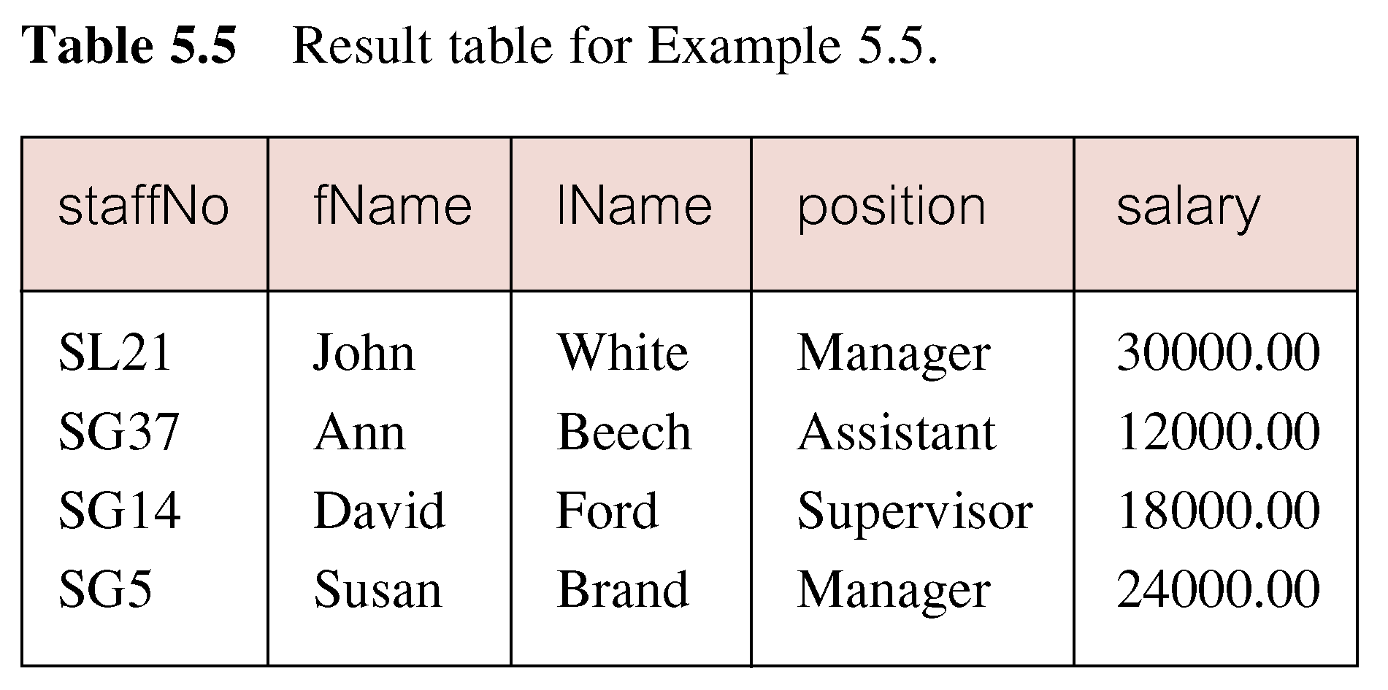
Example 6.5 Comparison Search Condition
Compound comparison operators: AND, OR, NOT, ( )
Order of evaluation: (1)Expression is evaluated left to right (2)Between brackets (3)NOT (4)AND (5)OR
List all staff with a salary greater than 10,000.
SELECT staffNo, fName, lName, position, salary
FROM Staff
WHERE salary > 10000;
Pearson Education © 2009

Slide 17
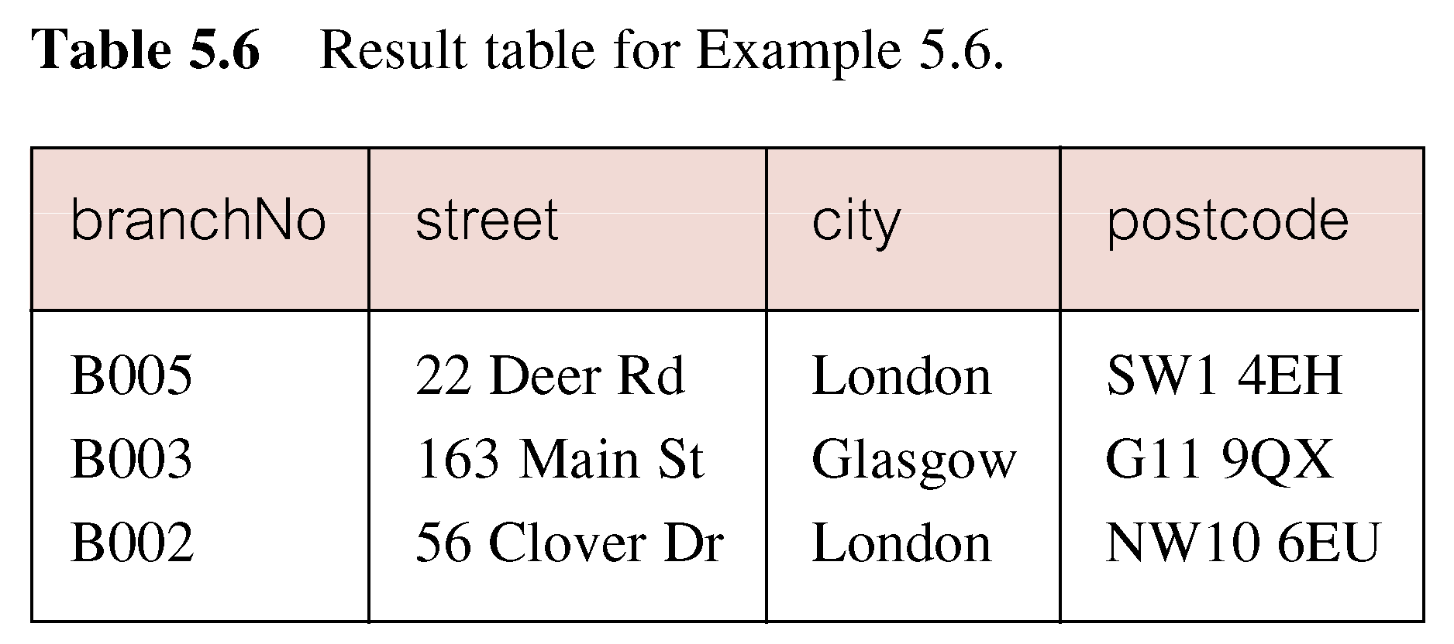
Example 6.6 Compound Comparison Search Condition
List addresses of all branch offices in London or Glasgow.
Branch (branchNo, street , city, postcode)
SELECT *
FROM Branch
WHERE city = ‘London’ OR city = ‘Glasgow’;
Pearson Education © 2009

Slide 18
Example 6.7 Range Search Condition
List all staff with a salary between 20,000 and 30,000.
SELECT staffNo, fName, lName, position, salary
FROM Staff
WHERE salary BETWEEN 20000 AND 30000;
BETWEEN test includes the endpoints of range.
Pearson Education © 2009

Slide 19
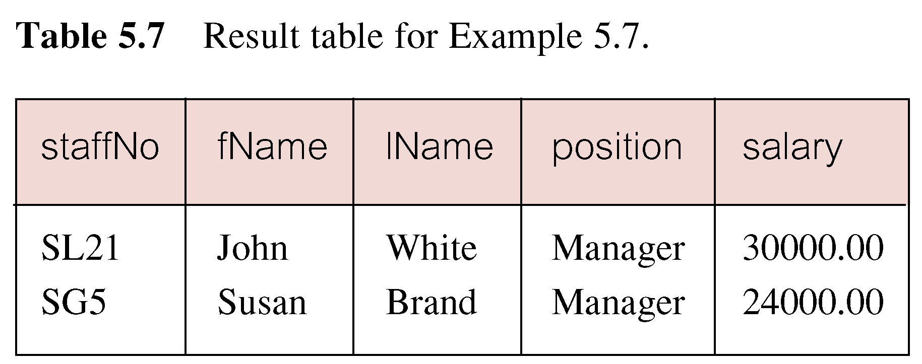
Example 6.7 Range Search Condition
Pearson Education © 2009

Slide 20
Example 6.7 Range Search Condition
Also a negated version NOT BETWEEN.
BETWEEN does not add much to SQL’s expressive power. Could also write:
SELECT staffNo, fName, lName, position, salary
FROM Staff
WHERE salary>=20000 AND salary <= 30000;
Useful, though, for a range of values.
Pearson Education © 2009

Slide 21
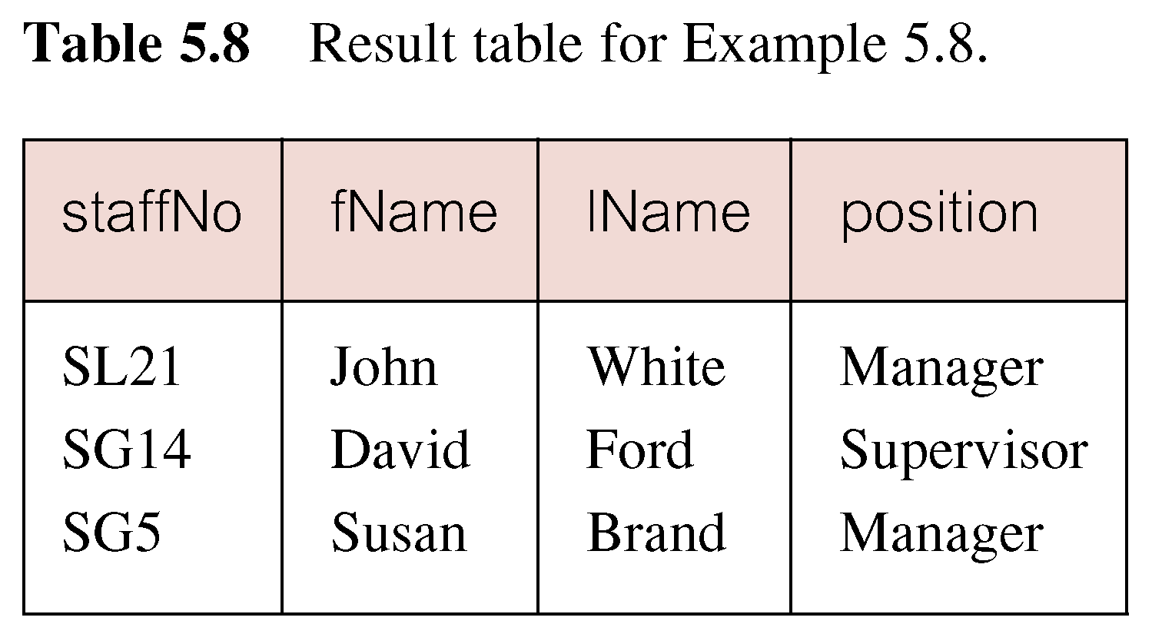
Example 6.8 Set Membership
List all managers and supervisors.
SELECT staffNo, fName, lName, position
FROM Staff
WHERE position IN (‘Manager’, ‘Supervisor’);
Pearson Education © 2009

Slide 22
Example 6.8 Set Membership
There is a negated version (NOT IN).
IN does not add much to SQL’s expressive power. Could have expressed this as:
SELECT staffNo, fName, lName, position
FROM Staff
WHERE position=‘Manager’ OR
position=‘Supervisor’;
IN is more efficient when set contains many values.
Pearson Education © 2009

Slide 23
Example 6.9 Pattern Matching
Find all owners with the string ‘Glasgow’ in their address.
SELECT ownerNo, fName, lName, address, telNo
FROM PrivateOwner
WHERE address LIKE ‘%Glasgow%’;
Pearson Education © 2009

Slide 24
Example 6.9 Pattern Matching
SQL has two special pattern matching symbols:
%: sequence of zero or more characters
_ (underscore): any single character.
LIKE ‘%Glasgow%’ means a sequence of characters of any length containing ‘Glasgow’.
Pearson Education © 2009

Slide 25
Example 6.10 NULL Search Condition
List details of all viewings on property PG4 where a comment has not been supplied.
Viewing (PropertyNo, RenterNo, DateViewed, Comments)
There are 2 viewings for property PG4, one with and one without a comment.
Have to test for null explicitly using special keyword IS NULL:
SELECT clientNo, viewDate
FROM Viewing
WHERE propertyNo = ‘PG4’ AND
comment IS NULL;
Pearson Education © 2009

Slide 26
Example 6.10 NULL Search Condition
Negated version (IS NOT NULL) can test for non-null values.
Pearson Education © 2009

Slide 27
Example 6.11 Single Column Ordering
Order by: allow the retrieved records to be ordered in ascending (ASC) or descending order (DESC) on any column or combination of columns.
List salaries for all staff, arranged in descending order of salary.
SELECT staffNo, fName, lName, salary
FROM Staff
ORDER BY salary DESC;
Pearson Education © 2009

Slide 28
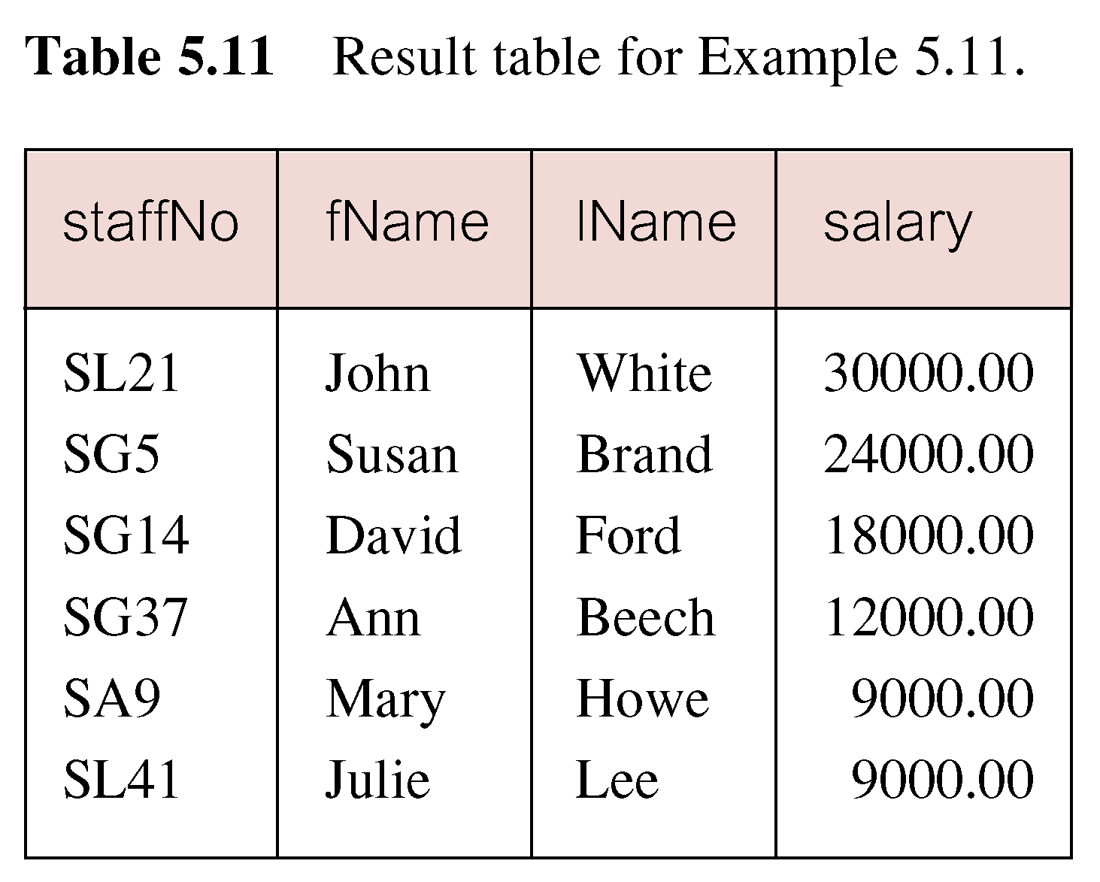
Example 6.11 Single Column Ordering
Pearson Education © 2009

Slide 29
Example 6.12 Multiple Column Ordering
Produce abbreviated list of properties in order of property type
PropertyForRent (PropertyNo, Street, Area, City, Postcode, Type, Rooms, Rent, PrivateOwnerNo, BusinessOwnerNo, StaffNo, BranchNo, Picture, Comments, Withdrawn, DeleteRecord)
SELECT propertyNo, type, rooms, rent
FROM PropertyForRent
ORDER BY type;
Pearson Education © 2009

Slide 30
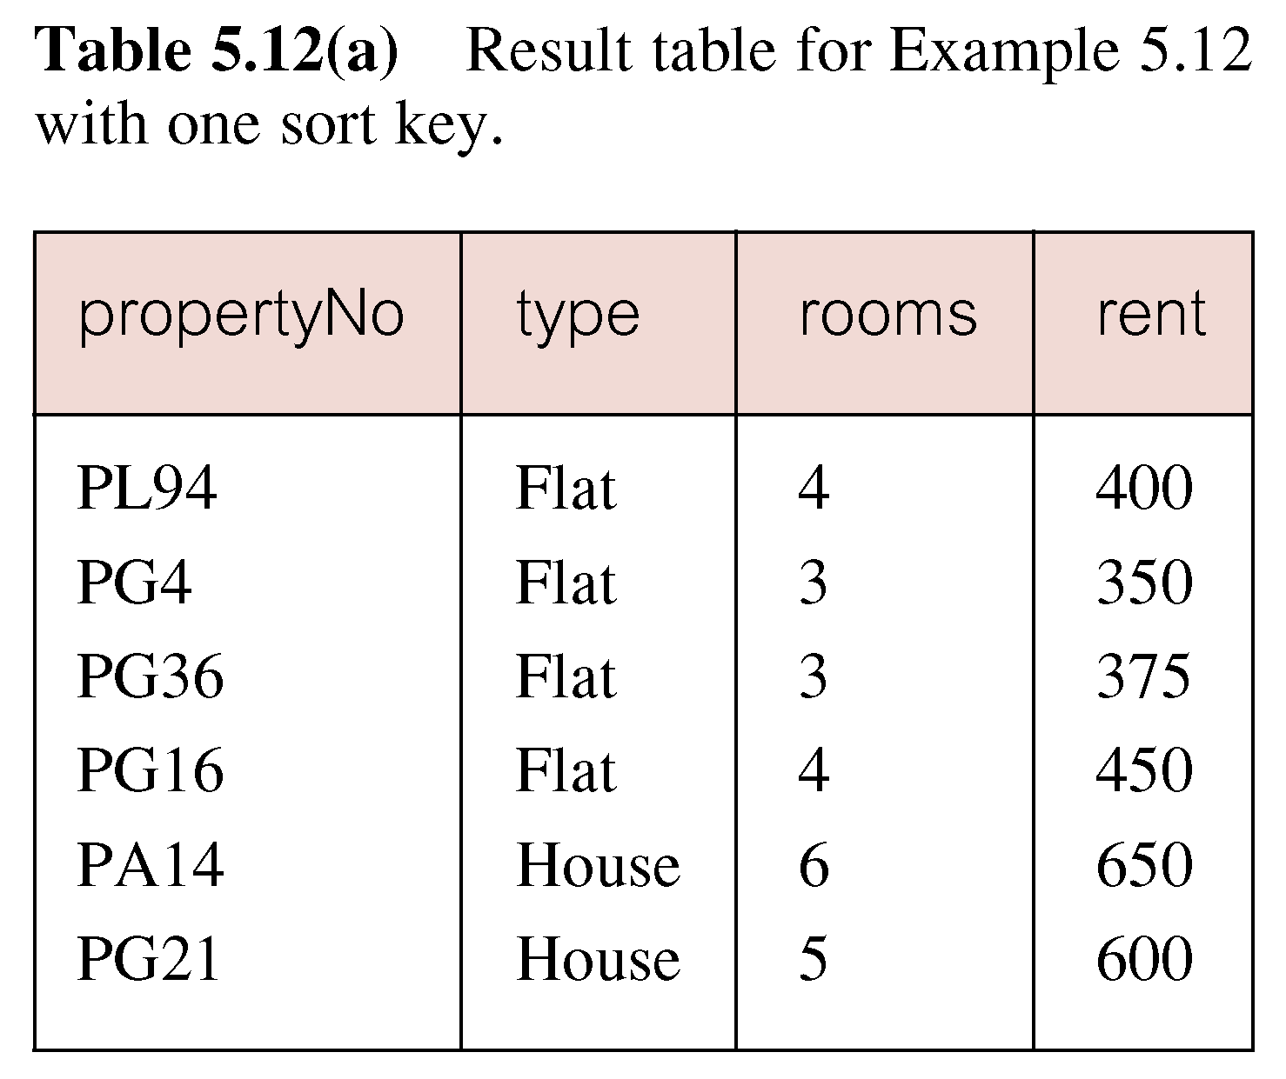
Example 6.12 Multiple Column Ordering
Pearson Education © 2009

Slide 31
Example 6.12 Multiple Column Ordering
Four flats in this list - as no minor sort key specified, system arranges these rows in any order it chooses.
To arrange in order of rent, specify minor order:
SELECT propertyNo, type, rooms, rent
FROM PropertyForRent
ORDER BY type, rent DESC;
Pearson Education © 2009

Slide 32
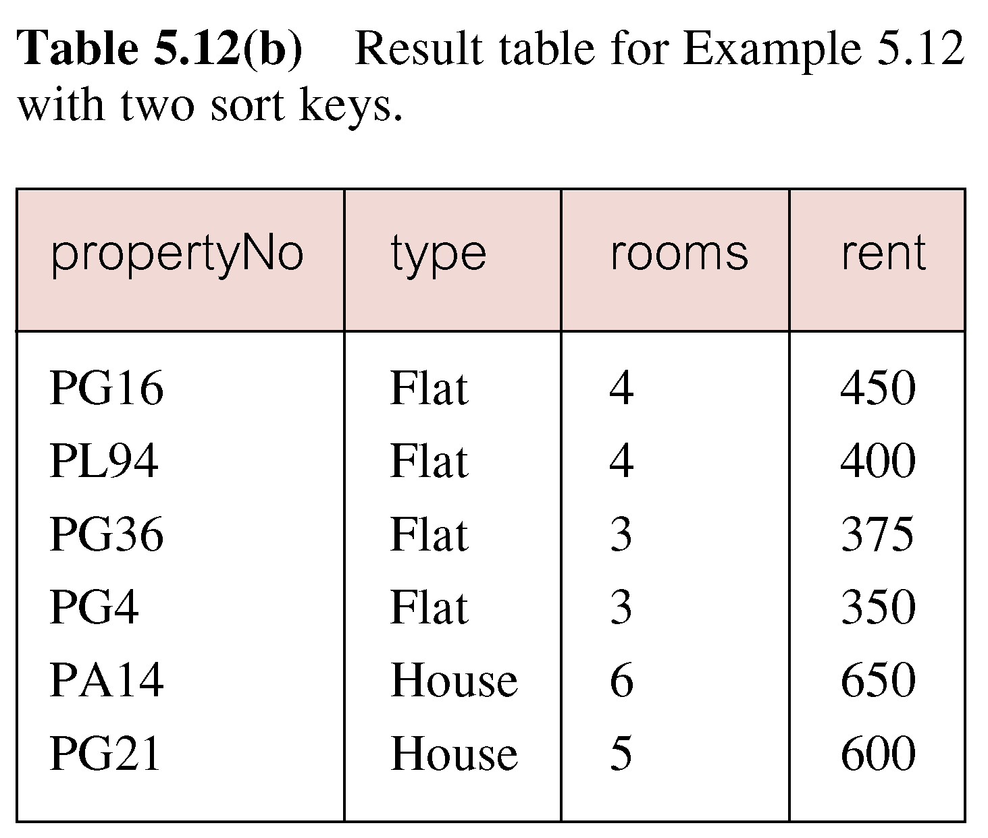
Example 6.12 Multiple Column Ordering
Pearson Education © 2009

Slide 33
SELECT Statement - Aggregates
ISO standard defines five aggregate functions:
COUNT returns number of values in specified column.
SUM returns sum of values in specified column.
AVG returns average of values in specified column.
MIN returns smallest value in specified column.
MAX returns largest value in specified column.
Pearson Education © 2009

Slide 34
SELECT Statement - Aggregates
Each operates on a single column of a table and returns a single value.
COUNT, MIN, and MAX apply to numeric and non-numeric fields, but SUM and AVG may be used on numeric fields only.
Apart from COUNT(*), each function eliminates nulls first and operates only on remaining non-null values.
Pearson Education © 2009

Slide 35
SELECT Statement - Aggregates
COUNT(*) counts all rows of a table, regardless of whether nulls or duplicate values occur.
Can use DISTINCT before column name to eliminate duplicates.
DISTINCT has no effect with MIN/MAX, but may have with SUM/AVG.
Pearson Education © 2009

Slide 36
SELECT Statement - Aggregates
Aggregate functions can be used only in SELECT list and in HAVING clause.
If SELECT list includes an aggregate function and there is no GROUP BY clause, SELECT list cannot reference a column out with an aggregate function.
For example, the following is illegal:
SELECT staffNo, COUNT(salary)
FROM Staff;
Pearson Education © 2009

Slide 37
Example 6.13 Use of COUNT(*)
How many properties cost more than £350 per month to rent?
PropertyForRent (PropertyNo, Street, Area, City, Postcode, Type, Rooms, Rent, PrivateOwnerNo, BusinessOwnerNo, StaffNo, BranchNo, Picture, Comments, Withdrawn, DeleteRecord)
SELECT COUNT(*) AS myCount
FROM PropertyForRent
WHERE rent > 350;
Pearson Education © 2009

Slide 38
Example 6.14 Use of COUNT(DISTINCT)
How many different properties viewed in May ‘04?
PropertyForRent (PropertyNo, Street, Area, City, Postcode, Type, Rooms, Rent, PrivateOwnerNo, BusinessOwnerNo, StaffNo, BranchNo, Picture, Comments, Withdrawn, DeleteRecord)
Viewing (PropertyNo, RenterNo, DateViewed, Comments)
SELECT COUNT(DISTINCT propertyNo) AS myCount
FROM Viewing
WHERE viewDate BETWEEN ‘1-May-04’
AND ‘31-May-04
Pearson Education © 2009
Notes:
SELECT COUNT(DISTINCT propertyNo) AS myCount
FROM Viewing
WHERE viewDate BETWEEN ‘1-May-04’
AND ‘31-May-04

Slide 39
Example 6.15 Use of COUNT and SUM
Find number of Managers and sum of their salaries.
SELECT COUNT(staffNo) AS myCount,
SUM(salary) AS mySum
FROM Staff
WHERE position = ‘Manager’;
Pearson Education © 2009

Slide 40
Example 6.16 Use of MIN, MAX, AVG
Find minimum, maximum, and average staff salary.
SELECT MIN(salary) AS myMin,
MAX(salary) AS myMax,
AVG(salary) AS myAvg
FROM Staff;
Pearson Education © 2009

Slide 41
GROUP BY clause
bno
sno
salary
B003
SG37
12000
count
sum
B003
SG14
18000
B003
SG5
24000
3
54000
B005
SL21
30000
2
39000
B005
SL41
9000
1
9000
B007
SA9
9000

Slide 42
SELECT Statement - Grouping
Use GROUP BY clause to get sub-totals.
SELECT and GROUP BY closely integrated: each item in SELECT list must be single-valued per group, and SELECT clause may only contain:
Column names
Aggregate functions
Constants
Expression involving combinations of the above.
Pearson Education © 2009

Slide 43
SELECT Statement - Grouping
All column names in SELECT list must appear in GROUP BY clause unless name is used only in an aggregate function.
If WHERE is used with GROUP BY, WHERE is applied first, then groups are formed from remaining rows satisfying predicate.
Pearson Education © 2009

Slide 44
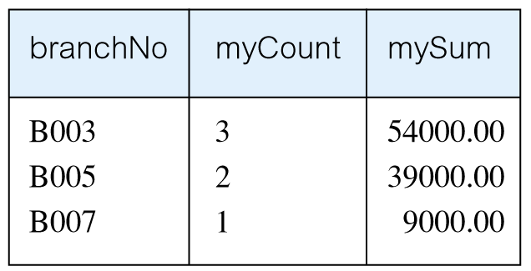
Example 6.17 Use of GROUP BY
Find number of staff in each branch and their total salaries.
SELECT branchNo, COUNT(staffNo) AS myCount, SUM(salary) AS mySum
FROM Staff
GROUP BY branchNo
ORDER BY branchNo;
Pearson Education © 2009

Slide 45
Restricted Groupings – HAVING clause
HAVING clause is designed for use with GROUP BY to restrict groups that appear in final result table.
Similar to WHERE, but WHERE filters individual rows whereas HAVING filters groups.
Column names in HAVING clause must also appear in the GROUP BY list or be contained within an aggregate function.
Pearson Education © 2009

Slide 46
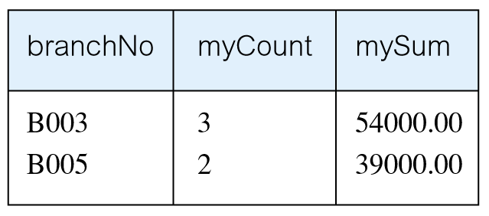
Example 6.18 Use of HAVING
For each branch with more than 1 member of staff, find number of staff in each branch and sum of their salaries.
SELECT branchNo,
COUNT(staffNo) AS myCount,
SUM(salary) AS mySum
FROM Staff
GROUP BY branchNo
HAVING COUNT(staffNo) > 1
ORDER BY branchNo;
Pearson Education © 2009

Slide 47
Multi-Table Queries
Can use subqueries provided result columns come from same table.
If result columns come from more than one table must use a join.
To perform join, include more than one table in FROM clause. Use comma as separator and typically include WHERE clause to specify join column(s).
Pearson Education © 2009

Slide 48
Multi-Table Queries
Also possible to use an alias for a table named in FROM clause.
Alias is separated from table name with a space.
Alias can be used to qualify column names when there is ambiguity.
Pearson Education © 2009

Slide 49
Example 6.24 Simple Join
List names of all clients who have viewed a property along with any comment supplied.
SELECT c.clientNo, fName, lName,
propertyNo, comment
FROM Client c, Viewing v
WHERE c.clientNo = v.clientNo;
Pearson Education © 2009

Slide 50
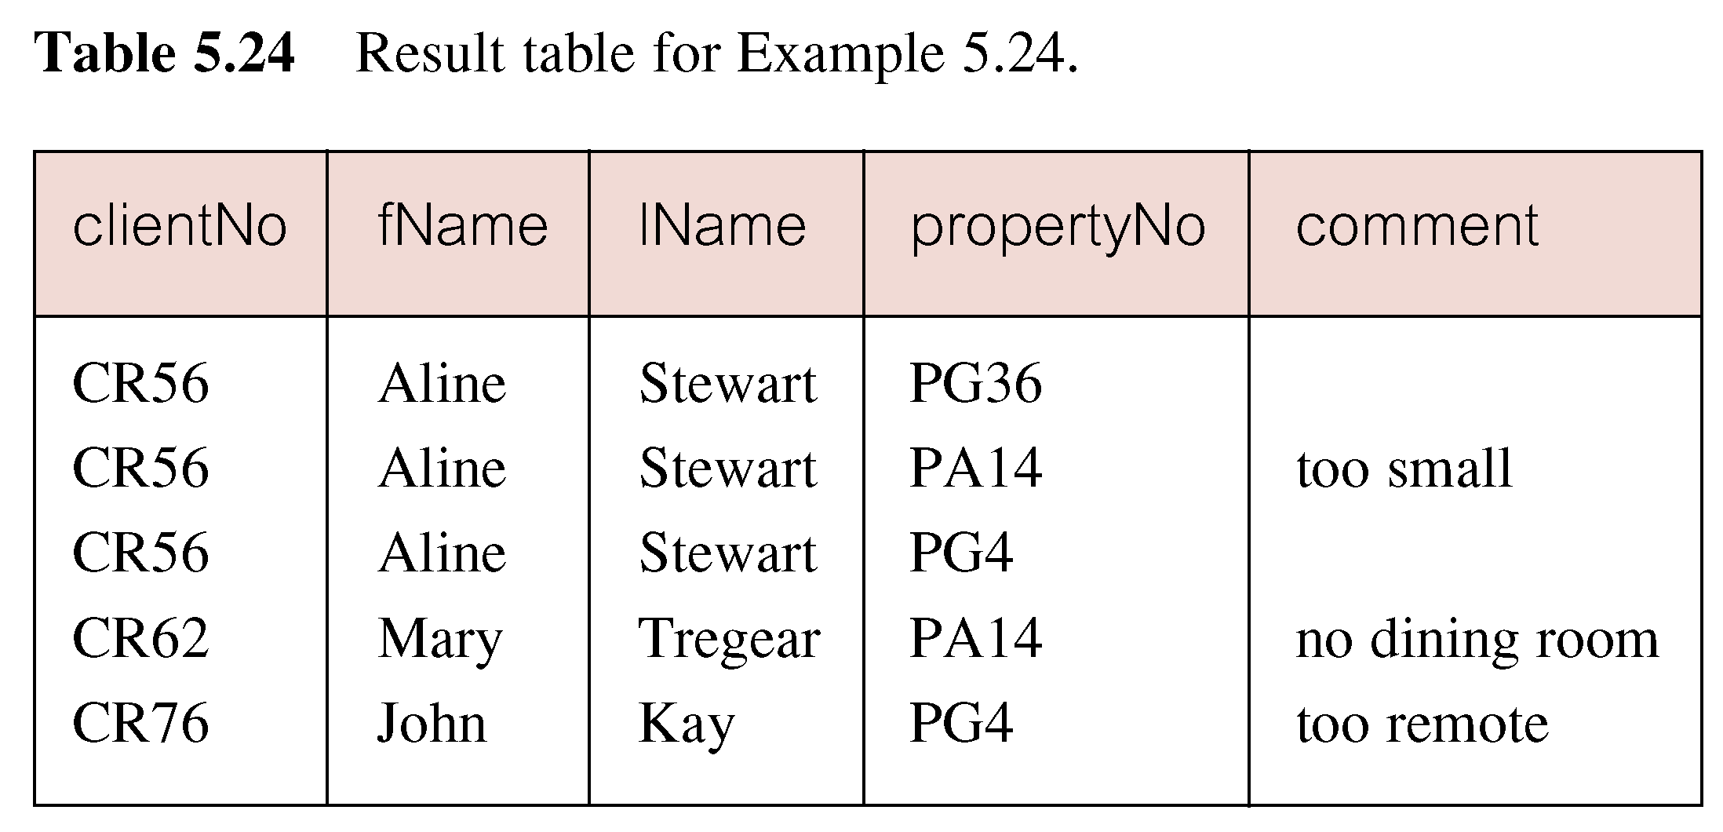
Example 6.24 Simple Join
Only those rows from both tables that have identical values in the clientNo columns (c.clientNo = v.clientNo) are included in result.
Equivalent to equi-join in relational algebra.
Pearson Education © 2009

Slide 51
Alternative JOIN Constructs
SQL provides alternative ways to specify joins:
FROM Client c JOIN Viewing v ON c.clientNo = v.clientNo
FROM Client JOIN Viewing USING clientNo
FROM Client NATURAL JOIN Viewing
In each case, FROM replaces original FROM and WHERE. However, the first one produces table with two identical clientNo columns.
Pearson Education © 2009

Slide 52
Example 6.25 Sorting a join
PROPERTYFORRENT (pno, street, area, city, pcode, type, rooms, rent, sno)
STAFF (sno, fname, lname, position, sex, DOB, salary, bno)
BRANCH (bno, street, city, postcode)
For each branch, list numbers and names of staff who manage properties, and properties they manage.
SELECT s.bno, s.sno, fName, lName,
pNo
FROM Staff s, PropertyForRent p
WHERE s.sno = p.sno
ORDER BY s.bno, s.sno, pNo;
Pearson Education © 2009

Slide 53
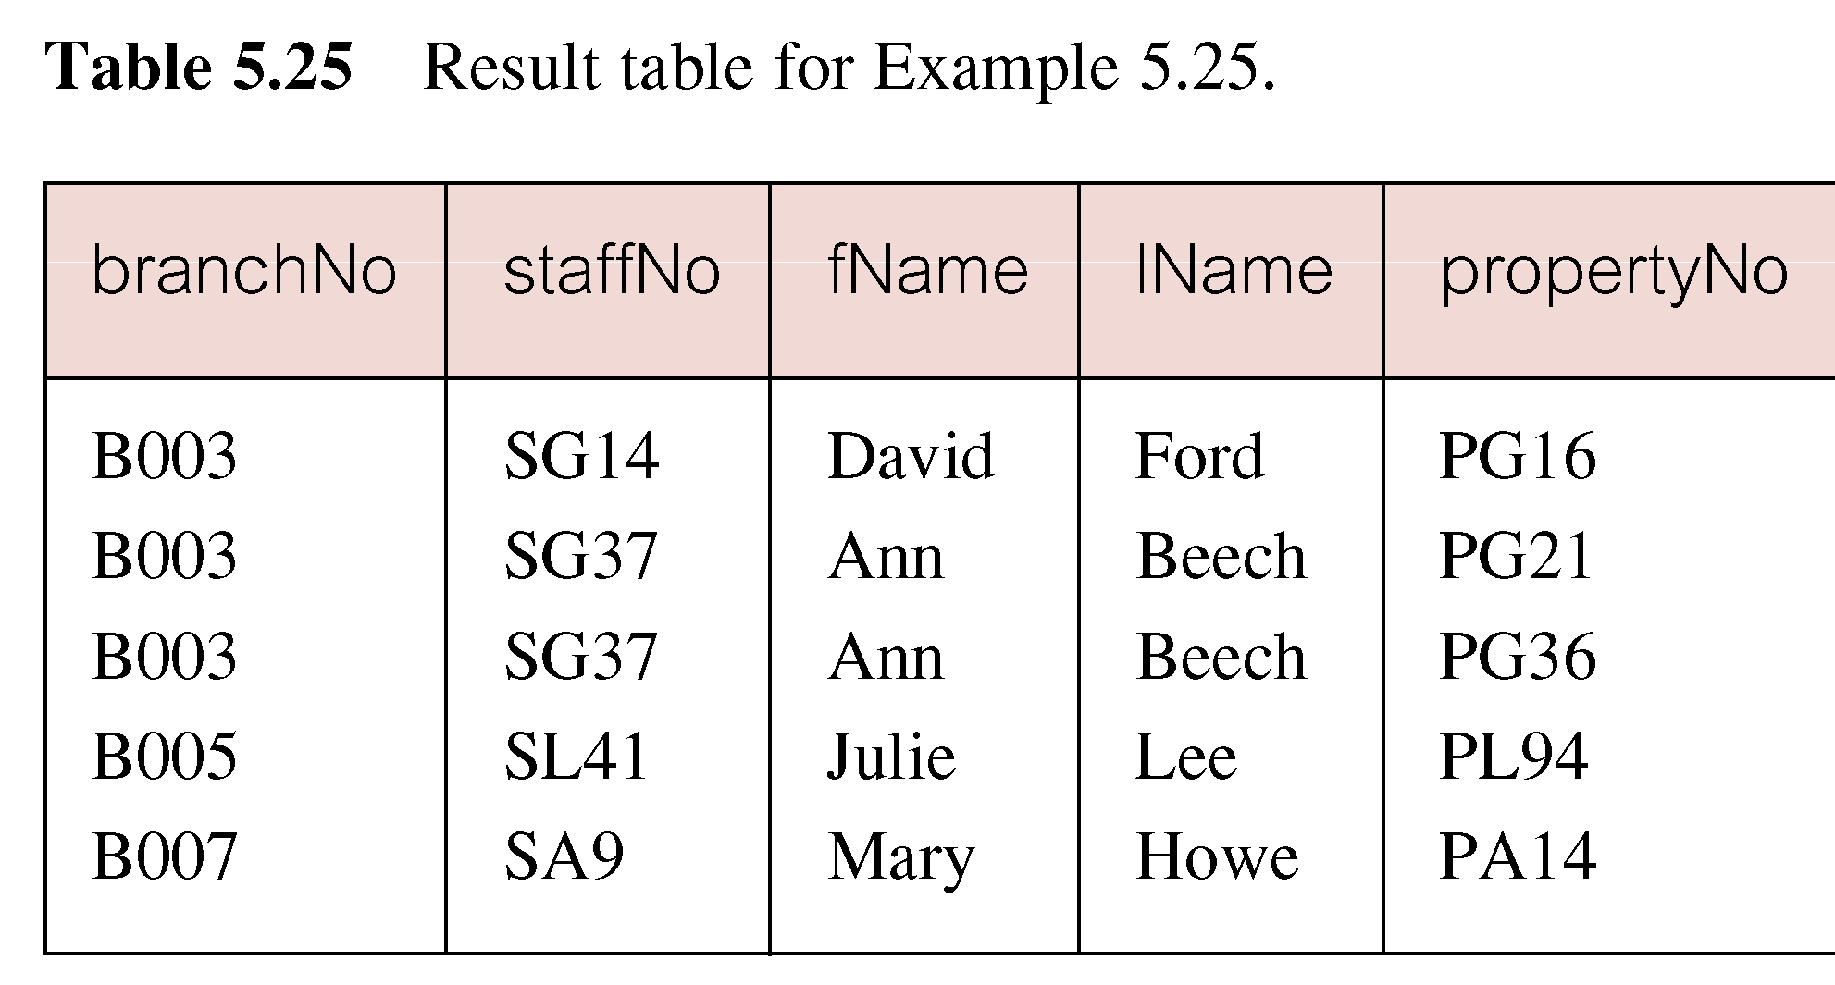
Example 6.25 Sorting a join
Pearson Education © 2009

Slide 54
Example 6.26 Three Table Join
For each branch, list staff who manage properties, including city in which branch is located and properties they manage.
SELECT s.bno,b.city , s.sno, fName, lName,
pNo
FROM Staff s, PropertyForRent p , Branch b
WHERE s.sno = p.sno AND b.bno=s.bno
ORDER BY s.bno, s.sno, pNo;
Pearson Education © 2009

Slide 55
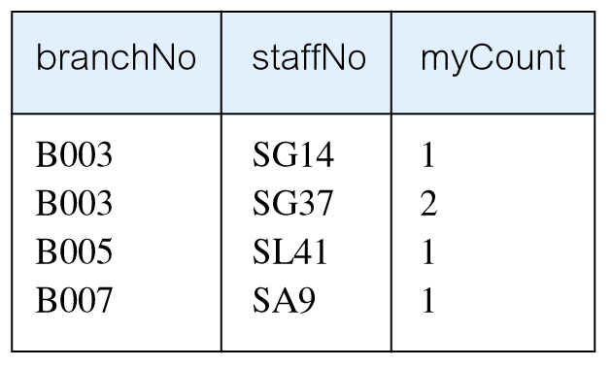
Example 6.27 Multiple Grouping Columns
Find number of properties handled by each staff member, along with the branch number of the member of staff
SELECT s.branchNo, s.staffNo, COUNT(*) AS myCount
FROM Staff s, PropertyForRent p
WHERE s.staffNo = p.staffNo
GROUP BY s.branchNo, s.staffNo
ORDER BY s.branchNo, s.staffNo;
Pearson Education © 2009

Slide 56
INSERT
INSERT INTO TableName [ (columnList) ]
VALUES (dataValueList)
columnList is optional; if omitted, SQL assumes a list of all columns in their original CREATE TABLE order.
Any columns omitted must have been declared as NULL when table was created, unless DEFAULT was specified when creating column.
Pearson Education © 2009

Slide 57
INSERT
dataValueList must match columnList as follows:
number of items in each list must be same;
must be direct correspondence in position of items in two lists;
data type of each item in dataValueList must be compatible with data type of corresponding column.
Pearson Education © 2009

Slide 58
Example 6.35 INSERT … VALUES
STAFF(sno, fname, lname, position, sex, DOB, salary, bno)
Insert a new row into Staff table supplying data for all columns.
INSERT INTO Staff
VALUES (‘SG16’, ‘Alan’, ‘Brown’, ‘Assistant’, ‘M’, Date‘1957-05-25’, 8300, ‘B003’);
Pearson Education © 2009

Slide 59
Example 6.36 INSERT using Defaults
STAFF(sno, fname, lname, position, sex, DOB, salary, bno)
Insert a new row into Staff table supplying data for all mandatory columns.
INSERT INTO Staff (staffNo, fName, lName,
position, salary, branchNo)
VALUES (‘SG44’, ‘Anne’, ‘Jones’,
‘Assistant’, 8100, ‘B003’);
Or
INSERT INTO Staff
VALUES (‘SG44’, ‘Anne’, ‘Jones’, ‘Assistant’, NULL,
NULL, 8100, ‘B003’);
Pearson Education © 2009

Slide 60
INSERT … SELECT
Second form of INSERT allows multiple rows to be copied from one or more tables to another:
INSERT INTO TableName [ (columnList) ]
SELECT ...
Pearson Education © 2009

Slide 61
Example 6.37 INSERT … SELECT
Assume there is a table StaffPropCount that contains names of staff and number of properties they manage:
StaffPropCount(staffNo, fName, lName, propCnt)
Populate StaffPropCount using Staff and PropertyForRent tables.
STAFF(sno, fname, lname, position, sex, DOB, salary, bno)
PROPERTYFORRENT(Pno, street, city, postcode, type, rooms, rent, ono, sno, bno)
Pearson Education © 2009

Slide 62
Example 6.37 INSERT … SELECT
INSERT INTO StaffPropCount
(SELECT s.staffNo, fName, lName, COUNT(*)
FROM Staff s, PropertyForRent p
WHERE s.staffNo = p.staffNo
GROUP BY s.staffNo, fName, lName)
UNION
(SELECT staffNo, fName, lName, 0
FROM Staff
WHERE staffNo NOT IN
(SELECT DISTINCT staffNo
FROM PropertyForRent));
Pearson Education © 2009

Slide 63
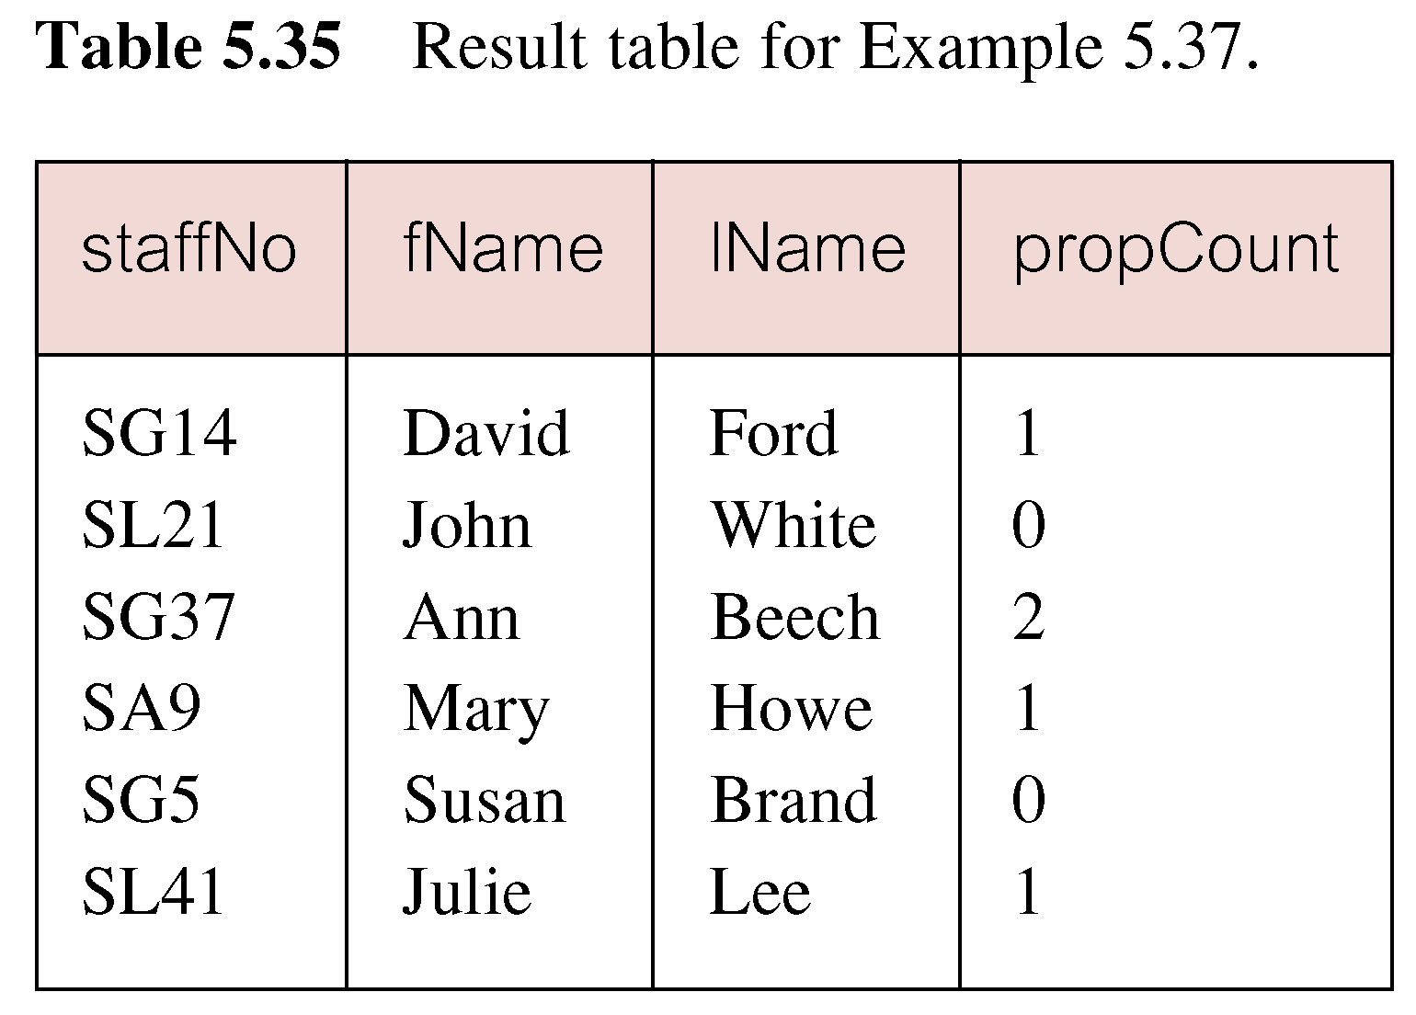
Example 6.37 INSERT … SELECT
If second part of UNION is omitted, excludes those staff who currently do not manage any properties.
Pearson Education © 2009

Slide 64
UPDATE
UPDATE TableName
SET columnName1 = dataValue1
[, columnName2 = dataValue2...]
[WHERE searchCondition]
TableName can be name of a base table or an updatable view.
SET clause specifies names of one or more columns that are to be updated.
Pearson Education © 2009

Slide 65
UPDATE
WHERE clause is optional:
if omitted, named columns are updated for all rows in table;
if specified, only those rows that satisfy searchCondition are updated.
New dataValue(s) must be compatible with data type for corresponding column.
Pearson Education © 2009

Slide 66
Example 6.38/39 UPDATE All Rows
Give all staff a 3% pay increase.
UPDATE Staff
SET salary = salary*1.03;
Give all Managers a 5% pay increase.
UPDATE Staff
SET salary = salary*1.05
WHERE position = ‘Manager’;
Pearson Education © 2009

Slide 67
Example 6.40 UPDATE Multiple Columns
Promote David Ford (staffNo=‘SG14’) to Manager and change his salary to £18,000.
UPDATE Staff
SET position = ‘Manager’, salary = 18000
WHERE staffNo = ‘SG14’;
Pearson Education © 2009

Slide 68
DELETE
DELETE FROM TableName
[WHERE searchCondition]
TableName can be name of a base table or an updatable view.
searchCondition is optional; if omitted, all rows are deleted from table. This does not delete table.
If search_condition is specified, only those rows that satisfy condition are deleted.
Pearson Education © 2009

Slide 69
Example 6.41/42 DELETE Specific Rows
Delete all viewings that relate to property PG4.
DELETE FROM Viewing
WHERE propertyNo = ‘PG4’;
Delete all records from the Viewing table.
DELETE FROM Viewing;
Pearson Education © 2009

