Slide 1
Structured Program Development in C++
King Saud University
College of Applied studies and Community Service
By: Asma Alosaimi
Edited By: Ghadah R. Hadba , Alaa Altheneyan, Noor Alhareqi& safaa albassam

Slide 2
Control structure
Normally, statements in a program are executed one after the other in the order in which they are written. This is called sequential execution.
Various C++ statements will enable you to specify the next statement to be executed which might be other than the next one in sequence. This is called transfer of control.

Slide 3
Types of Control structure
C++ has only three kinds of control structures, which from this point forward we refer to as control statements:
Sequence statements.
Selection statements ( if, if – else, and switch).
Repetition statements ( for, while, and do - while).
Each program combines these control statements as appropriate for the algorithm the program implements.

Slide 4
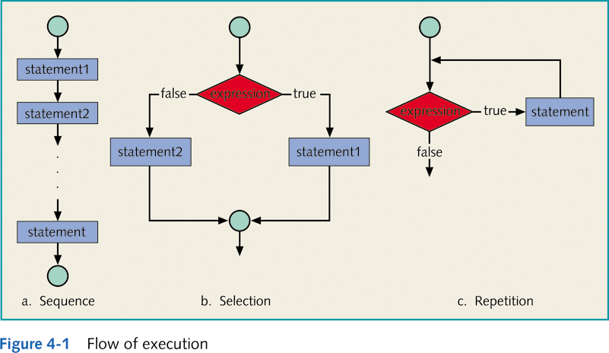
Types of Control Structures

Slide 5
Selection Structure
C++ provides three types of selection structures in the form of statements:
The if selection statement
either performs (selects) an action if a condition is true or skips the action if the condition is false.
The if…else selection statement
performs an action if a condition is true and performs a different action if the condition is false.
The switch selection statement
performs one of many different actions depending on the value of an expression.

Slide 6
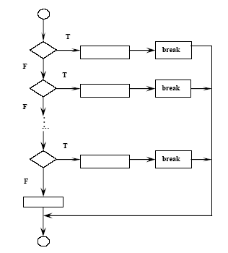
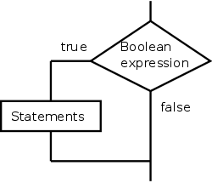
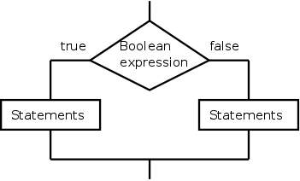
Selection Structure
if selection statement
if…else selection statement
switch selection statement

Slide 7
Exercise
What is the output for the following code lines if hours=35 and hours=60:
a) if (hours <= 40)
cout << “No overtime” << endl;
cout<<"You must work over 40 hours for overtime\n”;
cout << “Continue” << endl;
B) if (hours <= 40)
{
cout << “No overtime” << endl;
cout << "You must work over 40 hours for overtime.\n";
}
cout << “Continue” << endl;

Slide 8
Exercise
Write a fragment of code that test whether an integer variable score contains a valid test score. Valid test scores are in the range from 0 to 100.
Write a program that reads two numbers and then compare these two numbers and print the relations that they have satisfied

Slide 9
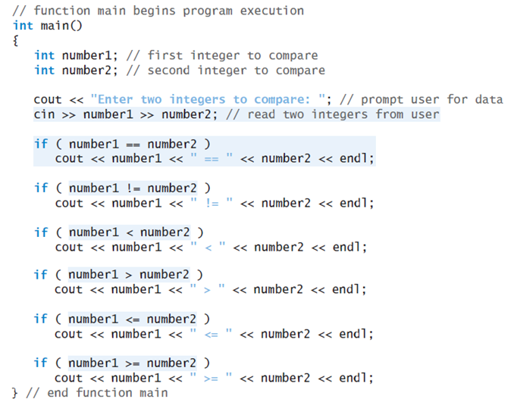

Slide 10
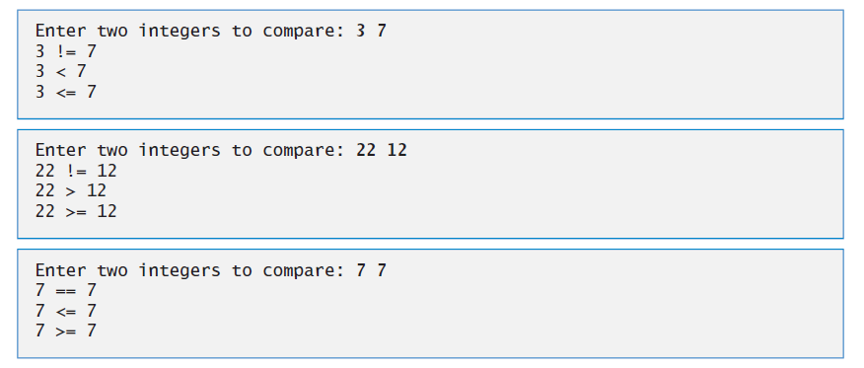
Example

Slide 11
selection structure: if … else
The if…else statement is called a double-selection statement because it selects between two different actions (or groups of actions).
Syntax:
if (expression)
statement1
else
statement2

Slide 12
selection structure: if … else -Example
For example,
pseudocode statement
If student’s grade is greater than or equal to 60 Print “Passed” else Print “Failed”
Code:
…
if ( grade >= 60 ) cout<<"Passed"; else cout<<"Failed";
…
Flowchart

Slide 13
Compound (Block of) Statements: Example
if ( grade >= 60 ) cout<<"Passed\n"; else
{ cout<<"Failed\n" ;
cout<<“you have to take this course again\n";
}

Slide 14
Exercise
Write a fragment of code that change an integer value stored in x as follows:
If x is even, divide x by 2.
If x is odd, multiply x by 3 and subtract 1.

Slide 15
Exercise
Find the errors for the following code and correct them?
A- if !x > x + y
x = 2 * x; else x = x + 3;
B- if(speed > 65)
cout << "Slow down";
else;
cout << "Speed is legal on I5";
else
cout << "\n Done";
C- if(speed > 65)
cout << "Slow down";
cout << "\n Relax, you'll live a longer and happier life\n";
else
cout << "Speed is legal on I5";

Slide 16
Exercise
What is the output of the following C++ code fragment
When the Price is 350?
When the Price is 60?
float price;
if (price>=100)
{
price=price*0.9;
cout<<"The price after the discount is:"<< price;
}
else
cout<<"There is no discount\n";

Slide 17
Exercise
Consider the following portion of C++ code:
if (y < 10)
x = 6*3;
else
x = y%(5+3) - 4;
Find the value of x when y=7?
Find the value of x when y=15?

Slide 18
Exercise
Consider the following portion of C++ code:
int a,b = 4;
int c = 3;
if((b > a) && (b++ > 0))
c = b+3;
else
c=b-3;
What are the values of b and c if the value of a = 1?
What are the values of b and c if the value of a = 5?

Slide 19
conditional Operator (? :)
C++ provides the conditional operator (?:) which is closely related to the if…else statement.
The conditional operator is C++’s only ternary operator i.e. it takes three operands.
Syntax:
expression1 ? expression2 : expression3
The first operand is a condition.
The second operand is the value for the entire conditional expression if the condition is true
The third operand is the value for the entire conditional expression if the condition is false.

Slide 20
Conditional (? :) Operator- example1
Example:
int x = 5 , y =3 , min ;
if (x <= y)
min = x ;
else
min = y ;
The above statement can be written using the conditional operator as following:
min = ( x <= y ? x : y);

Slide 21
Conditional (? :) Operator- example2
…
if ( grade >= 60 ) cout<<"Passed"; else cout<<"Failed";
…
The above statement can be written using the conditional operator as following:
Cout << ( grade >= 60 ? “Passed” : “Failed”);
The precedence of the conditional operator is low, so the parentheses in the preceding expression are required

Slide 22
Exercise
By using conditional Operator (? :) rewrite the code of
Write a fragment of code that change an integer value stored in x as follows:
If x is even, divide x by 2.
If x is odd, multiply x by 3 and subtract 1.

Slide 23
Exercise
Consider the following portion of C++ code:
int a = 10, b = 20;
int max ;
max = (a < b) ? ((b < 20)? b * 2 : ((b > 20) ? b % 3 : b / 4)) : ((a == 10) ? a / 2 : a % 3);
What is the max value after the evaluation of this expression?
5
5
5
5

Slide 24
Multiple Selection: Nested if
Multiple if statements can be used if there is more than two alternatives.
This mean we can place the if statement or the if-else statement inside a body of other if or/and else.
There are numerous situations to achieve that and it depends on the problem under consideration.
Here we will take a look on some situations .

Slide 25
Multiple Selection: Nested if (Example-1)
if( tempreture >= 50 )
{
if (tempreture >= 80)
cout<<“Good swimming day”;
else
cout<<“Good golfing day”;
}
else
cout<<“Good tennis day”;
Note: else is associated with the most recent if that does not have an else

Slide 26
Multiple Selection: Nested if (Example-2)
if( tempreture >= 50 )
{ if (tempreture >= 80)
cout<<“Good swimming day”;
else
cout<<“Good golfing day”;
}
Example of if-else inside an if statement
Remember: else is associated with the most recent if that does not have an else

Slide 27
Multiple Selection: Nested if (Example-3)
if( num == 0)
cout<<“ the entered number is zero \n”
else
{
if( num < 0)
cout<<“the entered number is negative\n”;
else
cout<<“the entered number is positive\n”;
}

Slide 28
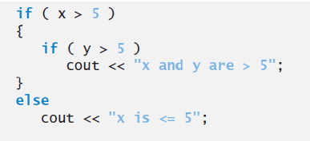
Multiple Selection: Nested if (Example-4)
//The following code does not work as intended.
X= 7 y= 6
X=7 y =4
//This is the correct way of writing the above code
To force the nested if..else statement to execute as it was originally intended we must use the braces {} as following:

Slide 29
selection structure: Switch
The switch statement is called a multiple-selection statement because it selects among many different actions.
The switch statement consists of a series of case labels and an optional default case.

Slide 30
selection structure: Switch
Syntax:
switch (expression)
{
case value1: statements1
break;
case value2: statements2
break;
...
case valuen: statementsn
break;
default: statements
}
Expression:
is also known as selector.
Expression can be an identifier.
Value can only be integral.

Slide 31
Type of values in Switch Cases
In Switch statement each action is associated with a value of constant integral expression (i.e. any combination of character constants and integer constant that evaluates to a constant integer value)
Thus, switch selector must be either :
An variable of integer or char data type, OR
An expression that evaluates to a constant integer value.

Slide 32
Switch With break Statements
true
switch (N) {
case 1: x = 10;
break;
case 2: x = 20;
break;
case 3: x = 30;
break;
}
N == 1 ?
x = 10;
false
break;
true
N == 2 ?
x = 20;
false
break;
true
N == 3 ?
x = 30;
false
break;

Slide 33
Switch With no break Statements
switch (N) {
case 1: x = 10;
case 2: x = 20;
case 3: x = 30;
}
true
N == 1 ?
x = 10;
false
true
Without break statements, each time a match occurs in the switch, the statements for that case and subsequent cases execute until a break statement or the end of the
switch is encountered.
N == 2 ?
x = 20;
false
true
N == 3 ?
x = 30;
false

Slide 34
Switch With break Statements
Example
switch (grade)
{
case 'A': cout<<"The grade is A.";
break;
case 'B': cout<<"The grade is B.";
break;
case 'C': cout<<"The grade is C.";
break;
case 'D': cout<<"The grade is D.";
break;
case 'F': cout<<"The grade is F.";
break;
default: cout<<"The grade is invalid.";
}

Slide 35
Previous Example - With Nested If
if (grade == 'A') cout<<"The grade is A. " ; else if (grade == 'B') cout<<"The grade is B "; else if (grade == 'C') cout<<"The grade is C. "; else if (grade == 'D') cout<<« The grade is D. "; else if (grade == 'F') cout<<"The grade is F. "; else cout<<"The grade is invalid. ";

Slide 36
Switch With more than one case labels
Example
switch (grade)
{
case 'A': case ‘a':
cout<<"The grade is A.";
break;
case 'B': case ‘b':
cout<<"The grade is B.";
break;
case 'C': case ‘c':
cout<<"The grade is C.";
break;
case 'D': case ‘d':
cout<<"The grade is D.";
break;
case 'F': case ‘f':
cout<<"The grade is F.";
break;
default: cout<<"The grade is invalid.";
}

Slide 37
Switch With break Statements
Example 2
switch (number1+number2)
{
case 0: cout<<"The sum is 0";
break;
case 1: cout<<"The sum is 1";
break;
case 2: cout<<"The sum is 2";
break;
case 3: cout<<"The sum is 3";
break;
case 4: cout<<"The sum is 4";
break;
default: cout<<“ illegal expression";
}

Slide 38
Switch With break Statements
Example 3
switch (number%2)
{
case 0: cout<<number<<“is an even number”;
break;
case 1: cout<< number<<“is an odd number”;
break;
default: cout<<number<<"is invalid.";
}

Slide 39
Common Errors in the switch

Slide 40
Comparison of if Statements and The Switch Statement
if statements are more general than the switch statement.
Case labels that contain type float values or strings are not permeated in switch statements.
The switch statement is more readable in many contexts. Thus, it should be used whenever practical.

