Slide 1
Programming II
Pointers and arrays

Slide 2
Topic
Passing arrays to functions
Discover dynamic arrays
Explore how dynamic arrays are used
2D arrays
Explore how dynamic 2D-arrays are used

Slide 3
Passing arrays to functions
Syntax :
Return_type functionName ( data_type * arrayName )
void myFunction(int *param) { . . . }
Or
Return_type functionName (data_type arrayName[length] )
void myFunction(int param[10]) { . . . }
Or
Rturn_type functionName (data_type arrayName[] )
void myFunction(int param[]) { . . . }

Slide 4
Example
double getAverage(int arr[], int size) {
int i, sum = 0;
for (i = 0; i < size; ++i) { sum += arr[i]; }
return double(sum) / size;}
int main () {
int balance[5] = {1000, 2, 3, 17, 50};
cout << "Average value is: " << getAverage( balance, 5 ) << endl;
return 0; }
Average value is: 214.4

Slide 5
Dynamic arrays
Dynamic arrays
Static array limitation
Fixed size
Not possible for same array to process different data sets of the same type
Solution
Declare array large enough to process a variety of data sets
Problem: potential memory waste
Dynamic array solution
Prompt for array size during program execution

Slide 6
Static array vs. Dynamic array
Array size of ststic array:
Can be specified with constant variable (const)
const int size = 20;
Constants cannot be changed
Constants must be initialized when declared
Also called named constants or read-only variables

Slide 7
Declaration of Dynamic arrays
Syntax
P = new SomeType[Expression];
Where
P is a pointer of type SomeType
Expression is the number of objects to be constructed -- we are making an array
Because of the flexible pointer syntax, P can be considered to be an array

Slide 8
Example
Declaration of Dynamic arrays
new
int *p;
p = new int;
p
new
p = new int[100];
p
new
p = new int[n];
p

Slide 9
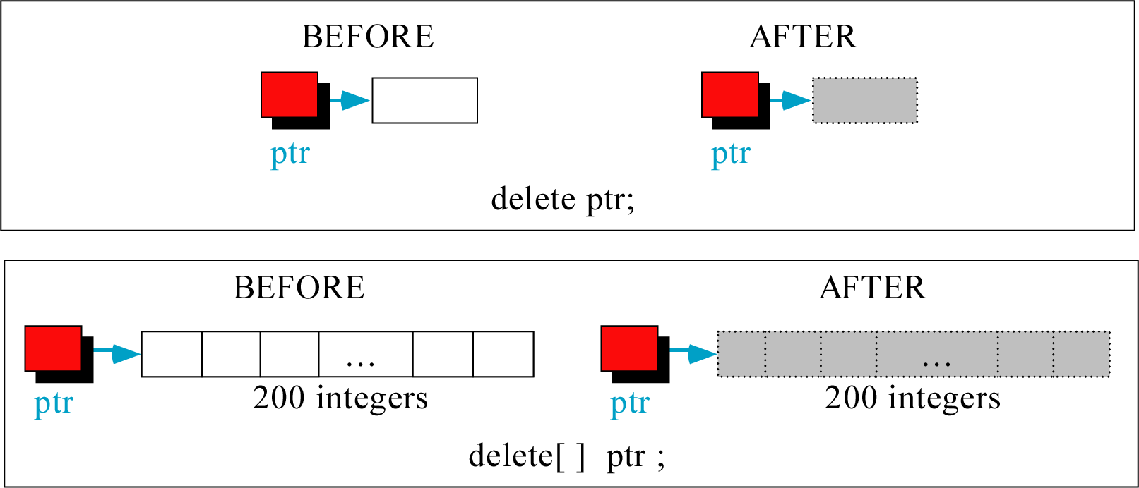
Freeing (or deleting) Dynamic Arrays

Slide 10
Example#1
#include <iostream>
#include<string>
#include <clocale>
using namespace std ;
void fill( string *, int * ,int &);
int find (string * ,int &, string);
double mean (int * ,int & );
string toLower(string );
void main(){
int n, loc, choice;
string name;
cout << "How many students? ";
cin >> n;
int *grades = new int[n];
string *names= new string[n];
fill( names, grades ,n) ;
do{
cout<<"Choose one of the following:\n";
cout<<"1-Print the mean of the grades.\n";
cout<<"2-serach about a specific student.\n";
cout<<"0-stop.\nChoice>";
cin>>choice;
switch(choice){
case 1:
cout<< "Mean=" << mean( grades, n )<<endl;
break;
case 2:
cout <<"Enter the wanted name:";
cin>>name;
loc =find( names, n,name);
if (loc !=-1 )
cout<<name<<"'s grade is "<<grades[loc]<<endl;
else
cout<< "This student is not found!\n";
break;
case 0: break;
default:
cout<< "Wrong choice !" ;}
}while(choice !=0);
}

Slide 11
Example #1(cont.)
void fill( string *listNames, int *listGrades ,int &size)
{for(int i = 0; i< size; i++){
cout<<"Enter the name followed by the grade fpr student#"<<i+1<<":";
cin>>listNames[i];
cin>>listGrades[i];}}
int find (string * listNames ,int & size, string na) {
for(int i = 0; i< size; i++)
if(toLower(listNames[i]) == toLower(na))
return i;
return -1; }
double mean (int * listGrades ,int & size) {
int sum=0;
for(int i = 0; i< size; i++)
sum+=listGrades[i] ;
return (double)sum/size;}
string toLower(string s) {
for ( int i=0; i<s.length() ;i++)
s[i] = tolower(s[i]);
return s;
}

Slide 12
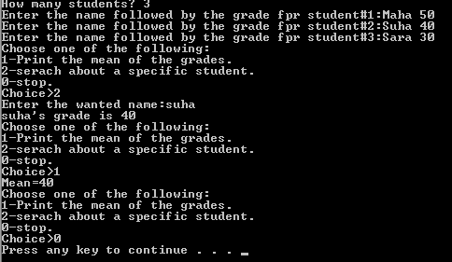
output

Slide 13
Example#2
#include <iostream>
#include<string>
using namespace std;
void print ( string *, int *, const int&);
bool add ( string * & , int * & , int & , const string & , const int & );
int find (string * ,int & , string& );
bool Delete ( string * & , int * &, int & , const string );
void main(){
int choice; string name; int grade , size=0;
string *nlist = 0;
int *glist=0;
do{
cout<<"Choose one of the following:\n";
cout<<"1-add a new student.\n";
cout<<"2-delete a student.\n";
cout<<"3-print the content.\n";
cout<<"4-Exit.\nChoice>";
cin>>choice;
switch(choice){
case 1:
cout<< "Enter the name followed by the grade of the new student:";
cin>>name;
cin>>grade;
if(add(nlist, glist , size, name, grade))
cout<<name<<"has been added sucessfully"<<endl;
else
cout<< "Duplicated names are not allowed!n";
break;
case 2:
cout <<"Enter the wanted name:";
cin>>name;
if (Delete(nlist , glist , size , name))
cout<<name<<"has been deleted"<<endl;
else
cout<< "This student is not found!\n";
break;
case 3: print (nlist ,glist,size); break;
case 4: break;
default:
cout<< "Wrong choice !" ;}
}while(choice !=0);
}

Slide 14
Example #2(cont.)
void print ( string *listNames, int *listGrades, const int & size)
{for(int i = 0; i< size; i++)
cout<<listNames[i]<<"\t"<<listGrades[i]<<endl;}
int find (string * listNames ,int & size, const string & na) {
for(int i = 0; i< size; i++)
if(listNames[i]==na) //assume all characters in lower case
return i;
// not found
return -1; }

Slide 15
Example #2(cont.)
bool add ( string * & listNames, int * & listGrades, int & size, const string & n , const int & g ){
//prevent the duplication
if ( find ( listNames , size , n)!=-1) return false;
// create a new dynamic array 1 element larger than original array
string * newListNames = new string [size + 1];
int * newListGrades = new int [size + 1];
// copy all elements from original array into new array
for( int i = 0; i < size; i++ ){
newListGrades [ i ] = listGrades[ i ];
newListNames [i]=listNames[i];}
// add the new entry onto the end of the new array
newListGrades [ size ] = g; newListNames [size]=n;
// increment size
size++;
// delete original array
if( size ) {delete [] listNames; listNames=0; delete [] listGrades; listGrades=0;}
//assign the new array to the original array
listNames = newListNames; listGrades=newListGrades; return true;}

Slide 16
Example #2 (cont.)
bool Delete ( string * & listNames, int * & listGrades, int & size, const string n){
int loc;
loc= find ( listNames , size , n);
if ( loc==-1) return false;
// only zero or one element in the array & it is the required element.
if( size <= 1 ){
if( size ){ delete [] listNames; delete [] listGrades;}
listGrades = NULL; listNames=NULL;
size = 0;
return true;
}
//if the size is more than one , decrement the size
size--;
//shift the elements up
for ( int i= loc; i<size; i++){
listNames[i]= listNames[i+1];
listGrades [i] = listGrades[i+1];}
return true;}

Slide 17
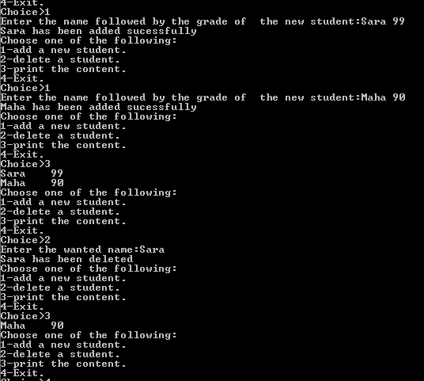
A sample run (part of the output)

Slide 18
Static Multidimensional Arrays
C++ also allows an array to have more than one dimension.
For example, a two-dimensional array consists of a certain number of rows and columns:
const int NUMROWS = 3;
const int NUMCOLS = 7;
int Array[NUMROWS][NUMCOLS];
 | 0 | 1 | 2 | 3 | 4 | 5 | 6
0 | 4 | 18 | 9 | 3 | -4 | 6 | 0
1 | 12 | 45 | 74 | 15 | 0 | 98 | 0
2 | 84 | 87 | 75 | 67 | 81 | 85 | 79
Array[2][5] 3rd value in 6th column Array[0][4] 1st value in 5th column
The declaration must specify the number of rows and the number of columns, and both must be constants.

Slide 19
Processing a 2-D Array
A one-dimensional array is usually processed via a for loop. Similarly, a two-dimensional array may be processed with a nested for loop:
for (int Row = 0; Row < NUMROWS; Row++) {
for (int Col = 0; Col < NUMCOLS; Col++) {
Array[Row][Col] = 0;
}
}
Each pass through the inner for loop will initialize all the elements of the current row to 0.
The outer for loop drives the inner loop to process each of the array's rows.

Slide 20
Static Multidimensional Arrays Initializing in Declarations
int Array1[2][3] = { {1, 2, 3} , {4, 5, 6} };
int Array2[2][3] = { 1, 2, 3, 4, 5 };
int Array3[2][3] = { {1, 2} , {4 } };
If we printed these arrays by rows, we would find the following initializations had taken place:
Rows of Array1:
1 2 3
4 5 6
Rows of Array2:
1 2 3
4 5 0
Rows of Array3:
1 2 0
4 0 0
for (int row = 0; row < 2; row++) {
for (int col = 0; col < 3; col++) {
cout << setw(3)
<< Array1[row][col];
}
cout << endl;
}

Slide 21
Example: storing 2D Array in 1D Array
int twod[3][4] = {{0,1,2,3}, {4,5,6,7},
{8,9,10,11}};
int oned[12];
for(int i=0; i<3; i++){
for(int j=0; j<4 ; j++)
oned[i*4+j] = twod[i][j]; }

Slide 22
Dereferencing with 2-Dimensional Arrays-
table
table[i] =
&table[i][0] refers to the address of the ith row
table + 1
table[ 0] or *( table + 0 )
table + 2
table[ 1] or *( table + 1 )
table[ 2] or *( table + 2 )
*(table[i]+j)
= table[i][j]
int table[3][4] = {{1,2,3,4},{5,6,7,8},{9,10,11,12}};
for(int i=0; i<3; i++){
for(int j=0; j<4; j++)
cout << *(*(table+i)+j);
cout << endl;
}
What is **table ?

Slide 23
The concept of dynamic two-dimensional array
Array of Pointers & Pointers to Array
a
p
b
c
An array of Pointers
A pointer to an array
int a = 1, b = 2, c = 3;
int *p[5];
p[0] = &a;
p[1] = &b;
p[2] = &c;
int list[5] = {9, 8, 7, 6, 5};
int *p;
P = list;//points to 1st entry
P = &list[0];//points to 1st entry
P = &list[1];//points to 2nd entry
P = list + 1; //points to 2nd entry
Dynamic 2D array is an array of pointers

Slide 24
How To Create A Dynamic Two-dimensional Array (1)
Suppose that we want to create a 4X6 matrix.How can we do that ?
int *board[4]; for (int row = 0; row < 4; row++) board[row] = new int[6]; // each row of board has six columns.
board

Slide 25
Note
Note that the expression new int[6] creates an array of six components of type int and returns the base address of the array.
The assignment statement then stores the returned address into board[row].
It follows that after the execution of the previous for loop, board is a two-dimensional array of four rows and six columns.
However, the way board is declared, the number of rows is fixed. So in reality, board is not a true dynamic two-dimensional array.

Slide 26
How To Create A Dynamic Two-dimensional Array (2)
Second approach to declare 2D array is
int **board;
// declares board to be a pointer to a pointer
Suppose that you want board to be an array of 10 rows and 15 columns. To accomplish this, first we create an array of 10 pointers of type int and assign the address of that array to board.
board = new int* [10];
Next, we create the columns of board. The following for loop accomplishes this.
for (int row = 0; row < 10; row++)
board[row] = new int[15];

Slide 27
A Dynamic 2D Array- example
A dynamic array is an array of pointers to save space when not all rows of the array are full.
int **table;
table
32
18
12
24
table[0]
table[1]
table[2]
table[3]
table[4]
table[5]
13
11
16
12
42
19
14
22
13
13
14
11
18
table = new int*[6];
…
table[0] = new int[4];
table[1] = new int[7];
table[2] = new int[1];
table[3] = new int[3];
table[4] = new int[2];
table[5] = NULL;

Slide 28
A Dynamic 2D Array- Memory Deallocation
Memory leak is a serious bug!
Each row must be deleted individually
Be careful to delete each row before deleting the table pointer.
for(int i=0; i<6; i++)
{delete [ ] table[i];
table [i]=0;}
delete [ ] table;
table =0;

Slide 29
Example:
Create a matrix of any dimensions, m by n:
void main(){
int m, n;
cin >> m >> n >> endl;
int** mat;
mat = new int*[m];
for (int i=0;i<m;i++)
mat[i] = new int[n];
…
}
Void main(){
int m, n;
cin >> m >> n >> endl;
int** mat;
mat = imatrix(m,n);
…}
int** imatrix(nr, nc) {
int** m;
m = new int*[nr];
for (int i=0;i<nr;i++)
m[i] = new int[nc];
return m;}
Put it into a function:

Slide 30
Example
#include <iostream>
using namespace std;
void fill (int **p, int row ,int column);
void print (int **p, int row ,int column);
void main()
{
int ** board;
int R, C;
cout<<"enter the array size :" <<endl;
cout << "number of rows : " <<endl;cin >>R;
cout<<"number of columns : " <<endl;
cin >> C;
cout <<" ****************" <<endl;
board = new int*[R];
for ( int i=0;i<R;i++)
{
board[i]= new int[C];
fill (board,R,C);
print(board ,R,C);
}
}

Slide 31
Example (cont.)
void fill (int **p, int row ,int column)
{
for ( int i=0;i<row;i++)
{
cout <<" enter "<<column<<" numbers to fill row number "
<< i<<endl;
for (int j=0;j<column ;j++)
cin>>p[i][j];
cout<<endl;
}
}

Slide 32
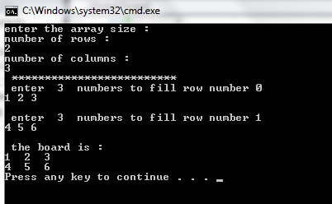
Example (cont.)
void print(int **p, int row ,int column){
cout << " the board is : "<<endl;
for (int i=0;i<row;i++)
{for (int j=0;j<column ;j++)
cout << p[i][j]<< " ";
cout<< endl;
}
}

